Slide 2
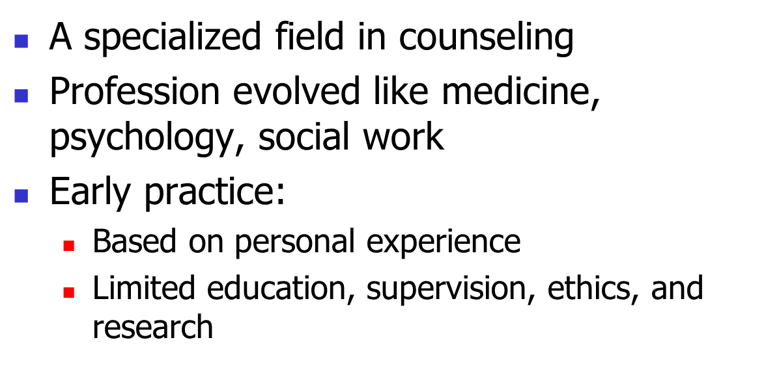
History of Addiction Counseling
Foundations of Addictions Counseling, 3e
Capuzzi & Stauffer
Copyright © 2016, 2012, 2008
by Pearson Education, Inc.
All Rights Reserved

Slide 3
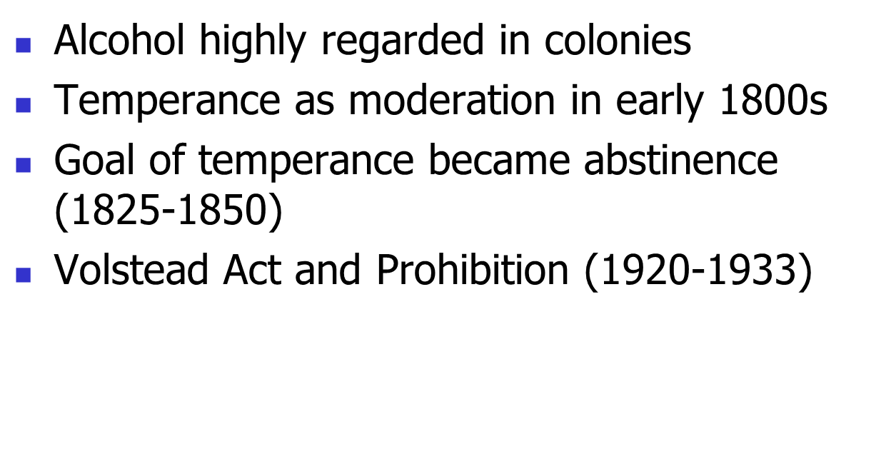
History of Prevention in the United States
Foundations of Addictions Counseling, 3e
Capuzzi & Stauffer
Copyright © 2016, 2012, 2008
by Pearson Education, Inc.
All Rights Reserved

Slide 4
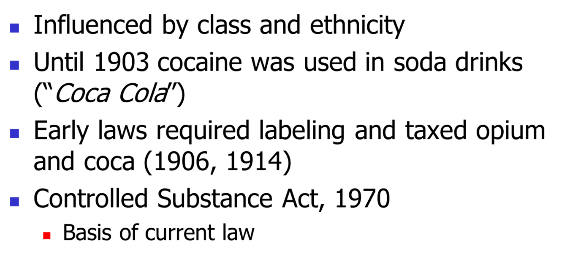
U.S. Drug Laws
Foundations of Addictions Counseling, 3e
Capuzzi & Stauffer
Copyright © 2016, 2012, 2008
by Pearson Education, Inc.
All Rights Reserved

Slide 5
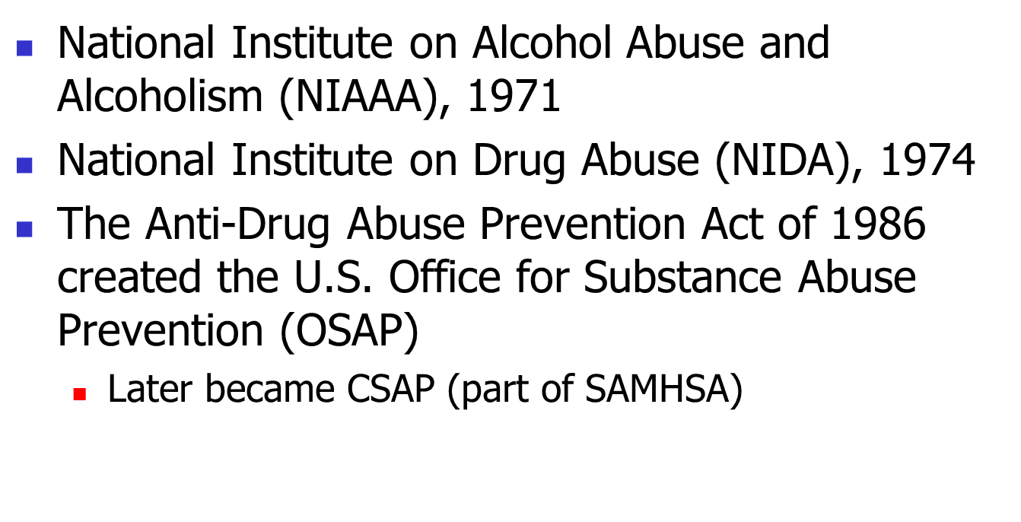
Agencies
Foundations of Addictions Counseling, 3e
Capuzzi & Stauffer
Copyright © 2016, 2012, 2008
by Pearson Education, Inc.
All Rights Reserved

Slide 6
Policies to Prevent Addiction
Limits on age
Taxation and control of distribution
More government focus on preventing use than treating addiction
SAMHSA reauthorized in 2000
  funding for co-occurring disorders
Foundations of Addictions Counseling, 3e
Capuzzi & Stauffer
Copyright © 2016, 2012, 2008
by Pearson Education, Inc.
All Rights Reserved

Slide 7
Models for Explaining the Etiology of Addiction
The Disease Model
Public Health
Developmental
Biological Models
Sociocultural Models
Multicausal Models
The Moral Model
Psychological Models
Family Models
Foundations of Addictions Counseling, 3e
Capuzzi & Stauffer
Copyright © 2016, 2012, 2008
by Pearson Education, Inc.
All Rights Reserved

Slide 8
The Moral Model
Personal choice; no biological basis
Religious beliefs of sinfulness
Punishment in legal system
Social stigma
Foundations of Addictions Counseling, 3e
Capuzzi & Stauffer
Copyright © 2016, 2012, 2008
by Pearson Education, Inc.
All Rights Reserved

Slide 9
Psychological Models
1. Cognitive-behavioral models
  Motivation, seeking pleasure
  Reinforcement (positive & negative)
2. Learning models
  Learned response
  Aversion to withdrawal leads to prolonged use
Foundations of Addictions Counseling, 3e
Capuzzi & Stauffer
Copyright © 2016, 2012, 2008
by Pearson Education, Inc.
All Rights Reserved

Slide 10
Psychological Models, (continued)
3. Psychodynamic models
  Underlying psychopathology (ego deficiencies, inadequate parenting, etc.)
  Problem with regulation of affect
  Disturbed object relations
4. Personality Theory Models
  “Alcoholic personality”
    Dependent, immature, impulsive, emotional, unable to express anger, etc.
Foundations of Addictions Counseling, 3e
Capuzzi & Stauffer
Copyright © 2016, 2012, 2008
by Pearson Education, Inc.
All Rights Reserved

Slide 11
Family Models
1. Behavioral
  Behavior is reinforced by family member(s)
2. Family Systems
  Roles in families
  Changes are threatening
  Identified patient
3. Family Disease
Foundations of Addictions Counseling, 3e
Capuzzi & Stauffer
Copyright © 2016, 2012, 2008
by Pearson Education, Inc.
All Rights Reserved

Slide 12
The Disease Model
Addiction as primary disease
  No moral stigma
Benjamin Rush (late 1700s)
E.M. Jellinek (1930s & 1940s)
  Progressive stages
    Prodromal, Middle or Crucial, Chronic
  Chronic and incurable; abstinence required
  Original research questioned
Foundations of Addictions Counseling, 3e
Capuzzi & Stauffer
Copyright © 2016, 2012, 2008
by Pearson Education, Inc.
All Rights Reserved

Slide 13
The Public Health Model
Paul Lemkau
  Establishment of community
Social issues play a role
  Addiction is a societal disease
Foundations of Addictions Counseling, 3e
Capuzzi & Stauffer
Copyright © 2016, 2012, 2008
by Pearson Education, Inc.
All Rights Reserved

Slide 14
The Developmental Model
Vulnerability to addiction is never static and varies across the life span.
  Developmental competencies decrease the possibility of engaging in risky behavior.
Foundations of Addictions Counseling, 3e
Capuzzi & Stauffer
Copyright © 2016, 2012, 2008
by Pearson Education, Inc.
All Rights Reserved

Slide 15
Biological Models
1. Genetic Models
  Strong statistical associations
  Human Genome Project
2. Neurobiological Models
  Limbic system
  Brain chemistry changes with use
Foundations of Addictions Counseling, 3e
Capuzzi & Stauffer
Copyright © 2016, 2012, 2008
by Pearson Education, Inc.
All Rights Reserved

Slide 16
Sociocultural Models
Context influences drug definitions, use, and effects
1. Supracultural
  Culture’s collective attitudes impact addictions
    Views of alcohol
    other social expectations
    Bales (1946) and Bacon (1974)
Foundations of Addictions Counseling, 3e
Capuzzi & Stauffer
Copyright © 2016, 2012, 2008
by Pearson Education, Inc.
All Rights Reserved

Slide 17
Sociocultural models, (continued)
2. Culture-specific Models
  cultural Stereotyping
  Address diversity issues in counseling
3. Subcultural Models
  Sociological and environmental causes
  Patterns within specific groups
    Age, gender, ethnicity
    Danger of stereotyping
Foundations of Addictions Counseling, 3e
Capuzzi & Stauffer
Copyright © 2016, 2012, 2008
by Pearson Education, Inc.
All Rights Reserved

Slide 18
Multi-causal Models
No single model explains addiction
1. Syndrome model
  Multiple and interacting antecedents
2. Integral Model
  Concepts from integrative medicine and transpersonal psychology
Similar to public health model
  Agent, Host, Environment
Foundations of Addictions Counseling, 3e
Capuzzi & Stauffer
Copyright © 2016, 2012, 2008
by Pearson Education, Inc.
All Rights Reserved

Slide 19
Useful Web Sites
NIH Grants for Mental Health, Addiction Research
  http://www.jointogether.org/sa/news/funding/reader/0%2C1854%2C575039%2C00.html
Foundations & Grantmakers Directory
  http://www.foundations.org/grantmakers.html
Foundations of Addictions Counseling, 3e
Capuzzi & Stauffer
Copyright © 2016, 2012, 2008
by Pearson Education, Inc.
All Rights Reserved

