Slide 2
Addiction
Addictive process has many components
Behavioral elements
May or may not involve physical dependence
Foundations of Addictions Counseling, 3e
Capuzzi & Stauffer
Copyright © 2016, 2012, 2008
by Pearson Education, Inc.
All Rights Reserved

Slide 3
Neurobiology and Physiology of Addiction
No single biological factor
Brain changes with addiction
  Permanent damage
  Changes in connections between neurons
Foundations of Addictions Counseling, 3e
Capuzzi & Stauffer
Copyright © 2016, 2012, 2008
by Pearson Education, Inc.
All Rights Reserved

Slide 4
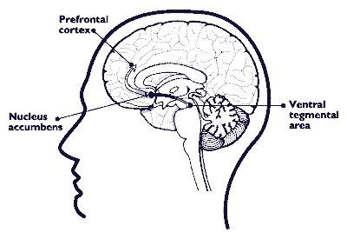
Reward Pathway
Areas of brain key to addictive cycle
  Ventral tegmental area (VTA)
  Nucleus accumbens
  Prefrontral cortex
Reward Circuit
http://teens.drugabuse.gov/mom/tg_brainimages_fig6.html
Foundations of Addictions Counseling, 3e
Capuzzi & Stauffer
Copyright © 2016, 2012, 2008
by Pearson Education, Inc.
All Rights Reserved

Slide 5
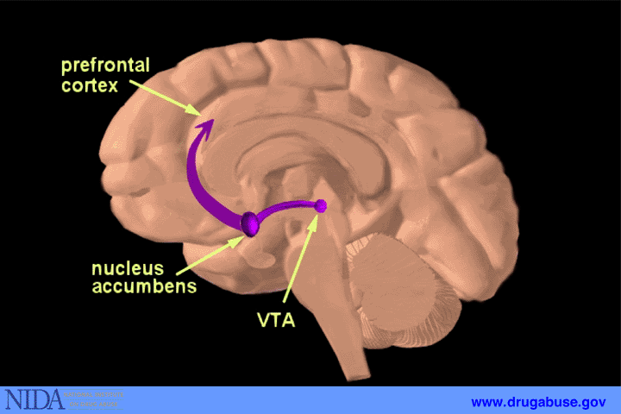
Reward Pathway, (continued)
Ventral tegmental area → NA → Prefrontal Cortex
Source: http://www.drugabuse.gov/pubs/teaching/Teaching3/Teaching2.html
Foundations of Addictions Counseling, 3e
Capuzzi & Stauffer
Copyright © 2016, 2012, 2008
by Pearson Education, Inc.
All Rights Reserved

Slide 6
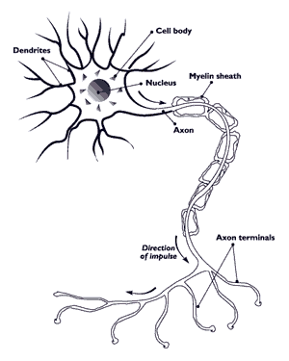
Nerve Cells and Neurotransmission
Neurons
  100 billion nerve cells
Neurotransmitters
  Dopamine
  Gamma-amino butyric acid (GABA)
  Glutamate
Neuroreceptors
Source: http://teens.drugabuse.gov/mom/tg_nerves.asp#
Foundations of Addictions Counseling, 3e
Capuzzi & Stauffer
Copyright © 2016, 2012, 2008
by Pearson Education, Inc.
All Rights Reserved

Slide 7
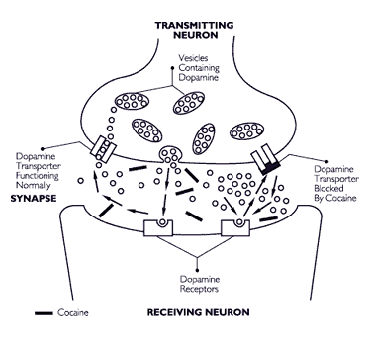
Cocaine Interference with Neurons
Source: http://teens.drugabuse.gov/mom/tg_brainimages_fig7.html
Foundations of Addictions Counseling, 3e
Capuzzi & Stauffer
Copyright © 2016, 2012, 2008
by Pearson Education, Inc.
All Rights Reserved

Slide 8
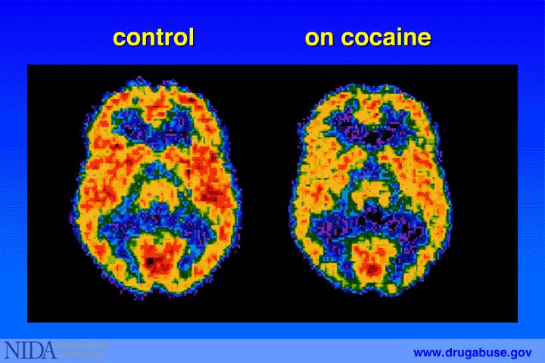
PET Scan:
Positron Emission Tomography
Foundations of Addictions Counseling, 3e
Capuzzi & Stauffer
Copyright © 2016, 2012, 2008
by Pearson Education, Inc.
All Rights Reserved

Slide 9
Neurobiology of Loss of Control & Compulsive Use
Frontal areas of brain
  Anterior cingulated cortex (ACC)
  Orbitofrontal cortex (OFC)
Cortico-basal ganglia network
  Dorsal striatum
Brain is physically damaged, less capable of learning
Foundations of Addictions Counseling, 3e
Capuzzi & Stauffer
Copyright © 2016, 2012, 2008
by Pearson Education, Inc.
All Rights Reserved

Slide 10
Effects of Alcohol on the Brain
Studies suggest
  50% of alcoholics have some degree of brain damage
  More damage to right hemisphere
  Volume shrinkage
Significantly disrupt neurogenesis
Foundations of Addictions Counseling, 3e
Capuzzi & Stauffer
Copyright © 2016, 2012, 2008
by Pearson Education, Inc.
All Rights Reserved

Slide 11
Other Physiological Factors in Addiction
Tolerance
  Neuroadaptation, genetic influences
  Metabolic tolerance
  Pharmacodynamic tolerance
  High tolerance leads to higher risk of dependency
Withdrawal
  Can be life-threatening
Foundations of Addictions Counseling, 3e
Capuzzi & Stauffer
Copyright © 2016, 2012, 2008
by Pearson Education, Inc.
All Rights Reserved

Slide 12
Substances of Addiction
Depressants
Stimulants
Cannabinoids
Hallucinogens
Opioids
Foundations of Addictions Counseling, 3e
Capuzzi & Stauffer
Copyright © 2016, 2012, 2008
by Pearson Education, Inc.
All Rights Reserved

Slide 13
Depressants
Suppress the central nervous system
1. Alcohol
2. Sedative/Hypnotic drugs
Foundations of Addictions Counseling, 3e
Capuzzi & Stauffer
Copyright © 2016, 2012, 2008
by Pearson Education, Inc.
All Rights Reserved

Slide 14
Alcohol
Ethanol
  Proof
    7% alcohol/ethanol = 14 proof
    151-proof rum = ___ % ethanol?
Mood altering effects within 20 minutes
Metabolized by the liver as a toxin
  Intoxicated
Blood alcohol concentration (BAC)
Foundations of Addictions Counseling, 3e
Capuzzi & Stauffer
Copyright © 2016, 2012, 2008
by Pearson Education, Inc.
All Rights Reserved

Slide 15
Sedative/Hypnotic drugs
Benzodiazepines (aka “tranquilizers”)
  Valium (diazepam), Xanax (alprazolam)
    High risk for abuse and addiction
    Women at risk
Barbiturates
  Tuinal (amobarbital with secobarbital), Nembutal (pentobarbital)
  Lethal potential
Non-barbiturates (Quaaludes)
Foundations of Addictions Counseling, 3e
Capuzzi & Stauffer
Copyright © 2016, 2012, 2008
by Pearson Education, Inc.
All Rights Reserved

Slide 16
Opioids
Derived from opium
  Morphine
  Heroin
    Highly addictive
    Intravenous injection, snorting and smoking
  Methadone and buprenorphine to treat addiction
  OxyContin
Foundations of Addictions Counseling, 3e
Capuzzi & Stauffer
Copyright © 2016, 2012, 2008
by Pearson Education, Inc.
All Rights Reserved

Slide 17
Stimulants
1.Tobacco
  Nicotine
2. Ephedrine
3. Amphetamines
4. Ritalin
5. Cocaine
Foundations of Addictions Counseling, 3e
Capuzzi & Stauffer
Copyright © 2016, 2012, 2008
by Pearson Education, Inc.
All Rights Reserved

Slide 18
Ephedrine and Amphetamines, Amphetamine-like Medications
Ephedrine
  Legal ban in 2004 (side effects)
Amphetamines (“Speed”)
  Methamphetamine
    Oral, snorted, smoked, injected
  Nonpharmaceutical: “ice” and “Kat” (methcathinone)
    Lower cost, many impurities
Foundations of Addictions Counseling, 3e
Capuzzi & Stauffer
Copyright © 2016, 2012, 2008
by Pearson Education, Inc.
All Rights Reserved

Slide 19
Amphetamine-like Medications
Ritalin (methylphenidate)
Prescribed for ADHD
Foundations of Addictions Counseling, 3e
Capuzzi & Stauffer
Copyright © 2016, 2012, 2008
by Pearson Education, Inc.
All Rights Reserved

Slide 20
Cocaine
Epidemics in late 1800s, early 1900s
  Use has declined since 1990s
“Crack” cocaine
  Smokeable, concentrated form of cocaine
Physical Dependence (tolerance/withdrawal)
Strong potential for abuse
Foundations of Addictions Counseling, 3e
Capuzzi & Stauffer
Copyright © 2016, 2012, 2008
by Pearson Education, Inc.
All Rights Reserved

Slide 21
Cannabinoids
Marijuana
  Can be stimulant, depressant, mildly psychedelic
  Tolerance, withdrawal, dependence
  Negative physical effects
Foundations of Addictions Counseling, 3e
Capuzzi & Stauffer
Copyright © 2016, 2012, 2008
by Pearson Education, Inc.
All Rights Reserved

Slide 22
Hallucinogens and Other Psychedelics
Lysergic acid derivatives (LSD)
Phencyclidine (PCP) – dissociative anesthetic
MDMA (Ectasy)
  The most popular psychedelic of the 1990’s
  Perception-altering properties
Psychological dependency; no tolerance or withdrawal
Foundations of Addictions Counseling, 3e
Capuzzi & Stauffer
Copyright © 2016, 2012, 2008
by Pearson Education, Inc.
All Rights Reserved

Slide 23
Useful Web Sites
Alcoholics Anonymous
  www.alcoholics-anonymous.org
Al-Anon and Alateen
  www.al-anon.org
Narcotics Anonymous
  www.na.org
Center for Substance Abuse Treatment
  www.samhsa.gov
Foundations of Addictions Counseling, 3e
Capuzzi & Stauffer
Copyright © 2016, 2012, 2008
by Pearson Education, Inc.
All Rights Reserved

