Slide 1

7 LEARNING AND CONDITIONING
7.1
Classical Conditioning
7.4
Principles of Operant Conditioning
7.2
Classical Conditioning in Real Life
7.5
Operant Conditioning in Real Life
7.3
Operant Conditioning
7.6
Learning and the Mind
PSYCHOLOGY, Twelfth Edition | Carole Wade • Carol Tavris
Copyright © 2017, 2014, 2011 Pearson Education Inc. All rights reserved.

Slide 2

7.1
Classical Conditioning

Slide 3
7.1
Module Learning Objectives
7.1.A
List and explain each of the four key elements that make classical conditioning take place.
7.1.B
Discuss the basic principles of classical conditioning, including the extinction and recovery of a classically conditioned response, how higher-order conditioning takes place, and the process of stimulus generalization and discrimination.
7.1.C
Explain why the stimulus to be conditioned should precede the unconditioned stimulus in order for classical conditioning to take place.

Slide 4

New Reflexes from Old
Ivan Pavlov
1849-1936
Russian physiologist
Discovered classical conditioning
  Reflexes, stimuli
  & responses
Notes:
Classical conditioning: The process by which a previously neutral stimulus becomes associated with a stimulus that already elicits a response and, in turn, acquires the capacity to elicit a similar or related response. Also called Pavlovian or respondent conditioning.

Slide 5
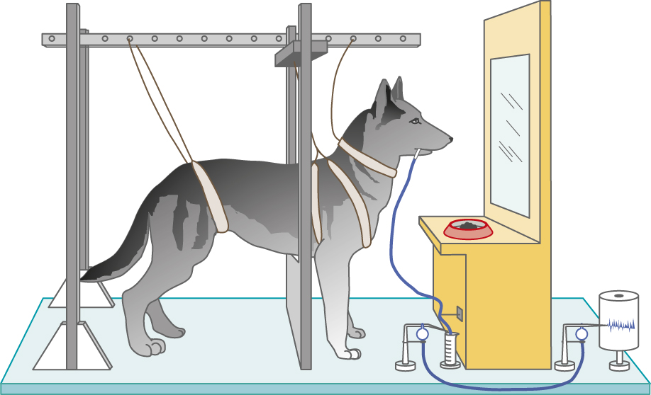
Figure 7.1: Pavlov’s Method
Notes:
Figure 7.1 Pavlov’s Method
The photo shows Ivan Pavlov (in the white beard), flanked by his students and a canine subject. The drawing depicts an apparatus similar to the one he used; saliva from a dog’s cheek flowed down a tube and was measured by the movement of a needle on a revolving drum.

Slide 6
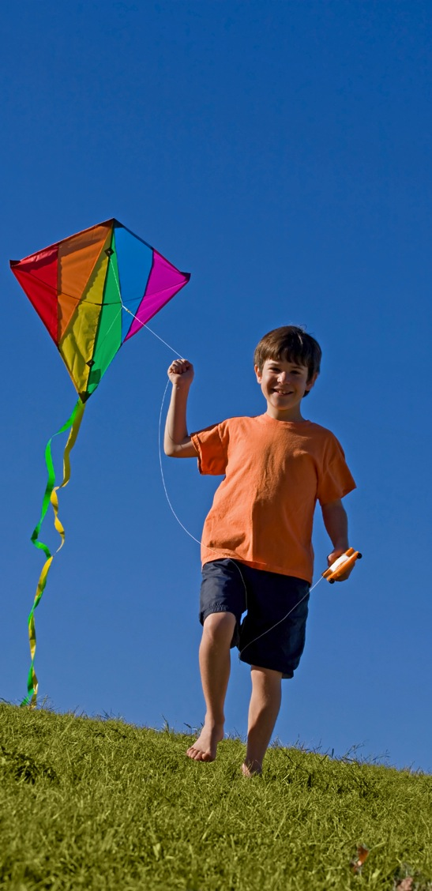
L
Relatively
permanent change in behavior (or behavioral potential) due to experience
e a r n i n g

Slide 7

C
onditioning
A basic kind of learning that involves associations among environmental stimuli and an organism’s behavior

Slide 8
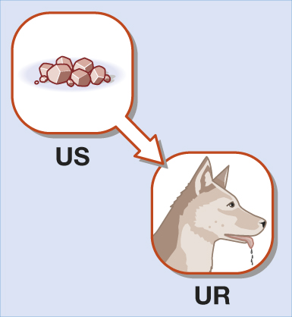
New Reflexes from Old
Unconditioned stimulus (US)
Unconditioned response (UR)
Notes:
Unconditioned stimulus (US): The classical-conditioning term for a stimulus that already elicits a certain response without additional learning.
Unconditioned response (UR): The classical-conditioning term for a response elicited by an unconditioned stimulus.

Slide 9
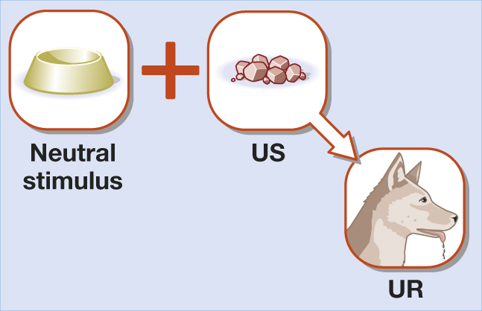
New Reflexes from Old
Notes:
In Pavlov’s lab, when some neutral stimulus such as the dish—a stimulus that did not typically cause the dog to salivate—was regularly paired with food, the dog learned to associate the dish and the food.
As a result, the dish alone acquired the power to make the dog salivate.

Slide 10
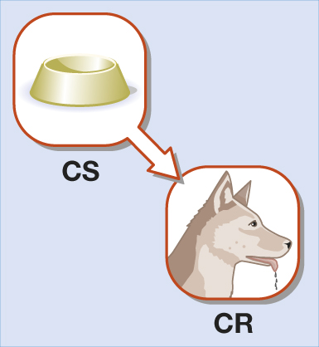
New Reflexes from Old
Conditioned stimulus (CS)
Conditioned response (CR)
Notes:
More generally, as a neutral stimulus and US become associated, the neutral stimulus becomes a conditioned stimulus (CS).
The CS then has the capacity to elicit a learned or conditioned response (CR) that is usually similar or related to the original, unlearned one.
In Pavlov’s laboratory, the sight of the food dish, which had not previously elicited salivation, became a CS for salivation.
Conditioned stimulus (CS): The classical-conditioning term for an initially neutral stimulus that comes to elicit a conditioned response after being associated with an unconditioned stimulus.
Conditioned response (CR): The classical-conditioning term for a response that is elicited by a conditioned stimulus; it occurs after the conditioned stimulus is associated with an unconditioned stimulus.
Classical conditioning: The process by which a previously neutral stimulus becomes associated with a stimulus that already elicits a response and, in turn, acquires the capacity to elicit a similar or related response. Also called Pavlovian or respondent conditioning.

Slide 11
Principles of Classical Conditioning
1
Extinction
2
Higher-Order Conditioning
3
Stimulus Generalization
Stimulus Discrimination
4

Slide 12
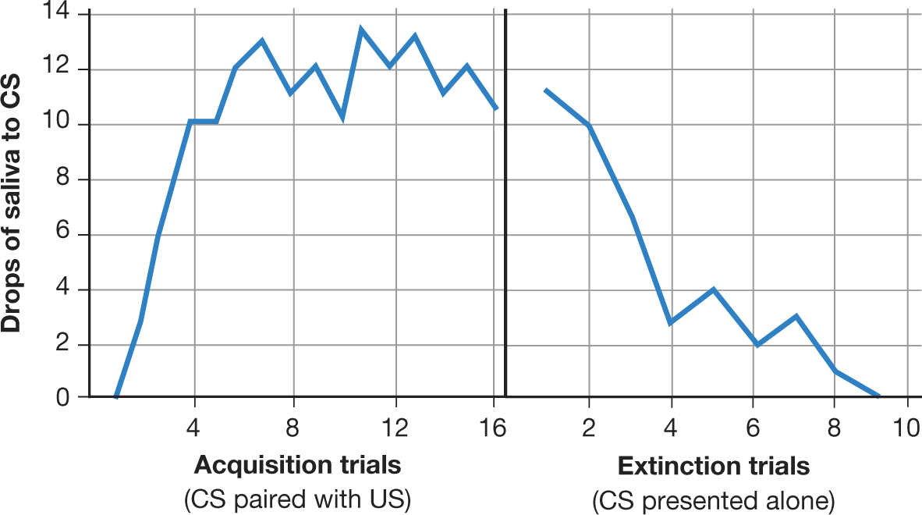
Figure 7.2: Acquisition and Extinction of a Salivary Response
Notes:
Figure 7.2 Acquisition and Extinction of a Salivary Response
A neutral stimulus that is consistently followed by an unconditioned stimulus for salivation will become a conditioned stimulus for salivation (left side of graph). But when this conditioned stimulus is then repeatedly presented without the unconditioned stimulus, the conditioned salivary response will weaken and eventually disappear; it has been extinguished.
Extinction: The weakening and eventual disappearance of a learned response; in classical conditioning, it occurs when the conditioned stimulus is no longer paired with the unconditioned stimulus.
Spontaneous recovery: The reappearance of a learned response after its apparent extinction.

Slide 13
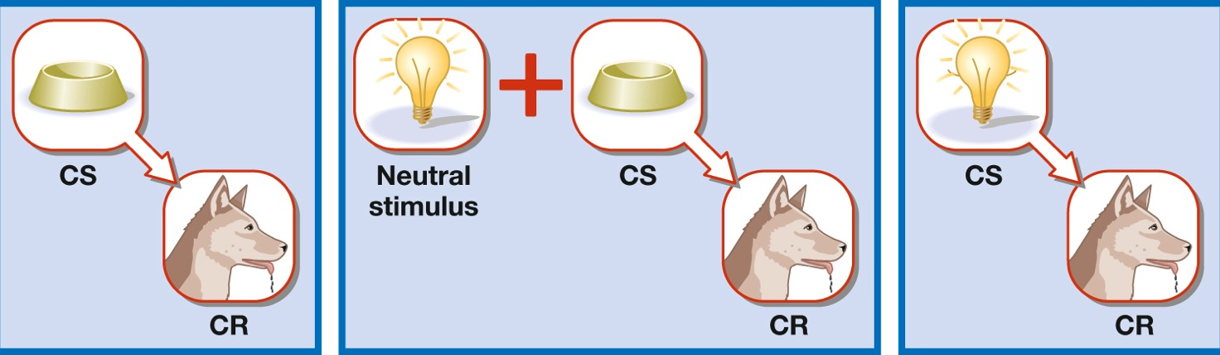
Figure 7.3: Higher-Order Conditioning
Notes:
Figure 7.3 Higher-Order Conditioning
In this illustration of higher-order conditioning, the food dish is a previously conditioned stimulus for salivation (left). When the light, a neutral stimulus, is paired with the dish (center), the light also becomes a conditioned stimulus for salivation (right).
Higher-order conditioning: In classical conditioning, a procedure in which a neutral stimulus becomes a conditioned stimulus through association with an already established conditioned stimulus.

Slide 14
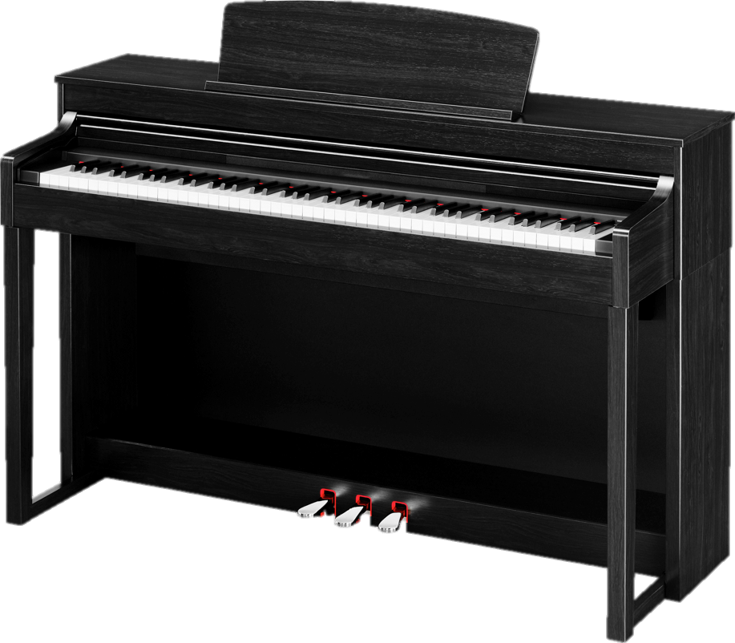

Stimulus Generalization and Discrimination
Stimulus generalization
After conditioning, the tendency to respond to a stimulus that resembles one involved in the original conditioning
In classical conditioning, it occurs when a stimulus that resembles the CS elicits the CR
Notes:
Stimulus generalization: After conditioning, the tendency to respond to a stimulus that resembles one involved in the original conditioning; in classical conditioning, it occurs when a stimulus that resembles the CS elicits the CR.

Slide 15
Stimulus Generalization and Discrimination
Stimulus discrimination
The tendency to respond differently to two or more similar stimuli
In classical conditioning, it occurs when a stimulus similar to the CS fails to evoke the CR
Notes:
Stimulus discrimination: The tendency to respond differently to two or more similar stimuli; in classical conditioning, it occurs when a stimulus similar to the CS fails to evoke the CR.

Slide 16

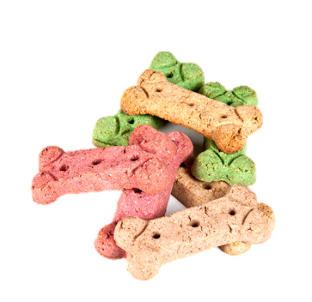
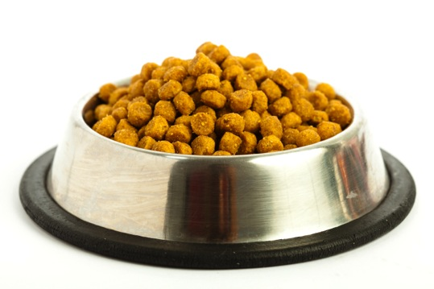
What Is Actually Learned in Classical Conditioning?
The stimulus to be conditioned should precede the unconditioned stimulus.
The first
stimulus predicts the second.
1
2
Notes:
This view is supported by the research of Robert Rescorla (1988, 2008), who showed, in a series of imaginative studies, that the mere pairing of an unconditioned stimulus and a neutral stimulus is not enough to produce learning.
To become a conditioned stimulus, the neutral stimulus must reliably signal, or predict, the unconditioned stimulus.
If food occurs just as often without a preceding tone as with it, the tone is unlikely to become a conditioned stimulus for salivation because the tone does not provide any information about the probability of getting food.

Slide 17
7.2
Classical Conditioning
in Real Life

Slide 18
7.2
Module Learning Objectives
7.2.A
Provide an example of how classical conditioning takes place in forming preferences.
7.2.B
Provide an example of how classical conditioning takes place in avoiding fearful stimuli, and describe how the process of counterconditioning takes place.
7.2.C
Describe how classical conditioning is involved in avoiding a food associated with aversive outcomes.
7.2.D
Describe how classical conditioning can affect reactions to medical treatments, including a patient’s reaction to a placebo.

Slide 19


ehaviorism
An approach to psychology that emphasizes the study of observable behavior and the role of the environment and prior experience as determinants of behavior

Slide 20
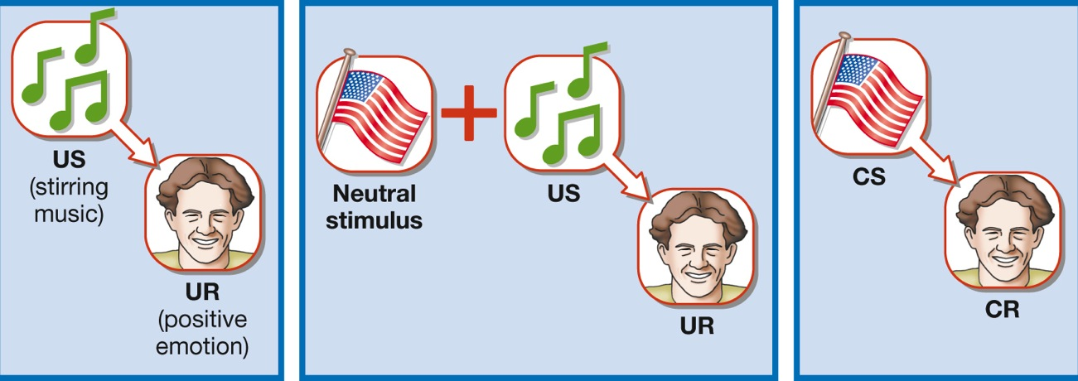
Learning to Like
Why do we have sentimental feelings when we see certain objects?
The objects have been associated in the past with positive feelings.
Notes:
Classical conditioning plays a big role in our emotional responses to objects, people, symbols, events, and places. It can explain why sentimental feelings sweep over us when we see a school mascot, a national flag, or the logo of the Olympic games. These objects have been associated in the past with positive feelings.

Slide 21
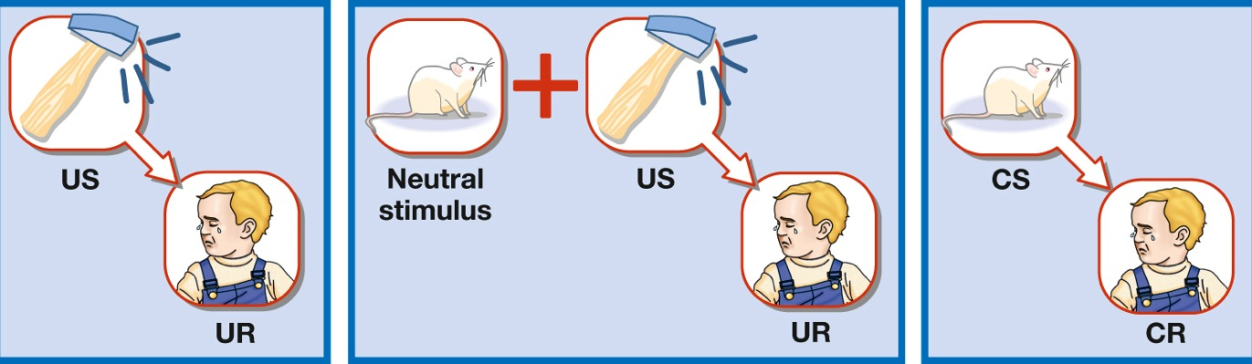
Learning to Fear
A person can learn to fear just about anything if it is paired with something that elicits pain, surprise, or embarrassment.
Notes:
Positive emotions are not the only ones that can be classically conditioned; so can dislikes and fears. A person can learn to fear just about anything if it is paired with something that elicits pain, surprise, or embarrassment. Human beings, however, are biologically primed or “prepared” to acquire some kinds of fears more readily than others. It is far easier to establish a conditioned fear of spiders, snakes, and heights than of butterflies, flowers, and toasters.
Counterconditioning: In classical conditioning, the process of pairing a conditioned stimulus with a stimulus that elicits a response that is incompatible with an unwanted conditioned response.

Slide 22
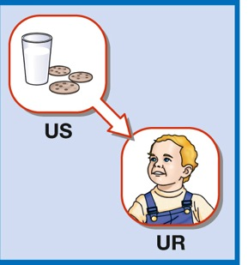
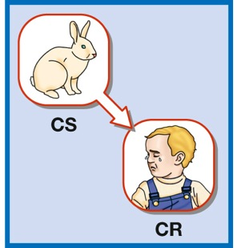
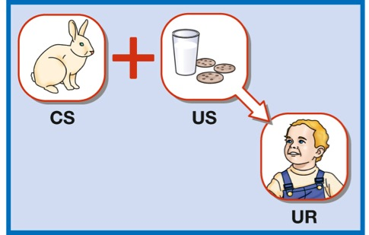
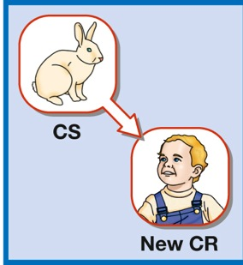
Learning to Fear
Notes:
A variation of this procedure, called systematic desensitization, was later devised for treating phobias in adults.

Slide 23


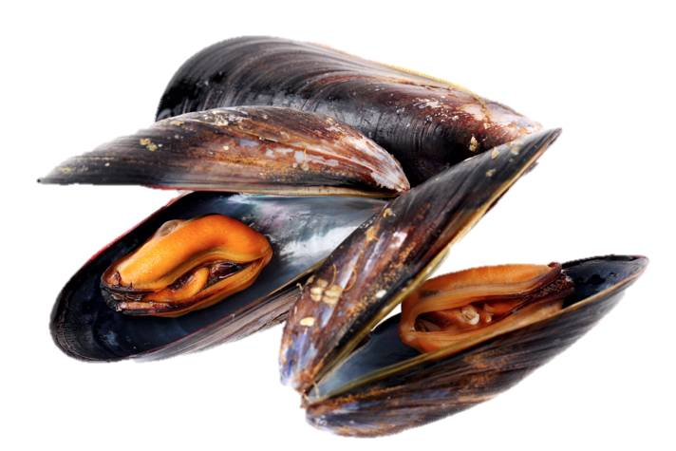
Accounting for Taste
Many people learn to dislike a food after eating it and then falling ill, even when the two events are unrelated.
Notes:
Many people have learned to dislike a food after eating it and then falling ill, even when the two events were unrelated. The food, previously a neutral stimulus, becomes a conditioned stimulus for nausea or other symptoms produced by the illness.
EXAMPLES:
Slugs learned an aversion to the smell of carrots, after it was paired with a bitter-tasting chemical.
Psychologist Martin Seligman developed an aversion to béarnaise sauce when he got the flu following a meal of filet mignon with béarnaise sauce.

Slide 24
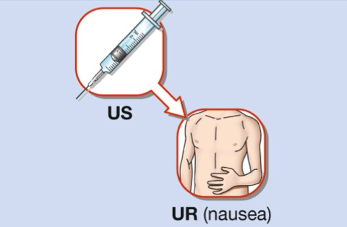
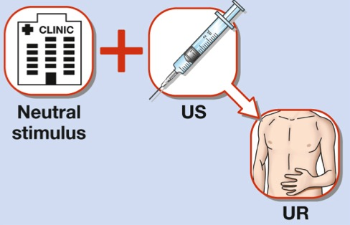
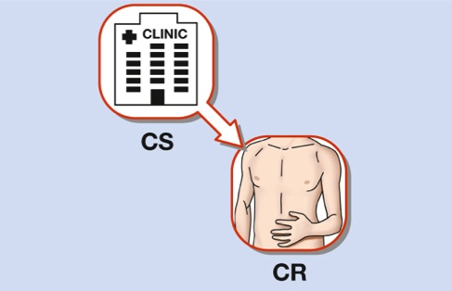
Reacting to Medical Treatments
Some cancer patients acquire a classically conditioned anxiety response to anything associated with their chemotherapy

Slide 25
7.3
Operant Conditioning

Slide 26
7.3
Module Learning Objectives
7.3.A
Discuss how Edward Thorndike’s research served as the basis for operant conditioning.
7.3.B
Distinguish between reinforcement and punishment and between a positive and negative stimulus, and provide examples of positive and negative reinforcement and punishment and primary and secondary reinforcement and punishment.

Slide 27
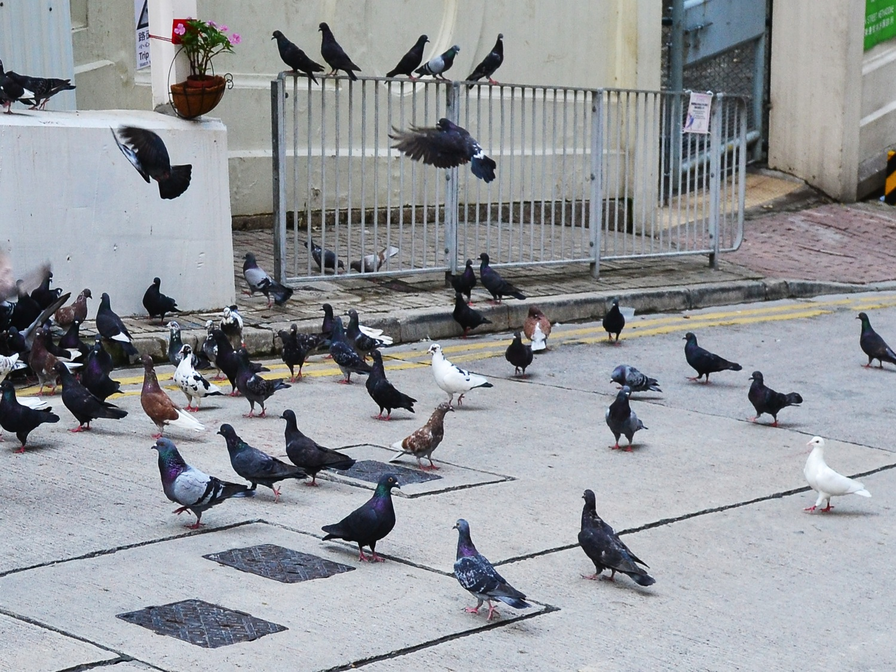
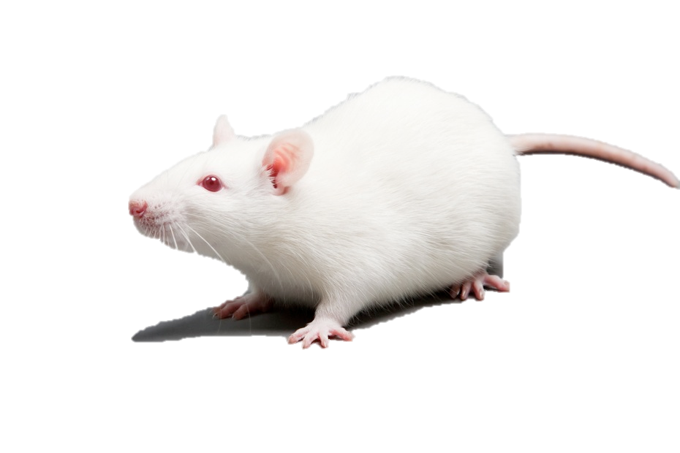
The Birth of Radical Behaviorism
B. F. Skinner
Radical behaviorism
  Distinguished from Watson’s classical conditioning
  External causes of an action
  Action’s consequences
  Explain behavior by looking outside
Notes:
The birth of radical behaviorism:
Began at the end of the 19th century
Thorndike: Behavior is controlled by its consequences
Puzzle box
B.F. Skinner: Behavior is explainable by looking outside of the individual

Slide 28
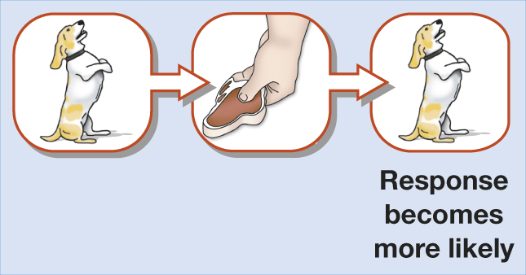
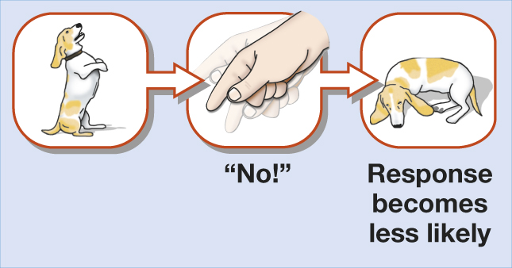
Consequences of Behavior
Reinforcement
Punishment
Notes:
Reinforcement: Strengthens the response or makes it more likely to recur.
Punishment: Weakens the response or makes it less likely to recur.

Slide 29

R
einforcement
The process by which a stimulus or event strengthens or increases the probability of the response that it follows

Slide 30
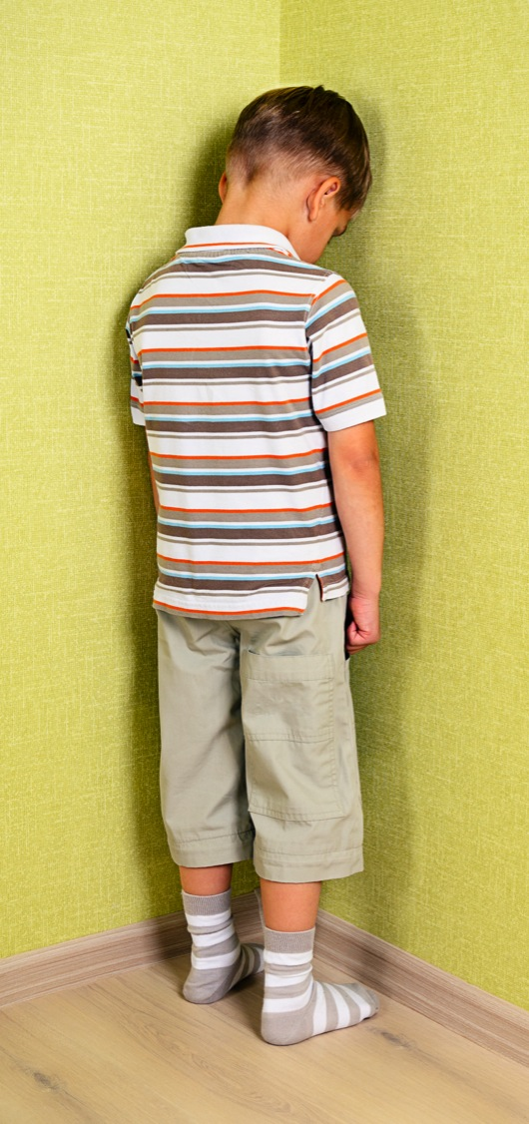


unishment
The process
by which
a stimulus or event weakens or reduces the probability of the response that it follows

Slide 31

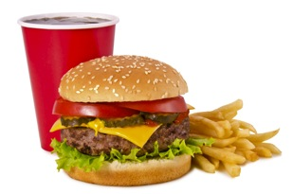

Primary and Secondary Reinforcers and Punishers
Primary Reinforcers: Inherently reinforcing and typically satisfy a physiological need
Secondary Reinforcers:
Stimuli that have acquired reinforcing properties through associations with other reinforcers
Notes:
Primary reinforcers satisfy biological needs.
Example: food
Secondary reinforcers are reinforcing through association with other (possibly primary) reinforcers.
Examples: money, praise, applause, good grades, awards, gold stars

Slide 32


Primary and Secondary Reinforcers and Punishers
Primary Punishers: Stimuli that are inherently punishing
Secondary Punishers:
Stimuli that have acquired punishing properties through associations with other punishers
Notes:
Primary punishers are inherently unpleasant.
Examples: pain, extreme heat or cold
Secondary punishers are punishing through association with other punishers.
Examples: criticism, demerits, scolding, fines, bad grades

Slide 33
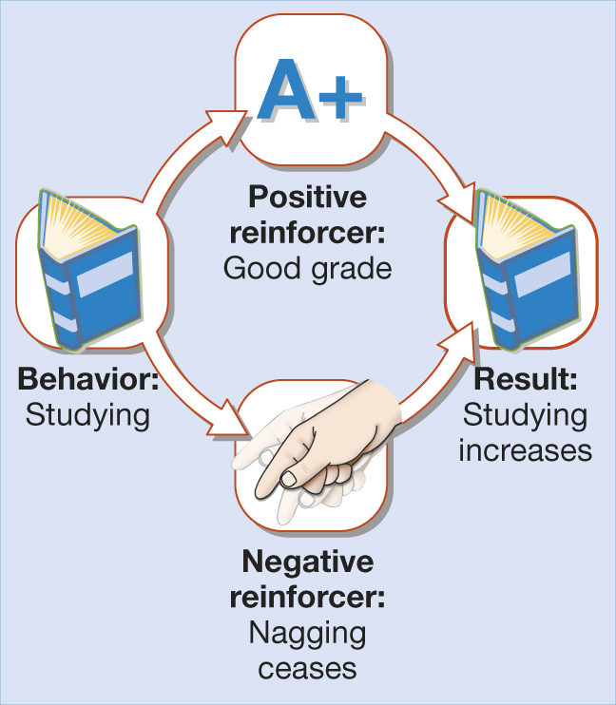
Positive and Negative Reinforcers and Punishers
Notes:
Positive reinforcement: A reinforcement procedure in which a response is followed by the presentation of, or increase in intensity of, a reinforcing stimulus; as a result, the response becomes stronger or more likely to occur.
Negative reinforcement: A reinforcement procedure in which a response is followed by the removal, delay, or decrease in intensity of an unpleasant stimulus; as a result, the response becomes stronger or more likely to occur.

Slide 34
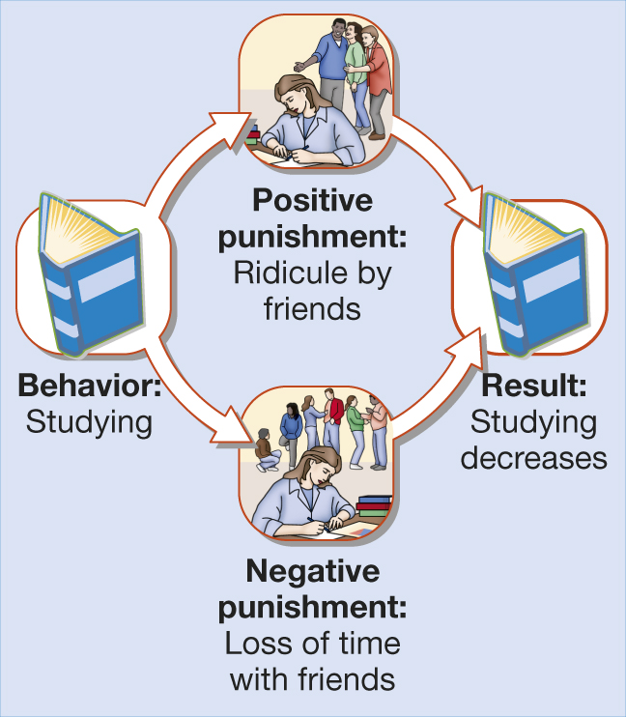
Positive and Negative Reinforcers and Punishers
Notes:
The positive–negative distinction can also be applied to punishment: Something unpleasant may occur following some behavior (positive punishment), or something pleasant may be removed (negative punishment).
If your friends tease you for studying (positive punishment) or if studying makes you lose time with your friends (negative punishment), you may stop studying.

Slide 35
7.4
Principles of Operant Conditioning

Slide 36
7.4
Module Learning Objectives
7.4.A
Describe the basic principles of operant conditioning, including extinction and recovery, stimulus generalization and discrimination, schedules of learning and shaping, and some biological limits on learning.
7.4.B
Discuss some of the misconceptions surrounding the work and ideas of B. F. Skinner and, by extension, some of the misconceptions surrounding the general goals of operant conditioning.

Slide 37
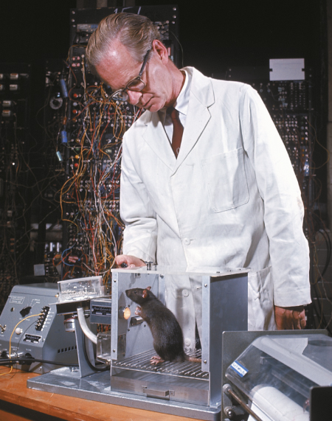
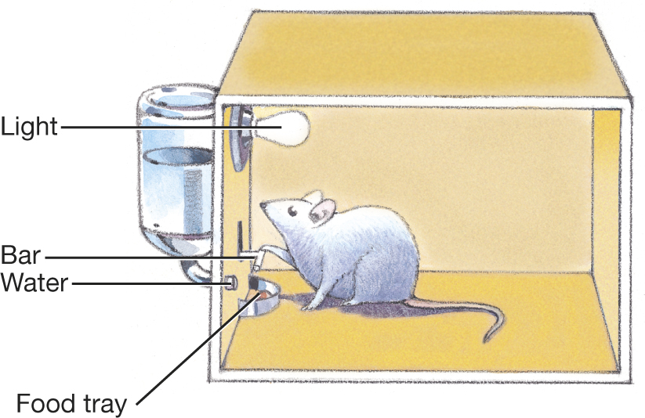
Figure 7.4: The Skinner Box
Notes:
Figure 7.4 The Skinner Box
When a rat in a Skinner box presses a bar, a food pellet or drop of water is automatically released. The photo shows Skinner training one of his subjects.

Slide 38
The Importance of Responses
1
Extinction
2
Stimulus generalization
3
Stimulus discrimination
4
Discriminative stimulus
Notes:
Extinction: The weakening and eventual disappearance of a learned response; in operant conditioning, it occurs when a response is no longer followed by a reinforcer.
Stimulus generalization: In operant conditioning, the tendency for a response that has been reinforced (or punished) in the presence of one stimulus to occur (or be suppressed) in the presence of other similar stimuli.
Stimulus discrimination: In operant conditioning, the tendency of a response to occur in the presence of one stimulus but not in the presence of other similar stimuli that differ from it on some dimension.
Discriminative stimulus: A stimulus that signals when a particular response is likely to be followed by a certain type of consequence.

Slide 39
Learning on Schedule
Intermittent (Partial) Reinforcement
A reinforcement schedule in which a particular response is sometimes but not always reinforced.
Continuous Reinforcement
A reinforcement schedule in which a particular response is always reinforced.

Slide 40

Shaping
Shaping:
Getting a response to
occur by reinforcing successive approximations of a desired response
Notes:
Shaping: An operant-conditioning procedure in which successive approximations of a desired response are reinforced.
Successive approximations: In the operant-conditioning procedure of shaping, behaviors that are ordered in terms of increasing similarity or closeness to the desired response.

Slide 41
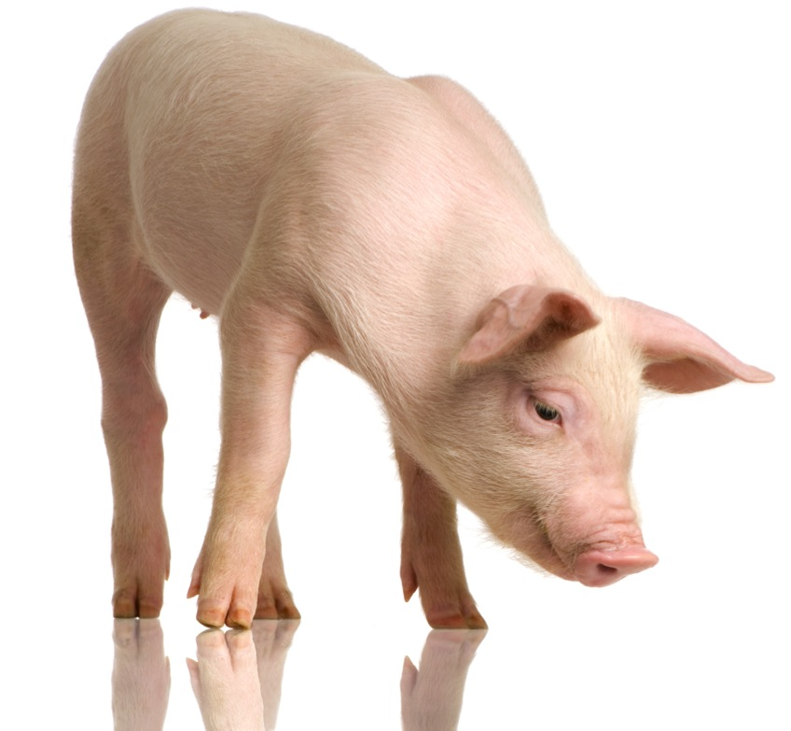
Biological Limits on Learning
Principles of conditioning are limited by:
Genetic dispositions
Physical characteristics
Instinctive drift:
The tendency for an organism to revert to instinctive behavior (pig rooting, etc.)

Slide 42
Skinner: The Man and the Myth
Skinner’s beliefs:
Private internal events are real and can be studied, but they cannot explain behavior.
Free will is an illusion.
Notes:
Skinner:
Maintained that private internal events – perceptions, emotions, and thoughts – are as real as any others, and we can study them by studying our own sensory experiences.
He insisted, however, that thoughts and feelings cannot explain behavior.
These components of consciousness are themselves simply behaviors that occur because of reinforcement and punishment.
He promoted the determinist view, saying that actions are determined by environment and genetics.

Slide 43
7.5
Operant Conditioning
in Real Life

Slide 44
7.5
Module Learning Objectives
7.5.A
List and discuss six reasons why punishment often fails to effectively change behavior.
7.5.B
Discuss reasons why rewards may backfire and not produce their intended results for behavior.

Slide 45
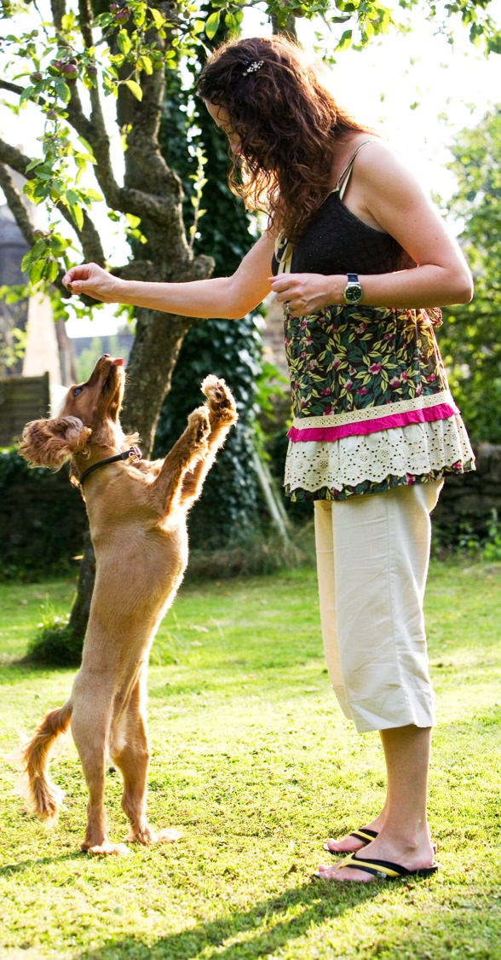
B
Application of operant conditioning techniques to teach new responses or to reduce or eliminate maladaptive or problematic behavior
ehavior
modification
Notes:
Also called applied behavior analysis.

Slide 46
When Punishment Works
1
Sometimes punishment is effective
2
Severity does not make a difference
3
Consistency is what matters most

Slide 47
When Punishment Fails
1
Administered inappropriately or mindlessly
2
Recipient responds with anxiety, fear, rage
3
Effect is temporary
4
Does not immediately follow the behavior
5
Does not inform recipient how to avoid future punishment
6
Punishment proves to be reinforcing
Notes:
People often administer punishment inappropriately or mindlessly.
The recipient of harsh or frequent punishment often responds with anxiety, fear, or rage.
The effectiveness of punishment is often temporary, depending heavily on the presence of the punishing person or circumstances.
Most misbehavior is hard to punish immediately.
Punishment conveys little information.
An action intended to punish may instead be reinforcing because it brings attention.

Slide 48
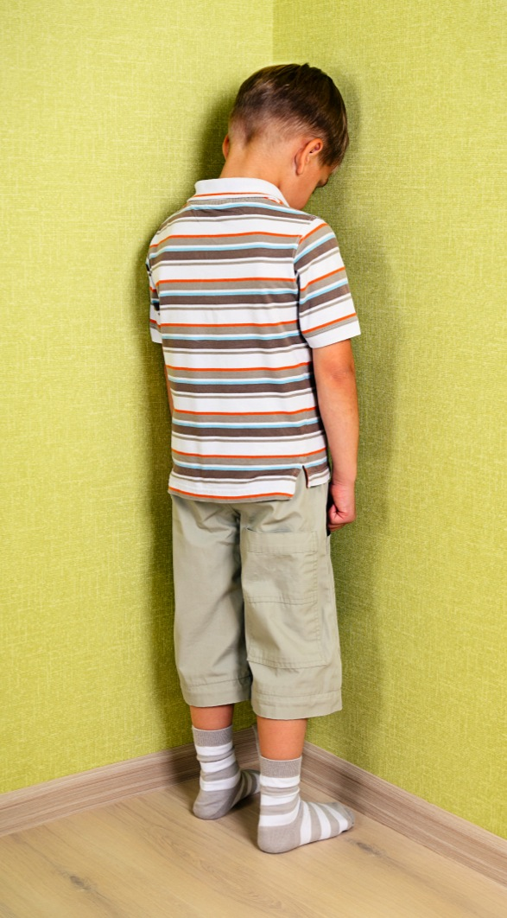
The Pros and Cons of Punishment
Alternatives to Punishment
Teach children problem-solving skills.
Reward good behavior.
Ignore behavior to extinguish it.
Use extinction + reinforcement..
Notes:
48
When punishment must be applied, these guidelines should be kept in mind:
(1) It should not involve physical abuse; instead, parents can use time-outs and loss of privileges (negative punishers).
(2) it should be consistent.
(3) it should be accompanied by information about the kind of behavior that would be appropriate.
(4) it should be followed, whenever possible, by the reinforcement of desirable behavior.

Slide 49


The Problems with Reward
Misuse of rewards
Self-esteem approach appears misguided
Grade inflation

Slide 50
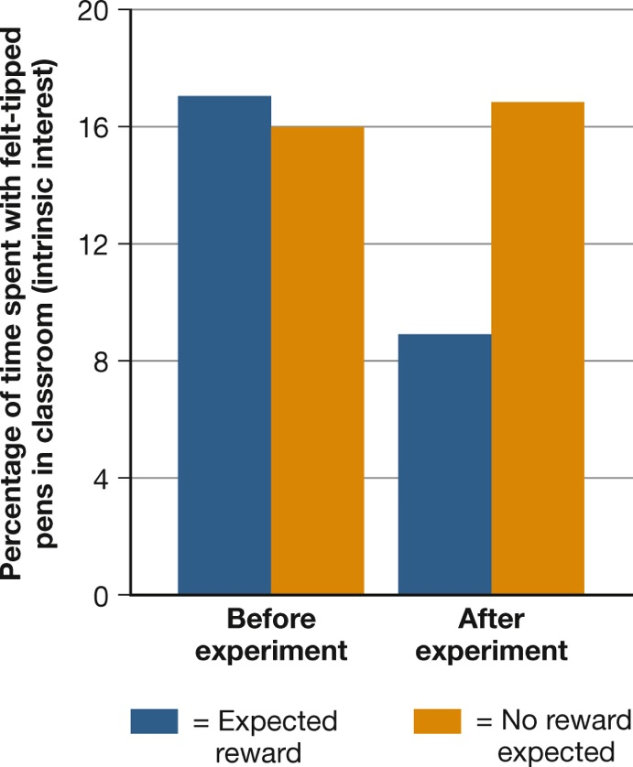
Why Rewards Can Backfire
Extrinsic reinforcers
Intrinsic reinforcers
Notes:
Figure 7.5 Turning Play into Work
Extrinsic rewards can sometimes reduce the intrinsic pleasure of an activity. When preschoolers were promised a prize for drawing with felt-tipped pens, the behavior temporarily increased. But after they got their prizes, they spent less time with the pens than they had before the study began (Lepper, Greene, & Nisbett, 1973).

Slide 51
7.6
Learning and the Mind

Slide 52
7.6
Module Learning Objectives
7.6.A
Define latent learning, and give an example of how it might work in the daily life of a college student.
7.6.B
Define observational learning, and give an example of how it might influence learning during childhood.

Slide 53
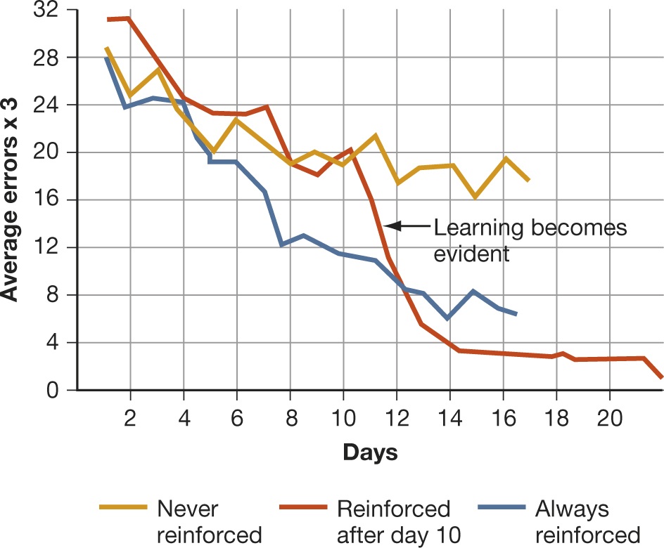
Latent Learning
Notes:
Figure 7.6 Latent Learning
In a classic experiment, rats that always found food in a maze made fewer and fewer errors in reaching the food (blue curve). In contrast, rats that received no food showed little improvement (gold curve). But rats that got no food for 10 days and then found food on the 11th day showed rapid improvement from then on (red curve). This result suggests that learning involves cognitive changes that can occur in the absence of reinforcement and that may not be acted on until a reinforcer becomes available (Tolman & Honzik, 1930).
Latent learning: A form of learning that is not immediately expressed in an overt response; it occurs without obvious reinforcement.

Slide 54

Social-Cognitive Learning Theories
Social cognitive theories emphasize how behavior is learned and maintained through:
Observation and imitation of others
Positive consequences
Cognitive processes
(i.e. plans, expectations, beliefs)
Notes:
These theories share an emphasis on the importance of beliefs, perceptions, and observations of other peoples’ behavior in determining what we learn, what we do at any given moment, and the personality traits we develop.
To a social-cognitive theorist, differences in beliefs and perceptions help explain why two people who live through the same event may come away with entirely different lessons from it (Bandura, 2012).

Slide 55

O
bservational
learning
A process in which an individual learns new responses by observing the behavior of another (a model) rather than through direct experience

Slide 56



Learning by Observing
Learning can
occur without
performance.

Slide 57
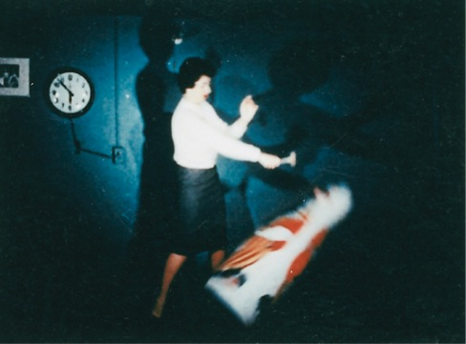
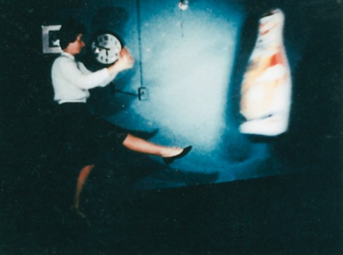
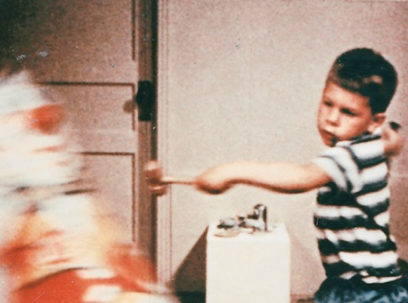
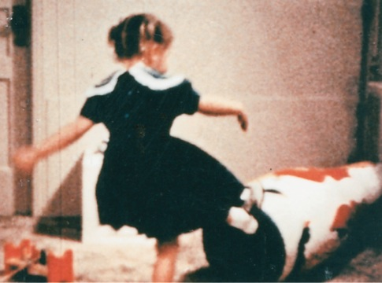
Bandura’s Classic Research
Notes:
In studies by Albert Bandura and his colleagues, children watched films of an adult kicking, punching, and hammering on a big rubber doll (top). Later, the children imitated the adult’s behavior, some of them almost exactly.

Slide 58

Taking Psychology with You
Does media violence make you violent?
Examine the evidence.
Consider other interpretations.
Don’t oversimplify.

Slide 59
End of Chapter

Slide 60
Interactive Figures

Slide 61
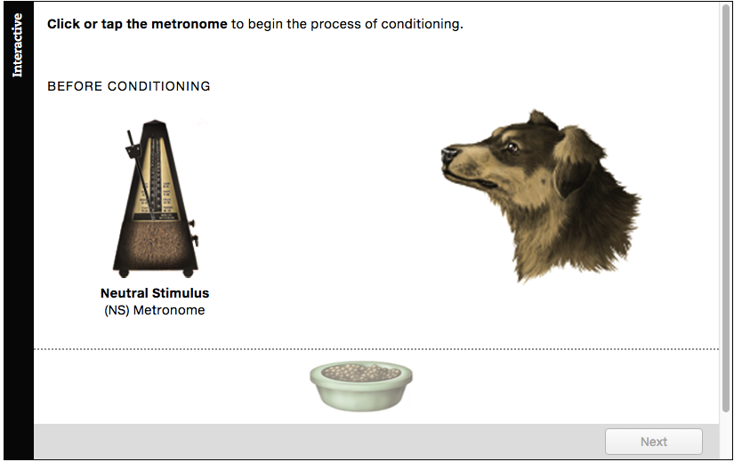
Interactive figure
Classical Conditioning
Click here to watch the interactive feature.

Slide 62
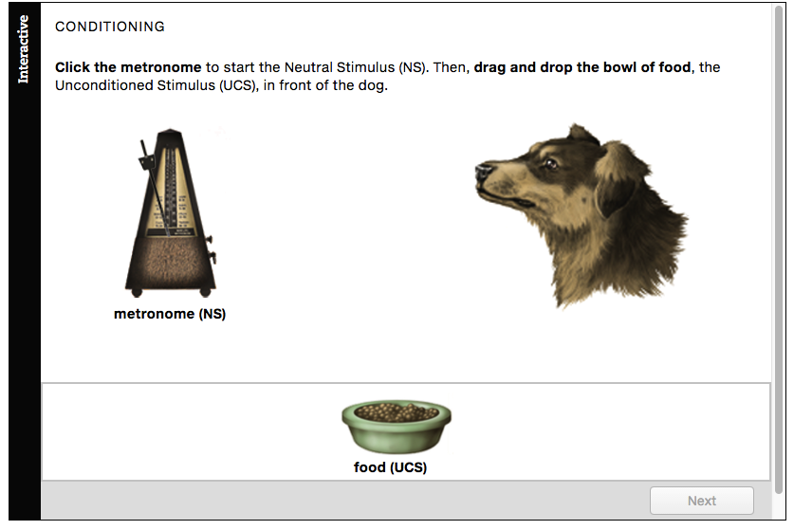
Interactive figure
Higher-Order Conditioning
Click here to watch the interactive feature.

Slide 63
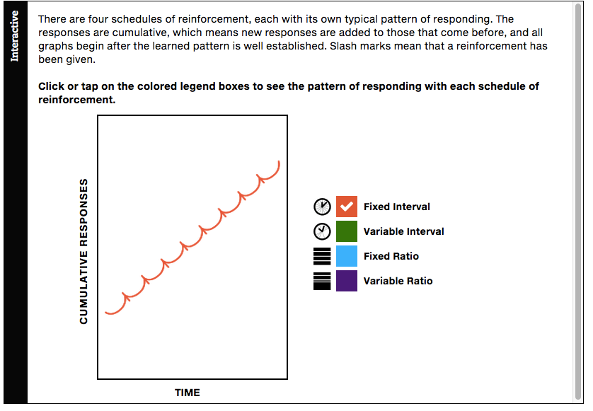
Interactive figure
Schedules of Reinforcement
Click here to watch the interactive feature.

Slide 64
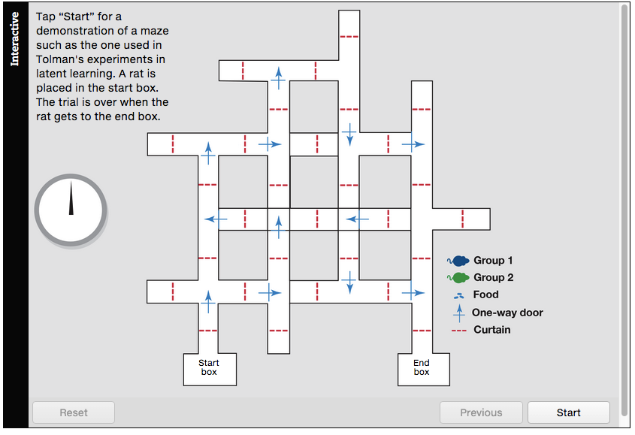
Interactive figure
Tolman’s Experiment
Click here to watch the interactive feature.

Slide 65
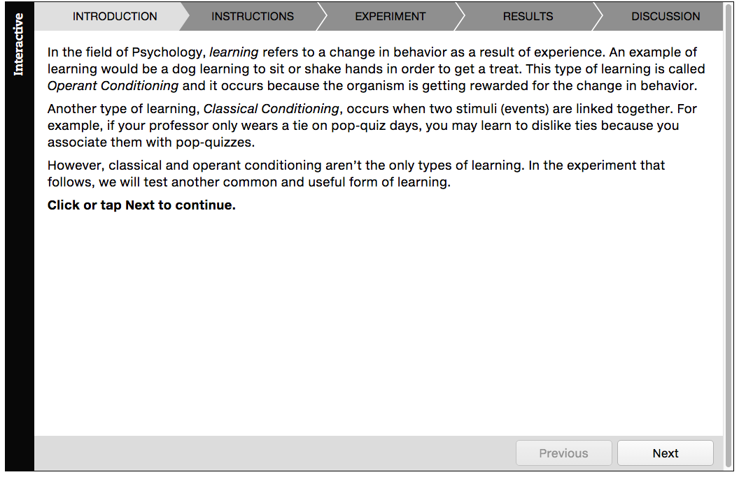
Interactive figure
Learning
Click here to watch the interactive feature.

Slide 66
Acknowledgments

Slide 67
Slide | Credit
Slide 4 | Alexander Demyanenko. Shutterstock
Slide 6 | sonya etchison. Shutterstock
Slide 7 | Cheryl Casey. Shutterstock
Slides 14, 15 | 123rf.com
Slides 14, 15 | Neamov. Shutterstock
Slide 16 | 123rf.com
Slide 16 | Aaron Amat. Shutterstock
Slide 16 | Steve Carroll. Shutterstock
Slide 19 | 123rf.com
Slide 23 | zcw. Shutterstock
Slide 23 | Sebastian Kaulitzki. Shutterstock
Slide 23 | cristovao. Shutterstock
Slide 27 | Coleman Yuen. Pearson Education Asia Ltd
Slide 27 | Vasiliy Koval. Shutterstock
Slide 29 | Nerthuz. Shutterstock
Slide 30 | Andrei Shumskiy. Shutterstock
Slide 31 | Andrey_Kuzmin. Shutterstock
Slide 31 | michelaubryphoto. Shutterstock
Slide 31 | 3445128471. Shutterstock
Slide 32 | Matthew Benoit. Shutterstock
Slide 32 | 123rf.com
Slide 32 | 3445128471. Shutterstock
Slide 41 | Eric Isselee. Shutterstock

Slide 68
Slide | Credit
Slide 42 | Coleman Yuen. Pearson Education Asia Ltd
Slide 42 | Vasiliy Koval. Shutterstock
Slide 45 | Lord and Leverett. Pearson Education Ltd
Slide 48 | Andrei Shumskiy. Shutterstock
Slide 49 | Pradeep Rawat. Pearson India Education Services Pvt. Ltd
Slide 49 | eurobanks. Shutterstock
Slide 54 | Seleznev Oleg. Shutterstock
Slide 55 | Pavel Burchenko. Shutterstock
Slide 56 | Happy person. Shutterstock
Slide 56 | Tom Wang. Shutterstock
Slide 56 | R. Gino Santa Maria. Shutterstock
Slide 58 | quetton. Shutterstock

