Slide 1
8 BEHAVIOR IN SOCIAL AND CULTURAL CONTEXT
8.1
Social Forces
8.2
Social Influences on Beliefs and Behavior
8.3
Individuals in Groups
8.4
Us Versus Them: Group Identity
8.5
Group Conflict and Prejudice
PSYCHOLOGY, Twelfth Edition | Carole Wade • Carol Tavris
Copyright © 2017, 2014, 2011 Pearson Education Inc. All rights reserved.

Slide 2
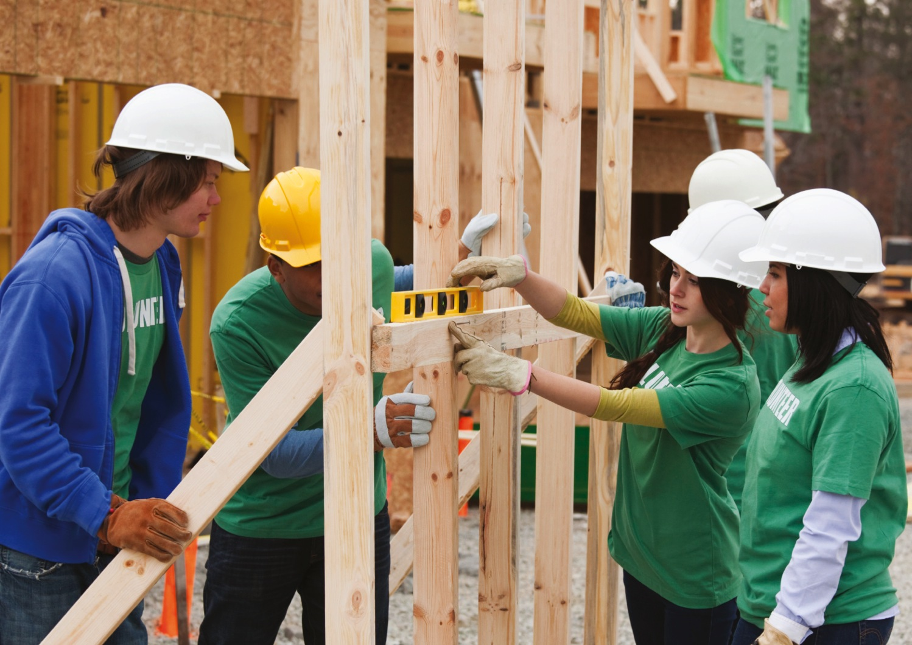
8.1
Social Forces

Slide 3
8.1
Module Learning Objectives
8.1.A
Compare social norms and social roles, and note how each contributes to the social rules that govern a culture.
8.1.B
Outline the basic procedures and findings of the Milgram obedience experiments, and discuss five conditions that make disobedience to authority more likely.
8.1.C
Outline the basic procedures and findings of the Zimbardo prison study.
8.1.D
Explain how feelings of entrapment contribute to destructive obedience.

Slide 4
Roles and Rules
Norms
(Social)
Role
Culture
Rules that regulate social life, including explicit laws and implicit cultural conventions
Social position that is governed by a set of norms for proper behavior
Program of shared rules that governs the behavior of people in a community or society, and a set of values, beliefs, and customs shared by most members of that community
Notes:
Examples:
Norms: Conducting courtships, raising children, making decisions, etc.
Roles: Gender roles, occupational roles, family roles
Culture: Conversational distance
4

Slide 5
The Obedience Study
METHOD:
Subjects told to give increasing levels of shock to another subject every time an error was made
RESULTS:
All: Shocked other subject at least once
2/3: Gave all levels of shock, even though many were upset by being asked to do so
CONCLUSIONS:
Obedience is a function of the situation, not of personalities
Nature of the relationship to authority influences obedience
Notes:
Would people obey an authority figure, even when the orders violated their ethical standards?
Subjects thought they were in an experiment about the effect of punishment on learning, and were instructed to give increasing levels of shock to another subject every time an error was made.
No one received shocks, but the subjects did not know this.
Every subject administered at least one shock to the learner; two-thirds obeyed the experimenter and gave all the levels of shock, even though they thought the victim was in pain.
Many subjects were visibly upset by being asked to administer shocks, but continued anyway.
Most people were far more obedient than anyone expected.
Results are controversial and have generated further research on violence and obedience.

Slide 6
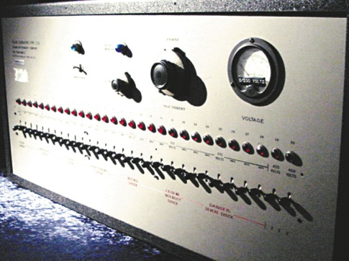
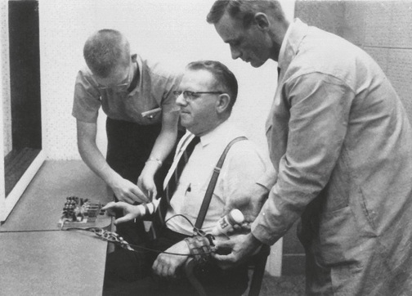
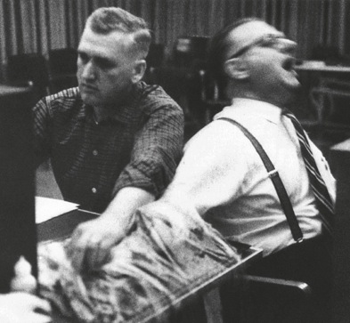
Figure 8.1: The Milgram Obedience Experiment
Notes:
Figure 8.1 The Milgram Obedience Experiment
(a) Milgram’s original shock machine; in 1963, it looked pretty ominous. (b) The “learner” is being strapped into his chair by the experimenter and the “teacher.” (c) In Milgram’s study, when the “teacher” had to
administer shock directly to the learner, most subjects refused, but this one continued to obey.
Copyright 1965 by Stanley Milgram. From the film Obedience, distributed by Penn State Media Sales.

Slide 7
The Obedience Study
Participants were more likely to disobey orders to give shocks when:
1
The experimenter left the room
2
The victim was right there in the room
Two experimenters issued conflicting demands
3
The person ordering them to continue was an ordinary man
4
5
The participant worked with peers who refused to go further
Notes:
7
The original study could never be repeated in the United States today because of these ethical concerns
However, a “softer” version of the experiment has been done, in which “teachers” who had not heard of the original Milgram study were asked to administer shocks only up to 150 volts, when they first heard the learner protest.
That amount of shock had been a critical choice point in Milgram’s study, and in the replication, nearly 80 percent of those who went past 150 ended up going all the way to the end (Packer, 2008).
Overall obedience rates were only slightly lower than Milgram’s, and once again, gender, education, age, and ethnicity had no effect on the likelihood of obeying (Burger, 2009).
In another, rather eerie cyberversion replication of Milgram’s study, participants had to shock a virtual woman on a computer screen. Even though they knew she wasn’t real, their heart rates increased and they reported feeling bad about delivering the “shocks.” Yet they kept doing it (Slater et al., 2006).

Slide 8
The Prison Study
PROCEDURE:
Subjects randomly assigned role of guard or prisoner
RESULTS:
Prisoners became:
Distressed
Helpless
Apathetic
Rebellious
Guards became one of the following:
Nice
“Tough but fair”
Tyrannical
Study stopped after six days
Notes:
Generations of students and the general public have seen emotionally charged clips from videos of the study made at the time.
To Zimbardo, the results demonstrated how roles affect behavior: The guards’ aggression was entirely a result of wearing a guard’s uniform and having the power conferred by a guard’s authority.
Despite flaws with the study, the Stanford prison study remains a useful cautionary tale.

Slide 9
Why People Obey
To avoid punishment
Out of respect for authority
Because of entrapment: A gradual process in which individuals escalate their commitment to a course of action to justify their investment of time, money, or effort
Notes:
The first stages of entrapment may pose no difficult choices, but as people take another step, or make a decision to continue, they will justify that action, which allows them to feel that it is the right one.
Before long, the person has become committed to a course of action that is increasingly self-defeating, cruel, or foolhardy.

Slide 10
8.2
Social Influences on Beliefs and Behavior

Slide 11
8.2
Module Learning Objectives
8.2.A
Contrast situational and dispositional attributions, explain how and why the fundamental attribution error takes place, and describe three biases that people hold about themselves and others.
8.2.B
Outline the process of cognitive dissonance, and explain how the validity effect and the familiarity effect shape our attitudes.
8.2.C
Summarize four elements that contribute to indoctrination.

Slide 12
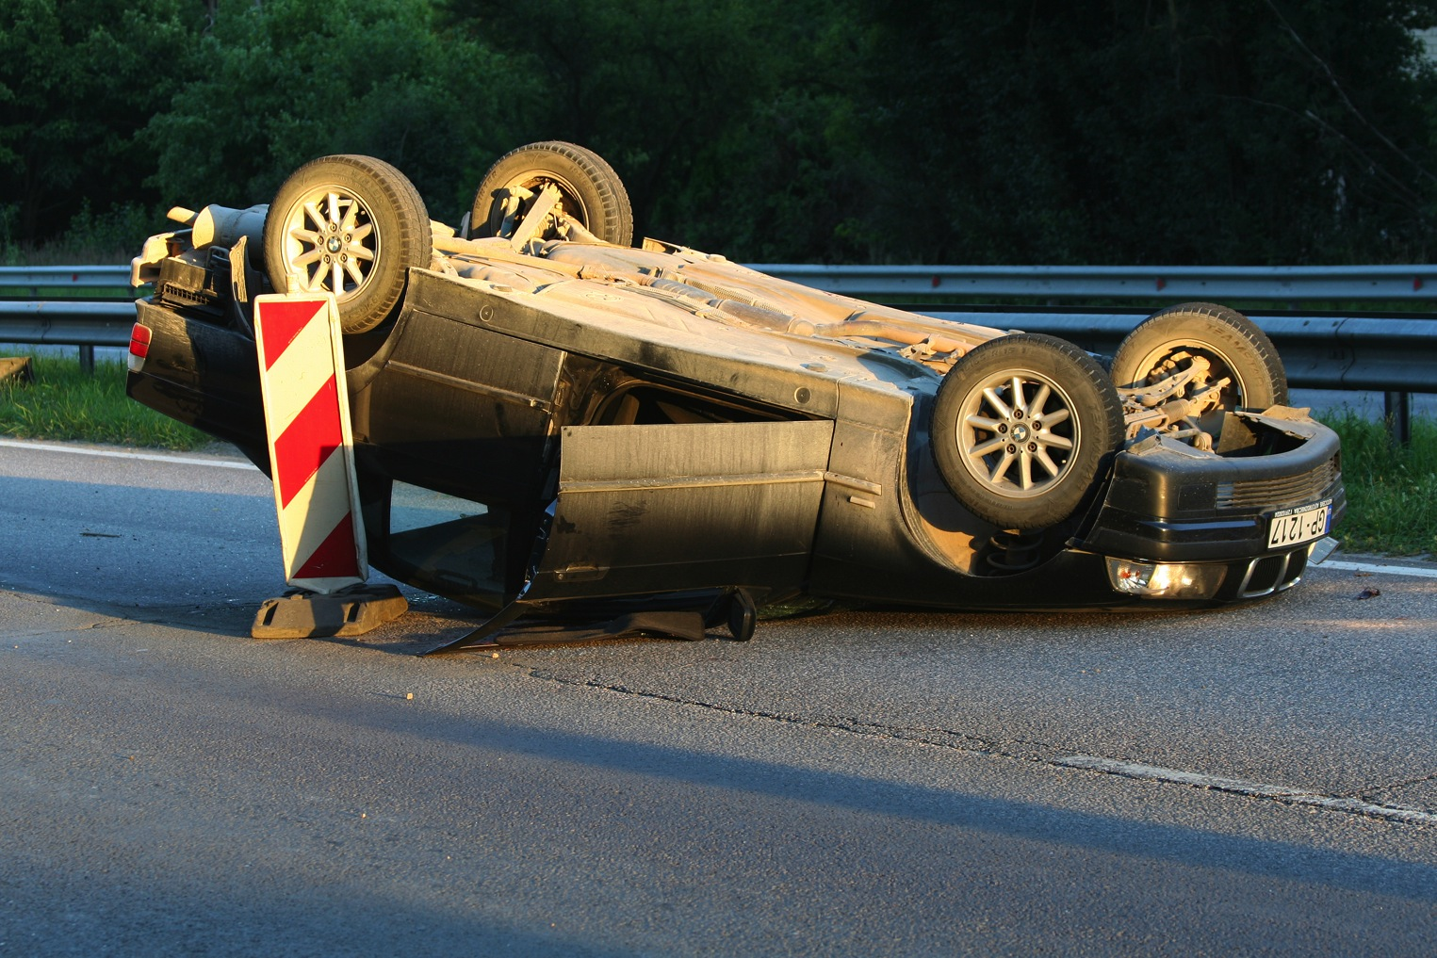
Attributions
_{Dispositional}
_{Situational}
“He's such a careless driver. He never watches out for other cars.”
“He probably got caught in some bad traffic, and then he was late for a meeting.”
Attribution theory
People are motivated to explain their own and others’ behavior by attributing causes of that behavior to a disposition or a situation.
Notes:
Situational attributions: Identify the cause of an action as something in the situation or environment.
Dispositional attributions: Identify the cause of an action as something in the person.

Slide 13
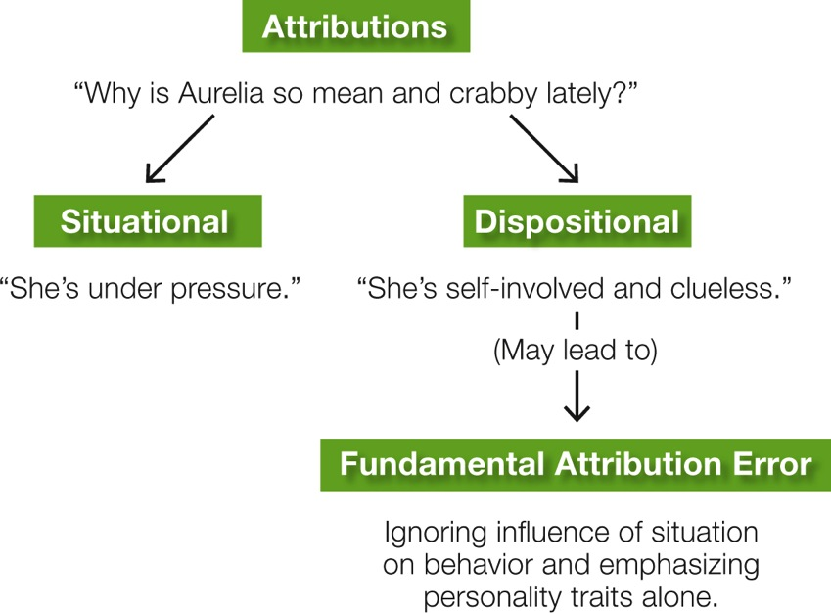
Attributions
Fundamental attribution error
The tendency, in explaining other people’s behavior, to overestimate personality factors and underestimate the influence of the situation
Notes:
The fundamental attribution error is especially prevalent in Western nations, where middle-class people tend to believe that individuals are responsible for their own actions and dislike the idea that the situation has much influence over them.

Slide 14
Self-Serving Biases
The bias to choose the most flattering and forgiving attributions of our own lapses
1
2
3
The bias that we are better, smarter, and kinder than others
The bias to believe that the world is fair (Just-world hypothesis)
Notes:
Self-serving biases: Habits of thinking that make us feel good about ourselves, even (perhaps especially) when we shouldn’t.
Just-world hypothesis: The notion that many people need to believe that the world is fair and that justice is served, that bad people are punished and good people are rewarded.

Slide 15
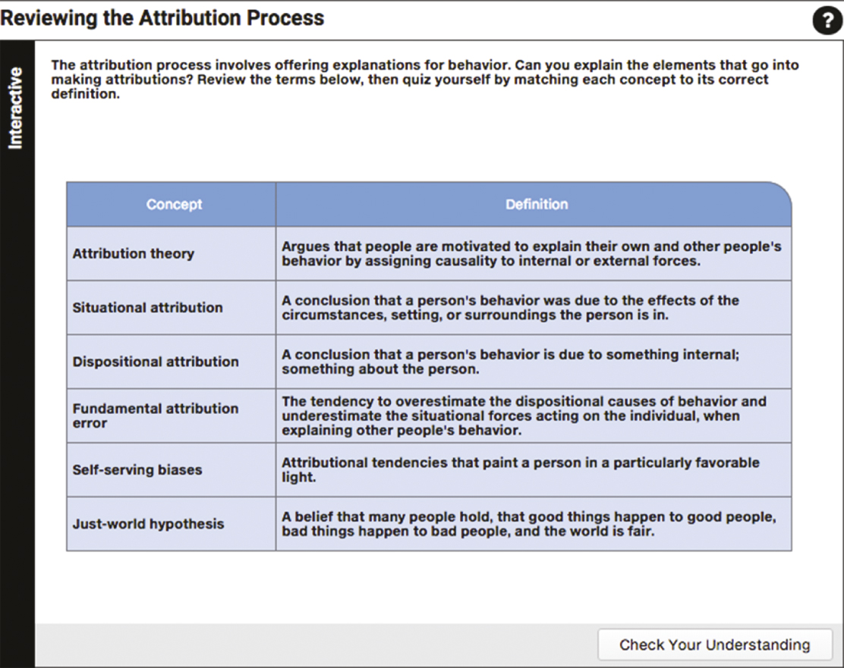
Reviewing the Attribution Process

Slide 16
Attitudes
“She is such a nice person.”
Beliefs about people, groups, ideas, or activities
Explicit
Implicit
Notes:
Some attitudes are explicit: We are aware of them, they shape our conscious decisions and actions, and they can be measured on self-report questionnaires.
Others are implicit: We are unaware of them, they may influence our behavior in ways we do not recognize, and they are measured in indirect ways (Stanley, Phelps, & Banaji, 2008).

Slide 17
Cognitive Dissonance
A state of tension that occurs when a person simultaneously holds two cognitions that are psychologically inconsistent or when a person’s belief is incongruent with his or her behavior
“I repeated gossip about my friend Chris.”
“I am a good, loyal friend.”

Slide 18
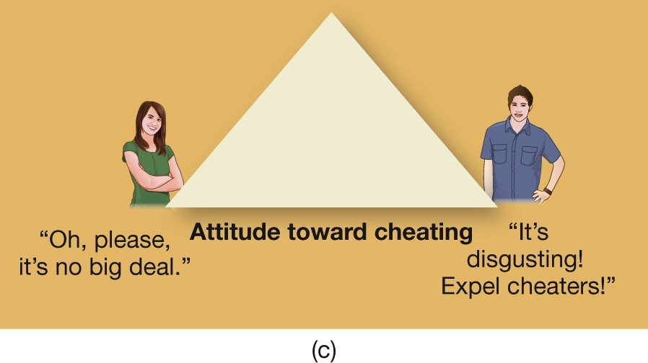
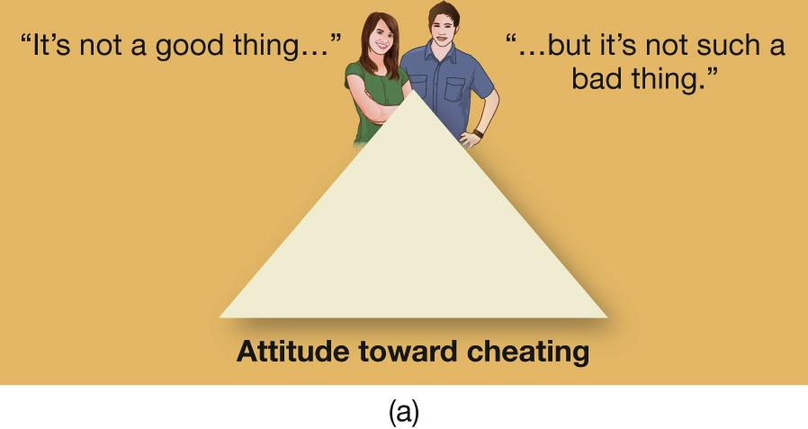
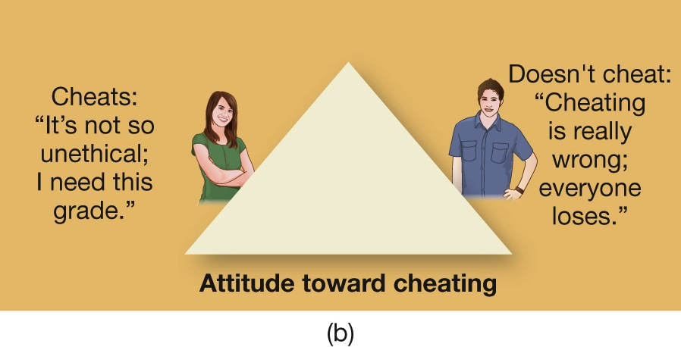
Figure 8.2: The Slippery Slope of Self-Justification
Notes:
Figure 8.2 The Slippery Slope of Self-Justification
(a) Imagine two people with the same neutral attitude toward cheating. (b) Given an opportunity, one cheats and the other doesn’t. (c) Because of the need to reduce cognitive dissonance, each will then justify the action they took so that their opinion about cheating is consonant with their behavior. Over time, they both will have moved a long way from their original attitude.

Slide 19
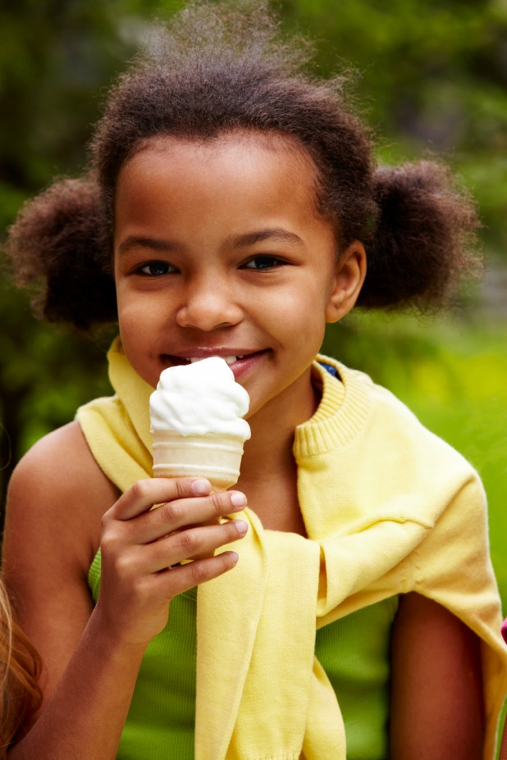
Shifting Opinions and Bedrock Beliefs
Ice cream is good for you.
Ice cream is good for you.
Familiarity effect:
The tendency of people to feel more positive toward a person, item, product, or other stimulus the more familiar they are with it
Validity effect:
The tendency of people to believe that a statement is true or valid simply because it has been repeated many times
Ice cream is good for you.
Ice cream is good for you.
Ice cream is good for you.
Ice cream is good for you.
Ice cream is good for you.
Ice cream is good for you.

Slide 20
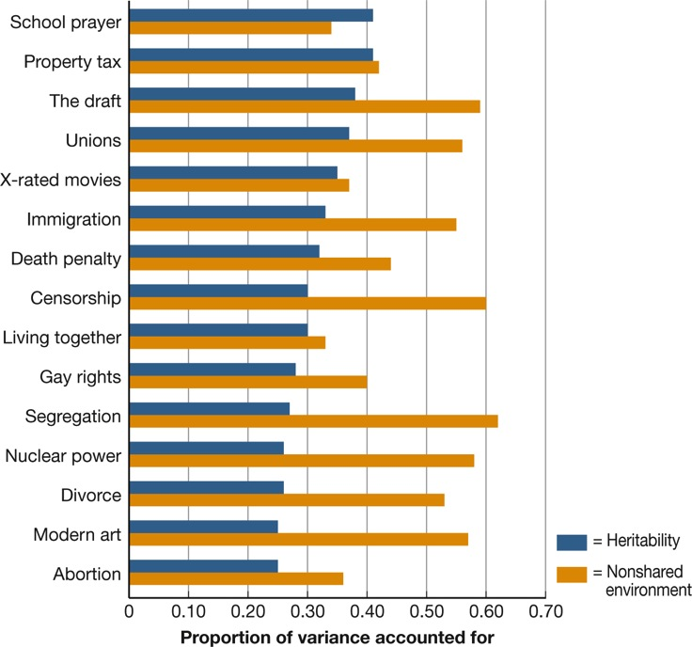
BIOLOGY AND beliefs
Belief Systems and Genetics
Ideological belief systems may have evolved to be organized along a left-right dimension, consisting of two core sets of attitudes:
Whether a person advocates social change or supports the system as it is
Whether a person thinks inequality is a result of human policies and can be overcome, or is inevitable and should be accepted as part of the natural order
Notes:
Figure 8.3 The Genetics of Belief
A study of thousands of identical and fraternal twins identified the approximate genetic contribution to the variation in attitudes about diverse topics. Heritability was greatest for school prayer and property tax, and lowest for divorce, modern art, and abortion. But notice that in almost all cases, a person’s unique life experiences (the “nonshared environment”) were far more influential than genes, especially on attitudes toward topics as unrelated as the draft, censorship, and segregation (Alford, Funk, & Hibbing, 2005).

Slide 21
Persuasion or “Brainwashing”? The Case of Suicide Bombers
Methods of indoctrination:
1
The person is subjected to entrapment
2
The person’s problems are explained by one simple attribution: “It is all the fault of those bad people; we have to eliminate them.”
3
The person is offered a new identity and is promised salvation
4
The person’s access to disconfirming (dissonant) information is severely controlled
Notes:
21

Slide 22
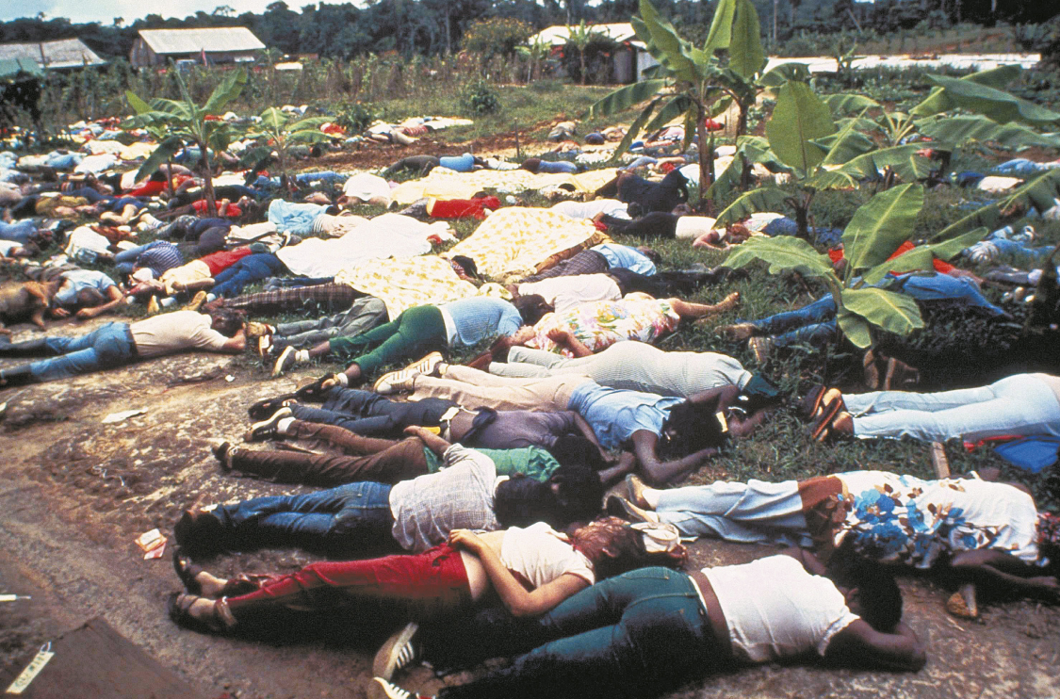
Persuasion or “Brainwashing”? The Case of Suicide Bombers
Notes:
More than 900 members of the People’s Temple committed mass suicide at the instigation of their leader, Jim Jones.

Slide 23
8.3
Individuals in Groups

Slide 24
8.3
Module Learning Objectives
8.3.A
Outline the basic procedures and findings of the Asch line-judging study.
8.3.B
List four symptoms of groupthink.
8.3.C
Explain how diffusion of responsibility and deindividuation contribute to the madness of crowds.
8.3.D
Discuss four situational factors that increase one’s likelihood to offer help to others.

Slide 25
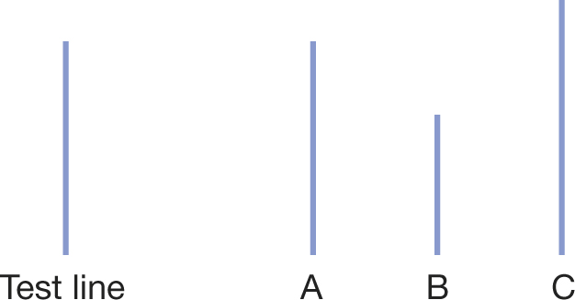
Conformity
Asch study:
Subjects in group asked to match line lengths
Confederates picked wrong line
Only 20% of students remained independent
Notes:
Conformity permits the smooth running of society and allows people to feel in harmony with others like them. But as the Asch experiment showed, most people will conform to the judgments of others even when the others are obviously wrong.

Slide 26
Conformity
Basic motives for conformity:
Need for social acceptance
Need for information

Slide 27
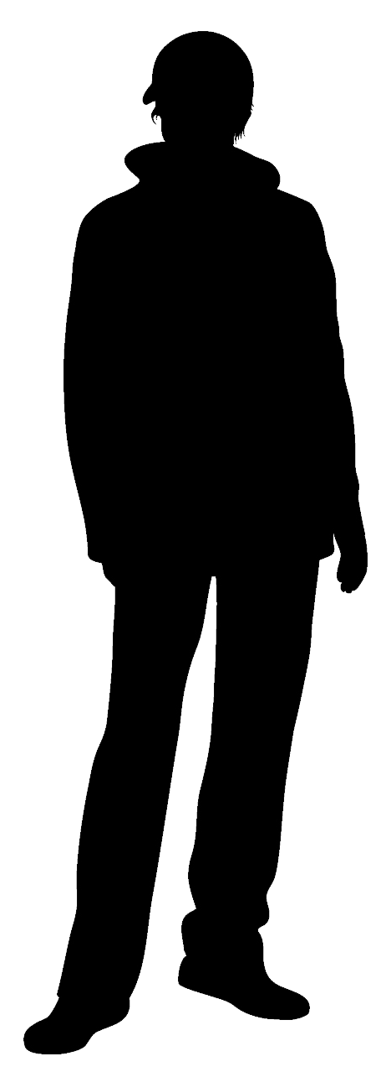
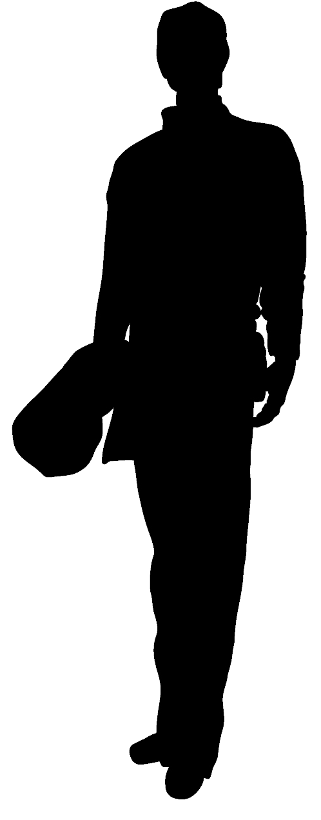
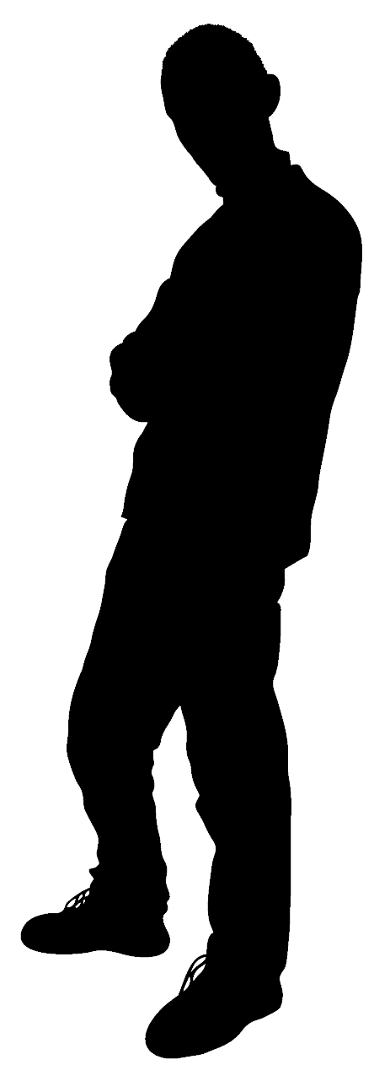
Groupthink
The tendency for all members of a group to think alike for the sake of harmony and to suppress disagreement
Examples:
Bay of Pigs
Challenger explosion
2003 invasion of Iraq
Notes:
Occurs when the need for total agreement overwhelms the need for the wisest decision.
Symptoms
Illusion of invulnerability
Self-censorship
Pressure on dissenters to conform
Illusion of unanimity
Counteracted by:
Creating conditions that reward dissent, protect and encourage minority views, and encourage problem-solving
Strong identification with collective enterprise – wouldn’t support decision that would harm group goals

Slide 28
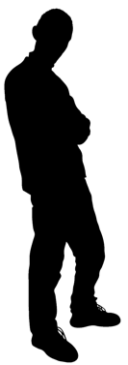
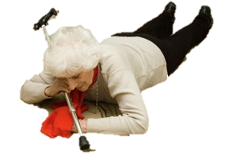
The Wisdom and Madness of Crowds
Diffusion of responsibility
In groups, the tendency of members to avoid taking action because they assume the others will
Bystander effect
Notes:
Bystander effect: Individuals often fail to take action or call for help when they see someone in trouble because they assume that someone else will do so.

Slide 29
Deindividuation
In groups or crowds, the loss of awareness of one’s own individuality
Notes:
The most extreme instances of the diffusion of responsibility occur in large, anonymous mobs or crowds. The crowds may consist of cheerful sports spectators or angry rioters.
Either way, people often lose awareness of their individuality and seem to hand themselves over to the mood and actions of the crowd, a state called deindividuation (Festinger, Pepitone, & Newcomb, 1952).

Slide 30
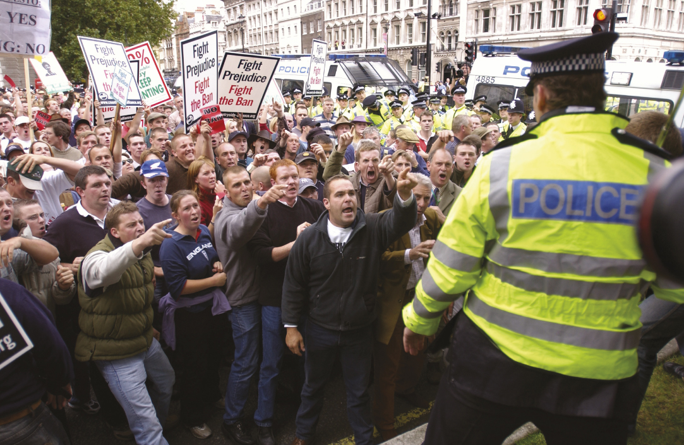
Deindividuation
Notes:
People in crowds, feeling anonymous, may do destructive things they would never do on their own.

Slide 31
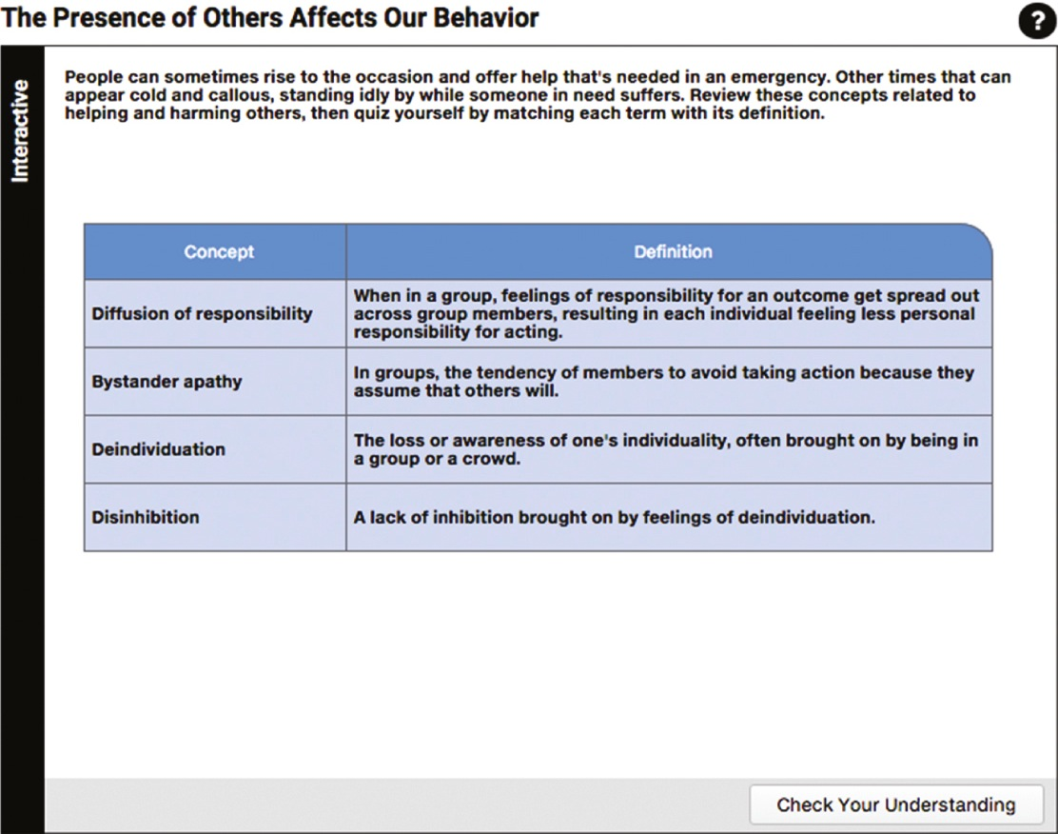
The Presence of Others Affects Our Behavior

Slide 32
Altruism and Dissent
Factors that can overcome bystander apathy and increase likelihood of helping others or behaving courageously:
You perceive the need for intervention or help.
Cultural norms encourage you to take action.
You have an ally.
You become entrapped.
Notes:
Altruism: The willingness to take selfless or dangerous action on behalf of others.

Slide 33
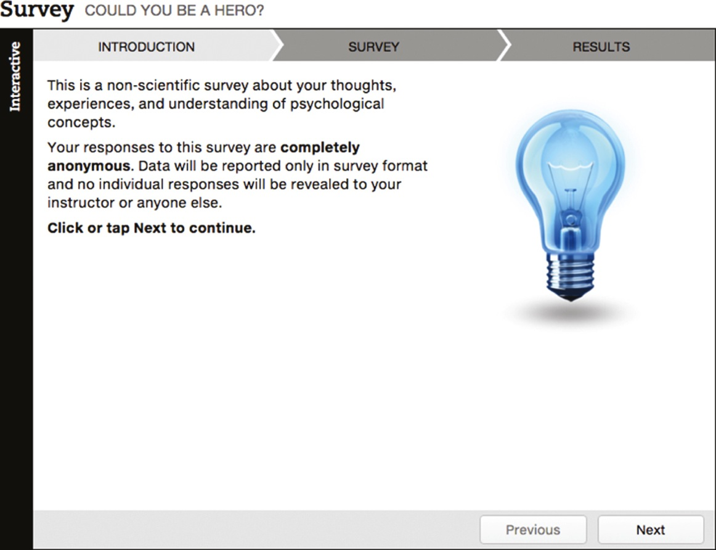
Could You Be a Hero?

Slide 34
8.4
Us Versus Them: Group Identity

Slide 35
8.4
Module Learning Objectives
8.4.A
Contrast social identity, ethnic identity, and acculturation, and offer examples of each concept.
8.4.B
Define ethnocentrism, and describe how it contributes to us–them dichotomies.
8.4.C
Define what a stereotype is, and discuss three ways in which stereotypes distort reality.

Slide 36
Ethnic Identity
Social Identities
Ethnic Identity
Acculturation
Notes:
Personal identity: A sense of self that is based on our particular traits and unique life history.
Social identity: The part of a person’s self-concept that is based on his or her identification with a nation, religious or political group, occupation, or other social affiliation.
Ethnic identity: A person’s identification with a racial or ethnic group.
Acculturation: The process by which members of minority groups come to identify with and feel part of the mainstream culture.
Many immigrants arrive in their host country with every intention of becoming part of the mainstream culture. If they encounter discrimination or other setbacks, however, they may realize that acculturation is harder than they anticipated and that their original ethnic identity offers greater solace

Slide 37
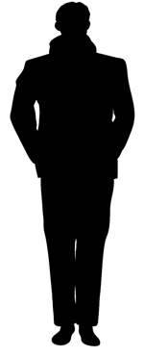
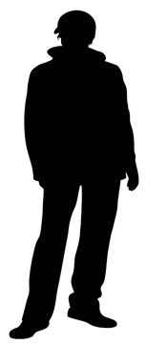
Ethnocentrism
The belief that one’s own ethnic group, nation, or religion is superior to all others
US
THEM
Notes:
“Us-them” thinking
Aids survival by making people feel attached to their own group and willing to work on group’s behalf
Ethnocentrism rests on a fundamental social identity: us. As soon as people have created a category called “us,” however, they invariably perceive everybody else as “not-us.”

Slide 38
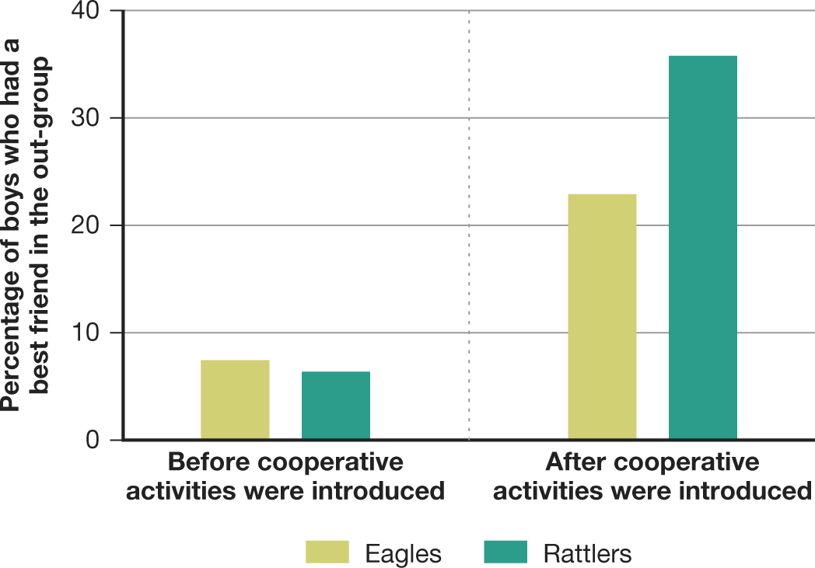
Figure 8.4: The Experiment at Robbers Cave
Notes:
Figure 8.4 The Experiment at Robbers Cave
In this study, competitive games fostered hostility between the Rattlers and the Eagles. Few boys had a best friend from the other group (left). But after the teams had to cooperate to solve various problems, the percentage that made friends across “enemy lines” shot up (right) (Sherif et al., 1961).

Slide 39
Stereotypes
Stereotypes:
Aren’t necessarily bad and are sometimes accurate
Can distort reality by:
Exaggerating differences between groups
Producing selective perception
Underestimating differences within the stereotyped group
Notes:
Stereotype: A summary impression of a group, in which a person believes that all members of the group share a common trait or traits (positive, negative, or neutral).
Stereotypes aren’t necessarily bad and they are sometimes accurate (Lee, McCauley, & Jussim, 2013).
They are, as some psychologists have called them, useful tools in the mental toolbox—energy-saving devices that allow us to make efficient decisions (Macrae & Bodenhausen, 2000).
They help us quickly process new information and retrieve memories. They allow us to organize experience, make sense of differences among individuals and groups, and predict how people will behave.
In fact, the brain automatically registers and encodes the basic categories of gender, ethnicity, and age, suggesting that there is a neurological basis for the cognitive efficiency of stereotyping (Ito & Urland, 2003).

Slide 40
8.5
Group Conflict and Prejudice

Slide 41
8.5
Module Learning Objectives
8.5.A
Describe four sources of prejudice.
8.5.B
Describe five ways of measuring prejudicial attitudes.
8.5.C
Describe four situations that can help reduce prejudice and intergroup conflict.
8.5.D
Explain the phrase “the banality of evil,” and discuss how it contributes to otherwise-good people behaving badly.

Slide 42
The Origins of Prejudice
Psychological causes
Social causes
Economic causes
Cultural and national causes
Notes:
Psychological causes: Prejudice often serves to ward off feelings of doubt, fear, and insecurity.
Social causes: Some prejudices are acquired through pressure to conform to the views of friends, relatives, or associates.
Economic causes: Prejudice makes official forms of discrimination seem legitimate, by justifying the majority group’s dominance, status, or greater wealth.
Cultural and national causes: Prejudice bonds people to their own ethnic or national group and its ways; by disliking “them,” we feel closer to our own group.

Slide 43
Defining and Measuring Prejudice
Five ways of measuring prejudice:
1
Measures of social distance and “microaggressions”
2
Measures of unequal treatment
3
Measures of what people do when they are stressed or angry
4
Measures of brain activity
5
Measures of implicit attitudes
Notes:
Psychologists disagree on whether racism and other prejudices are declining or have merely taken new forms.
To understand prejudice, we must distinguish explicit attitudes from unconscious ones, active hostility from simple discomfort, what people say from what they feel, and what people feel from how they actually behave.

Slide 44
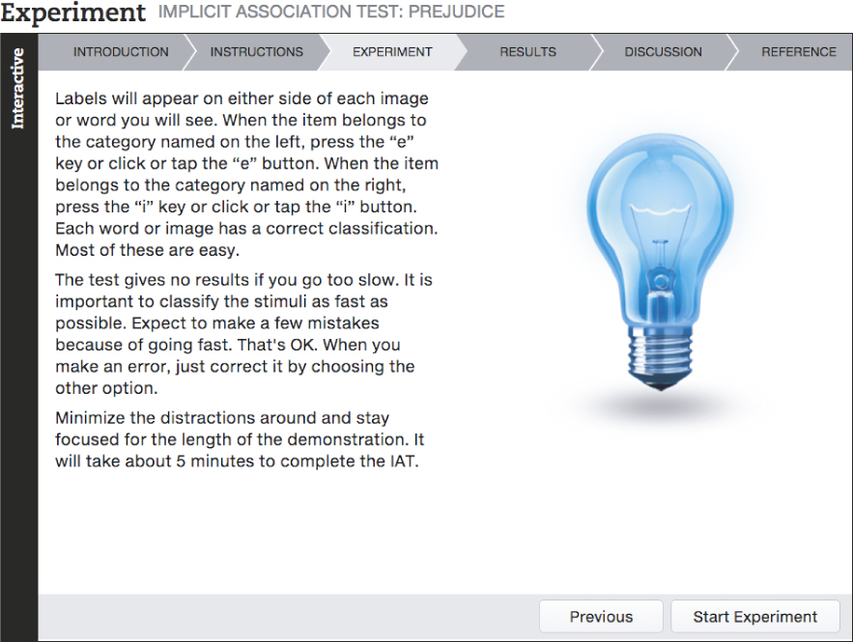
Implicit Association Test: Prejudice

Slide 45
Reducing Conflict and Prejudice
Four situations that can help reduce prejudice and intergroup conflict
Both sides must have equal legal status, economic opportunities, and power
Authorities and community institutions must provide moral, legal, and economic support for both sides
Both sides must have many opportunities to work and socialize together, formally and informally
Both sides must cooperate, working together for a common goal

Slide 46
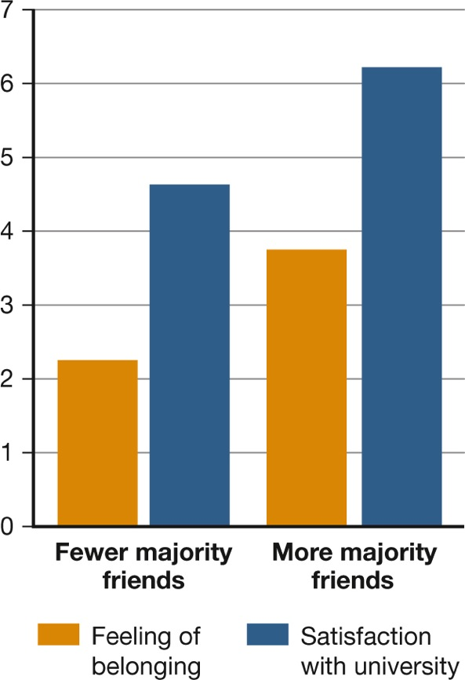
Figure 8.5: The Impact of Cross-Ethnic Friendships on Minority Students’ Well-Being
Notes:
Figure 8.5 The Impact of Cross-Ethnic Friendships on Minority Students’ Well-Being
Cross-ethnic friendships benefit both parties. In a longitudinal study of minority black students at a predominantly white university, many black students at first felt left out of school life and thus dissatisfied with their educational experience. But the more white friends they made, the higher their sense of belonging (orange bar) and satisfaction with the university (blue bar). This finding was particularly significant for minority students who initially had been the most sensitive to rejection and who had felt the most anxious and insecure about being in a largely white school. The study was later replicated with minority Latino students (Mendoza-Denton & Page-Gould, 2008).

Slide 47
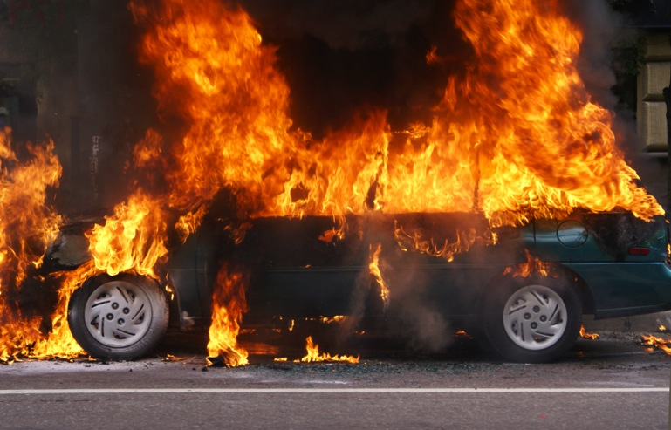
The Question of Human Nature
From the standpoint of social and cultural psychology, all human beings, like all cultures, contain the potential for both good and evil.
Notes:
Virtually no nation has bloodless hands.
It’s easy to conclude that outbreaks of violence are a result of inner aggressive drives, the sheer villainy of the perpetrators, or age-old tribal hatreds.
But in the social-psychological view, they result from the all-too-normal processes we have discussed in this chapter, including mindless obedience to authority, conformity, groupthink, deindividuation, stereotyping, ethnocentrism, and prejudice.

Slide 48
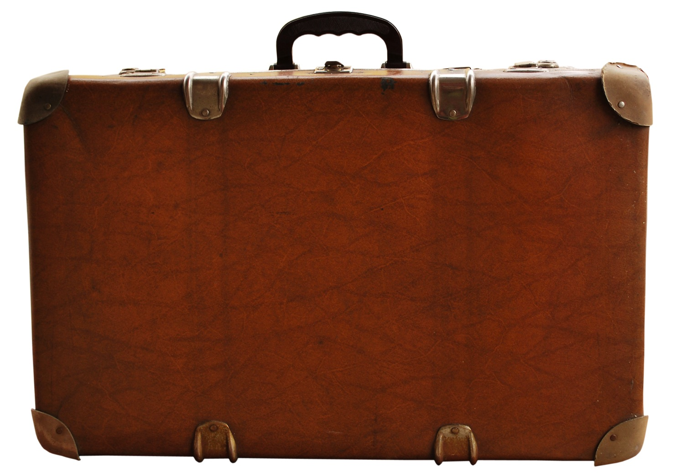
Taking Psychology with You
Dealing with Cultural Differences
Sociocultural research helps us appreciate the cultural rules that govern behavior, values, attitudes, and ways of doing business.
Understanding these rules can help people avoid jumping to conclusions about group differences.

Slide 49
End of Chapter

Slide 50
Interactive Figures

Slide 51
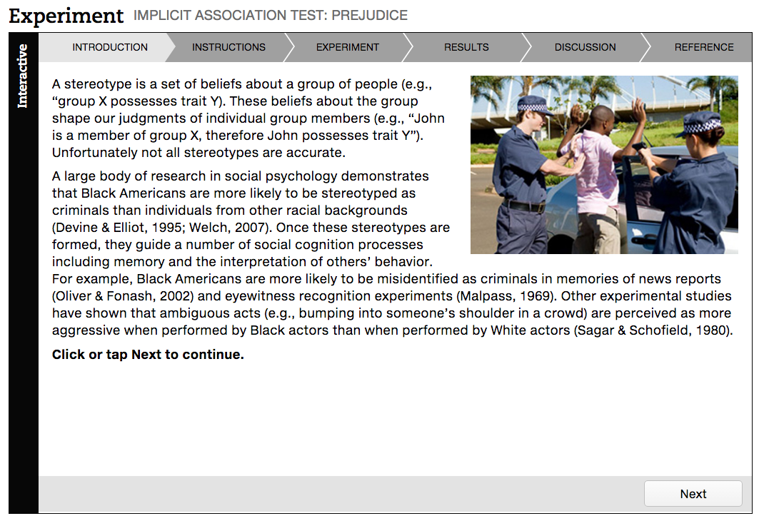
Interactive figure
Implicit Association Test: Prejudice
Click here to watch the interactive feature.

Slide 52
Acknowledgments

Slide 53
Slide | Credit
Slide 5 | StudioSmart. Shutterstock
Slide 8 | Naaman Abreu. Shutterstock
Slide 9 | Alexsander Isachenko. Shutterstock
Slide 12 | Liga Alksne. Shutterstock
Slide 12 | ghoststone. 123rf.com
Slide 12 | 123rf.com
Slide 16 | Andresr. Shutterstock
Slide 17 | Andresr. Shutterstock
Slide 19 | Pressmaster. Shutterstock
Slide 28 | Alita Bobrov. Shutterstock
Slide 28 | stephen rudolph. Shutterstock
Slide 32 | AntonSokolov. Shutterstock
Slide 36 | Belinda Pretorius. Shutterstock
Slide 42 | XRoig. Shutterstock
Slide 45 | Suzanne Tucker. Shutterstock
Slide 47 | maxstockphoto. Shutterstock
Slide 47 | AlexKalashnikov. Shutterstock
Slide 48 | quetton. Shutterstock

