Slide 1
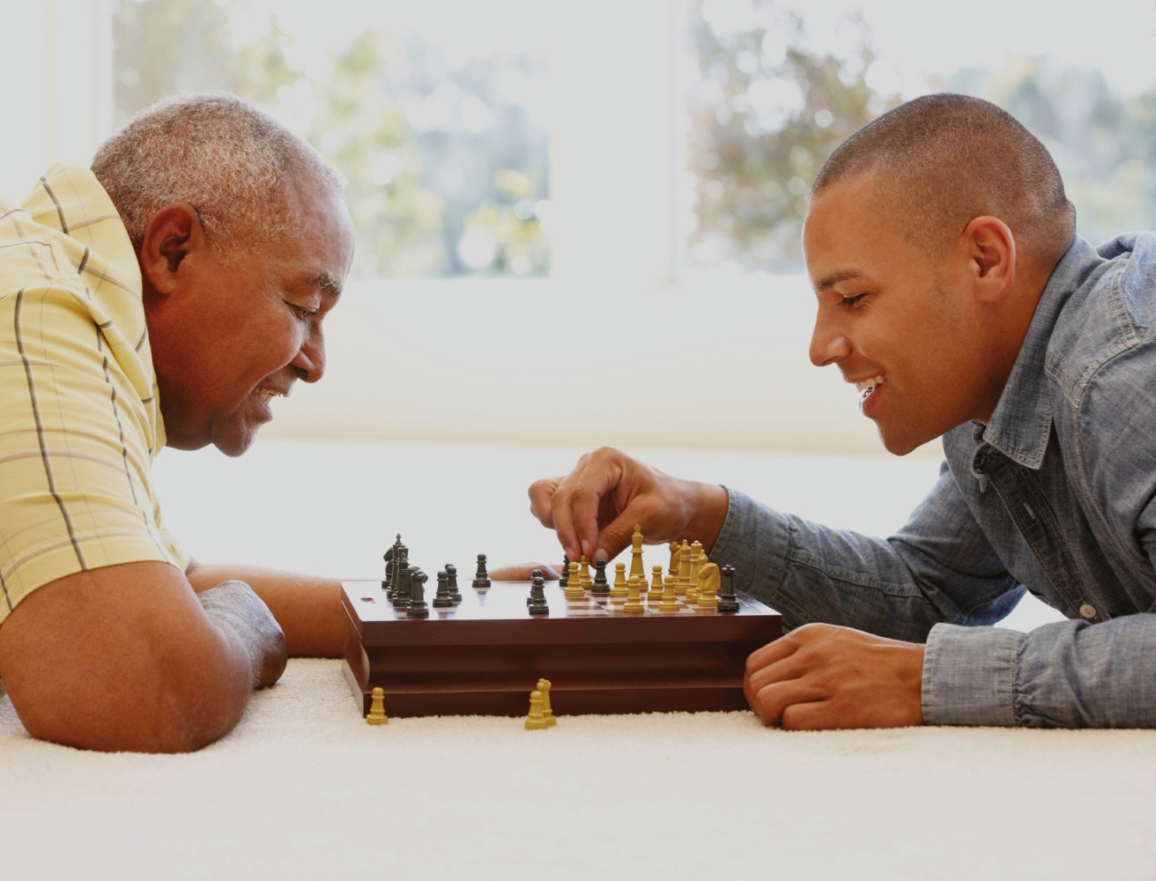
9 THINKING AND INTELLIGENCE
9.1
Thought: Using What We Know
9.2
Barriers to Reasoning Rationally
9.3
Measuring Intelligence: The Psychometric Approach
9.4
Dissecting Intelligence: The Cognitive Approach
9.5
Animal Minds
PSYCHOLOGY, Twelfth Edition | Carole Wade • Carol Tavris
Copyright © 2017, 2014, 2011 Pearson Education Inc. All rights reserved.

Slide 2
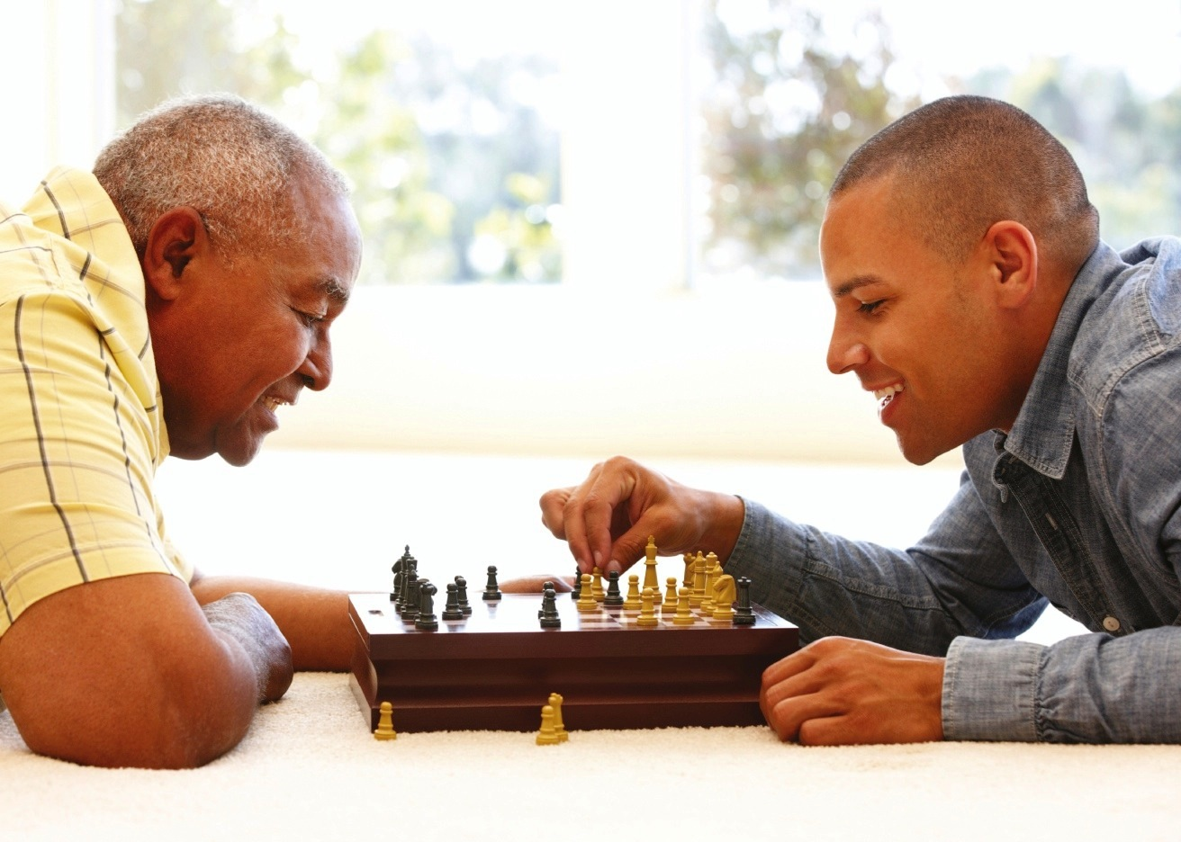
9.1
Thought: Using What We Know

Slide 3
9.1
Module Learning Objectives
9.1.A
Distinguish between the various elements of cognition, such as concepts, prototypes, propositions, schemas, and mental images.
9.1.B
Distinguish between the varieties of conscious thought, such as subconscious thinking, nonconscious thinking, and implicit learning.
9.1.C
Contrast algorithms and heuristics as problem-solving strategies, and give an example of each.
9.1.D
Discuss the various types of reasoning, such as formal reasoning, informal reasoning, dialectical reasoning, and stages of reflective judgment, and note the defining characteristics of each.

Slide 4
The Elements of Cognition
Propositions
Concepts
Mental images
Cognitive schemas
Notes:
4

Slide 5
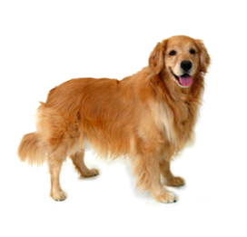
The Elements of Cognition: Concepts
Mental category that groups objects, relations, activities, abstractions, or qualities having common properties
Example:
Golden retriever, cocker spaniel, border collie = instances of the concept “dog”
DOG
Golden retriever
Border collie
Cocker spaniel
Notes:
The words used to express concepts may influence or shape how we think about them.
Benjamin Whorf: proposed that language molds cognition and perception.
5

Slide 6
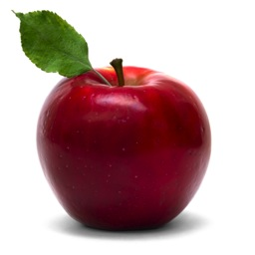
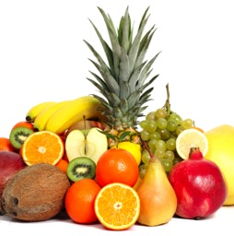
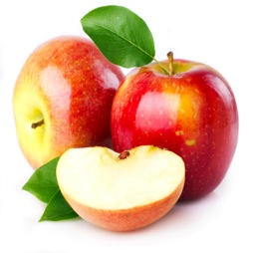
The Elements of Cognition: Basic Concepts
Have a moderate number of instances
Example: APPLE
Are easier to acquire than those having many instances
Example: FRUIT
Are easier to acquire than those having few instances
Example: BRAEBURN APPLE

Slide 7
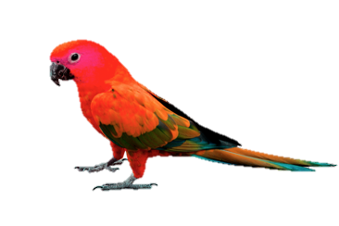
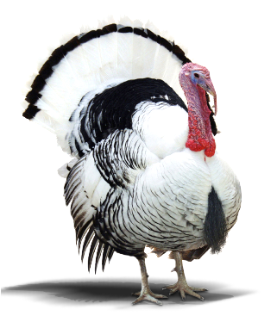
The Elements of Cognition: Prototypes
When we need to decide whether something belongs to a concept, we are likely to compare it to a prototype as a representative instance of the concept.
Notes:
7

Slide 8
The Elements of Cognition: Propositions and Cognitive Schemas
Proposition: A unit of meaning that is made up of concepts and expresses a single idea
Propositions are linked together in cognitive schemas.
Cognitive schema: An integrated mental network of knowledge, beliefs, and expectations concerning a particular topic or aspect of the world

Slide 9
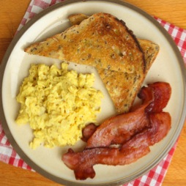
The Elements of Cognition: Mental Images
A mental representation that mirrors or resembles the thing it represents
Occurs in many and perhaps all sensory modalities
Also important in thinking and in constructing cognitive schemas

Slide 10
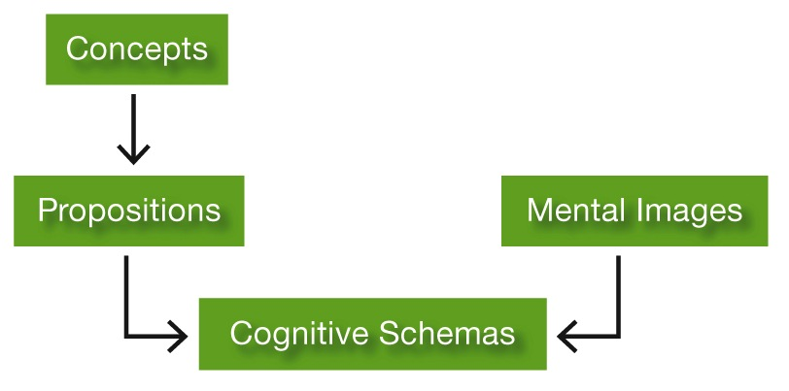
The Elements of Cognition: A Visual Summary
Notes:
Figure 9.1 The Elements of Cognition

Slide 11
How Conscious Is Thought?
Subconscious
processes
Nonconscious
processes
Mindlessness
Mental processes occurring outside of conscious awareness but accessible to consciousness when necessary
Multitasking
Mental processes occurring outside of and not available to consciousness
Implicit learning
Mental inflexibility, inertia, and obliviousness in the present context
Notes:
Subconscious processes allow us to handle more information and to perform more complex tasks than if we depended entirely on conscious processing.
Nonconscious processes remain outside of awareness, even when you try to bring them back.
Implicit learning: Learning that occurs when you acquire knowledge about something without being aware of how you did so and without being able to state exactly what it is you have learned.
Mindlessness: Mental inflexibility, inertia, and obliviousness to the present context—keeps people from recognizing when a change in a situation requires a change in behavior.
11

Slide 12
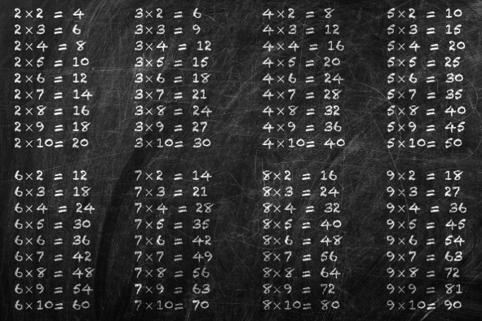
Problem Solving and Decision Making
A problem-solving strategy guaranteed to produce a solution even if the user does not know how it works
Algorithm
Heuristic
Openness
Notes:
To increase a cookie recipe, for example, you can simply multiply the number of cookies you want per person by the number of people you need to feed. If the original recipe produced 10 cookies and you need 40, you can then multiply each ingredient by four.
The recipe itself is also an algorithm (add flour, stir lightly, add raisins . . .), though you probably won't know the chemical changes involved when you combine the ingredients and heat the batter in an oven.

Slide 13
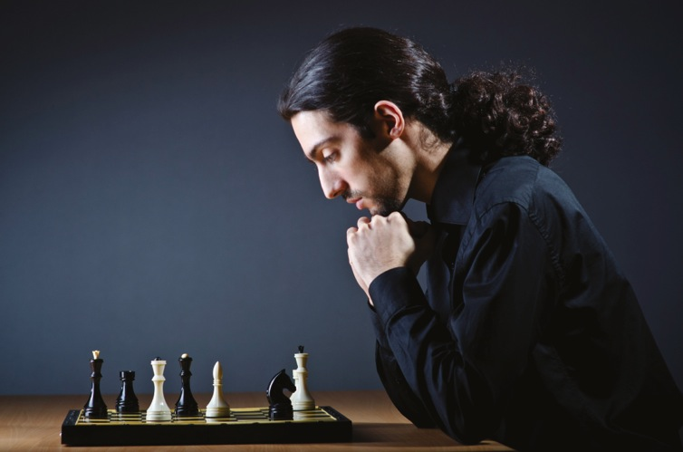
Problem Solving and Decision Making
A rule of thumb that suggests a course of action or guides problem solving.
Does not guarantee an optimal solution.
Algorithm
Heuristic
Notes:
Many heuristics, like those used when playing chess, help you limit your options to a manageable number of promising ones, reducing the cognitive effort it takes to arrive at a decision (Galotti, 2007; Galotti, Wiener, & Tandler, 2014).
Heuristics are useful to a student trying to choose a major, an investor trying to predict the stock market, a doctor trying to determine the best treatment for a patient, and a factory owner trying to boost production.
All of them are faced with incomplete information with which to reach a solution, and may therefore resort to rules of thumb that have proven effective in the past.

Slide 14
The drawing of conclusions or inferences from observations, facts, or assumptions
easoning

Slide 15
Reasoning Rationally
Formal reasoning:
Information needed for drawing a conclusion or reaching a solution is specified clearly
There is a single right (or best) answer
Informal reasoning:
Often no clearly correct solution
Many approaches, viewpoints, or possible solutions may compete

Slide 16
Reasoning Rationally
Prereflective thinkers:
Do not distinguish between knowledge and belief or between belief and evidence
See no reason to justify a belief
Quasi-reflective thinkers:
Think that because knowledge is sometimes uncertain, any judgment about the evidence is purely subjective
Reflective thinkers:
Understand that although some things cannot be known with certainty, some judgments are more valid than others
Notes:
Sometimes the types of judgments people make depend on the kind of problem or issue they are thinking about.
They might be able to use reflective judgment for some issues yet be prereflective on others that hold deep emotional meaning for them (Haidt, 2012; King & Kitchener, 2004).
But most people show no evidence of reflective judgment until their middle or late 20s, if ever.
16

Slide 17
Figure 9.2: Reflective Thinking
Q: Can you ever say you know for sure that your point of view on chemical additives is correct?
A: No, I don't think so . . . [but] I think that we can usually be reasonably certain, given the information we have now, and considering our methodologies. . . . [I]t might be that the research wasn’t conducted rigorously enough. In other words, we might have flaws in our data or sample, things like that.
Q: How then would you identify the “better opinion”?
A: One that takes as many factors as possible into consideration. I mean one that uses the higher percentage of the data that we have, and perhaps that uses the methodology that has been most reliable.
Q: And how do you come to a conclusion about what the evidence suggests?
A: I think you have to take a look at the different opinions and studies that different groups offer. Maybe some studies offered by the chemical industry, some studies by the government, some private studies. . . . You have to try to interpret people’s motives and that makes it a more complex soup to try to strain out.
Notes:
Figure 9.2 Reflective Thinking
Here's an example of the process of reflective thinking. Notice how the discussants consider multiple perspectives and weigh the merits of the available evidence when reaching their conclusions.

Slide 18
9.2
Barriers to Reasoning Rationally

Slide 19
9.2
Module Learning Objectives
9.2.A
Describe how the affect heuristic and the availability heuristic both illustrate the tendency to exaggerate the improbable.
9.2.B
Explain how the framing effect leads people to avoid loss in probabilistic judgments.
9.2.C
Summarize the mechanisms driving the fairness bias, hindsight bias, confirmation bias, and mental sets, and give an example of each.
9.2.D
Explain the process of cognitive dissonance, and describe three conditions under which feelings of cognitive dissonance are likely to occur.

Slide 20
9.2
Module Learning Objectives
9.2.E
Discuss the conditions under which cognitive biases can be detrimental to reasoning, and when they might be beneficial.

Slide 21
Barriers to Reasoning Rationally
Exaggerating the improbable
Cognitive dissonance
Avoiding loss
MENTAL BIASES
Mental sets
Fairness bias
Confirmation bias
Hindsight bias

Slide 22
Exaggerating the Improbable (and Minimizing the Probable)
Affect heuristic: Tendency to consult one’s emotions instead of estimating probabilities objectively
Availability heuristic: Tendency to judge the probability of a type of event by how easy it is to think of examples or instances
Notes:
One common bias is the inclination to exaggerate the probability of rare events.

Slide 23
Avoiding Loss
Framing effect
The tendency for people’s choices to be affected by how a choice is presented, or framed; for example, whether it is worded in terms of potential losses or gains
Notes:
People generally try to avoid/minimize the risk of incurring losses when making decisions, but people's perceptions of risk are subject to the framing effect.
23

Slide 24
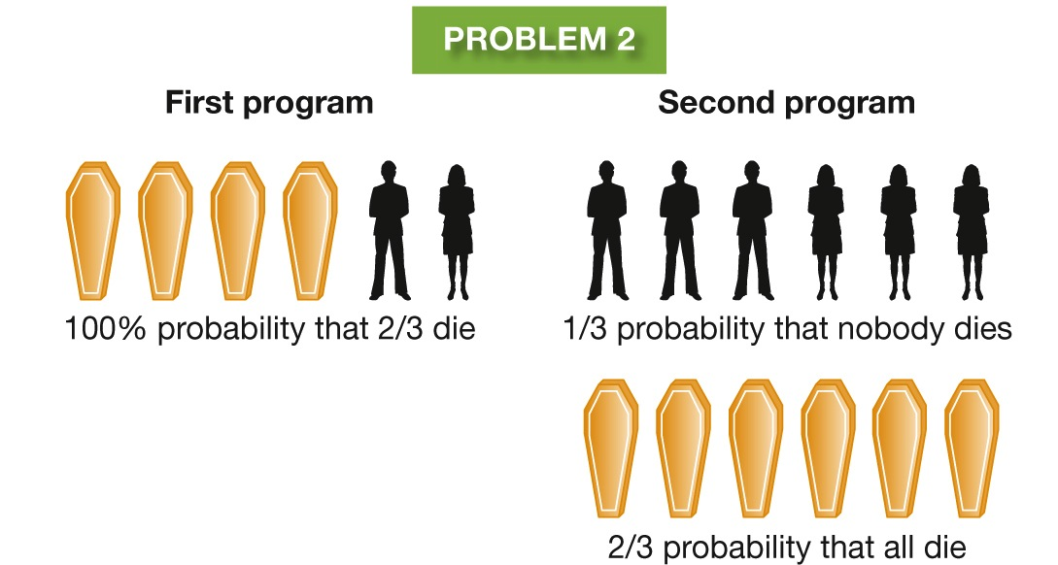
Figure 9.3: A Matter of Wording
Notes:
Figure 9.3 A Matter of Wording
The decisions we make can depend on how the alternatives are framed. When asked to choose between the two programs in Problem 1, which are described in terms of lives saved, most people choose the first program. When asked to choose between the programs in Problem 2, which are described in terms of lives lost, most people choose the second program. Yet the alternatives in the two problems are actually identical.

Slide 25
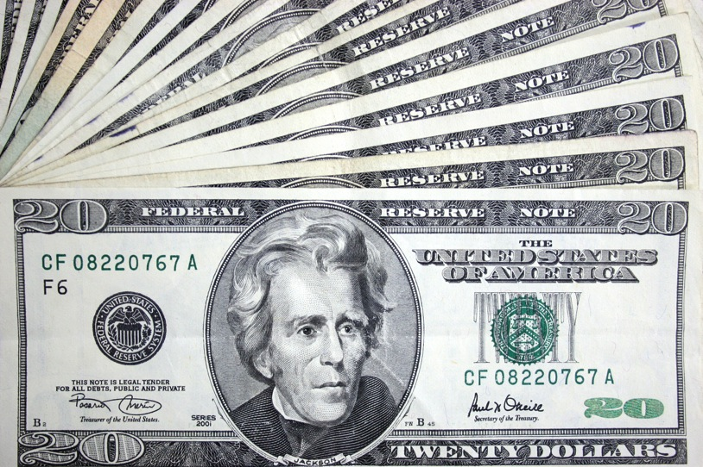
The Fairness Bias
Ultimatum Game:
Your partner gets $20 and must decide how much to share with you.
You can accept or reject the offer, but if you reject it, neither of you get any money.
What makes sense: Accept any offer, since you always end up with more money than if you reject the offer.
What happens: If offer is too low, people are likely to reject it.
Notes:
In industrial societies, offers of 50 percent are typical and offers below 20 or 30 percent are commonly rejected, even when the absolute sums are large.
In other societies, the amounts offered and accepted may be higher or lower, but there is always some amount that people consider unfair and refuse to accept (Güth & Kocher, 2014; Henrich et al., 2001).
People may be competitive and love to win, but they are also powerfully swayed by a fairness bias, and motivated to see fairness prevail in these situations.

Slide 26
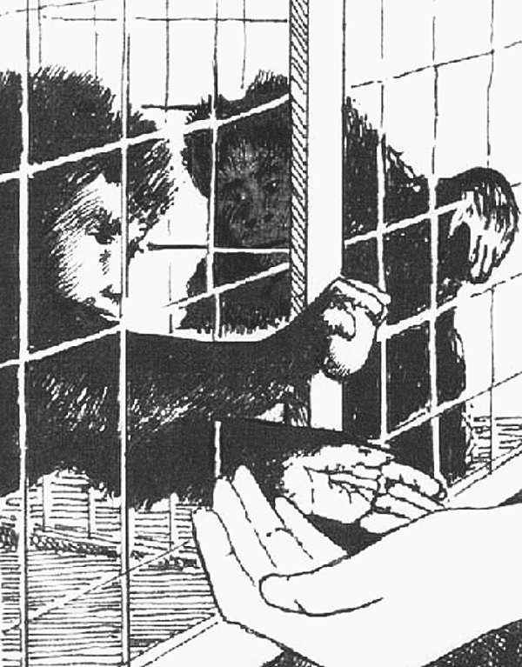
BIOLOGY AND ECONOMIC CHOICE
Rejecting Unfair Offers
Fairness bias:
Appears to have evolutionary roots
Is being studied using brain scans
Notes:
In this drawing, made from a video, the monkey on the right watches as the one on the left exchanges a token for a reward.
Later, the observing monkey may refuse a lesser reward.

Slide 27
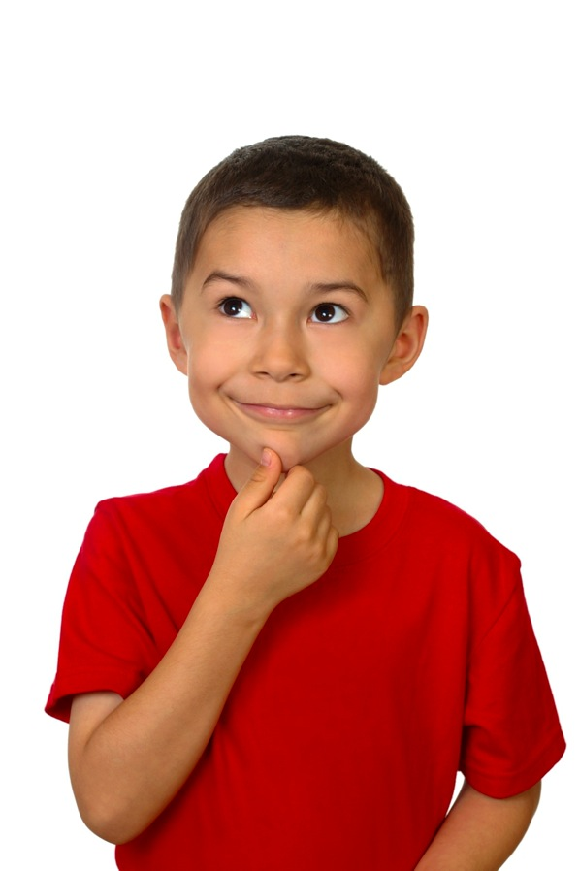
The Hindsight Bias
“I knew it all along!”
The tendency to overestimate one’s ability to have predicted an event once the outcome is known

Slide 28
The Confirmation Bias
The tendency to look for or pay attention only to information that confirms one’s own beliefs

Slide 29
Figure 9.4: Confirming the Confirmation Bias
Notes:
Figure 9.4 Confirming the Confirmation Bias
Suppose someone deals out four cards, each with a letter on one side and a number on the other. You can see only one side of each card, as shown here. Your task is to find out whether the following rule is true: “If a card has a vowel on one side, then it has an even number on the other side.” Which two cards do you need to turn over to find out? The majority of people say they would turn over the E and the 6, but they are wrong. You do need to turn over the E (a vowel), because if the number on the other side is even, it confirms the rule, and if it is odd, the rule is false. However, the card with the 6 tells you nothing. The rule does not say that a card with an even number must always have a vowel on the other side. Therefore, it doesn’t matter whether the 6 has a vowel or a consonant on the other side. The card you do need to turn over is the 7, because if it has a vowel on the other side, that fact disconfirms the rule. People do poorly on this problem because they are biased to look for confirming evidence and to ignore the possibility of disconfirming evidence.

Slide 30
Mental Sets
Tendency to solve new problems by using the same heuristics, strategies, and rules that worked in the past on similar problems
Mental sets make learning and problem solving more efficient
Not helpful when problem calls for fresh insights and methods
Notes:
One general mental set is the tendency to find patterns in events.
This tendency is adaptive because it helps us understand and exert some control over what happens in our lives. But it also leads us to see meaningful patterns even when they do not exist.
Example: Thinking that arthritis symptoms follow a pattern dictated by the weather.

Slide 31
Figure 9.5: Connect the Dots
Notes:
Figure 9.5 Connect the Dots
Copy this figure, and try to connect the dots by using no more than four straight lines without lifting your pencil or pen. A line must pass through each point. Can you do it? Most people have difficulty with this problem because they have a mental set to interpret the arrangement of dots as a square. They then assume that they can’t extend a line beyond the apparent boundaries of the square. Now that you know this, you might try again if you haven’t yet solved the puzzle. Some solutions are given at the end of this chapter.

Slide 32
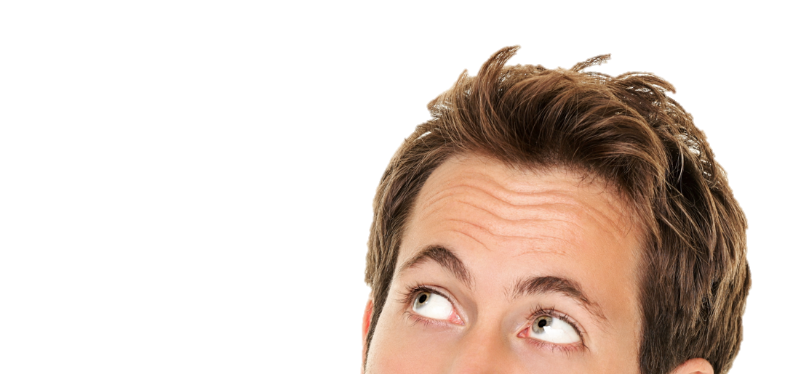
The Need for Cognitive Consistency
Cognitive dissonance: A state of tension that occurs when a person holds two cognitions that are psychologically inconsistent, or when a person’s belief is incongruent with his or her behavior.
“University X has the top-rated major I want.”
“But all my friends are going to University Y.”

Slide 33
Figure 9.6: The Process of Cognitive Dissonance

Slide 34
Reducing Cognitive Dissonance
You are particularly likely to reduce dissonance under three conditions:
When you need to justify a choice or decision you freely made
1
When you need to justify behavior that conflicts with your view of yourself
2
3
When you need to justify the effort put into a decision or choice

Slide 35
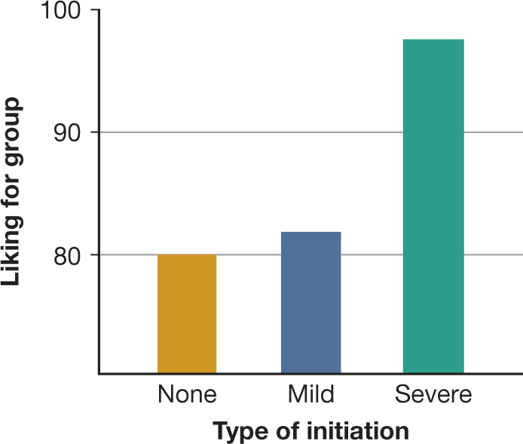
The Justification of Effort
The tendency of people to increase their liking for something they have worked hard for or suffered to attain
A common form of dissonance reduction
Notes:
Figure 9.7 The Justification of Effort
The more effort you put into reaching a goal, the more highly you are likely to value it. As you can see in the graph on the left, after people listened to a boring group discussion, those who went through a severe
initiation to join the group rated it most highly (Aronson & Mills, 1959).

Slide 36
Overcoming Our Cognitive Biases
After we understand a bias, we may be able to reduce or eliminate it
Active, mindful effort

Slide 37
9.3
Measuring Intelligence: The Psychometric Approach

Slide 38
9.3
Module Learning Objectives
9.3.A
Outline the basic logic underlying factor analysis, and describe its use in measuring intelligence.
9.3.B
Summarize the original notion of IQ and some problems associated with it, and discuss how intelligence tests evolved during the early 1900s.

Slide 39
Inferred characteristic
of an individual, usually defined as the ability to profit from experience,
acquire knowledge, think abstractly, act purposefully, or adapt to changes in the environment
ntelligence

Slide 40
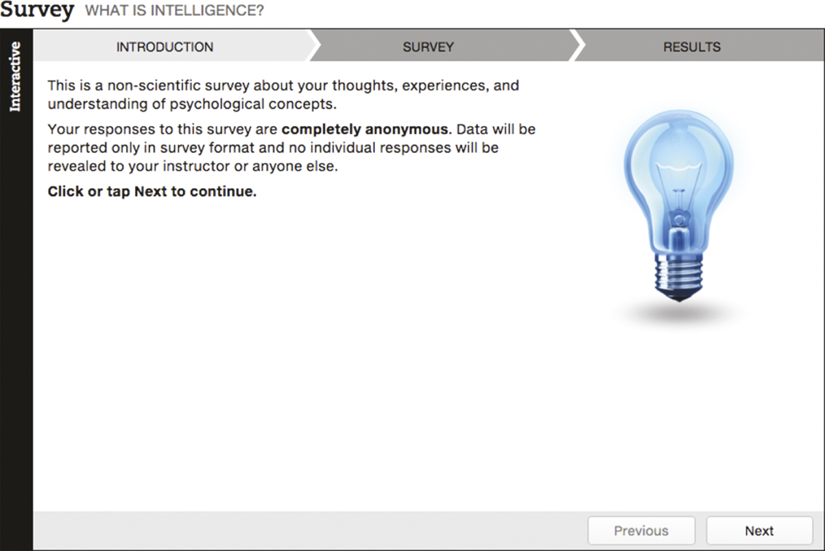
What Is Intelligence?

Slide 41
Measuring the Invisible
Most psychometric psychologists:
A general ability, a g factor, underlies performance
Psychometric approach
Traditional approach to intelligence
Focuses on how well people perform on standardized aptitude tests
Factor analysis
Others:
Dispute the idea of a global quality of intelligence; people can be smart in some areas but not others
Notes:
Factor analysis: A statistical method for analyzing the intercorrelations among various measures or test scores; clusters of measures or scores that are highly correlated are assumed to measure the same underlying trait, ability, or aptitude (factor).
g factor: A general intellectual ability assumed by many theorists to underlie specific mental abilities and talents.

Slide 42
The Invention of IQ Tests
Alfred Binet:
Designed the first widely used intelligence test to identify children who could benefit from remedial work
Intelligence quotient (IQ)
Measure of intelligence originally computed by dividing a person’s mental age by his or her chronological age and multiplying by 100
Now derived from norms provided for standardized intelligence tests
In America:
Became widely used to categorize people according to their presumed “natural ability”
Notes:
IQ tests in America:
Stanford–Binet Intelligence Scale
Wechsler Adult Intelligence Scale (WAIS)
Wechsler Intelligence Scale for Children (WISC)

Slide 43
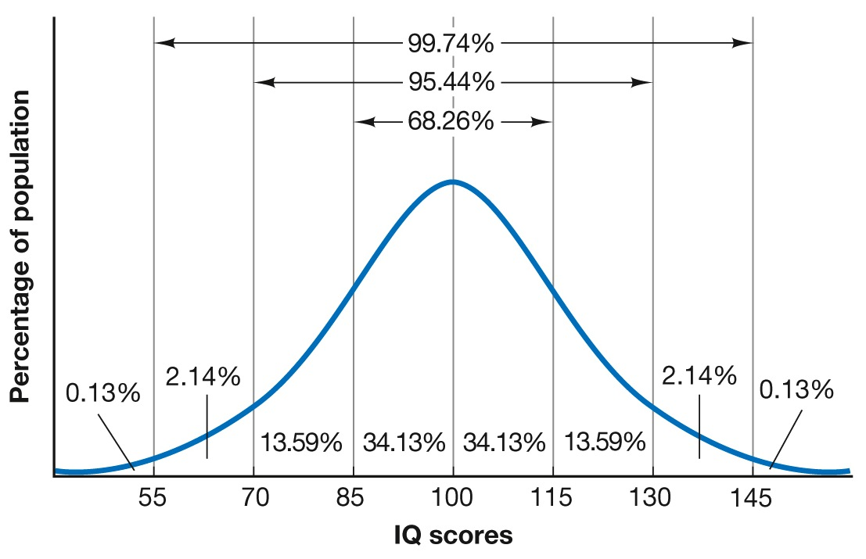
Figure 9.8: Expected Distribution of IQ Scores
Notes:
Figure 9.8 Expected Distribution of IQ Scores
In a large population, IQ scores tend to be distributed on a normal (bell-shaped) curve. On most tests, about 68 percent of all people will score between 85 and 115; about 95 percent will score between 70 and 130; and about 99.7 percent will score between 55 and 145. In any actual sample, however, the distribution will depart somewhat from the theoretical ideal.

Slide 44
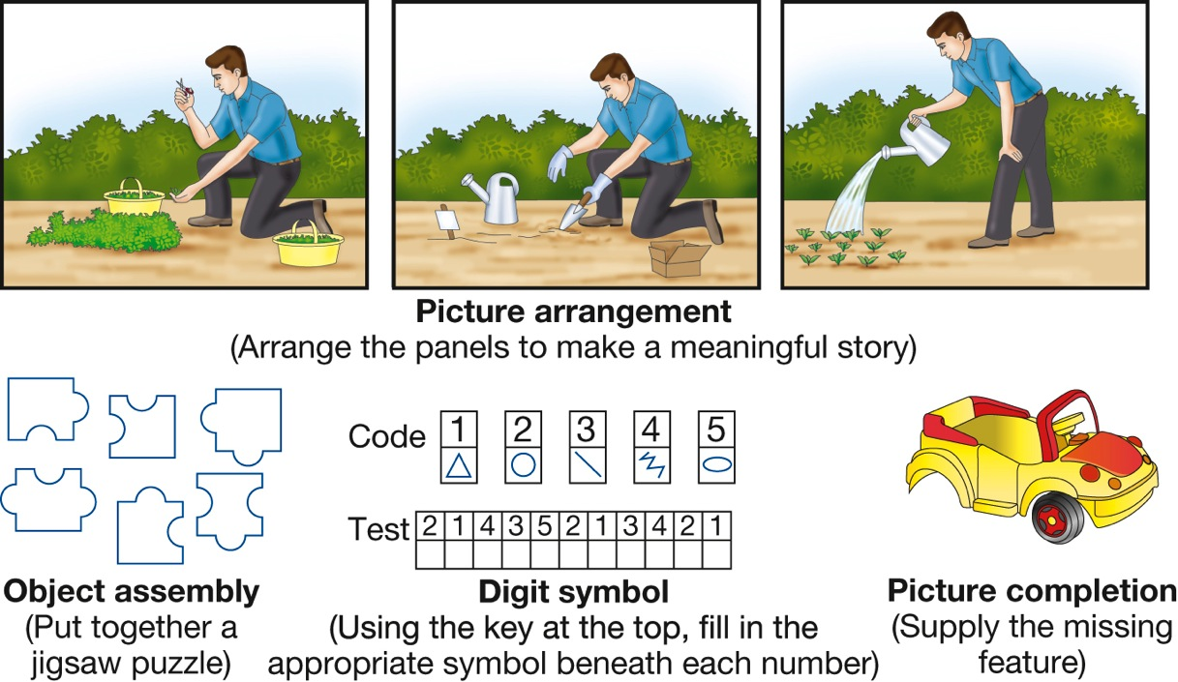
Figure 9.9: Performance Tasks on the Wechsler Tests
Notes:
Figure 9.9 Performance Tasks on the Wechsler Tests
Nonverbal items such as these are particularly useful for measuring the abilities of those who have poor hearing, are not fluent in the tester’s language, have limited education, or resist doing classroom-type problems. A large gap between a person’s verbal score and performance on nonverbal tasks such as these sometimes indicates a specific learning problem.

Slide 45
CULTURE AND intelligence testing
Can IQ Tests Ever Be Culturally Fair?
Attempts to make IQ tests culture fair or culture free have been disappointing
Culture affects nearly everything to do with taking a test
Stereotype threat: Burden of doubt one feels about his or her performance due to negative stereotypes about his or her group’s abilities
Notes:
Figure 9.10 Stereotype Threat
Stereotype threat occurs when people believe that if they do not do well, they will confirm the stereotypes about their group.
Negative thoughts intrude and disrupt their concentration (“I hate this test,” “I’m no good at math”) (Cadinu et al., 2005).
The resulting anxiety may then worsen their performance or kill their motivation to even try to do well.

Slide 46
9.4
Dissecting Intelligence: The Cognitive Approach

Slide 47
9.4
Module Learning Objectives
9.4.A
Describe how metacognition, the triarchic theory of intelligence, the theory of multiple intelligences, and emotional intelligence shed light on the diversity of what “intelligence” means.
9.4.B
Outline how longitudinal studies and crosscultural studies shed light on the interplay of motivation, hard work, and intellectual achievement.

Slide 48
Elements of Intelligence
Metacognition
The knowledge or awareness of one’s own cognitive processes, and the ability to monitor and control those processes

Slide 49
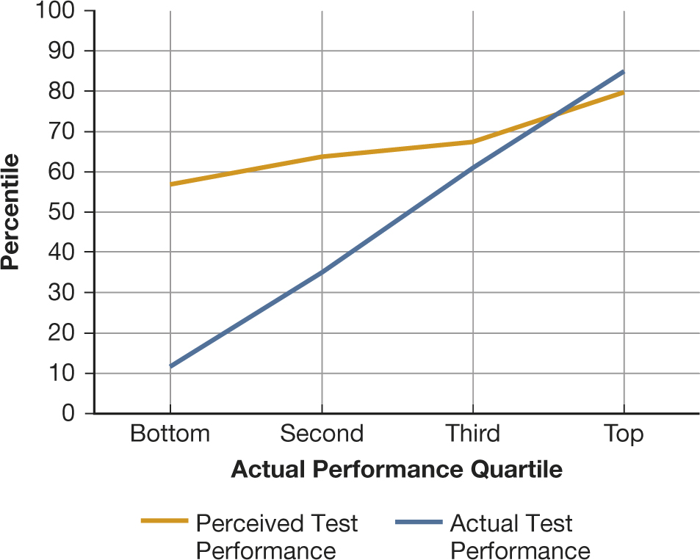
Figure 9.11: Ignorance Is Bliss
Notes:
Figure 9.11 Ignorance Is Bliss
In school and in other settings, people who perform poorly often have poor metacognitive skills and therefore fail to recognize their own lack of competence. As you can see, the lower that students scored on an exam, the greater the gap between how they thought they had done and how they actually had done (Dunning et al., 2003).

Slide 50
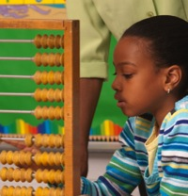
The Triarchic Theory
Componential (analytical): Recognizing and defining problems; comparing and contrasting; strategy and evaluation of results
Contextual (practical): Taking into account different contexts, fixing situations
- Tacit knowledge
Experiential (creative): Transferring skills to new situations; cope with novelty, make new tasks automatic
Notes:
Triarchic theory of intelligence: A theory of intelligence that emphasizes analytic, creative, and practical abilities.
Componential or analytical intelligence refers to the information-processing strategies you draw on when you are thinking intelligently about a problem: recognizing and defining the problem, comparing and contrasting, selecting a strategy for solving it, mastering and carrying out the strategy, and evaluating the result.
Experiential or creative intelligence refers to your creativity in transferring skills to new situations.
Contextual or practical intelligence refers to the practical application of intelligence, which requires you to take into account the different contexts in which you find yourself.

Slide 51
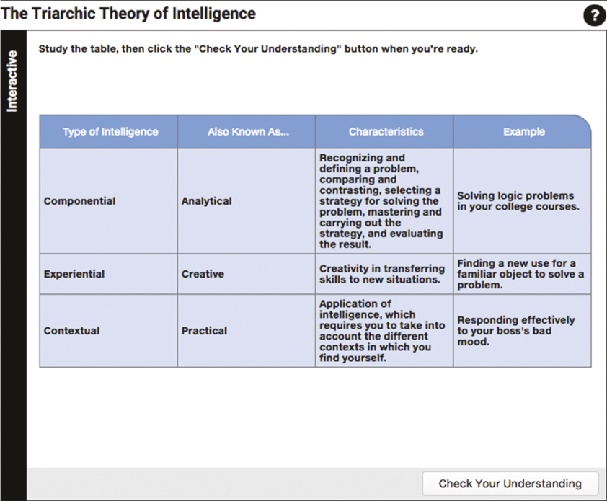
The Triarchic Theory of Intelligence

Slide 52
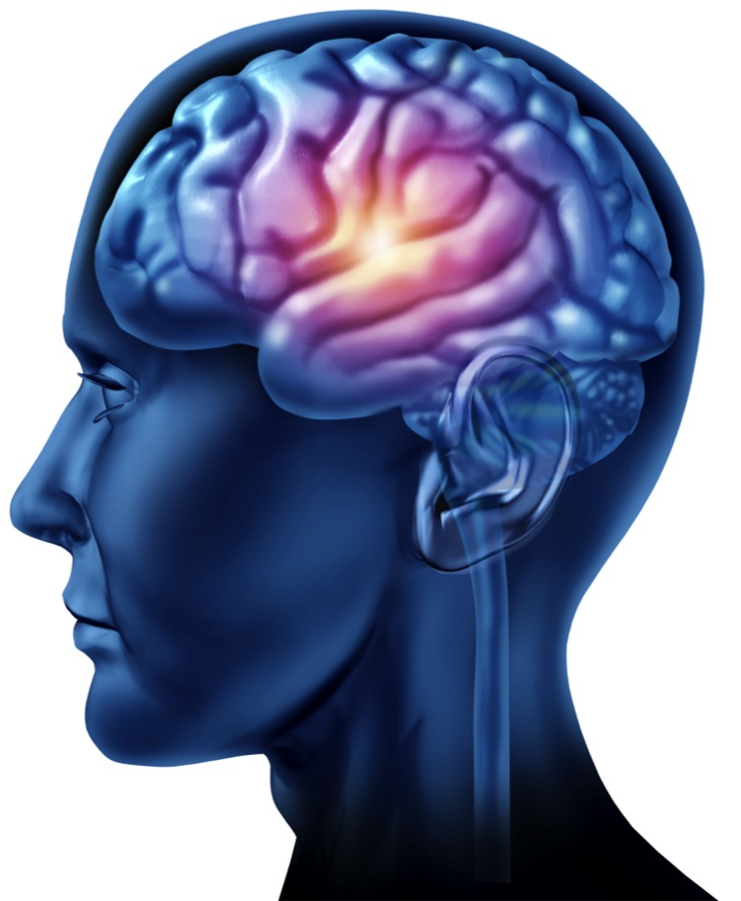
Multiple Intelligences and Emotional Intelligence
Some psychologists argue that certain domains are as important as the kind of intelligence measured by standardized IQ tests.
Examples:
Musical intelligence
Kinesthetic intelligence
Capacity for insight
Emotional intelligence
Notes:
Emotional intelligence: The ability to identify your own and other people's emotions accurately, express your emotions clearly, and regulate emotions in yourself and others.

Slide 53
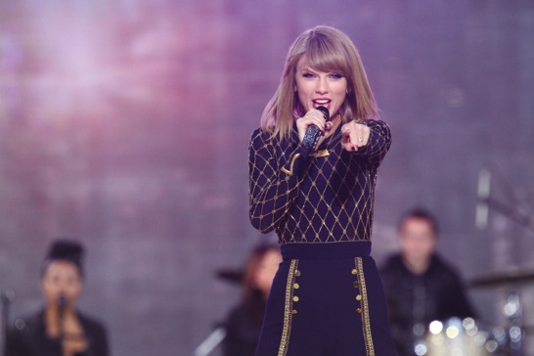
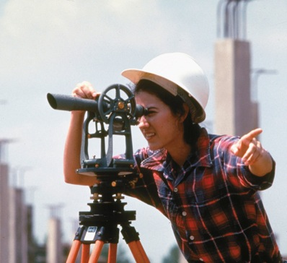
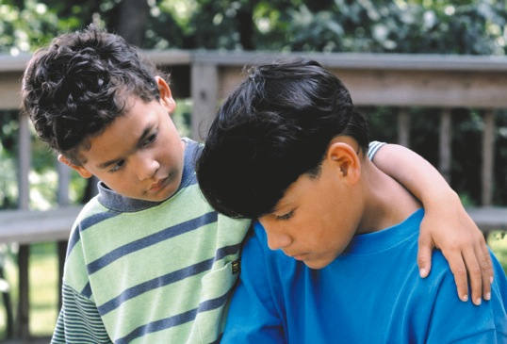
Multiple Intelligences and Emotional Intelligence
Notes:
Theorists who argue for an expanded definition of intelligence would say that Taylor Swift has musical intelligence, a surveyor has spatial intelligence, and a compassionate friend has emotional intelligence. Should the definition be broadened in this way? Or are these abilities better defined as talents?

Slide 54
Motivation, Hard Work, and Intellectual Success
Intellectual achievement depends on:
Motivation
Hard work
Self-discipline
The following can also help account for differences in academic performance:
Beliefs about intelligence
Standards
Values

Slide 55
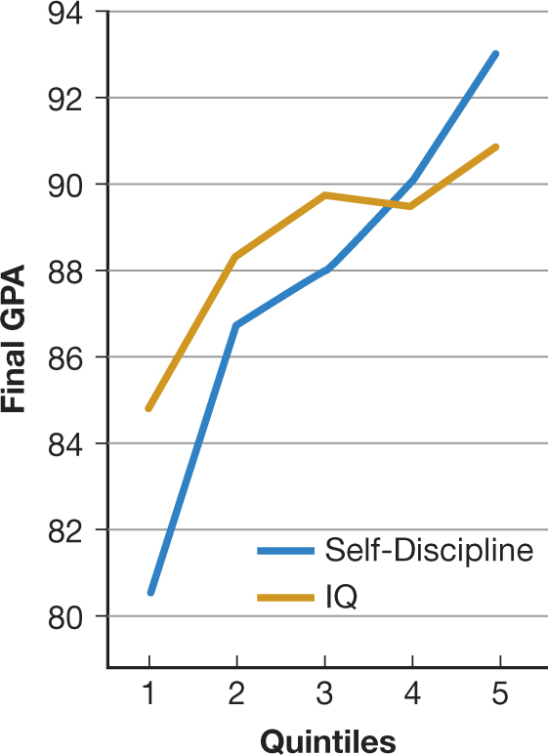
Figure 9.12: Grades, IQ, and Self-Discipline
Notes:
Figure 9.12 Grades, IQ, and Self-Discipline
Eighth-grade students were divided into five groups (quintiles) based on their IQ scores and then followed them for a year to test their academic achievement. Self-discipline was a stronger predictor of success than IQ was (Duckworth & Seligman, 2005).

Slide 56
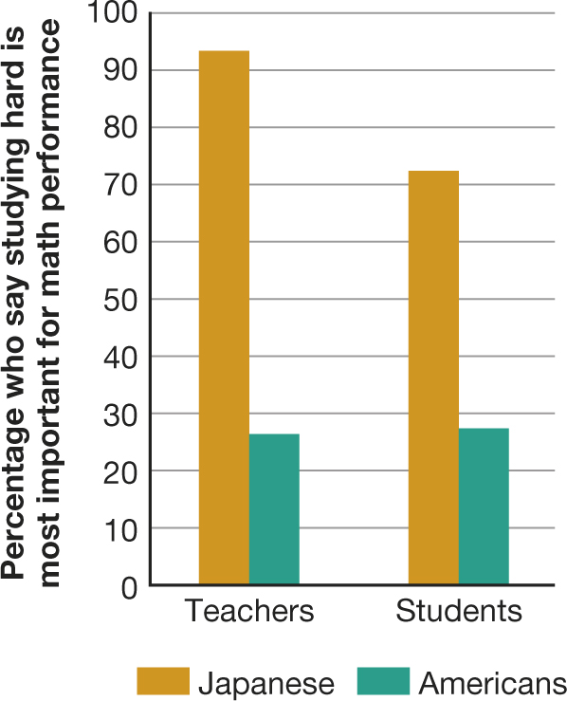
Figure 9.13: What’s the Secret of Math Success?
Notes:
Figure 9.13 What’s the Secret of Math Success?
Japanese schoolteachers and students are much more likely than their American counterparts to believe that the secret to doing well in math is working hard. Americans tend to think that you either have mathematical intelligence or you don’t (Stevenson, Chen, & Lee, 1993).

Slide 57
9.5
Animal Minds

Slide 58
9.5
Module Learning Objectives
9.5.A
Summarize the evidence both supporting and refuting the concept of animal intelligence.
9.5.B
Summarize the evidence both supporting and refuting the concept of animal language use.
9.5.C
Explain why both anthropomorphism and anthropodenial are unwise approaches to understanding animal cognition.

Slide 59
Animal Intelligence
Cognitive ethology: The study of cognitive processes in nonhuman animals
Cognitive ethologists argue that some animals can:
Anticipate future events
Make plans
Coordinate activities with other animals
Controversial question: Do animals have a theory of mind?
Notes:
Some researchers, especially those in cognitive ethology, argue that nonhuman animals have greater cognitive abilities than has previously been thought.
Some animals can use objects as simple tools.
Chimpanzees have shown evidence of a simple understanding of number.
Some researchers believe that the great apes, dolphins, and elephants have aspects of a theory of mind, a system of beliefs about the way one's own mind and the minds of others work, and of how individuals are affected by their beliefs and feelings.
In some apes and monkeys, these aspects may include some metacognition.

Slide 60
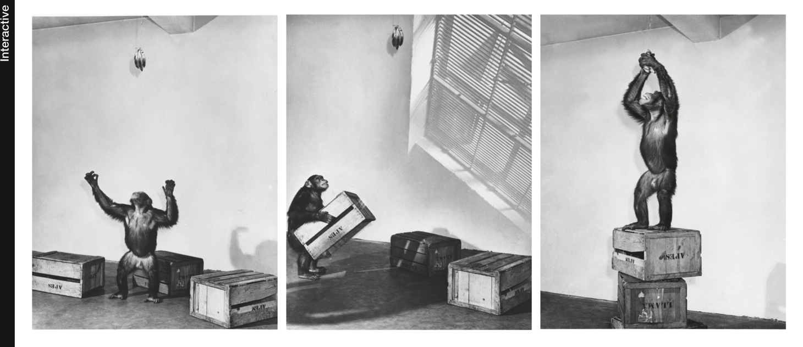
Animal Intelligence
Notes:
In an early study of animal intelligence, Sultan, a talented chimpanzee studied by Wolfgang Köhler, was able to figure out how to reach a cluster of bananas by stacking some boxes and climbing on top of them.

Slide 61
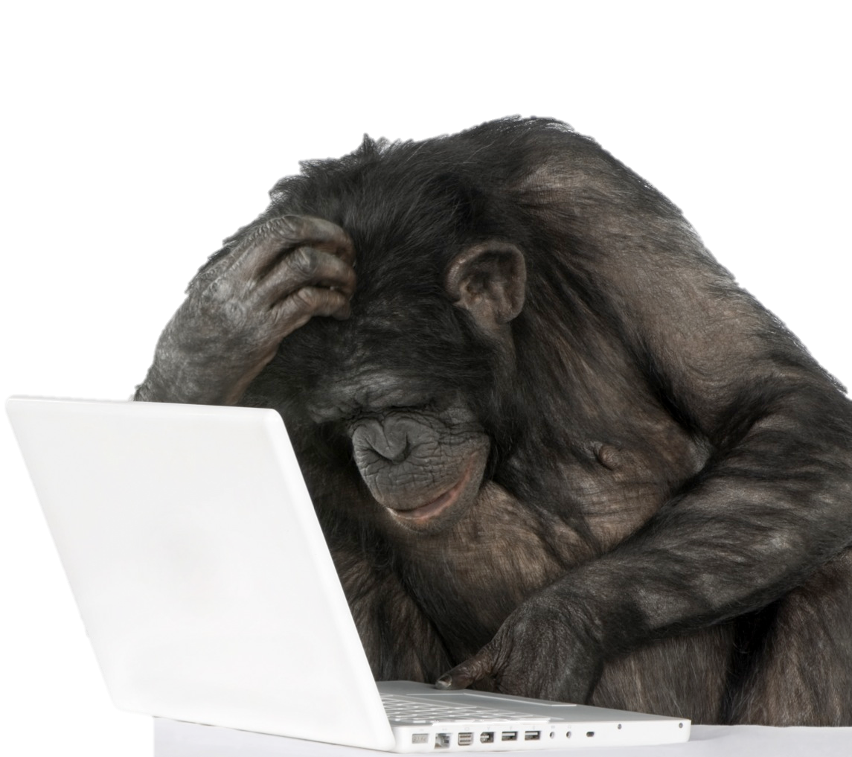
Animals and Language
Many species can be taught to communicate in ways that resemble language.
Notes:
Unfortunately, in their desire to talk to the animals and their affection for their primate friends, some early researchers overinterpreted the animals’ utterances, reading all sorts of meanings and intentions into a single sign or symbol, ignoring scrambled word order (“banana eat me”) and unwittingly giving nonverbal cues that might enable the apes to respond correctly.
But over the past few decades, as researchers have improved their techniques, they have discovered that with careful training, chimps can indeed acquire some aspects of language, including the ability to use symbols to refer to objects.
Some animals have also used signs spontaneously to converse with each other, suggesting that they are not merely imitating or trying to get a reward (Van Cantfort & Rimpau, 1982).
Research on animal language and comprehension of symbols is altering our understanding of animal cognition, and not only of primates.
Photo: Kanzi, a bonobo who answers questions and makes requests by punching symbols on a specially designed computer keyboard, also understands short English sentences.

Slide 62
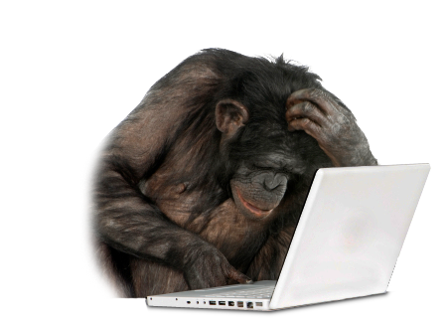
Thinking about the Thinking of Animals
Anthropomorphism: The tendency to falsely attribute human qualities to nonhuman beings
Anthropodenial: The tendency to think, mistakenly, that human beings have nothing in common with other animals
Notes:
Scientists are divided about how to interpret the findings on animal cognition, with some worrying about anthropomorphism and others about anthropodenial.

Slide 63
Taking Psychology with You
Becoming More Creative
Divergent rather than convergent thinking
Nonconformity
Curiosity
Persistence

Slide 64
End of Chapter

Slide 65
Interactive Figures

Slide 66
Interactive figure
The String Problem
Click here to watch the interactive feature.

Slide 67
Interactive figure
The Dot Problem
Click here to watch the interactive feature.

Slide 68
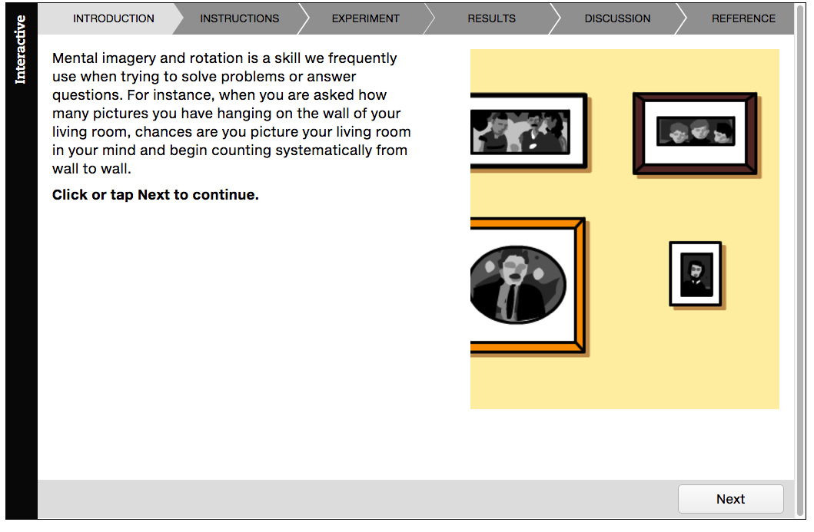
Interactive figure
Mental Rotation
Click here to watch the interactive feature.

Slide 69
Acknowledgments

Slide 70
Slide | Credit
Slide 5 | Lisa A. Svara. Shutterstock
Slide 5 | Stefan Petru Andronache. Shutterstock
Slide 5 | Paul Cotney. Shutterstock
Slide 6 | topseller. Shutterstock
Slide 6 | Valery121283. Shutterstock
Slide 6 | LeventeGyori. Shutterstock
Slide 7 | 123rf.com
Slide 7 | James Steidl. Shutterstock
Slide 7 | Ariwasabi. Shutterstock
Slide 9 | Joe Gough. Shutterstock
Slide 9 | Ariwasabi. Shutterstock
Slide 12 | Liv friis-larsen. Shutterstock
Slide 12 | doomu. Shutterstock
Slide 14 | Alberto Zornetta. Shutterstock
Slide 22 | bioraven. Shutterstock
Slide 23 | Studio DMM Photography, Designs & Art. Shutterstock
Slide 25 | Vladimir Mucibabic. Shutterstock
Slide 27 | 3445128471. Shutterstock
Slide 28 | corgarashu. Shutterstock
Slide 30 | 123rf.com
Slide 32 | Ariwasabi. Shutterstock
Slide 36 | racorn. 123rf.com
Slide 39 | 123rf.com

Slide 71
Slide | Credit
Slide 39 | 123rf.com
Slide 48 | arek_malang. Shutterstock
Slide 50 | Hasan Shaheed. Shutterstock
Slide 50 | Samuel Borges Photography. Shutterstock
Slide 50 | Jules Selmes. Pearson Education Ltd
Slide 52 | Lightspring. Shutterstock
Slide 54 | bikeriderlondon. Shutterstock
Slide 59 | 123rf.com
Slide 61 | Eric Isselee. Shutterstock
Slide 62 | Andresr. Shutterstock
Slide 62 | Eric Isselee. Shutterstock
Slide 63 | quetton. Shutterstock

