Slide 1

11 EMOTION, STRESS, AND HEALTH
11.1
The Nature of Emotion
11.2
Emotion and Culture
11.3
The Nature of Stress
11.4
Stress and Emotion
11.5
Coping with Stress
PSYCHOLOGY, Twelfth Edition | Carole Wade • Carol Tavris
Copyright © 2017, 2014, 2011 Pearson Education Inc. All rights reserved.

Slide 2

11.1
The Nature
of Emotion

Slide 3
11.1
Module Learning Objectives
11.1.A
Explain the components that define an emotion, list the emotions that have a universal facial expression, and describe some of the limits affecting the ability to decode facial expressions of emotion.
11.1.B
Discuss the brain structures involved in the experience of emotions, explain what mirror neurons do, and describe the primary chemicals involved in emotional experience.
11.1.C
Summarize the basic research findings indicating that cognitive appraisal plays a role in emotional experience.

Slide 4


A state of arousal involving facial and bodily changes, brain activation, cognitive appraisals, subjective feelings, and tendencies toward action
motion
Notes:
Although negative emotions are often painful, emotions evolved to bind people together, motivate them to achieve their goals, and help them make decisions and plans.
The experience of emotion involves:
Physiological changes in the face, brain, and body
Cognitive processes
Cultural and social context
4

Slide 5

Emotion and the Face
Verbal communication
Refers to a person’s speech or writing
The words we use to send a message to another person
Nonverbal communication
Includes all other mechanisms used in communication
  Vocal channels
  Body language
  Facial expressions
  Even clothing

Slide 6


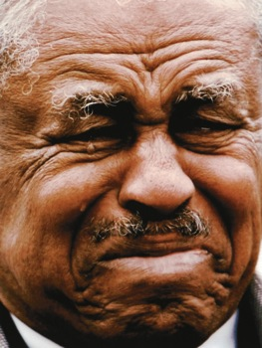




Figure 11.1: Some Universal Expressions
Notes:
Figure 11.1 Some Universal Expressions
Most people around the world can readily identify expressions of anger, happiness, disgust, surprise, contempt, sadness, and fear—no matter what the age, culture, sex, or historical era of the person conveying the emotion. Can you match the emotion to each face shown here?

Slide 7
Emotion and the Face
Facial expressions:
  Reflect internal feelings AND influence them (facial feedback)
  Foster communication
  with others
  Signal intentions to others
  Enhance infant survival
Cultural and social limits to readability of facial expressions:
People are better at identifying emotions expressed by others in their own ethnic, national, or regional group
Within a culture, facial expressions can have:
  Different meanings depending on the situation
  Different interpretations depending on the social context
Facial expressions are only part of the emotional picture:
People can feel emotions without showing them.
People use facial expressions to lie about their feelings.
Notes:
Facial feedback: The process by which the facial muscles send messages to the brain about the basic emotion being expressed.
7

Slide 8
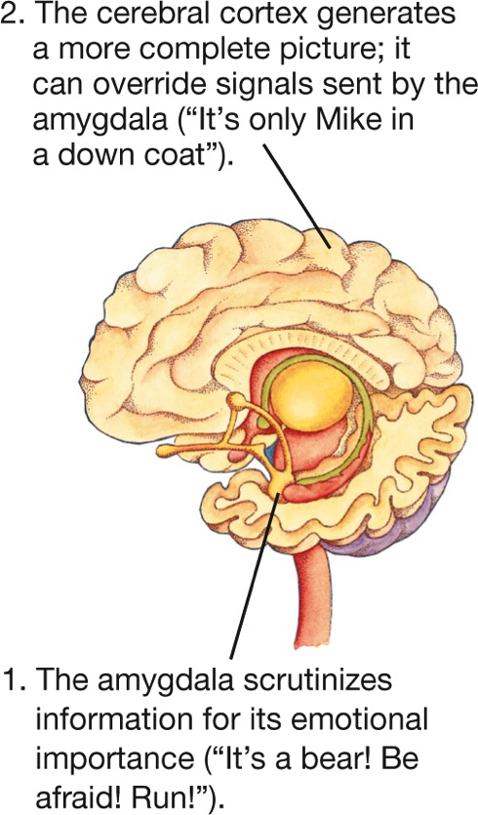
Emotion and the Brain
Cerebral cortex
Can override the amygdala’s initial appraisal
Amygdala
Responsible for assessing threat
Notes:
The amygdala plays a key role in emotion, especially anger and fear. It is responsible for evaluating sensory information, determining its emotional importance, and making the initial decision to approach or withdraw from a person or situation (LeDoux, 1996).

Slide 9
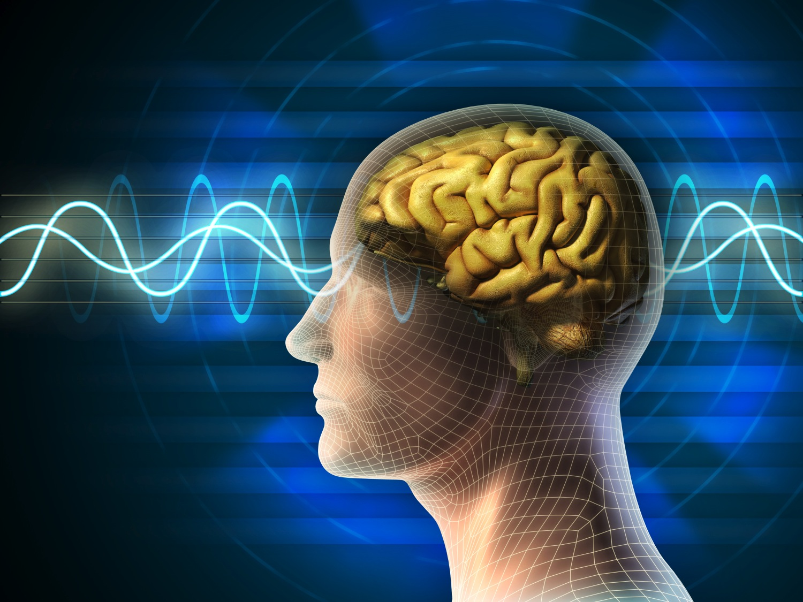
Emotion and the Brain
Left prefrontal cortex
“Approach emotions”
Right prefrontal cortex
“Escape emotions”
Notes:
Regions of the right prefrontal region are specialized for the impulse to withdraw or escape (as in disgust and fear).
Regions of the left prefrontal cortex are specialized for the motivation to approach others (as in happiness, a positive emotion, and anger, a negative one) (Harmon-Jones & Harmon-Jones, 2015).

Slide 10
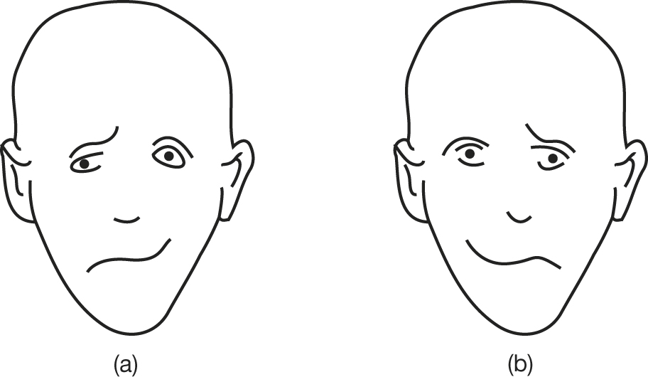
Emotion and the Brain
Notes:
These faces have expressions of happiness on one side and sadness on the other. Look at the nose of each face; which face looks happier? Which face looks sadder?
You are likely to see face b as the happier one and face a as the sadder one. The reason is that in most people the left side of a picture is processed by the right side of the brain, where recognition of emotional expression primarily occurs (Oatley, Keltner, & Jenkins, 2006).

Slide 11
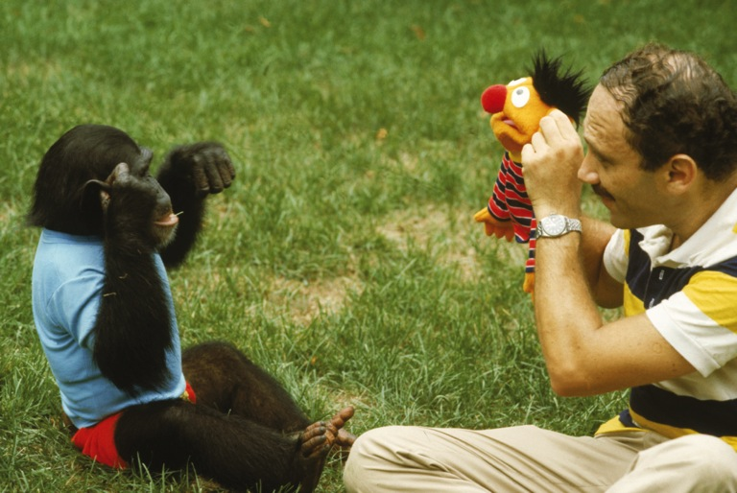
Neurons for Imitation and Empathy
Mirror neurons
Brain cells that fire when a person or animal observes another carrying out an action
Involved in:
Empathy
Language comprehension
Imitation
Reading emotions
Mood contagion
Rapport
Notes:
Mood contagion: The spreading of emotion from one person to another.

Slide 12
The Energy of Emotion
When under stress or experiencing an intense emotion, two hormones are released:
Epinephrine
Norepinephrine
This results in increased:
Alertness
Arousal
Notes:
Epinephrine in particular provides the energy of an emotion, that familiar tingle of excitement.
At high levels, it can create the sensation of being “seized” or “flooded” by an emotion that is out of your control.

Slide 13
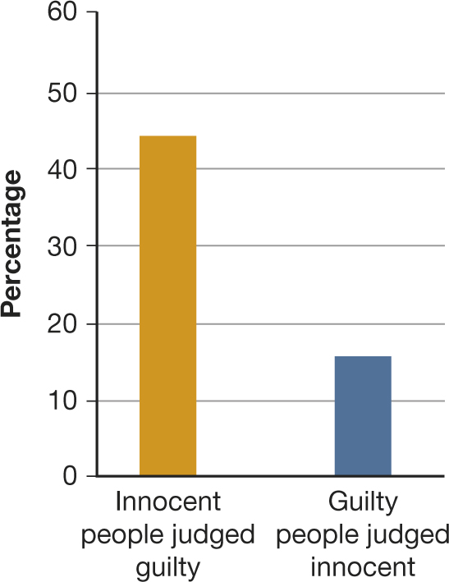
BIOLOGY AND lie detection
Can Lies Be Detected in the Brain and Body?
Polygraph machines:
Based on the assumption that a lie generates emotional arousal
Low reliability and validity
High rate of labeling innocent people as guilty
Other approaches:
Brain imaging (fMRI)
Increasing cognitive load
Notes:
Figure 11.2 Misjudging the Innocent
This graph shows the average percentages across three studies of classifications by lie detectors. Nearly half of the innocent people were classified as guilty, and a significant number of guilty people were classified as innocent. The suspect’s guilt or innocence had been independently confirmed by other means, such as by admissions by the actual perpetrators (Iacono & Lykken, 1997).

Slide 14

Emotions and the Mind
Emotions are created and influenced by appraisals:
Beliefs
Attributions
Perceptions
Goals
Notes:
Appraisals: A person's perceptions, beliefs, attributions, and goals, which determine which emotion he or she will feel in a given circumstance; they are a central component of emotion and the emotional experience.
The importance of appraisals in emotion explains why two people often have different emotional reactions to the same situation.
Appraisal patterns also differ across cultures. Japanese and Americans tend to differ in their appraisals of the causes and responsibility for errors and for success.

Slide 15
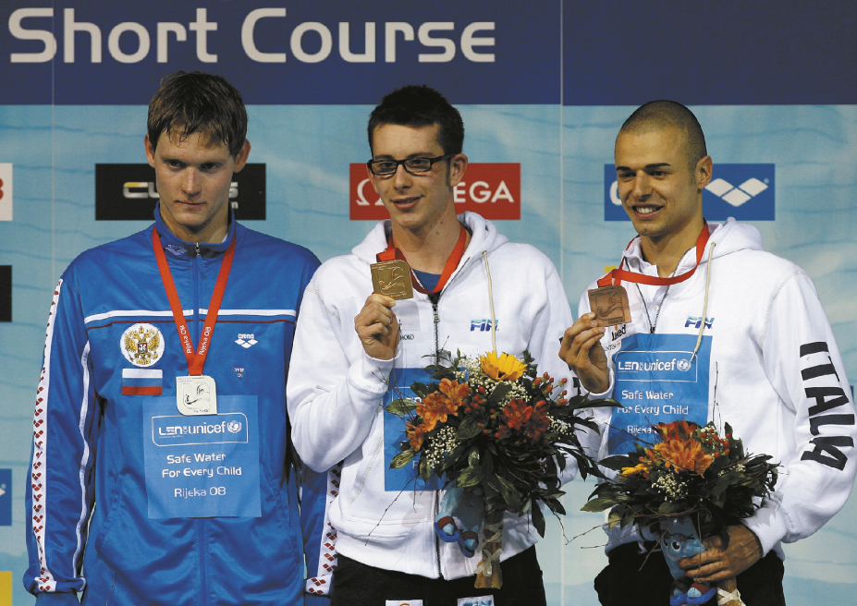
Emotions and the Mind
Notes:
Most people assume that second-place winners feel happier about their performance than third-place winners do. Yet when psychologists questioned this assumption, they found that usually the opposite is true, as the text explains. In this European swimming competition, silver medalist Vitaly Romanovich of Russia (left) is clearly feeling a lot grumpier not only than the gold medalist Federico Colbertaldo of Italy (center) or bronze medalist Samuel Pizzetti of Italy—he can’t even bring himself to display his medal!

Slide 16

Emotions and the Mind
Notes:
Children need to be old enough to have a sense of self before they can feel the moral emotions of shame, guilt, or remorse.

Slide 17
11.2
Emotion
and Culture

Slide 18
11.2
Module Learning Objectives
11.2.A
Describe the ways emotional experience can differ across cultures, in terms of concepts, language, and expectations.
11.2.B
Explain how display rules and emotion work influence the communication of emotion in a social and cultural context.
11.2.C
Explain sex differences that appear to exist in emotional experience, and comment on the complex reasons for these differences.

Slide 19
How Culture Shapes Emotions
Most people in all cultures are capable of feeling certain innate emotions, the ones that have physiological hallmarks in the brain and nervous system.
But people in different cultures might indeed differ in their abilities to experience emotional blends and variations.
Culture determines much of what people feel emotional about.
Notes:
Some languages have words for subtle emotional states that other languages lack.
Examples:
Germans: schadenfreude
Japanese: hagaii
Tahitians: mehameha

Slide 20

Communicating Emotions
Display rules
Social and cultural rules that regulate when, how, and where a person may express (or suppress) emotions
Body language
The nonverbal signals of body movement, posture, and gaze
Emotion work
Expression of an emotion, often because of a role requirement, that a person does not really feel

Slide 21
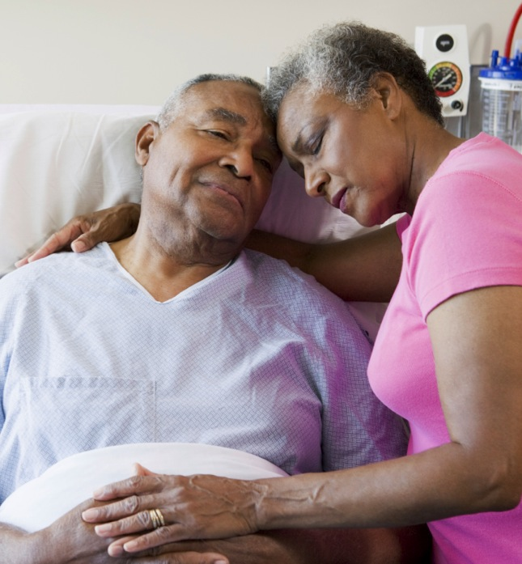
Gender and Emotion
Women and men are equally likely to feel all emotions, although gender rules shape differences in emotional expression.
North American women are on average more expressive than men, except for anger at strangers.
Both sexes do similar emotion work when the situation or job requires it.
Notes:
In North America, women:
Smile more than men
Gaze at listeners more
Have more emotionally expressive faces
Use more expressive hand and body movements
Touch others more
Talk about their emotions more
Cry more
Acknowledge emotions that reveal vulnerability and weakness
21

Slide 22
11.3
The Nature
of Stress

Slide 23
11.3
Module Learning Objectives
11.3.A
Describe the three phases of the general adaptation syndrome, and discuss how modern conceptualizations of the HPA axis and psychoneuroimmunology extend those ideas.
11.3.B
Describe some of the contributions to health that result from optimism, conscientiousness, and a sense of control.

Slide 24
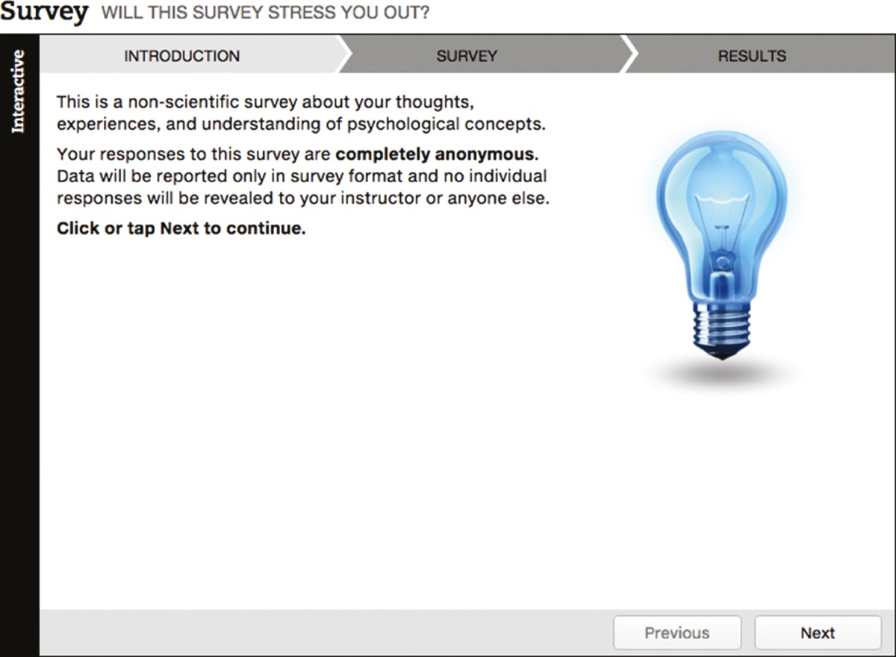
Will This Survey Stress You Out?

Slide 25
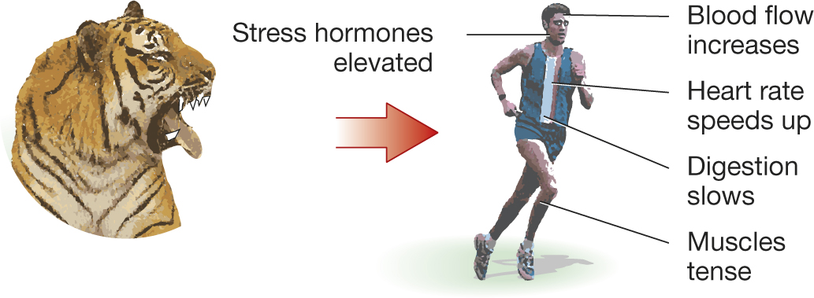
Stress and the Body
General adaptation syndrome
Phase 1:
Alarm
Phase 2:
Resistance
Phase 3:
Exhaustion
Notes:
Hans Selye concluded that “stress” consists of a series of physiological reactions that occur in three phases:
Alarm phase: Body mobilizes the sympathetic nervous system to meet the immediate threat.
Resistance phase: Body attempts to resist or cope with a stressor that cannot be avoided.
Exhaustion phase: Persistent threat depletes the body of energy, thereby increasing vulnerability to physical problems and illness.

Slide 26
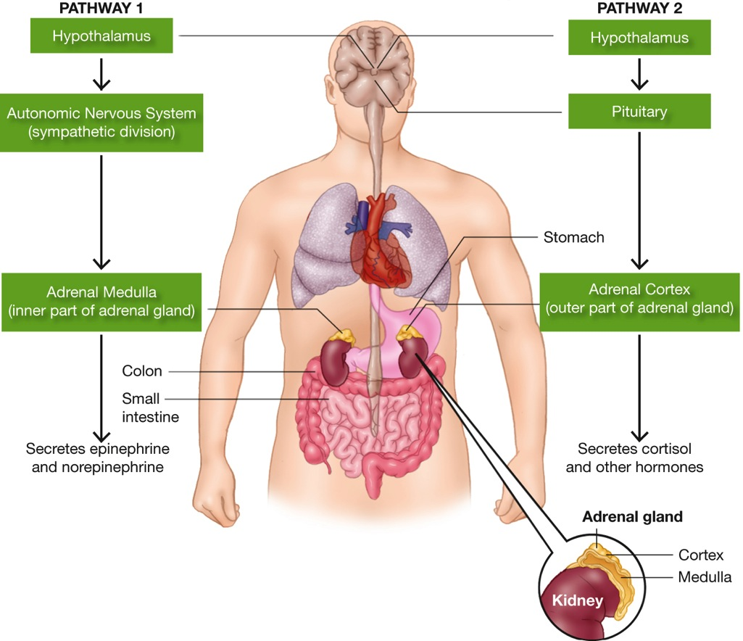
Current Approaches
Notes:
Figure 11.3 The Brain and Body Under Stress
When a person is in danger or under stress, the hypothalamus sends messages to the endocrine glands along two major pathways. In one, the hypothalamus activates the sympathetic division of the autonomic nervous system, which stimulates the adrenal medulla to produce epinephrine and norepinephrine. The result is the many bodily changes associated with “fight or flight.” In the other pathway, messages travel along the HPA axis to the adrenal cortex, which produces cortisol and other hormones. The result is increased energy and protection from tissue inflammation in case of injury.
HPA (hypothalamus–pituitary–adrenal cortex) axis: A system activated to energize the body to respond to stressors. The hypothalamus sends chemical messengers to the pituitary gland, which in turn prompts
the adrenal cortex to produce cortisol and other hormones.
Cortisol: A hormone secreted by the adrenal cortex that elevates blood sugar and protects the body's tissues in case of injury; if chronically elevated due to stress, it can lead to hypertension, immune disorders, other illnesses, and possibly depression.

Slide 27
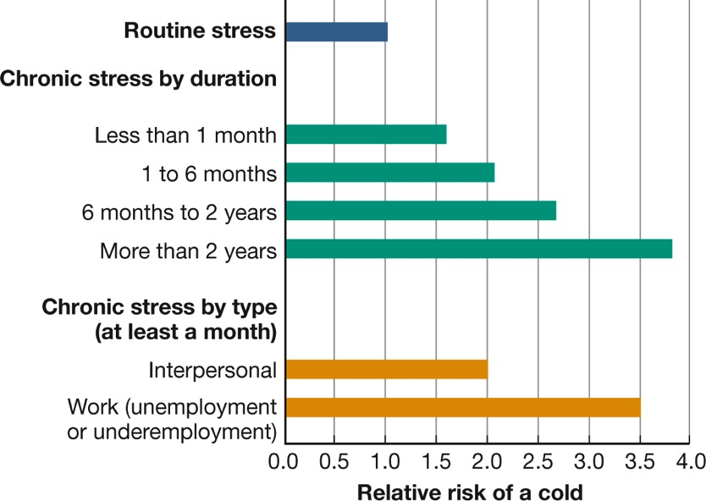
Current Approaches
When stressors of poverty and unemployment become chronic, they can increase people’s chances of illness.
People’s responses to stress vary according to their:
Learning history
Gender
Preexisting medical conditions
Genetic predispositions
Notes:
Figure 11.4 Stress and the Common Cold
Chronic stress lasting a month or more boosts the risk of catching a cold. The risk is increased among people undergoing problems with their friends or loved ones; it is highest among people who are out of work (Cohen et al., 1998).

Slide 28
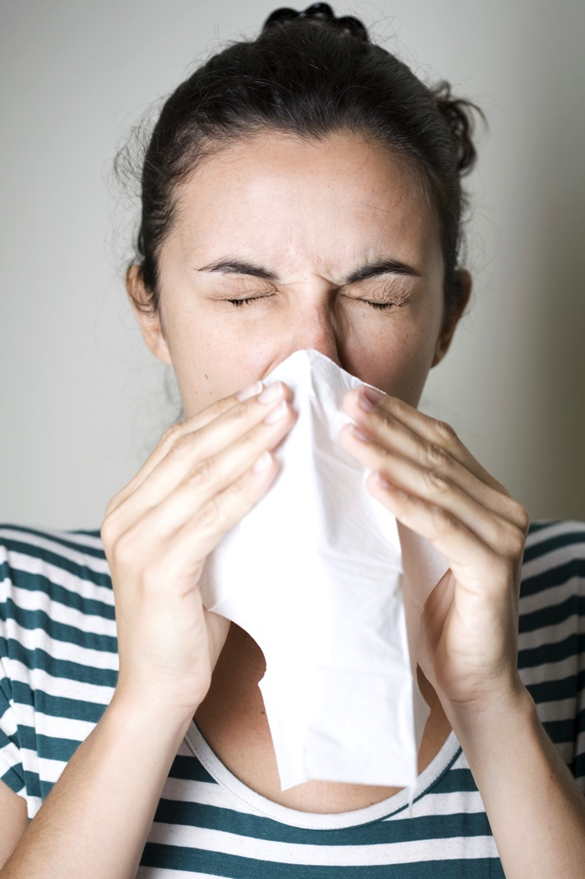
The Immune System: PNI
Psychoneuroimmunology (PNI)
The study of the relationships among psychology, the nervous and endocrine systems, and the immune system
PNI researchers are particularly interested in the white blood cells that destroy harmful foreign bodies (antigens).
Notes:
28

Slide 29
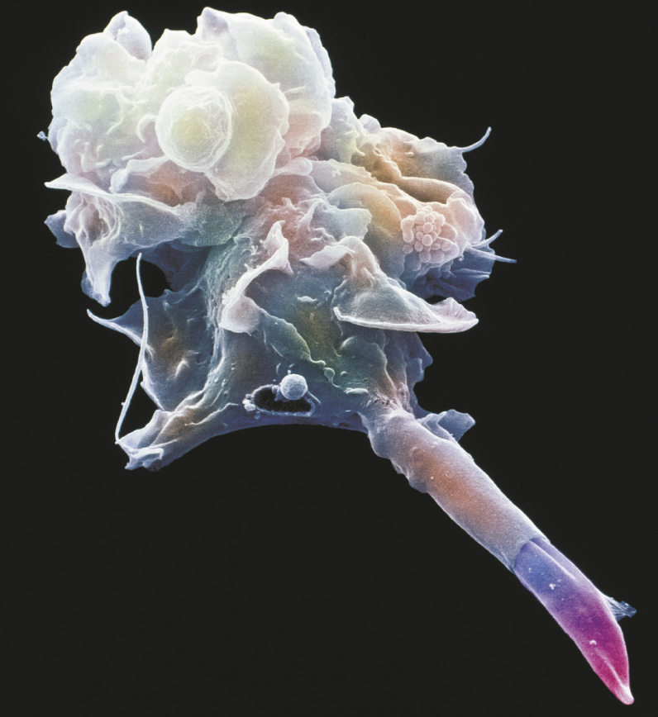
The Immune System: PNI
Notes:
The immune system consists of fighter cells that look more fantastical than any alien creature Hollywood could design. This one is about to engulf and destroy a cigarette-shaped parasite that causes a tropical disease.

Slide 30
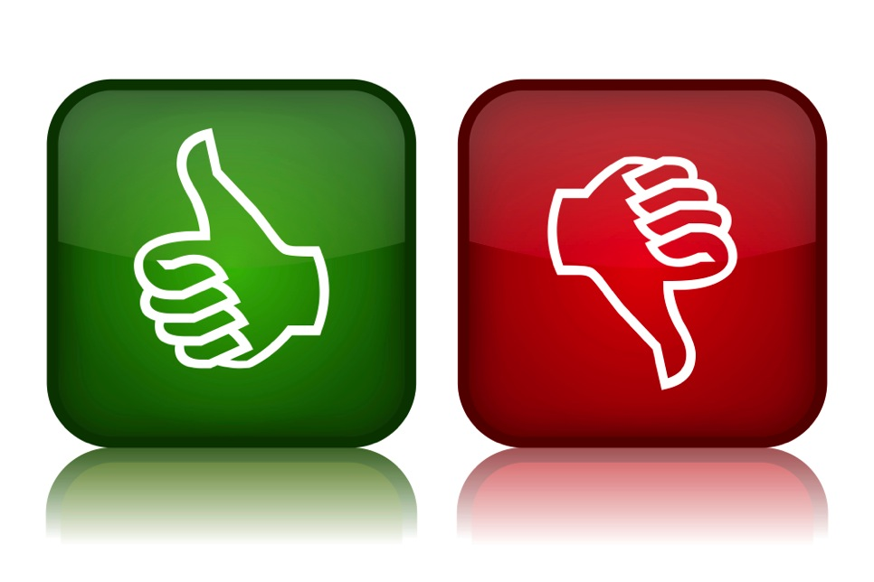
Stress and the Mind
At first, studies reported that optimism is better for health, well-being and longevity than pessimism.
However, studies have since indicated both positive and negative outcomes for optimism and pessimism.

Slide 31

Conscientiousness and Control
Locus of control:
A general expectation about whether the results of your actions are under your own control (internal locus) or beyond your control (external locus)
Feeling in control provides numerous beneficial outcomes, especially those related to stress
Notes:
People who have an internal locus of control (“internals”) tend to believe that they are responsible for what happens to them.
Those who have an external locus of control (“externals”) tend to believe that their lives are controlled by luck, fate, or other people.

Slide 32

CULTURE AND control
What Can We Change, and What Must We Accept?
Cultures generally differ in the kind of control they emphasize and value.
Western cultures:
Primary control
“Fighting back” philosophy
Eastern cultures:
Secondary control
“Learn to live with
it” philosophy
Notes:
Primary control: An effort to modify reality by changing other people, the situation, or events; a “fighting back” philosophy.
Secondary control: An effort to accept reality by changing your own attitudes, goals, or emotions; a “learn to live with it” philosophy.

Slide 33
11.4
Stress and Emotion

Slide 34
11.4
Module Learning Objectives
11.4.A
Summarize the evidence that negative emotions (such as hostility and depression) detract from health.
11.4.B
Summarize the evidence that positive emotions contribute to health.
11.4.C
Discuss how confession, forgiveness, and other forms of “letting grievances go” contribute to health benefits.

Slide 35
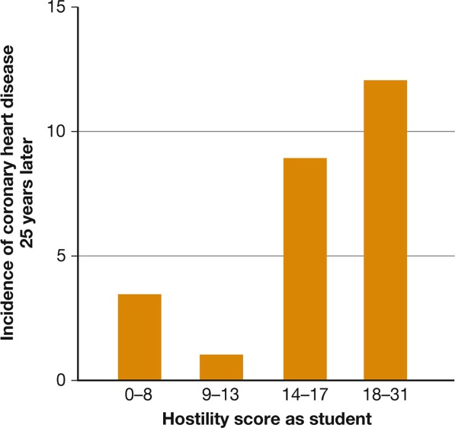
Hostility and Depression: Do They Hurt?
Personality type is less predictive of health problems than is hostility.
Proneness to anger is a major risk factor.
Notes:
Type A personality characteristics originally thought to be associated with heart disease:
Ambitiousness
Impatience
Anger
Working hard
Having high standards for oneself
Later work ruled out all those factors except one: hostility. Recent research shows that people who are characterized by cynical or antagonistic hostility are at increased risk for heart disease.
Figure 11.5 Hostility and Heart Disease
Anger is more hazardous to health than a heavy workload. Men who had the highest hostility scores as young medical students were the most likely to have coronary heart disease 25 years later (Williams, Barefoot, & Shekelle, 1985).

Slide 36

Hostility and Depression: Do They Hurt?
Clinical depression is linked to at least a doubled risk of later heart attack and cardiovascular disease.
Lethargy
Overeating
Notes:
Cancer can cause depression, and not just because the diagnosis is “depressing.” Cancerous tumors and the immune system fighting them produce high levels of a chemical that cause the emotional and behavioral symptoms of depression.

Slide 37

Positive Emotions: Do They Help?
Positive emotions seem to be healthful, but it is difficult to separate cause and effect
Counteract high arousal
More creativity and motivation
More likely to attract friends and supporters
Notes:
A longitudinal study of Harvard men found that some life paths led the men to be happy and well and others to be sad and ill.
Happiness did not cause wellness, and sadness did not cause illness (Vaillant, 2012).
37

Slide 38

Emotional Inhibition and Expression
Continued inhibition of thoughts and emotions actually requires physical effort that can be stressful to the body.
Two ways of letting go of negative emotions:
Confession
Forgiveness
Notes:
Confession: Divulging (even if only to yourself) private thoughts and feelings that make you ashamed, worried, frightened, or sad.
Forgiveness: Give up thoughts that produce grudges and replacing them with different perspectives.
Forgiveness does not mean that the offended person denies, ignores, or excuses the offense, which might be serious. It does mean that the victim is able, finally, to come to terms with the injustice and let go of obsessive feelings of hurt, rage, and vengefulness.

Slide 39
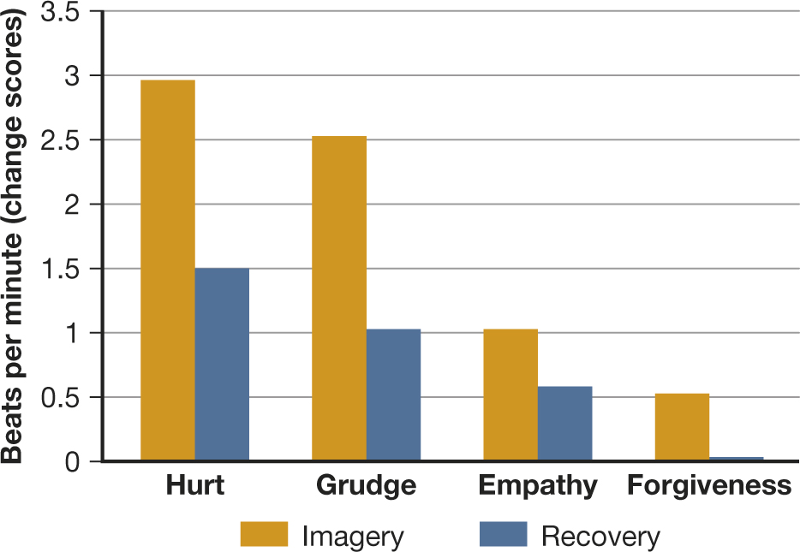
Figure 11.6: Heartfelt Forgiveness
Notes:
Figure 11.6 Heartfelt Forgiveness
Participants in a study were asked to think of someone who they felt had offended or hurt them. Then they were asked to imagine unforgiving reactions (such as rehearsing the hurt and harboring a grudge) and forgiving reactions (such as feeling empathy or forgiving the person). As you can see from the orange bars, people’s heart rates increased much more sharply when their thoughts were unforgiving. The blue bars indicate the heart rates also took longer to return to normal in the unforgiving conditions.

Slide 40
11.5
Coping with Stress

Slide 41
11.5
Module Learning Objectives
11.5.A
Discuss how emotion-focused coping and problem-focused coping contribute to the problem-solving approach to dealing with stress.
11.5.B
Describe three effective coping strategies that rely on rethinking the stressful problem at hand, and give an example of each.
11.5.C
Discuss the ways in which friends can help or hinder successful coping efforts.

Slide 42

Coping with Stress
Mindfulness meditation
Calming activities
Exercise
Notes:
Meditation and exercise, along with any other activities that calm your body and focus your mind—massage, prayer, music, dancing, baking bread—are all good for health.

Slide 43

Solving the Problem
Emotion-focused coping
Concentrating on the emotions
the problem has caused
Problem-focused coping
Taking steps to solve the problem
Notes:
The specific steps in problem-focused coping depend on the nature of the problem: whether it is a pressing but one-time decision; a continuing difficulty, such as living with a disability; or an anticipated event, such as having an operation.
After the problem is identified, the coper can learn as much as possible about it from professionals and from others in the same predicament (Clarke & Evans, 1998).
Becoming informed increases the feeling of control, which in turn can speed recovery (Doering et al., 2000).

Slide 44
Rethinking the Problem
Learning from the experience
Making social comparisons
Reappraising the situation
Notes:
Although you may not be able to get rid of a stressor, you can choose to think about it differently, a process called reappraisal.
Many people emerge from adversity with newfound or newly acquired skills, having been forced to learn something they had not known before.
Successful copers often compare themselves to others who they feel are less fortunate.

Slide 45

Drawing on Social Support
When Friends Help You Cope
  Friends can help: Friends and social support help to improve health and reduce stress
  Partner support: Touching can elevate levels of oxytocin, the hormone that induces relaxation
  Giving support to others can be a valuable source of comfort

Slide 46
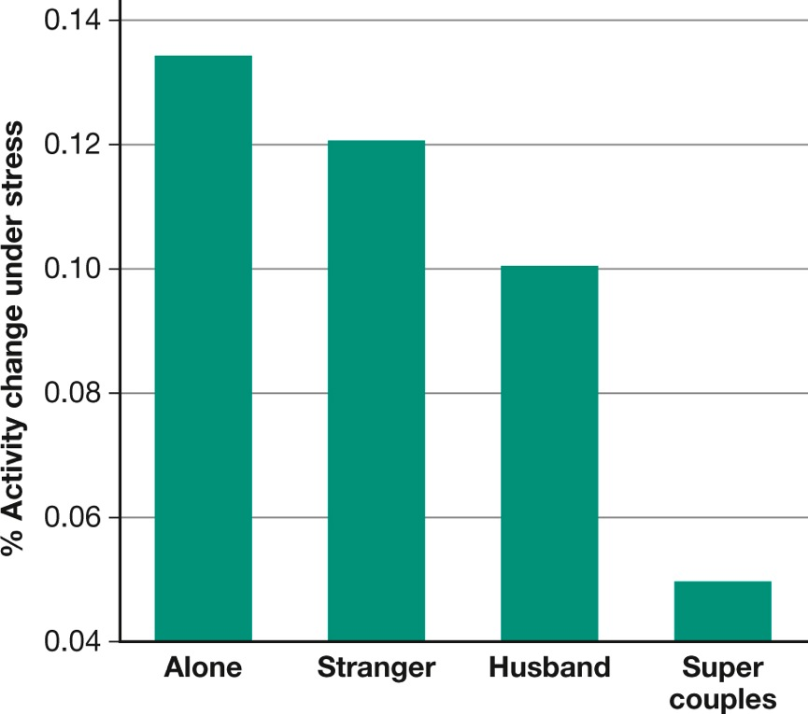
Figure 11.7: Hugs and Health
Notes:
Figure 11.7 Hugs and Health
Women had to lie in an MRI machine while receiving mild but stressful shocks on their ankle. Those who showed the highest activation of the hypothalamus and other regions of the brain involved in stress and anxiety went through the test alone. A stranger’s calming touch reduced activation somewhat, and a husband’s touch reduced it even more. The women in “super couples,” those who felt the closest to their husbands (right bar), showed the lowest signs of stress (Coan, Schaefer, & Davidson, 2006).

Slide 47
Drawing on Social Support
Coping with Friends
In close relationships, the support person may also be the source of stress.
Married couples who argue in a hostile way have:
  Increased elevations of stress hormones
  Weakened immune systems
Friends may be unsupportive or offer the wrong kind of support.

Slide 48

Taking Psychology with You
How Much Control Do We Have Over Our Emotions and Our Health?
We do have some control over the factors involved in many illnesses.
Solutions and ways of coping do not require either-or answers.
We may not always be able to control the stressors in our lives, but we have the ability to think about our actions and control what we do next.

Slide 49
End of Chapter

Slide 50
Interactive Figures

Slide 51
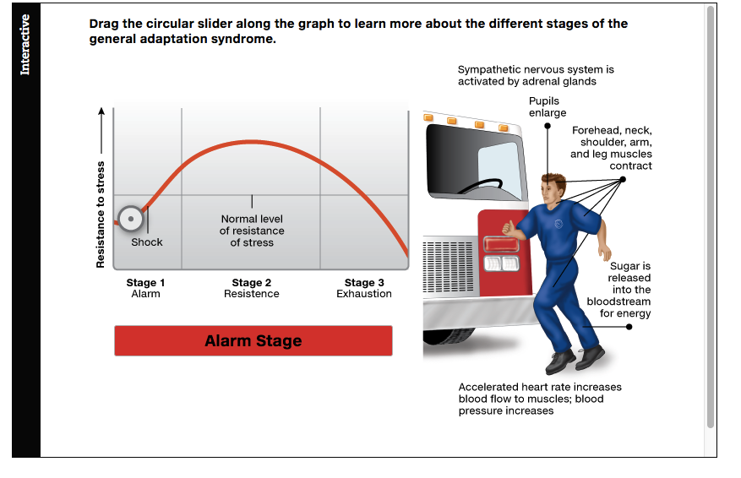
Interactive figure
General Adaptation Syndrome
Click here to watch the interactive feature.

Slide 52
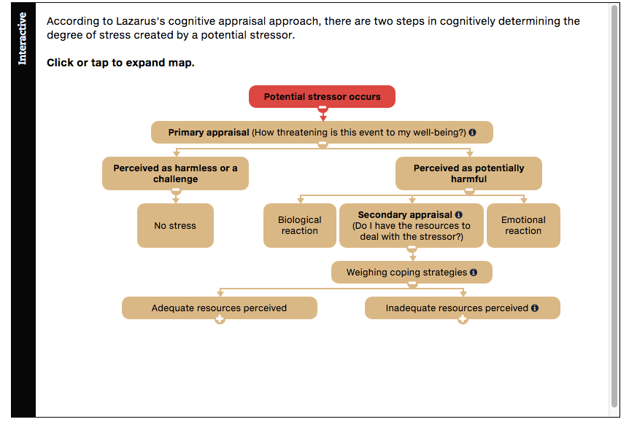
Interactive figure
Responses to a Stressor
Click here to watch the interactive feature.

Slide 53
Acknowledgments

Slide 54
Slide | Credit
Slide 4 | bikeriderlondon. Shutterstock
Slide 5 | vita khorzhevska. Shutterstock
Slide 9 | Andrea Danti. Shutterstock
Slide 14 | Alberto Zornetta. Shutterstock
Slide 20 | StockLite. Shutterstock
Slide 21 | Monkey Business Images. Shutterstock
Slide 28 | Adam Gregor. Shutterstock
Slide 30 | Arcady. Shutterstock
Slide 31 | Shkurd. Shutterstock
Slide 32 | Thorsten Schmitt. Shutterstock
Slide 36 | Lichtmeister. Shutterstock
Slide 37 | Ariwasabi. Shutterstock
Slide 38 | biletskiy. Shutterstock
Slide 42 | Serg64. Shutterstock
Slide 43 | Eugene Sergeev. Shutterstock
Slide 44 | Alberto Zornetta. Shutterstock
Slide 45 | Andresr. Shutterstock
Slide 48 | quetton. Shutterstock

