Slide 1

14 Theories of personality
14.1
Psychodynamic Theories of Personality
14.4
Environmental Influences on Personality
14.2
The Modern Study of Personality
14.5
Cultural Influences on Personality
14.3
Genetic Influences on Personality
14.6
The Inner Experience
PSYCHOLOGY, Twelfth Edition | Carole Wade • Carol Tavris
Copyright © 2017, 2014, 2011 Pearson Education Inc. All rights reserved.

Slide 2

14.1
Psychodynamic Theories of Personality

Slide 3
14.1
Module Learning Objectives
14.1.A
Describe the structure of personality according to psychoanalysis, five psychological defense mechanisms, and five stages of psychosexual development.
14.1.B
Explain how the views of Carl Jung and the object-relations school differed from Sigmund Freud's approach to personality.
14.1.C
Summarize three ways in which psychodynamic theories falter under scientific scrutiny.

Slide 4


Distinctive
and relatively stable pattern of behaviors, thoughts, motives, and emotions that characterizes an individual
ersonality

Slide 5

Freud and Psychoanalysis
Sigmund Freud
Psychodynamic Theories
Theories that explain behavior and personality in terms of unconscious energy dynamics within the individual
Psychoanalysis
A theory of personality and a method of psychotherapy developed by Sigmund Freud; it emphasizes unconscious motives and conflicts
Notes:
5

Slide 6



The Structure of Personality
Conscious
_{Ego}
_{Superego}
Unconscious
_{Id}
Notes:
Id: The part of personality containing inherited psychic energy, particularly sexual and aggressive instincts.
Libido: The psychic energy that fuels the life or sexual instincts of the id.
Ego: The part of personality that represents reason, good sense, and rational self-control.
Superego: The part of personality that represents conscience, morality, and social standards.

Slide 7
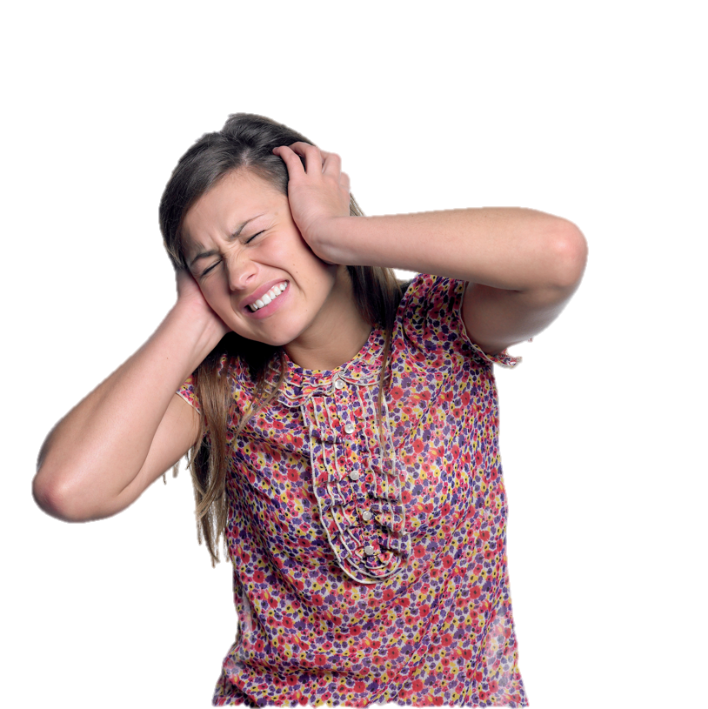
Defense Mechanisms
When a threatening idea, memory, or emotion is blocked from consciousness
Repression
Projection
Displacement
Regression
Denial
Notes:
Defense mechanisms: Methods used by the ego to prevent unconscious anxiety or threatening thoughts from entering consciousness.

Slide 8

Defense Mechanisms
When a person’s own unacceptable or threatening feelings are repressed and then attributed to someone else
Repression
Projection
Displacement
Regression
Denial

Slide 9

Defense Mechanisms
When people direct their emotions toward people, animals, or objects that are not the real object of their feelings
Repression
Projection
Displacement
Regression
Denial
Notes:
When displacement serves a higher cultural or socially useful purpose, as in the creation of art or inventions, it is called sublimation. Freud argued that society has a duty to help people sublimate their unacceptable impulses for the sake of civilization. Sexual passion, for example, may be sublimated into the creation of art or literature, and aggressive energy into sports.

Slide 10

Defense Mechanisms
When a person reverts to a previous phase of psychological development
Repression
Projection
Displacement
Regression
Denial

Slide 11

Defense Mechanisms
When a person refuses to admit that something unpleasant is happening
Repression
Projection
Displacement
Regression
Denial

Slide 12
The Development of Personality
  When:
  Age 2 or 3
  If fixated:
  Anal retentive (obsessively neat, clean) or anal expulsive (messy, disorganized)
    When:
    First year of life
    If fixated:
    Seek oral gratification (e.g. smoking); May become clingy, dependent
ORAL STAGE
ANAL STAGE
FREUD’S PSYCHOSEXUAL STAGES
  When:
  Age 3 to age 5 or 6
  Most crucial stage in personality formation; Oedipus complex
  When:
  Begins at puberty
  Leads to adult sexuality
PHALLIC (OEDIPAL) STAGE
GENITAL STAGE
  When:
  Begins at about age 5 or 6
  Supposedly nonsexual stage
LATENCY STAGE
Notes:
Psychosexual stages: In Freud’s theory, the idea that sexual energy takes different forms as the child matures; the stages are oral, anal, phallic (Oedipal), latency, and genital.
Oedipus complex: A conflict occurring in the phallic (Oedipal) stage, in which a child desires the parent of the other sex and views the same-sex parent as a rival.
According to Freud, when the Oedipus complex is resolved, the child identifies with the same-sex parent, but females retain a lingering sense of inferiority and “penis envy.”
12

Slide 13
Freud in Perspective
-
Biased in reaching his conclusions, sometimes bullying clients into accepting his explanations
Often ignored disconfirming evidence
Sparked greater dialogue about sexuality
Welcomed women into the profession
+
Notes:
Freud was a mixture of intellectual vision and blindness, sensitivity and arrogance. His provocative ideas left a controversial legacy to psychology, one that others began to tinker with immediately.
13

Slide 14
Other Psychodynamic Approaches
Jungian Theory
Collective unconscious
The universal memories and experiences of the human kind, represented in the symbols, stories, and images (archetypes) that occur across all cultures
Archetypes
Universal, symbolic images that appear in myths, art, stories, and dreams; to Jungians, they reflect the collective unconscious
Notes:
Examples of archetypes: the Hero, Earth Mother, Voldemort (shadow archetype)
14

Slide 15
Other Psychodynamic Approaches
Object-Relations School
Emphasizes the importance of the infant’s first two years of life and the baby’s formative relationships, especially with the mother
Life’s central problem:
Find a balance between the need for independence and the need for others
Notes:
15

Slide 16
Evaluating Psychodynamic Theories
Psychodynamic theories:
Violate principle of falsifiability
Draw universal principles from experiences of a few atypical patients
Base theories of personality development on retrospective accounts of adults
However, some concepts have been empirically tested and validated.
Notes:
Some concepts have been empirically tested and validated, including the existence of:
Unconscious processes
Defense mechanisms
The idea that we are unaware of some of our own motives
16

Slide 17
14.2
The Modern Study of Personality

Slide 18
14.2
Module Learning Objectives
14.2.A
Outline some ways in which objective personality inventories differ from popular personality tests used in business, dating, or other areas.
14.2.B
List the Big Five personality dimensions, and describe the characteristics of each one.

Slide 19
Popular Personality Tests
Myers-Briggs Type Indicator
Popular in business, at motivational seminars, and with matchmaking services
Low reliability
Objective Tests (inventories)
Standardized questionnaires requiring written responses
Scientifically valid, useful in research
Notes:
Myers-Briggs Type Indicator: Assigns people to one of 16 different types based on individual’s scores on the dimensions of introverted or extroverted, logical or intuitive.
Objective tests (inventories) provide information about countless aspects of personality, including values, interests, self-esteem, emotional problems, and typical ways of responding to situations.

Slide 20


T
A characteristic of an individual, describing a habitual way of behaving, thinking, and feeling
rait

Slide 21
Core Personality Traits
Central traits
Reflect a characteristic way of behaving, dealing with others, and reacting to new situations
Most people have 5-10
Secondary traits
More changeable aspects of personality
  Music preferences
  Habits
  Casual opinions
Notes:
Gordon Allport argued that people have a few central traits that are key to their personalities and a greater number of secondary traits that are less fundamental.
Example of central traits: Some see the world as a hostile, dangerous place; others see it as a place for fun and frolic.
Examples of secondary traits: Music preferences, habits, casual opinions.

Slide 22

Core Personality Traits: The Big Five
Extroversion vs. introversion
1
Neuroticism vs. emotional stability
2
Openness
vs. resistance to new experience
5
3
Agreeableness vs. antagonism
4
Conscientiousness vs. impulsiveness
Notes:
Raymond Cattell used factor analysis to identify clusters of traits that he considered the basic components of personality.
Factor analysis: A statistical method for analyzing the intercorrelations among various measures or test scores; clusters of measures or scores that are highly correlated are assumed to measure the same underlying trait or ability (factor).
Today, hundreds of factor-analytic studies support the existence of a cluster of five central “robust factors,” known informally as the Big Five.
22

Slide 23
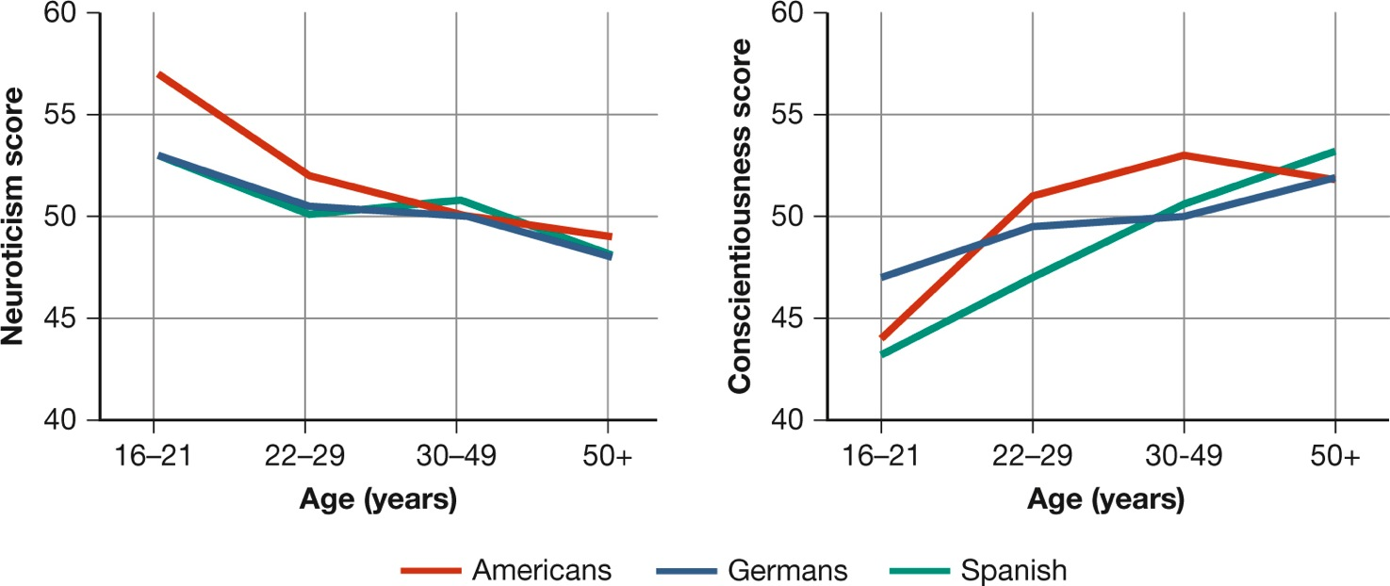
Figure 14.1: Consistency and Change in Personality over the Lifespan
Notes:
Figure 14.1 Consistency and Change in Personality over the Lifespan
Although the Big Five traits are fairly stable, changes do occur over the lifespan. As you can see, neuroticism (negative emotionality) is highest among young adults and then declines, whereas conscientiousness is lowest among young adults and then steadily increases (Costa et al., 1999).

Slide 24
14.3
Genetic Influences on Personality

Slide 25
14.3
Module Learning Objectives
14.3.A
Define what temperaments are, and discuss how they relate to personality traits.
14.3.B
Explain how twin studies can be used to estimate the heritability of personality traits.
14.3.C
Summarize the arguments for and against the conclusion that personality “is all in our genes.”

Slide 26

Genetic Influences on Personality
    Study personality traits in other species
  Study temperaments
  of human infants and children
  Conduct
  heritability studies of twins and adopted individuals
Notes:
26

Slide 27

BIOLOGY AND animal traits
Do Puppies Have Personalities?
Members of many other species vary in the same characteristic traits that humans do.
Evidence has been found for most of the Big Five factors in 64 different species.
These findings point to the evolutionary importance of the Big Five and their biological basis.

Slide 28

Heredity and Temperament
Temperaments:
Physiological dispositions
to respond to the environment in certain ways
Present in infancy,
assumed to be innate
Relatively stable over time
Include:
Reactivity
Soothability
Positive and negative emotionality
Notes:
Temperaments are quite stable over time and are the clay out of which later personality traits are molded (Clark & Watson, 2008; Dyson et al., 2015; Else-Quest et al., 2006).

Slide 29
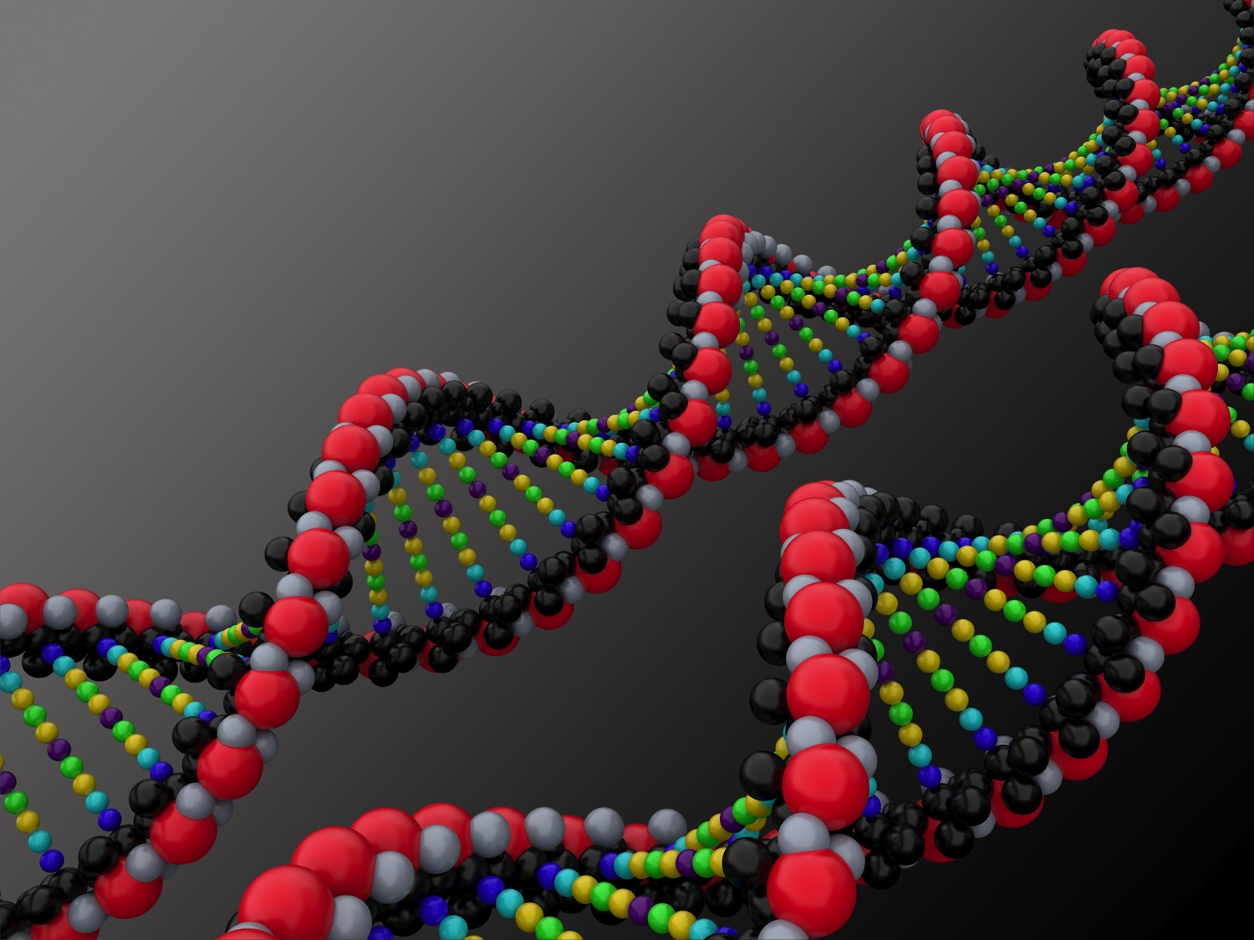
Heredity and Traits
Heritability
A statistical estimate of the proportion of the total variance in some trait that is attributable to genetic differences among individuals within a group
Heritability of personality traits is about .50
Notes:
Heritability of personality traits is about .50: Within a group of people, about 50% of the variation associated with a given trait is attributable to genetic differences among individuals in the group.
Genetic influences create dispositions and set limits on the expression of specific traits. But even traits that are highly heritable are often modified throughout life by circumstances, chance, and learning.

Slide 30
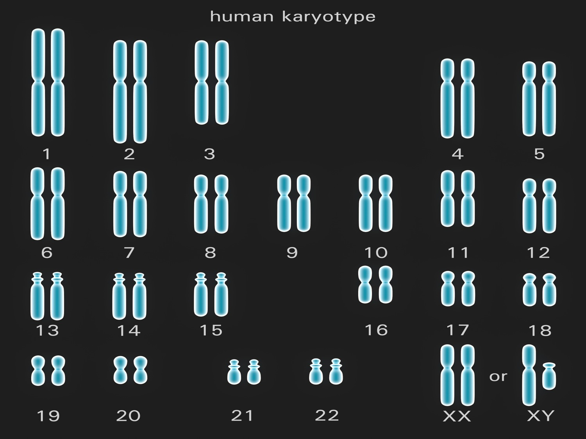
Evaluating Genetic Theories
Behavioral-genetic research, to date, permits us only to infer the existence of relevant genes
Many people oversimplify this information and conclude “it’s all in our genes”

Slide 31
14.4
Environmental Influences on Personality

Slide 32
14.4
Module Learning Objectives
14.4.A
Explain how reciprocal determinism and the nonshared environment contribute to our understanding of how traits and behavior can be shaped by the environment.
14.4.B
Summarize three lines of evidence that suggest parental influence over children's personality development is limited.
14.4.C
Discuss some ways in which peers influence the development of personality in children.

Slide 33

Situations and Social Learning
Social-cognitive learning theorists argue that we acquire central personality traits from:
Our learning history
Our resulting expectations and beliefs

Slide 34
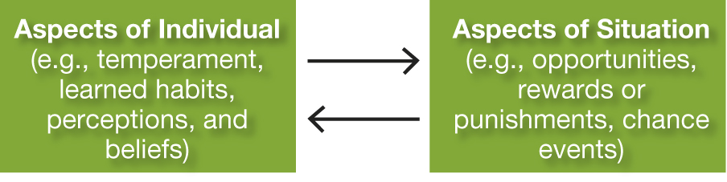
Situations and Social Learning
Reciprocal determinism
Two-way interaction between aspects of the environment and aspects of the individual in the shaping of personality traits

Slide 35

Situations and Social Learning
Nonshared environment
Unique aspects of a person’s environment and experience that are not shared with family members
Notes:
35

Slide 36
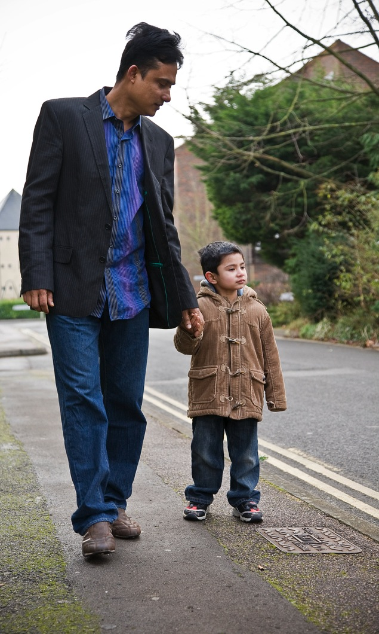
Parental Influence—and Its Limits
1. The shared environment of the home has relatively little influence on most personality traits.
2. Few parents have a single child-rearing style that is consistent over time and that they use with all children.
3. Even when parents try to be consistent, there may be little relation between what they do and how their children turn out.
Parents do influence their children in lots of ways that are unrelated to personality.
Notes:
Parents contribute to their children's religious beliefs, intellectual and occupational interests, motivation to succeed, skills, values, and adherence to traditional or modern notions of masculinity and femininity (Beer, Arnold, & Loehlin, 1998; Krueger, Hicks, & McGue, 2001).
Above all, what parents do profoundly affects the quality of their relationship with their children—whether their children feel loved, secure, and valued or humiliated, frightened, and worthless (Harris, 2009).
Parents also have some influence even on traits in their children that are highly heritable.

Slide 37
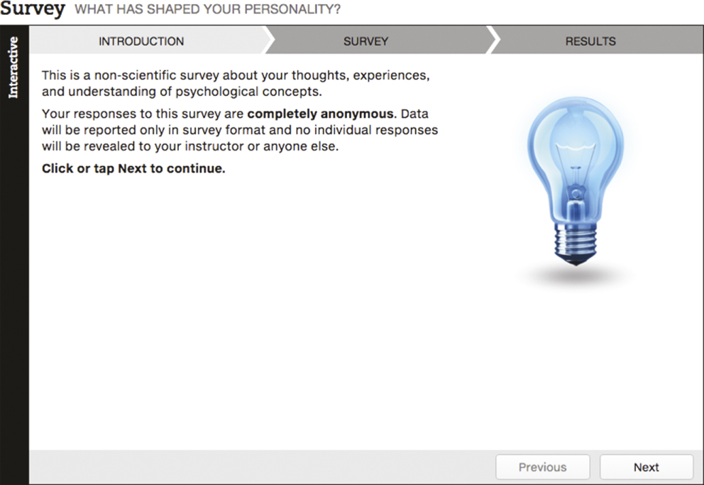
What Has Shaped Your Personality?

Slide 38

The Power of Peers
Peers play a tremendous role in shaping our personality traits and behavior, causing us to emphasize some attributes or abilities and downplay others.

Slide 39
14.5
Cultural Influences on Personality

Slide 40
14.5
Module Learning Objectives
14.5.A
Compare individualist and collectivist cultures, describe some average personality differences between them, and describe three traits that show considerable cultural variability.
14.5.B
Evaluate some pros and cons of the cultural approach to understanding personality.

Slide 41

Culture, Values, and Traits
Individualist cultures
Cultures in which the self is regarded as autonomous, and individual goals and wishes are prized above duty and relations with others
Collectivist cultures
Cultures in which the self is regarded as embedded in relationships, and harmony with one’s group is prized above individual goals and wishes

Slide 42


Culture and Self
Individualist and collectivist ways of defining the self influence many aspects of life:
Which personality traits we value
How and whether we express emotions
How much we value relationships vs. freedom
How we express anger or aggressive feelings

Slide 43
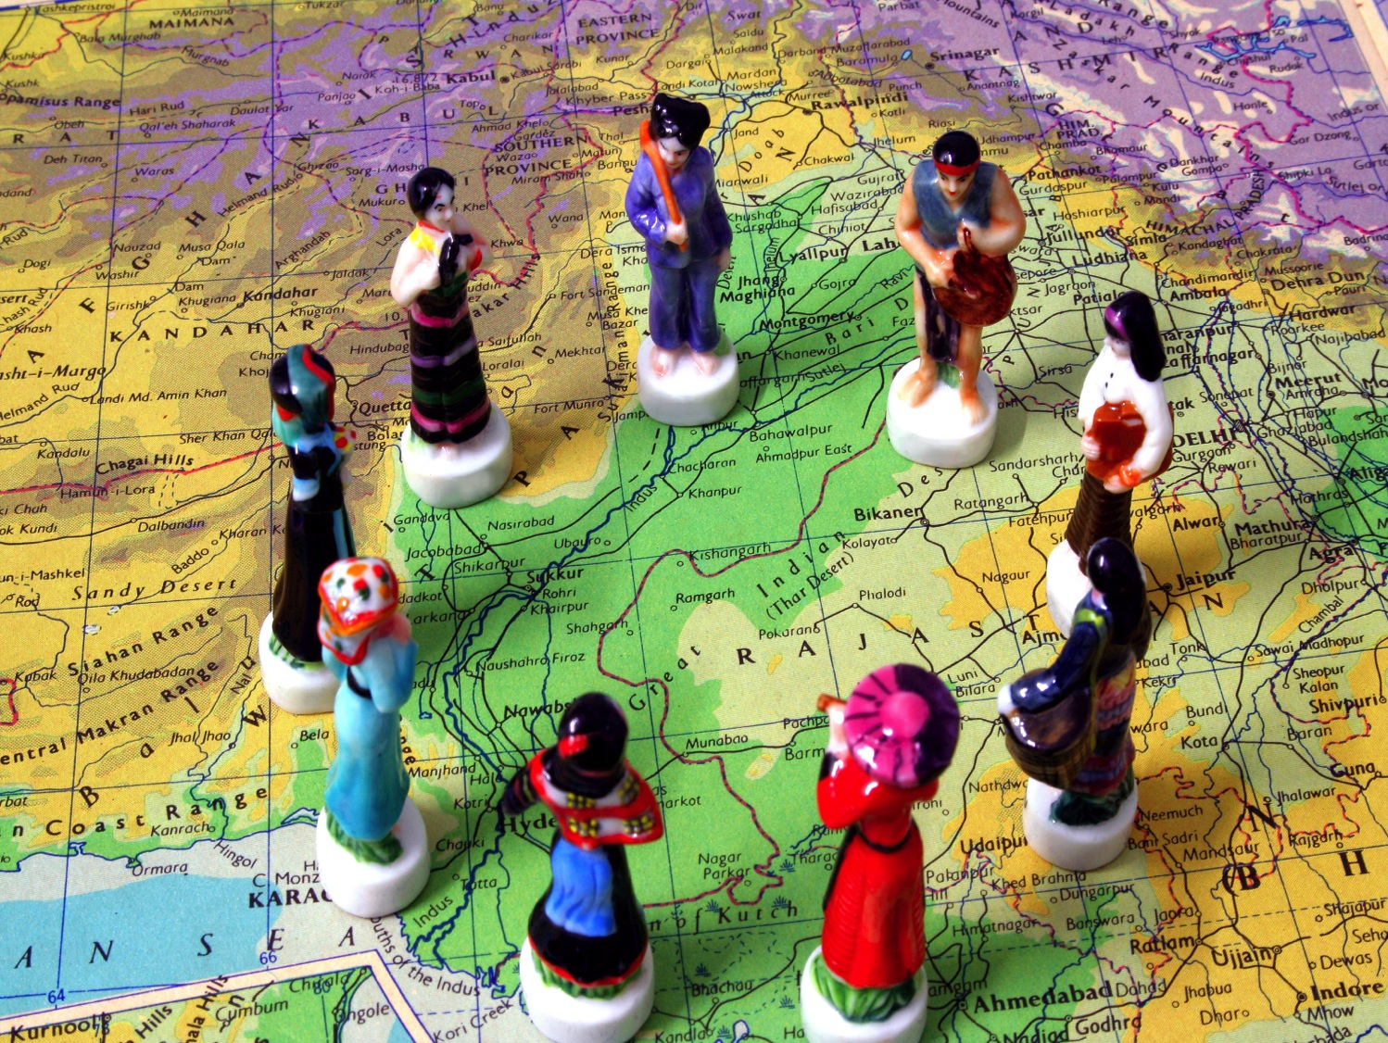
Culture and Traits
When people fail to understand the influence of culture on behavior, they often attribute another person’s actions to individual personality traits when they are really due to cultural norms.
Cleanliness
Helpfulness
Tardiness and time

Slide 44

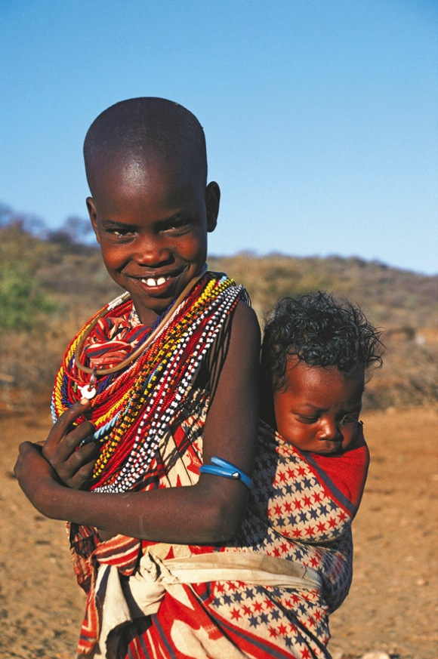
Culture and Traits
Notes:
In many cultures, children are expected to contribute to the family income and to take care of their younger siblings. These experiences encourage helpfulness over independence.

Slide 45

CULTURE AND violence
The Cultivation of Male Aggression
Emphasis on aggressiveness and vigilance in herding cultures creates culture of honor
Used to explain increased likelihood of fighting in the South and the West, versus the North and Midwest
Notes:
Culture of honor: Even small disputes and trivial insults (trivial to people from other cultures, that is) put a man’s reputation for toughness on the line, requiring him to respond with violence to restore his status.
45

Slide 46
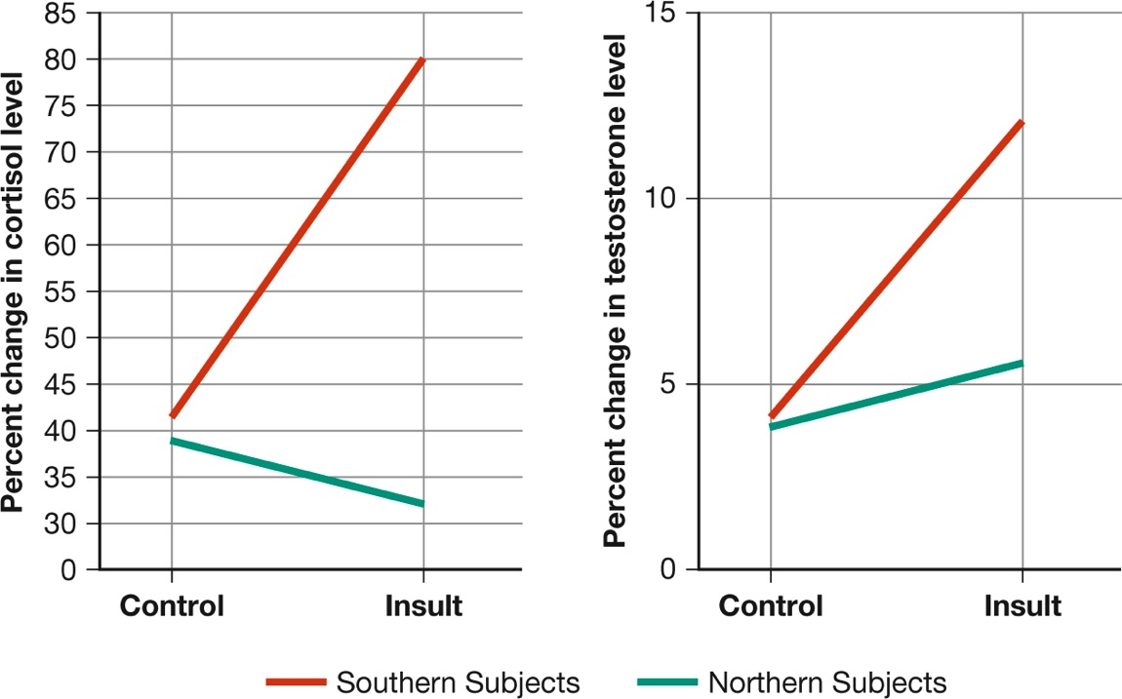
Figure 14.2: Aggression and Cultures of Honor
Notes:
Figure 14.2 Aggression and Cultures of Honor
As these two graphs show, when young men from Northern states were insulted in an experiment, they shrugged it off, thinking it was funny or trivial. But for young Southern men, levels of the stress hormone cortisol and of testosterone shot up, and they were more likely to retaliate aggressively (Cohen et al., 1996).

Slide 47

Evaluating Cultural Approaches
Cultural psychologists face the problem of how to describe cultural influences on personality without oversimplifying or stereotyping.
People vary according to:
Temperaments
Beliefs
Learning histories
  Variation occurs within every culture

Slide 48
14.6
The Inner Experience

Slide 49
14.6
Module Learning Objectives
14.6.A
Describe the core humanist ideas advanced by Abraham Maslow, Carl Rogers, and Rollo May.
14.6.B
Discuss how the narrative approach to personality hinges on answering the central question, “Who am I?”
14.6.C
Summarize the shortcomings of the humanist approach to personality, and identify some areas of substantial contribution.

Slide 50

Humanist Psychology
An approach that emphasizes personal growth, resilience, and the achievement of human potential
Notes:
50

Slide 51
Humanist Approaches
Abraham
Maslow
Carl Rogers
Rollo May
Peak experiences:
Rare moments of rapture caused by the attainment of excellence or the experience of beauty
Self-actualization: Striving for a life that is meaningful, challenging, and satisfying
Conditional positive regard: The acceptance and love one receives from significant others is contingent upon one’s behavior
Unconditional positive regard: Love and support given to another person with no conditions attached
Shared with humanists the belief in free will, but also emphasized loneliness, anxiety,
and alienation
Existentialism:
Emphasizes the inevitable dilemmas and challenges of human existence
Notes:
51

Slide 52

Narrative Approaches
Life narrative
The story that each of us develops over time to explain ourselves and make meaning of everything that has happened to us
Notes:
These stories are the essence of your personality, capturing everything that has happened to you and all the factors that affect your biology, psychology, and relationships.

Slide 53
Evaluating Humanist and Narrative Approaches
Humanist psychology:
Added balance to the study of personality
Encouraged others to focus on
“positive psychology”
Fostered new appreciation for resilience
However, it is hard to operationally define many of the concepts.
Notes:
The humanist, existential, and narrative views of personality share one central message: We have the power to choose our own destinies, even when fate delivers us into tragedy.
Across psychology, this message has fostered an appreciation of resilience in the face of adversity.
53

Slide 54
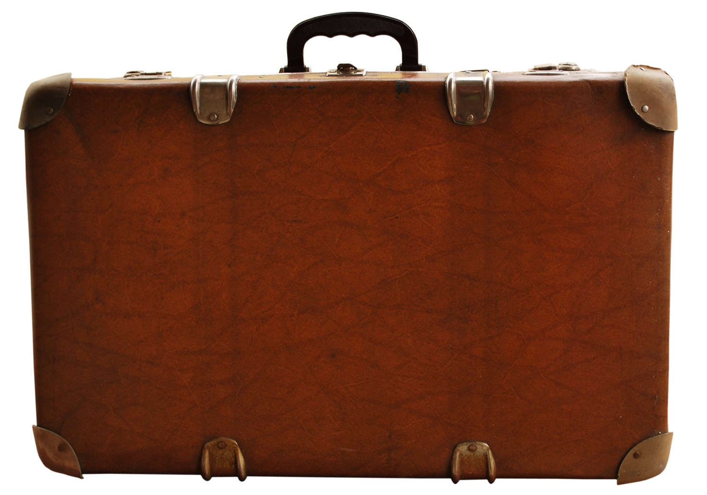
Taking Psychology with You
How to Avoid the “Barnum Effect”
Beware of all-purpose descriptions that could apply to anyone.
Beware of your own selective perceptions.
Resist flattery and emotional reasoning.

Slide 55
End of Chapter

Slide 56
Acknowledgments

Slide 57
Slide | Credit
Slide 4 | Maridav. Shutterstock
Slide 5 | musicman. Shutterstock
Slide 6 | musicman. Shutterstock
Slide 7 | Gareth Boden. Pearson Education Ltd
Slide 8 | zwola fasola. Shutterstock
Slide 9 | Bannu. Shutterstock
Slide 10 | tanaphongpict. Shutterstock
Slide 11 | Roger costa morera. Shutterstock
Slide 13 | musicman. Shutterstock
Slide 14 | musicman. Shutterstock
Slide 15 | musicman. Shutterstock
Slide 16 | musicman. Shutterstock
Slide 20 | Photosani. Shutterstock
Slide 22 | Deniseus. Shutterstock
Slide 26 | Sashkin. Shutterstock
Slide 27 | 123rf.com
Slide 28 | Jezper. Shutterstock
Slide 29 | Mara008. Shutterstock
Slide 30 | somersault1824. Shutterstock
Slide 33 | vlad09. Shutterstock
Slide 35 | Morgan Lane Photography. Shutterstock
Slide 36 | Lisa Payne Photography. Pearson Education Ltd
Slide 38 | Studio Natacha. Pearson Education Ltd

Slide 58
Slide | Credit
Slide 43 | Wei Ming. Shutterstock
Slide 45 | kazoka. Shutterstock
Slide 47 | Thorsten Schmitt. Shutterstock
Slide 50 | gornjak. Shutterstock
Slide 51 | gornjak. Shutterstock
Slide 52 | Naki Kouyioumtzis. Pearson Education Ltd
Slide 54 | quetton. Shutterstock

