Slide 1
15 Psychological disorders
15.1
Diagnosing Mental Disorders
15.5
Personality Disorders
15.2
Anxiety Disorders
15.6
Drug Abuse and Addiction
15.3
Trauma and Obsessive–Compulsive Disorders
15.7
Dissociative Identity Disorder
15.4
Depressive and Bipolar Disorders
15.8
Schizophrenia
PSYCHOLOGY, Twelfth Edition | Carole Wade • Carol Tavris
Copyright © 2017, 2014, 2011 Pearson Education Inc. All rights reserved.

Slide 2
15.1
Diagnosing Mental Disorders

Slide 3
15.1
Module Learning Objectives
15.1.A
Consider why it is difficult to obtain a universally agreed-upon definition of “mental disorder.”
15.1.B
Describe four dangers associated with using the DSM for diagnosis of mental disorders, and give an example of each.
15.1.C
Explain the theoretical basis of projective tests, and identify the problems associated with these techniques.

Slide 4
Dilemmas of Definition
Mental disorder: Any behavior or emotional state that:
Causes an individual great suffering
Is self-destructive
Seriously impairs the person’s ability to work or get along with others
Makes a person unable to control the impulse to endanger others
Notes:
People confuse mental disorder and insanity.
Insanity is a legal term that depends on whether the person is aware of the consequences of behavior and is able to control it.

Slide 5
Dilemmas of Diagnosis
Diagnostic and Statistical Manual of Mental Disorders (DSM): APA’s standard reference manual used to diagnose mental disorders
Notes:
Primary aim is descriptive: to provide clear diagnostic categories so that clinicians and researchers can agree on which disorders they are talking about and then can study and treat these disorders.

Slide 6
Classifying Disorders: The DSM
Critics:
Inherent problems in DSM:
The danger of overdiagnosis
The power of diagnostic labels
Confusion of serious mental disorders with normal problems
The illusion of objectivity
Supporters:
It is important to help clinicians distinguish among disorders that share certain symptoms, such as anxiety, irritability, or delusions, so they can be diagnosed reliably and treated properly.

Slide 7
CULTURE AND mental illness
Are Mental Problems the Same Everywhere?
Universal disorders
Examples: Schizophrenic delusions, depression, panic attacks
The DSM-5 discusses three culture-related concepts:
Cultural syndrome
Ataque de nervios
Culture idiom of distress
Kufungisisa
Cultural explanation of symptoms
Maladi moun

Slide 8
Dilemmas of Determination: Projective Tests
Projective tests: Used to infer a person’s motives, conflicts, and unconscious dynamics on the basis of the person’s interpretation of ambiguous stimuli
Rorschach Inkblot Test
Anatomically detailed dolls
Low reliability and validity
Notes:
One of the most popular projectives is the Rorschach Inkblot Test.
Consists of ten cards with symmetrical abstract patterns, originally formed by spilling ink on paper and folding the paper in half.
The test taker reports what he or she sees in the inkblots, and the clinician interprets the answers according to the symbolic meanings emphasized by psychodynamic theories.

Slide 9
Dilemmas of Measurement: Objective Tests
Objective tests (inventories): Standardized objective questionnaires requiring written responses; typically include scales on which people are asked to rate themselves
Beck Depression Inventory
Minnesota Multiphasic Personality Inventory (MMPI)
Generally more reliable and valid than projective tests
Notes:
The leading objective test of major depression is the Beck Depression Inventory.
The most widely used diagnostic assessment for personality and emotional disorders is the Minnesota Multiphasic Personality Inventory (MMPI).
The MMPI is organized into ten categories, or scales, covering such problems as depression, paranoia, schizophrenia, and introversion.
Four additional validity scales indicate whether a test-taker is likely to be lying, defensive, or evasive while answering the items.

Slide 10
15.2
Anxiety Disorders

Slide 11
15.2
Module Learning Objectives
15.2.A
Differentiate the major symptoms of generalized anxiety disorder and panic disorder.
15.2.B
Describe the characteristics of a phobia, and explain why agoraphobia can be so disabling.

Slide 12
Anxiety and Panic
Generalized anxiety disorder
A continuous state of anxiety marked by:
Feelings of worry and dread
Apprehension
Difficulties in concentration
Signs of motor tension
Possible causes:
Genetic predisposition
Experience

Slide 13
Panic Disorder
An anxiety disorder in which a person experiences recurring panic attacks, periods of intense fear, and feelings of impending doom or death, accompanied by physiological symptoms such as rapid heart rate and dizziness
Notes:
Panic attacks are often related to stress, prolonged emotion, specific worries, or frightening experiences.
Panic attacks are not uncommon; whether it develops into a disorder depends on how the bodily reactions are interpreted.

Slide 14
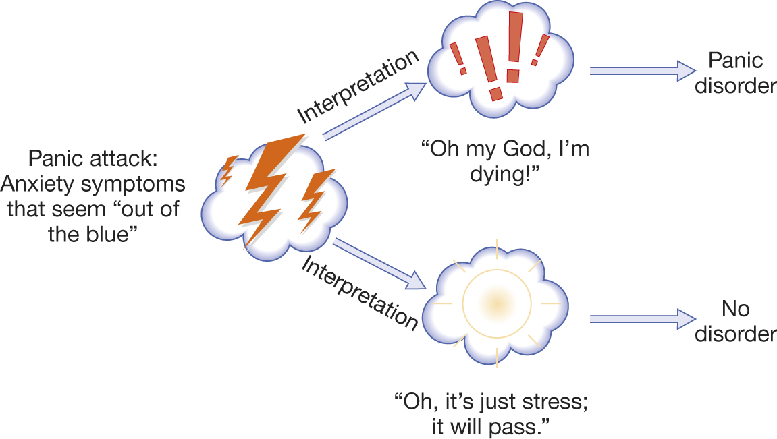
Panic Disorder

Slide 15
Fears and Phobias
Phobia
An exaggerated, unrealistic fear of a specific situation, activity, or object
Social phobia
Individuals become extremely anxious in situations in which they will be observed by others
Agoraphobia
A set of phobias, often set off by a panic attack, involving the basic fear of being away from a safe place or person; a “fear of fear”
Notes:
Common social phobias include fears of speaking in public, eating in a restaurant, or having to perform for an audience.
Agoraphobia, the fear of being away from a safe place or person, is the most disabling phobia—a “fear of fear.” It often begins with a panic attack, which the person tries to avoid in the future by staying close to “safe” places or people.

Slide 16
15.3
Trauma and Obsessive–Compulsive Disorders

Slide 17
15.3
Module Learning Objectives
15.3.A
Define posttraumatic stress disorder, and discuss its symptoms and origins.
15.3.B
Distinguish between obsessions and compulsions, and discuss the defining elements of obsessive–compulsive disorder.

Slide 18
Posttraumatic Stress Disorder
A disorder in which a person who has experienced a traumatic or life-threatening event has symptoms such as nightmares, flashbacks, insomnia, reliving of the trauma, and increased physiological arousal
Diagnosed if symptoms persist for one month or longer
Notes:
Most people who live through a traumatic experience eventually recover, but a minority develop PTSD. The reasons for their increased vulnerability to traumatic events include:
Genetic vulnerability
A history of psychological problems
A lack of social and cognitive resources
Having a smaller hippocampus than average
18

Slide 19
Obsessions and Compulsions
Obsessive–compulsive disorder (OCD)
An anxiety disorder in which a person feels trapped in repetitive, persistent thoughts (obsessions) and repetitive, ritualized behaviors (compulsions) designed to reduce anxiety
Person understands that the ritual behavior is senseless but guilt mounts if the behavior is not performed
Notes:
Some people with OCD have abnormalities in an area of the prefrontal cortex, which may contribute to their cognitive and behavioral rigidity.
Normally, after danger has passed or a person realizes that there is no cause for fear, the brain’s alarm signal turns off. In people with OCD, however, false alarms keep clanging and the emotional networks keep sending out mistaken fear messages (Schwartz et al., 1996).
A PET-scan study that compared obsessive hoarders with other people with obsessive symptoms found that hoarders had less activity in parts of the brain involved in decision making, problem solving, spatial orientation, and memory (Saxena et al., 2004).

Slide 20
15.4
Depressive and Bipolar Disorders

Slide 21
15.4
Module Learning Objectives
15.4.A
Describe how major depression differs from normal feelings of sadness or loneliness.
15.4.B
Explain the main features of bipolar disorder.
15.4.C
Discuss the four major factors that contribute to the onset of depression.

Slide 22
Depression
Major depression
A disorder involving disturbances in:
Emotion (excessive sadness)
Behavior (loss of interest in one’s usual activities)
Cognition (thoughts of hopelessness)
Body function (fatigue and loss of appetite)

Slide 23
Bipolar Disorder
Bipolar disorder:
A mood disorder in which episodes of both depression and mania (excessive euphoria) occur

Slide 24
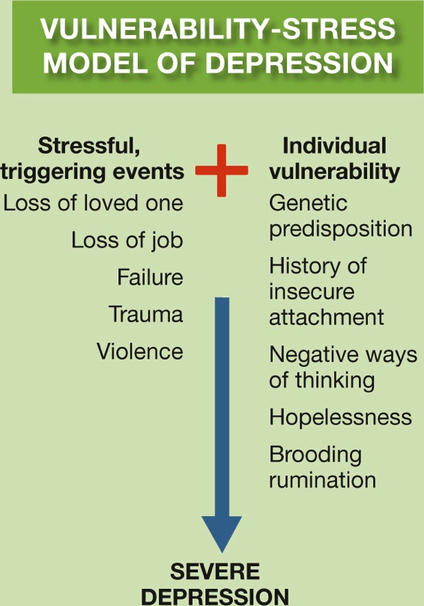
Origins of Depression
Vulnerability-Stress Model:
Approaches that emphasize how individual vulnerabilities interact with external stresses or circumstances to produce specific mental disorders, such as depression
Notes:
Figure 15.1 The Vulnerability–Stress Model of Depression
The vulnerability–stress model highlights the interplay between individual differences (in genetics, personality, or cognitive styles) and eliciting situations (stressful life events). The vulnerabilities by themselves may not lead to a diagnosable disorder, just as the stressful events may not be perceived as such by some individuals. But for some people with some vulnerabilities in some stressful situations, the outcome may be a disordered reaction, such as depression.

Slide 25
Origins of Depression
Genetic predispositions
Violence, childhood physical abuse, and parental neglect
Losses of important relationships
Cognitive habits

Slide 26
Genetic Predispositions
Major depression is moderately heritable; genes must be involved for some individuals.
Search for specific genes has been unsuccessful.
New Zealand study on serotonin receptor gene 5-HTT
Initial conclusions showing interactions between genes and experience were premature.
Nonetheless, research into gene–environment interactions continues.

Slide 27
Violence and Parental Neglect
Repeated experiences with violence
One of the most powerful factors associated with clinical depression
Childhood maltreatment
Effects of maltreatment in childhood on later depression are independent of all other childhood and adult risk factors
Domestic violence
Contributes to depression in women

Slide 28
Losses of Important Relationships
When an infant is separated from a primary attachment figure:
Despair
Passivity
Harm to immune system
Many depressed people have a history of:
Separations
Losses
Rejections
Impaired, insecure attachments

Slide 29
Cognitive Habits
Depression involves specific, negative ways of thinking about one’s situation
Depressed people believe their situation is:
Permanent
Uncontrollable
Rumination: Brooding about negative aspects of one’s life
More common in women
Notes:
Beginning in adolescence, women are much more likely than men to develop a ruminating, introspective style, which contributes both to longer-lasting depressions in women and to the sex difference in reported rates (Nolen-Hoeksema, 2004).

Slide 30
15.5
Personality Disorders

Slide 31
15.5
Module Learning Objectives
15.5.A
Explain the main features of borderline personality disorder.
15.5.B
Distinguish between the terms psychopathy and antisocial personality disorder, and note the common elements of each.
15.5.C
List and explain the major factors that contribute to the central features of psychopathy.

Slide 32
Personality Disorders
Personality disorders
Impairments in personality that cause great distress or an inability to get along with others
Borderline personality disorder: Characterized by extreme negative emotionality and inability to regulate emotions

Slide 33
Antisocial Personality Disorder
Characterized by a lifelong pattern of irresponsible, antisocial behavior such as law-breaking, violence, and other impulsive, restless acts

Slide 34
Psychopathy: Myths and Evidence
Psychopathy
A personality disorder characterized by:
Fearlessness
Lack of empathy, guilt, and remorse
The use of deceit
Coldheartedness
Notes:
In the popular imagination, psychopaths are sadistic and violent. Gary L. Ridgway, the deadliest convicted serial killer in U.S. history (known as the Green River Killer), strangled 48 women, placing their bodies in clusters around the country so he could “keep track of them.” But most psychopaths are not murderers. Lacking empathy and conscience, they use charm and elaborate scams to deceive and defraud. Bernie Madoff swindled investors out of $17 billion in a Ponzi scheme (a kind of “shell game” where investors are paid from other people’s investments, rather than from any actual gains accrued from the investments). Madoff used his charm and reputation in the industry to commit his crimes.

Slide 35
Psychopathy: Myths and Evidence
Psychopathy:
It is not the same as being violent and sadistic
It is not the same as being psychotic
“Born, not made” appears to be wrong
The belief that psychopaths cannot change is wrong
Notes:
In the popular imagination, psychopaths are sadistic and violent. Gary L. Ridgway, the deadliest convicted serial killer in U.S. history (known as the Green River Killer), strangled 48 women, placing their bodies in clusters around the country so he could “keep track of them.” But most psychopaths are not murderers. Lacking empathy and conscience, they use charm and elaborate scams to deceive and defraud. Bernie Madoff swindled investors out of $17 billion in a Ponzi scheme (a kind of “shell game” where investors are paid from other people’s investments, rather than from any actual gains accrued from the investments). Madoff used his charm and reputation in the industry to commit his crimes.

Slide 36
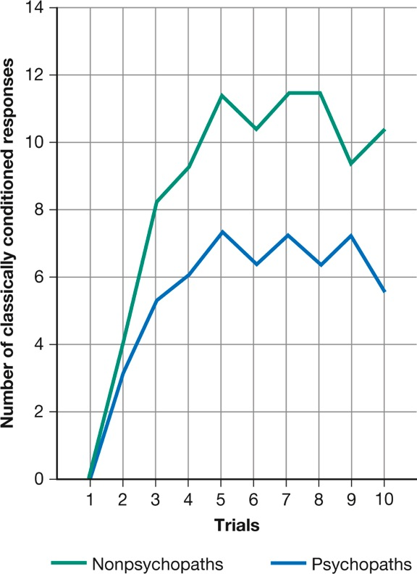
Figure 15.2: Emotions and Psychopathy
Notes:
Figure 15.2 Emotions and Psychopathy
In several experiments, people diagnosed as psychopaths were slow to develop classically conditioned responses to anticipated danger, pain, or shock—responses that indicate normal anxiety. This deficit may be related to the ability of psychopaths to behave in destructive ways without remorse or regard for the consequences (Hare, 1965, 1993).

Slide 37
15.6
Drug Abuse and Addiction

Slide 38
15.6
Module Learning Objectives
15.6.A
Discuss how the biological model of addiction would explain drug abuse and alcoholism.
15.6.B
Discuss how the learning model of addiction would explain drug abuse and alcoholism.
15.6.C
Explain the different predictions that the biological model and learning model would make regarding the benefits of total abstinence from versus moderate intake of alcohol.

Slide 39
Biology and Addiction
Biological model
Addiction is due primarily to a person’s neurology and genetic predisposition:
Begins in early adolescence
Is linked to impulsivity, antisocial behavior, criminality
Genes affect sensitivity to alcohol.
Heavy drug abuse changes the brain and makes addiction more likely.

Slide 40
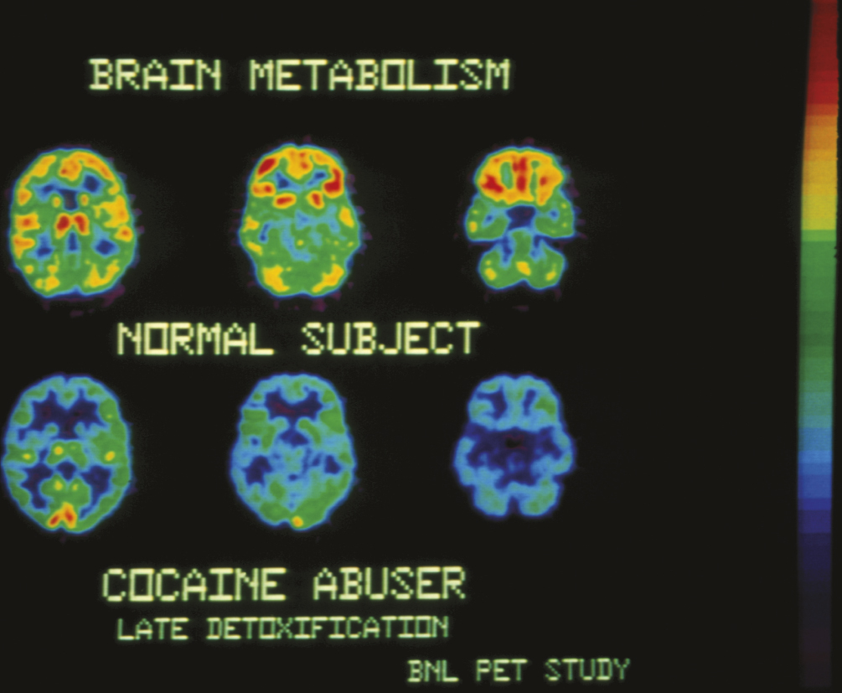
Figure 15.3: The Addicted Brain
Notes:
Figure 15.3 The Addicted Brain
PET studies show that the brains of cocaine addicts have fewer receptors for dopamine, a neurotransmitter involved in pleasurable sensations. (The more yellow and red in the brain image, the more receptors.) The brains of people addicted to methamphetamine, alcohol, and even food show a similar dopamine deficiency.

Slide 41
Learning, Culture, and Addiction
Addiction patterns vary according to cultural practices.
Policies of total abstinence tend to increase addiction rates rather than reduce them.
Not all addicts have withdrawal symptoms when they stop taking a drug.
Addiction does not depend on properties of the drug alone but also on the reasons for taking it.

Slide 42
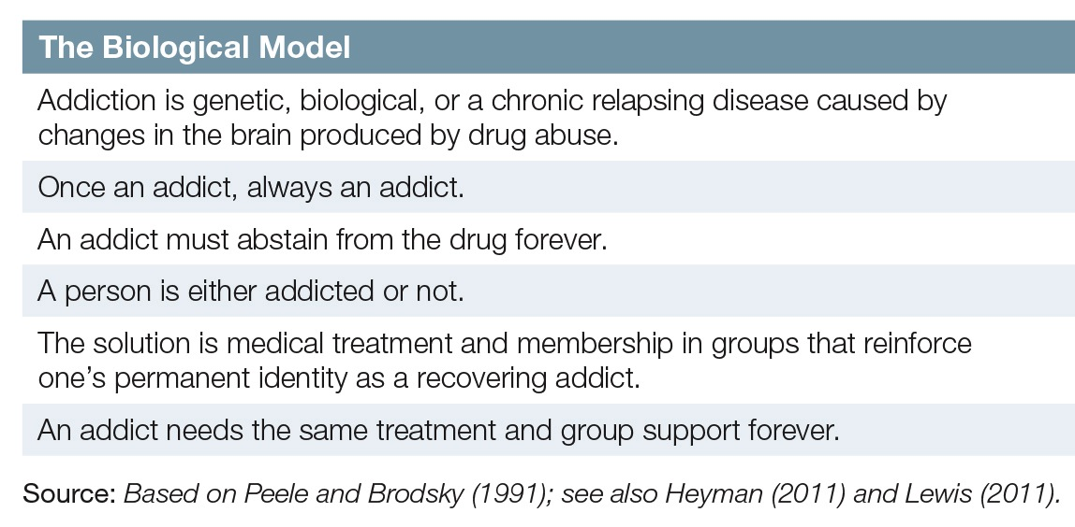
Debating the Causes of Addiction
Notes:
The biological and learning models both contribute to our understanding of drug use and addiction.
Yet, among many researchers and public health professionals, these views are quite polarized, especially when it comes to thinking about treatment (see Review 15.1). Such polarization often leads to either–or thinking on a national scale: Either complete abstinence is the solution, or it is the problem.

Slide 43
15.7
Dissociative Identity Disorder

Slide 44
15.7
Module Learning Objectives
15.7.A
Discuss the factors that make dissociative identity disorder a controversial diagnosis.
15.7.B
Evaluate the likely explanations for dissociative personality disorder.

Slide 45
Dissociative Identity Disorder
A controversial disorder marked by the appearance within one person of two or more distinct personalities, each with its own name and traits
Formerly known as Multiple Personality Disorder (MPD)

Slide 46
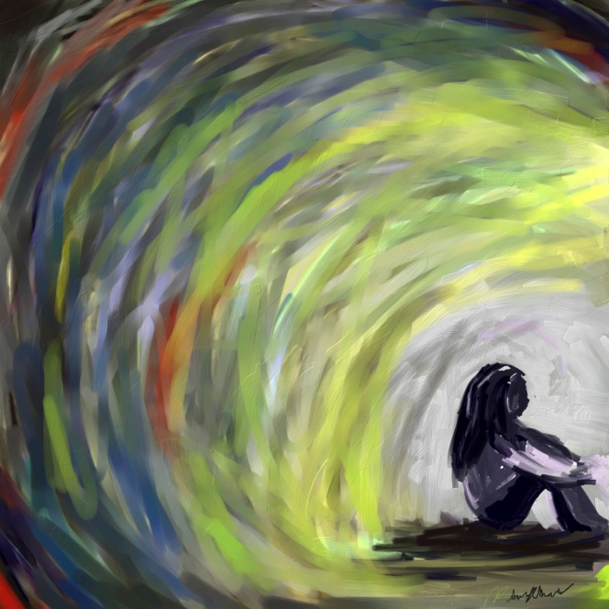
Can You See the Real Me?
Some psychiatrists and clinical psychologists take dissociative identity disorder very seriously
Starts in childhood as a means of coping with sexual abuse, traumatic experiences
Mental “splitting” (dissociation) caused by trauma
“Dissociative amnesia” lacks historical and empirical support

Slide 47
Putting the Pieces Together
Extreme form of the ability to present different aspects of our personalities to others
Created through pressure and suggestion by clinicians working with vulnerable patients
Shift from handfuls of diagnoses to tens of thousands in a decade
Media coverage
Lucrative business

Slide 48
15.8
Schizophrenia

Slide 49
15.8
Module Learning Objectives
15.8.A
Describe the five major symptoms of schizophrenia, and give an example of each.
15.8.B
Describe the three main contributing factors to the origin of schizophrenia.

Slide 50
Symptoms of Schizophrenia
Psychotic disorder marked by delusions, hallucinations, disorganized and incoherent speech, inappropriate behavior, and cognitive impairments.
Example of a psychosis
Notes:
Psychosis: An extreme mental disturbance involving distorted perceptions and irrational behavior; it may have psychological or organic causes. (Plural: psychoses.)
People with schizophrenia do not have a “split” or “multiple” personality. Schizophrenia is a fragmented condition in which words are split from meaning, actions from motives, perceptions from reality.

Slide 51
Symptoms of Schizophrenia
1
Bizarre delusions
2
Hallucinations
3
Disorganized, incoherent speech
4
Grossly disorganized or catatonic behavior
5
Negative symptoms

Slide 52
Origins of Schizophrenia
Genetic predispositions
Prenatal problems or birth complications
Biological events during adolescence

Slide 53
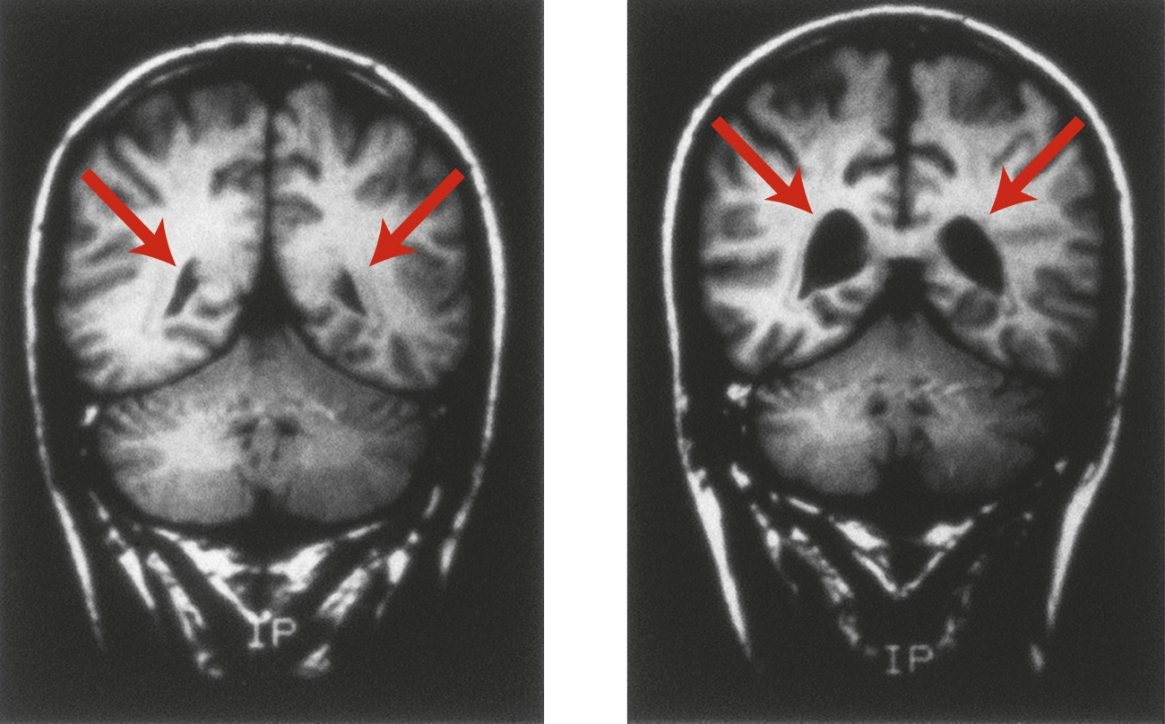
Figure 15.4: Schizophrenia and the Brain
Notes:
Figure 15.4 Schizophrenia and the Brain
People with schizophrenia are more likely to have enlarged ventricles (spaces) in the brain. These MRI scans of 28-year-old male identical twins show the difference in the size of ventricles between the twin without schizophrenia (left) and the one with schizophrenia (right).

Slide 54
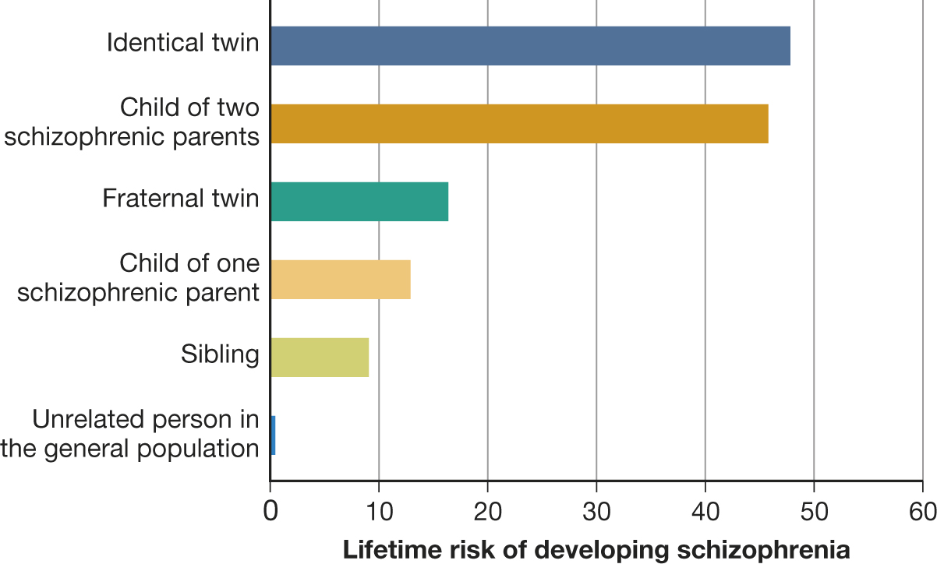
Figure 15.5: Genetic Vulnerability to Schizophrenia
Notes:
Figure 15.5 Genetic Vulnerability to Schizophrenia
This graph, based on combined data from 40 European twin and adoption studies conducted over seven decades, shows that the closer the genetic relationship to a person with schizophrenia, the higher the risk of developing the disorder. (Based on Gottesman, 1991; see also Gottesman et al., 2010.)

Slide 55
Prenatal Problems or Birth Complications
Damage to the fetal brain increases likelihood of schizophrenia later in life.
May occur as a function of maternal malnutrition or illness
May also occur if brain injury or oxygen deprivation occurs at birth
There are other nongenetic prenatal factors

Slide 56
Biological Events During Adolescence
In adolescence, the brain undergoes a natural pruning-away of synapses.
In individuals with schizophrenia, a greater number of synapses are pruned away.
May explain why first episode occurs in adolescence or early adulthood

Slide 57
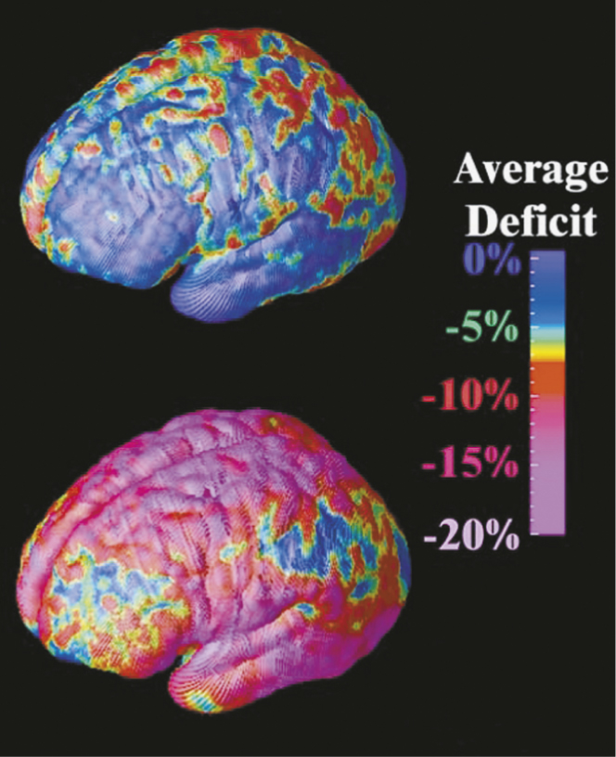
Figure 15.6: The Adolescent Brain and Schizophrenia
Notes:
Figure 15.6 The Adolescent Brain and Schizophrenia
These dramatic images highlight areas of brain-tissue loss in adolescents with schizophrenia over a 5-year span. The areas of greatest tissue loss (regions that control memory, hearing, motor functions, and attention) are shown in red and magenta. The brain of a person without schizophrenia (top) looks almost entirely blue (P. Thompson et al., 2001b).

Slide 58
Taking Psychology with You
Mental Disorder and Personal Responsibility
People who commit crimes or behave reprehensibly must face the consequences of their behavior.
At the same time, people with psychological problems should have the compassionate support of society in their search for help.

Slide 59
End of Chapter

Slide 60
Acknowledgments

Slide 61
Slide | Credit
Slide 4 | Ioannis Pantzi. Shutterstock
Slide 5 | Adisa. Shutterstock
Slide 7 | Thorsten Schmitt. Shutterstock
Slide 8 | Kovalchuk Oleksandr. Shutterstock
Slide 9 | Mega Pixel. Shutterstock
Slide 12 | Kamira. Shutterstock
Slide 13 | Velychko. Shutterstock
Slide 15 | Nachiketa Bajaj. Shutterstock
Slide 18 | Oleg Zabielin. Shutterstock
Slide 19 | Abas Kamal bin Sulaiman. Shutterstock
Slide 22 | Piotr Marcinski. Shutterstock
Slide 23 | Dmitry Lobanov. Shutterstock
Slide 23 | Piotr Marcinski. Shutterstock
Slide 26 | Alex Mit. Shutterstock
Slide 27 | Artem Furman. Shutterstock
Slide 28 | hikrcn. Shutterstock
Slide 29 | Oleg Golovnev. Shutterstock
Slide 32 | luxorphoto. Shutterstock
Slide 33 | Blazej Lyjak. Shutterstock
Slide 39 | David Orcea. Shutterstock
Slide 41 | David Orcea. Shutterstock
Slide 45 | Gabriela Trojanowska. Shutterstock
Slide 46 | A.R. Monko. Shutterstock

Slide 62
Slide | Credit
Slide 50 | Steven Frame. Shutterstock
Slide 55 | 123rf.com
Slide 56 | Cheryl Casey. Shutterstock
Slide 58 | quetton. Shutterstock

