Slide 1
Psychology
Twelfth Edition
Chapter 2
How Psychologists Do Research

Slide 2
What Makes Psychological Research Scientific?
LO 2.1.A Distinguish between a theory, a hypothesis, and an operational definition.
LO 2.1.B Explain why skepticism in science involves more than just disbelief.
LO 2.1.C Explain why falsifiability is an important component of scientific research.
LO 2.1.D Describe why openness and replication are important qualities of the scientific enterprise.

Slide 3
Precision and Reliance on Empirical Evidence (1 of 5)
Theories are systems of assumptions and principles that try to explain a specified set of phenomena.
Many scientific theories are tentative, pending more research.
Others, such as the theory of evolution, are accepted by nearly all scientists.

Slide 4
Precision and Reliance on Empirical Evidence (2 of 5)
Hypotheses are derived from a theory.
They are precise statements that describe or explain a given behavior.
A hypothesis leads to predictions about what will happen in a particular situation.

Slide 5
Precision and Reliance on Empirical Evidence (3 of 5)
Operational definitions summarize the way terms will be measured and studied in a particular research project.
Examples:
“anxiety” might be defined operationally as a score on an anxiety questionnaire
“threatening situation” as the threat of an electric shock

Slide 6
Precision and Reliance on Empirical Evidence (4 of 5)
Psychology, like all sciences, is empirical.
Psychologists rely on information gathered from studies using the scientific method as the basis for their evidence.
This approach is used rather than anecdotes, conjecture, or opinions.

Slide 7
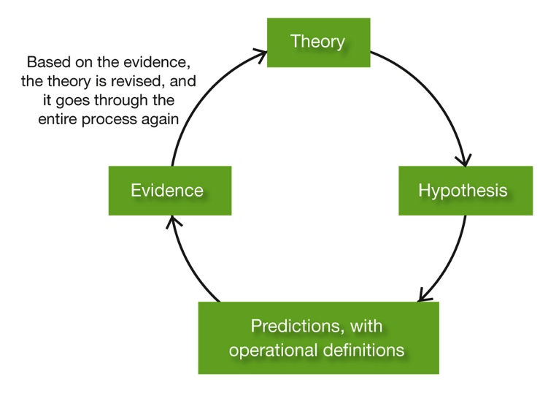
Precision and Reliance on Empirical Evidence (5 of 5) Figure 2.1 The Cycle of Scientific Research
Notes:
“Doing science” involves many interactive elements. Theories allow a researcher to derive testable hypotheses, and make predictions about the pattern of results that should occur. Hypotheses are tested empirically by gathering data on operationally defined variables. By examining the evidence, modifications, extensions, and revisions to the theory can take place, thereby generating new hypotheses and continuing the cycle of research investigation.

Slide 8
Skepticism
Scientists practice skepticism as a way of treating claims and research findings with caution.
Skepticism is not simply about debunking some claim, but showing why the claim is invalid—so that better methods can replace it.
Skepticism and caution, however, must be balanced by:
openness to new ideas
evidence

Slide 9
Willingness to Make “Risky Predictions” (1 of 3)
Scientists must state an idea in such a way that it can be refuted, or disproved by counterevidence.
The principle of falsifiability instructs scientists to design studies in such a way that evidence can either:
confirm, or
disconfirm the existence of a phenomenon

Slide 10
Willingness to Make “Risky Predictions” (2 of 3)
As a general operating procedure, falsifiability also helps ward off the confirmation bias.
Confirmation bias: the tendency to look for or only pay attention to information that confirms our beliefs.

Slide 11
Willingness to Make “Risky Predictions” (3 of 3) Figure 2.2 The Principle of Falsifiability
Notes:
The scientific method requires researchers to expose their ideas to the possibility of counterevidence. Examining the outcomes of a simple study testing the idea that “misery loves company” would allow a researcher to either support or refute that hypothesis.

Slide 12
Openness
Scientists must be willing to tell others:
where they got their ideas
how those ideas were tested
what the results were
This is important so that:
studies can be replicated
findings can be verified independently

Slide 13
Descriptive Studies: Establishing the Facts
LO 2.2.A Describe the major ways participants are selected for psychological studies, and why the method of selection might influence interpretations of a study’s outcomes.
LO 2.2.B Discuss the advantages and disadvantages of using case studies as a means of data collection.
LO 2.2.C Discuss the advantages and disadvantages of using observational methods as a means of data collection.
LO 2.2.D Explain why norms, reliability, and validity are the three key hallmarks of any standardized psychological test.
LO 2.2.E Describe the advantages and limitations of using surveys in data collection.

Slide 14
Research Participants (1 of 3)
One of the first challenges facing any researcher is to select the participants (“subjects”) for a study.
In any study, the researcher would ideally like to use a representative sample.
Representative sample: A group of individuals, selected from a population for study, which matches the population on important characteristics such as age and sex.

Slide 15
Research Participants (2 of 3)
But in practice, researchers must often use “convenience” samples.
This typically means college undergraduates.

Slide 16
Research Participants (3 of 3)
In the study of many topics, the consequences are minimal.
However, in other cases, conclusions about “people in general” must be interpreted with caution.

Slide 17
Case Studies (1 of 3)
Case studies are detailed descriptions of individuals.
They may include information about a person’s:
childhood
dreams
fantasies
experiences
relationships
anything that will provide insight into the person’s behavior

Slide 18
Case Studies (2 of 3)
Case studies are often used by clinicians.
They can also be valuable in:
exploring new research topics
addressing questions that would otherwise be difficult to study

Slide 19
Case Studies (3 of 3)
Case studies illustrate psychological principles in a way that abstract generalizations and cold statistics never can.
They produce a more detailed picture of an individual than other methods do.
But because the person under study may not be representative of people in general, case studies are typically sources rather than tests of hypotheses.

Slide 20
Observational Studies (1 of 3)
In observational studies, researchers systematically:
observe
measure
record behavior
However, they do this without interfering in any way with the behavior.
Unlike case studies, observational studies usually involve many participants.

Slide 21
Observational Studies (2 of 3)
Naturalistic observation is used to find out how animals and people behave in their natural environments.
Psychologists use naturalistic observation wherever people happen to be:
at home
on playgrounds or streets
in schoolrooms
in offices

Slide 22
Observational Studies (3 of 3)
Laboratory observation allows more control and the use of special equipment.
Behavior in the laboratory, however, may differ in certain ways from behavior in natural contexts.
Observational studies are more useful for describing behavior than for explaining it.

Slide 23
Tests (1 of 4)
Psychological tests are used to measure and evaluate:
personality traits
emotional states
aptitudes
interests
abilities
values

Slide 24
Tests (2 of 4)
A good test is one that has been:
standardized
scored using established norms
reliable
valid
Critics have questioned the reliability and validity of even some widely used tests.

Slide 25
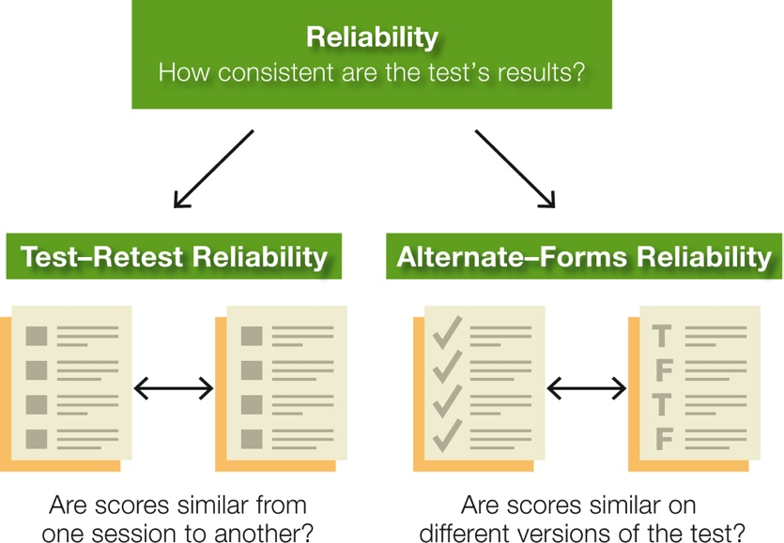
Tests (3 of 4) Figure 2.3 Consistency in the Measurement Process
Notes:
Psychological tests, like all forms of scientific measurement, need to have the property of reliability. This means that a measuring instrument measures the same way each time someone uses it.

Slide 26
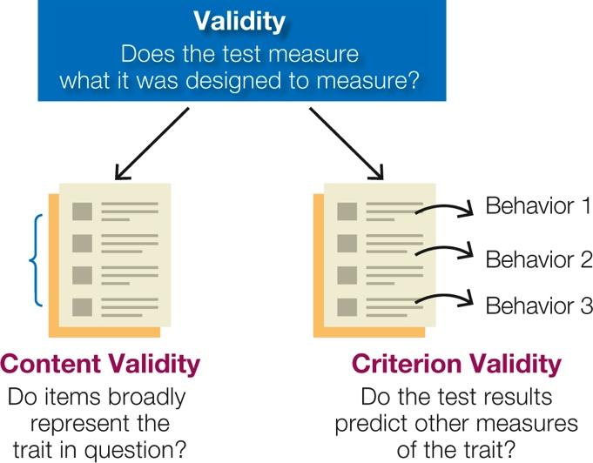
Tests (4 of 4) Figure 2.4 Accuracy in the Measurement Process
Notes:
Psychological tests, like all forms of scientific measurement, need to have the property of validity. This means that a measuring instrument actually measures what it was designed to measure.

Slide 27
Surveys (1 of 4)
Surveys are questionnaires or interviews that ask people directly about their:
experiences
attitudes
opinions
Surveys produce bushels of data, but they are not easy to do well.
Sampling problems are often an issue.

Slide 28
Surveys (2 of 4)
The generalizability of survey results can be influenced by:
unrepresentative samples
volunteer bias
Findings can also be affected by the fact that respondents sometimes:
lie
misremember
misinterpret the questions

Slide 29
Surveys (3 of 4)
Technology and use of the Internet can help psychologists minimize some of these problems.
However, they also introduce some new methodological challenges.
It is hard for researchers to know whether participants:
understand the instructions
understand the questions
are taking them seriously

Slide 30
Surveys (4 of 4)
People should be cautious about tests they take on the Internet.
Not all of them meet scientific standards.
Many tests and surveys on the Web have never been validated.
Always check the credentials of those designing the test or survey.

Slide 31
Correlational Studies: Looking For Relationships
LO 2.3.A Illustrate with an example how a correlation coefficient gives both the size and direction of the relationship between two variables.
LO 2.3.B Explain why a correlation between two variables does not establish a causal relationship between those variables.

Slide 32
Measuring Correlations (1 of 2)
In descriptive research, studies that look for relationships between phenomena are known as correlational.
A correlation is a measure of the strength of a positive or negative relationship between two variables.
It is expressed by the correlation coefficient:
a measure of correlation that ranges in value from −1.00 to +1.00

Slide 33
Measuring Correlations (2 of 2) Figure 2.5 Correlations
Notes:
Graph (a) shows a positive correlation between scores on a psychology test and number of boiled kumquats eaten per month: The higher the score, the higher the number of kumquats. Graph (b) shows a negative correlation between test scores and number of grilled kumquats eaten: The higher the scores, the lower the number of kumquats. Graph (c) shows the reality—a zero correlation between kumquat-eating and test scores.

Slide 34
Cautions about Correlations (1 of 3)
Many correlations reported in the media or on the Internet are:
based on rumor and anecdote
not supported by data
Some are merely illusory correlations, apparent associations between two things that are not really related.

Slide 35
Cautions about Correlations (2 of 3)
Illusory correlations can create dangerous beliefs and cause great social harm.
Example: Claims of an association between autism and vaccination for childhood diseases have alarmed many parents.
A correlation between two variables does not necessarily demonstrate a causal relationship between the variables.

Slide 36
Cautions about Correlations (3 of 3)
Even when correlations are meaningful, they can still be hard to interpret because a correlation does not establish causation.
The first variable could be causing the second to happen.
The second variable could be causing the first to happen.
A third variable could be causing both of the other two to happen.

Slide 37
Experiments: Hunting For Causes
LO 2.4.A Contrast an independent variable from a dependent variable and give an example of each concept in a psychology experiment.
LO 2.4.B Explain the difference between an experimental group and a control group, and discuss how random assignment helps create these two groups.
LO 2.4.C Explain why single-blind and double-blind procedures are crucial to establishing the soundness of an experiment.

Slide 38
Experimental Variables (1 of 2)
Experiments allow researchers to:
control the situation being studied
manipulate an independent variable
assess the effects of the manipulation on a dependent variable
Ideally, everything in the experimental situation except the independent variable is held constant.
kept the same for all participants

Slide 39
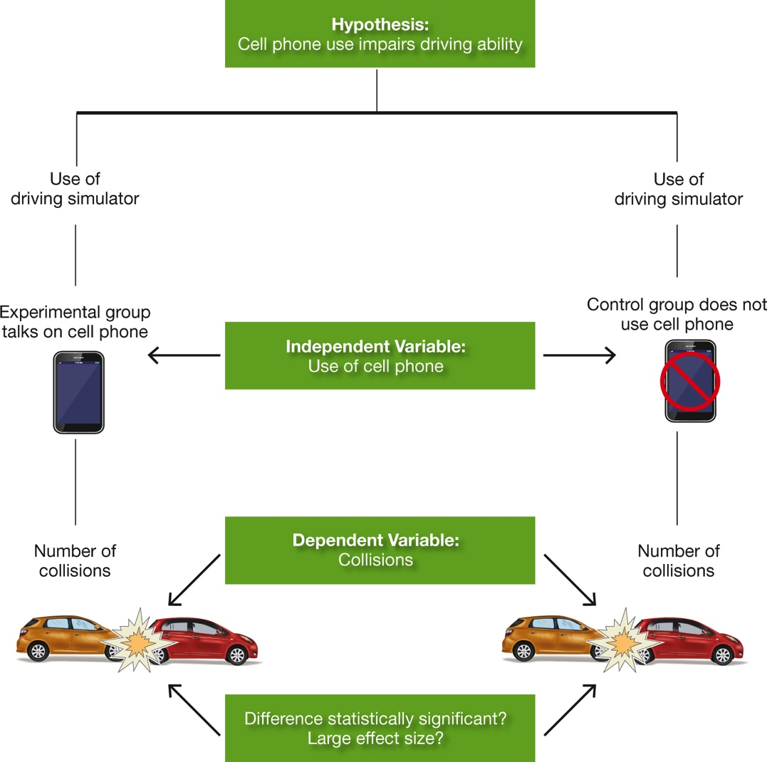
Experimental Variables (2 of 2) Figure 2.6 Do Cell Phone Use and Driving Mix?
Notes:
The text describes this experimental design to test the hypothesis that talking on a cell phone while driving impairs driving skills and leads to accidents.

Slide 40
Experimental and Control Conditions (1 of 3)
Experimental studies require a comparison or control condition.
They often involve random assignment of participants to:
experimental groups
control groups
Sometimes researchers use different groups or conditions within their experiment.

Slide 41
Experimental and Control Conditions (2 of 3)
In some studies, those in the control group receive a placebo, or fake treatment.
If the placebo produces the same result as the real thing, the reason must be the participants’ expectations rather than the treatment itself.
Placebos are critical in testing new drugs.
important because of the optimism that a potential “miracle cure” often brings with it

Slide 42
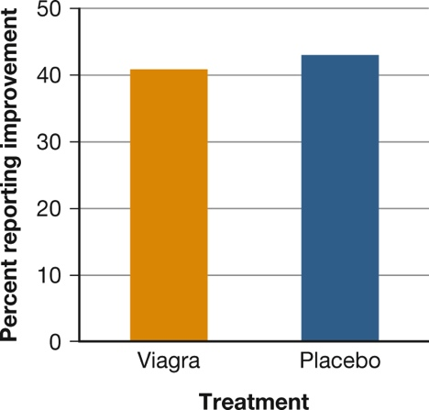
Experimental and Control Conditions (3 of 3) Figure 2.7 Does Viagra Work for Women?
Notes:
Placebos are essential to determine whether people taking a new drug improve because of the drug or because of their expectations about it. In one study, 41 percent of women taking Viagra said their sex lives had improved. That sounds impressive, but 43 percent taking a placebo pill also said their sex lives had improved (Basson et al., 2002).

Slide 43
Experimenter Effects
Single-blind and double-blind procedures can be used to prevent the results from being affected by:
the expectations of the participants
the expectations of the experimenter
However, like all methods, the experiment has its limitations.
Every research method has both its strengths and its weaknesses.

Slide 44
Evaluating the Findings
LO 2.5.A Provide an example of how the arithmetic mean and standard deviation could be used to compare the performance of two groups of research participants.
LO 2.5.B Explain what a statistically significant research result means to an experimenter.
LO 2.5.C Compare cross-sectional and longitudinal studies, and discuss how effect size, meta analysis, and Bayesian statistics allow us to judge the importance of a research outcome.

Slide 45
Descriptive Statistics: Finding Out What’s So (1 of 2)
Psychologists use descriptive statistics to summarize data.
arithmetic mean
standard deviation
Scientists get a good idea of what the measurements as a whole look like by:
finding the average score in a set of measurements, and
how clustered or spread out the scores are around that average

Slide 46
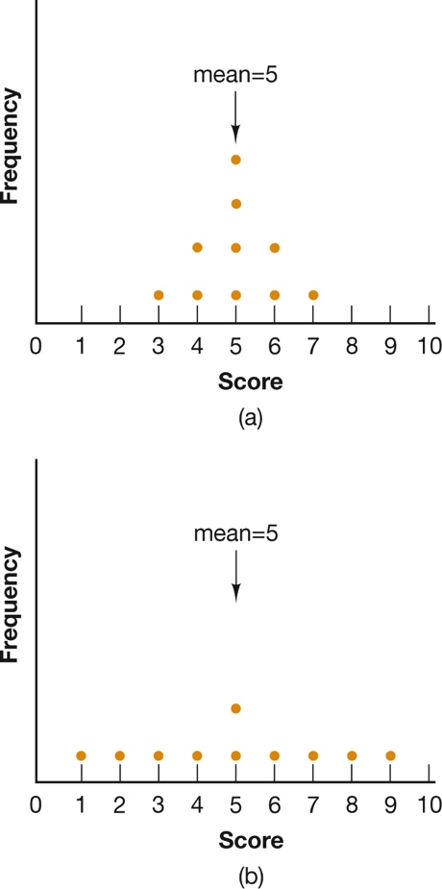
Descriptive Statistics: Finding Out What’s So (2 of 2) Figure 2.8 Same Mean, Different Meaning
Notes:
In both distributions of scores, the mean is 5, but in (a), the scores are clustered around the mean, whereas in (b), they are widely dispersed, so the standard deviations for the distributions will be quite different. In which distribution is the mean more “typical” of all scores?

Slide 47
Inferential Statistics: Asking “So What?” (1 of 3)
Psychological scientists use inferential statistics to find out how impressive the data are.
These statistics do not merely describe or summarize the data.
They permit a researcher to draw inferences about how meaningful the findings are.

Slide 48
Inferential Statistics: Asking “So What?” (2 of 3)
Significance tests tell the researchers how likely it is that the results of a study occurred merely by chance.
The results are said to be statistically significant if this likelihood is very low.
A growing number of psychologists and other researchers use a statistical formula that creates a confidence interval.

Slide 49
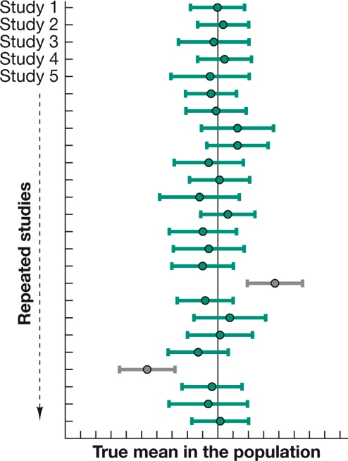
Inferential Statistics: Asking “So What?” (3 of 3) Figure 2.9 Confidence Intervals across Repeated Studies

Slide 50
Interpreting the Findings (1 of 6)
The last step in any study is to figure out what the findings mean.
Choosing among competing interpretations of a finding can be difficult.
Care must be taken to avoid going beyond the facts.

Slide 51
Interpreting the Findings (2 of 6)
Sometimes the best interpretation does not emerge until a hypothesis has been tested in more than one way.
Testing can involve using:
cross-sectional methods
longitudinal methods

Slide 52
Interpreting the Findings (3 of 6)
Sometimes psychologists agree on the reliability and meaning of a finding but not on its ultimate relevance for theory or practice.
Part of the problem is statistical.
Traditional tests have important drawbacks.

Slide 53
Interpreting the Findings (4 of 6)
Better protection is required against spurious, unsubstantial results.
Many psychology journals now encourage or require the use of:
alternate methods
statistics
The effect size is an objective, standardized way of describing the strength of the independent variable’s influence on the dependent variable.

Slide 54
Interpreting the Findings (5 of 6)
Meta-analysis is a procedure for:
combining data from many related studies
determine the overall strength of an independent variable
This approach is important because rarely does one study prove anything.
Be suspicious of headlines that announce a major scientific breakthrough based on a single study.

Slide 55
Interpreting the Findings (6 of 6)
Bayesian statistics take prior knowledge into account in assessing the likelihood that a finding is true and meaningful.
The Bayesian approach is controversial.
arguments continue about how precisely to quantify “prior knowledge”
can vary from strong empirical evidence to more subjective estimates

Slide 56
Keeping the Enterprise Ethical
LO 2.6.A Discuss why the principles of informed consent and debriefing are two key characteristics of a researcher’s code of ethics.
LO 2.6.B List and discuss four reasons why psychologists might use animals in research.

Slide 57
The Ethics of Studying Human Beings (1 of 3)
Participants must enter a study voluntarily and must know enough about it to make an intelligent decision about taking part.
This doctrine is known as informed consent.
The APA’s ethical code requires researchers to:
obtain the informed consent of anyone who is participating in a study or experiment
protect them from harm
warn them in advance of any risks

Slide 58
The Ethics of Studying Human Beings (2 of 3)
The policy of informed consent sometimes clashes with an experimenter’s need to disguise the true purpose of the study.
Many studies require deceptive procedures.
Concern about the morality of such procedures has led to guidelines to protect participants.

Slide 59
The Ethics of Studying Human Beings (3 of 3)
The APA code requires that participants be:
thoroughly debriefed when the study is over
told why deception was necessary
In addition to debriefing, the APA’s ethical guidelines require researchers to show that any deception is:
justified by a study’s potential value, and
to consider alternative procedures

Slide 60
The Ethics of Studying Animals (1 of 2)
Psychologists study animals to:
gain knowledge about particular species
discover practical applications of psychological principles
study issues that cannot be studied with human beings for practical or ethical reasons
clarify theoretical questions
improve human welfare

Slide 61
The Ethics of Studying Animals (2 of 2)
Debate over the use of animals in research has led to more comprehensive regulations.
These regulations govern the treatment and care of animals.

