Slide 1
Psychology
Twelfth Edition
Chapter 3
Genes, Evolution, and Environment

Slide 2
Unlocking the Secrets of Genes
LO 3.1.A Explain how genes, chromosomes, DNA, and genomes all relate to one another.
LO 3.1.B Explain why the study of epigenetics offers an important avenue for understanding the genetic components of thought and behavior.

Slide 3
The Human Genome (1 of 8)
In general, behavioral geneticists study our differences, such as those originating in heredity.
Researchers attempt to tease apart the relative contributions of:
heredity
environment
They adopt a nature and nurture approach in their investigations.

Slide 4
The Human Genome (2 of 8)
Genes, the basic units of heredity, are located on chromosomes, which consist of strands of DNA.
Each sperm cell and each egg cell (ovum) contains 23 chromosomes.
At conception, the fertilized egg and all the body cells that eventually develop from it (except for sperm cells and ova) contain:
46 chromosomes
arranged in 23 pairs

Slide 5
The Human Genome (3 of 8)
Our genes, together with noncoding DNA, make up the human genome.
Many genes contribute directly to a particular trait.
Others work indirectly by switching other genes on or off.
Many genes are inherited in the same form by everyone.
Others vary, contributing to our individuality.

Slide 6
The Human Genome (4 of 8)
Most human traits depend on more than one gene pair.
This makes tracking down the genetic contributions to a trait extremely difficult.

Slide 7
The Human Genome (5 of 8)
However, advances in technology now permit scientists to carry out:
genome-wide association studies
examining variations in many DNA elements at once
whole-genome sequencing
examines the entire 3 billion base pairs of DNA
The researchers start by looking for DNA differences called genetic markers.

Slide 8
The Human Genome (6 of 8)
Locating a gene does not automatically tell us:
what it does
how it does it
how multiple genes interact and influence behavior
Usually, locating a gene is just the first small step in understanding exactly what it does and how it works.

Slide 9
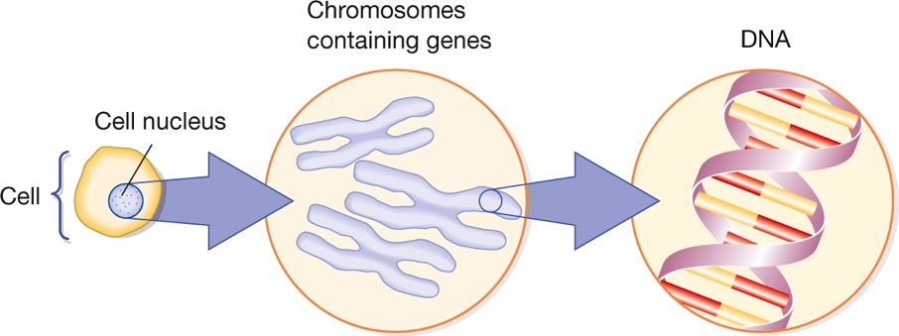
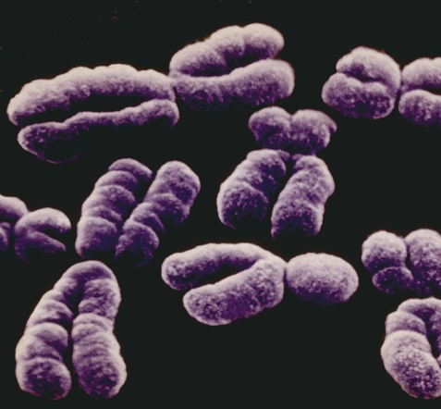
The Human Genome (7 of 8) Figure 3.1 Genes and Chromosomes
Science Source
Notes:
Genes are located on chromosomes, shown in the photo magnified almost 55,000 times.

Slide 10
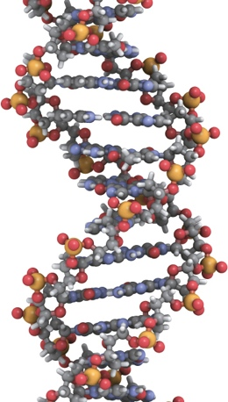
The Human Genome (8 of 8) Figure 3.2 DNA Double Helix
Africa Studio/Fotolia
Notes:
A “helix” is an object with a three-dimensional twisting shape that looks like a wire wrapped around a cylinder. Crick and Watson’s famous discovery was that DNA is always made up of two helixes, with the strands held together by four chemical elements called bases.

Slide 11
Epigenetics (1 of 2)
Many people think of the genome as a static blueprint, a set of coded messages that never changes over a person’s lifetime.
But this is a big misconception.
The genome changes over time because of:
mutations that arise before or after birth
epigenetic changes that affect the expression (activity) of specific genes without altering the sequence of bases in those genes

Slide 12
Epigenetics (2 of 2)
Mutations and epigenetic changes can be affected by environmental factors.
Example: Epigenetic changes may help explain why one identical twin might get a disease and the other not get it.
Epigenetic changes affect:
behavior
learning and memory
vulnerability to mental disorders

Slide 13
The Genetics of Similarity
LO 3.2.A Explain how natural selection contributes to changes in gene frequencies in a population.
LO 3.2.B List and describe five innate human characteristics.

Slide 14
Evolution and Natural Selection (1 of 3)
Evolutionary psychologists study our commonalities:
personality
emotion
sexual behavior
reasoning
They trace these to the processes of evolution, especially the process of natural selection.

Slide 15
Evolution and Natural Selection (2 of 3)
They draw inferences about the behavioral tendencies that might have been selected.
These tendencies:
helped our forebears solve survival problems
enhanced reproductive fitness
They then conduct research to see if such tendencies actually exist throughout the world.

Slide 16
Evolution and Natural Selection (3 of 3)
Many evolutionary psychologists believe that the mind is not a general-purpose computer.
It is viewed as a collection of specialized mental modules to handle specific survival problems.
a module does not have to correspond to one specific brain area
Critics are concerned that the notion of mental modules might lead to misguided assumptions.
namely, that virtually every human activity and capacity is innate

Slide 17
Innate Human Characteristics (1 of 2)
Because of the way our species evolved, many abilities, tendencies, and characteristics are:
either present at birth in all human beings, or
develop rapidly as a child matures
Examples of traits:
inborn reflexes
an attraction to novelty
a motive to explore and manipulate objects
an impulse to play
the capacity for certain basic cognitive skills

Slide 18
Innate Human Characteristics (2 of 2)
There are adaptive and evolutionary aspects of:
sensory and perceptual abilities
learning
ethnocentrism
cognitive biases
memory
emotions and emotional expressions
stress reactions
the tendency to gain weight when food is plentiful
attachment to others

Slide 19
Our Human Heritage: Courtship and Mating
LO 3.3.A Compare the sexual strategies of females and males, according to the sociobiological perspective.
LO 3.3.B Discuss four challenges to the evolutionary view of human mating strategies.

Slide 20
Evolution and Sexual Strategies (1 of 3)
Sociobiologists and evolutionary psychologists argue that males and females have evolved different sexual and courtship strategies.
These have evolved in response to survival problems faced in the distant past.

Slide 21
Evolution and Sexual Strategies (2 of 3)
In this view, it has been adaptive for:
males to be promiscuous, to be attracted to young partners, and to want sexual novelty
females to be monogamous, to be choosy about partners, and to prefer security to novelty
Evolutionary psychologists research commonalities in human mating and dating practices around the world.

Slide 22
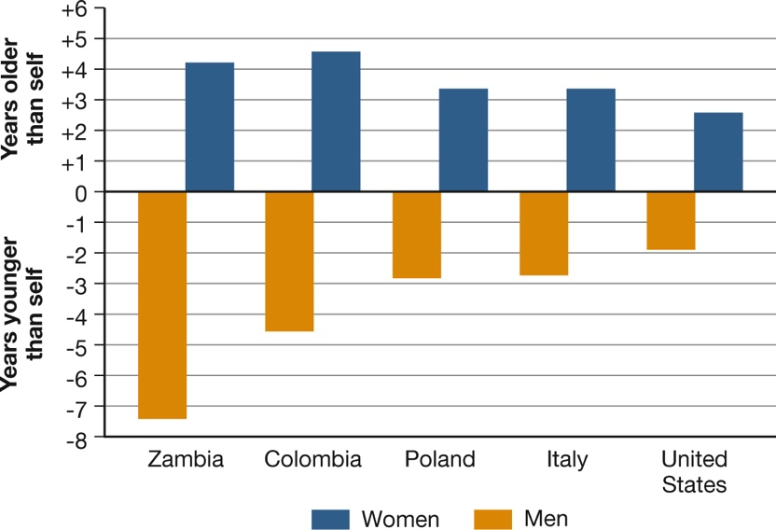
Evolution and Sexual Strategies (3 of 3) Figure 3.3 Preferred Age in a Mate
Notes:
In most societies, men say they prefer to marry women younger than themselves, whereas women prefer men who are older (Buss, 1995). Evolutionary psychologists attribute these preferences to male concern with a partner’s fertility and female concern with a partner’s material resources and status. When the man is much older than the woman, people rarely comment, but when the woman is older, people take notice. Today, the gossip and jokes about women who are “cougars” reflect (1) the rising number of women who have male partners younger than they and (2) the ambivalence that many people feel about it. Do you think the word cougar is a compliment or an insult?

Slide 23
The “Genetic Leash” (1 of 3)
Critics argue that evolutionary explanations of infidelity and monogamy:
are based on simplistic stereotypes of gender differences
that they rely too heavily on answers to questionnaires, which often do not reflect real-life choices
that convenience samples used in questionnaire studies are not necessarily representative of people in general
that the evolutionary emphasis on the Pleistocene Age may not be warranted

Slide 24
The “Genetic Leash” (2 of 3)
Moreover, our ancestors probably did not have a wide range of partners to choose from.
Evidence suggests that what may have evolved is mate selection based on:
similarity
proximity
The central issue dividing evolutionary theorists and their critics is the length of the “genetic leash.”

Slide 25
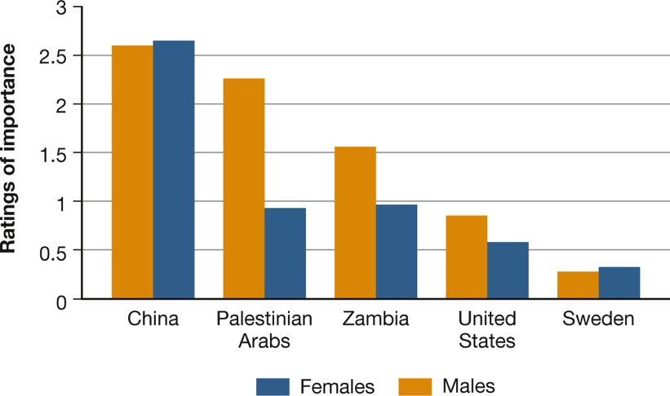
The “Genetic Leash” (3 of 3) Figure 3.4 Attitudes toward Chastity
Notes:
In many places, men care more about a partner’s chastity than women do, as evolutionary psychologists would predict. But culture has a powerful impact on these attitudes, as this graph shows (from Buss, 1995). Notice that in China, both sexes prefer a partner who has not yet had intercourse, whereas in Sweden, chastity is a nonissue.

Slide 26
The Genetics of Difference
LO 3.4.A Explain what heritability refers to, and discuss three important facts about heritability that should be kept in mind when discussing genetic contributions to behavior.
LO 3.4.B Outline the basic design of a heritability study that involves twins and adoptees.

Slide 27
The Meaning of Heritability (1 of 2)
Heritability refers to the extent to which differences in a trait or ability within a group of individuals are accounted for by genetic differences.
Heritability estimates do not apply to specific individuals or to differences between groups.
They apply only to differences within a particular group living in a particular environment.
Example: Heritability is higher for children in affluent families than in impoverished ones.

Slide 28
The Meaning of Heritability (2 of 2)
Even highly heritable traits can often be modified by the environment.
Behavioral geneticists have found many examples of how genes interact with the environment.
Although height is highly heritable, malnourished children may not grow to be as tall as they would with sufficient food.
Children who eat an extremely nutritious diet may grow to be taller than anyone thought they could.
The same principle applies to psychological traits and skills.

Slide 29
Computing Heritability (1 of 3)
Behavioral geneticists often study differences among individuals by using data from studies of:
adopted children
identical and fraternal twins
By comparing the genetic and environmental “overlap,” researchers can estimate the heritability of a trait.
Example: If identical twins are more alike than fraternal twins, then the increased similarity must be due to genetic influences.

Slide 30
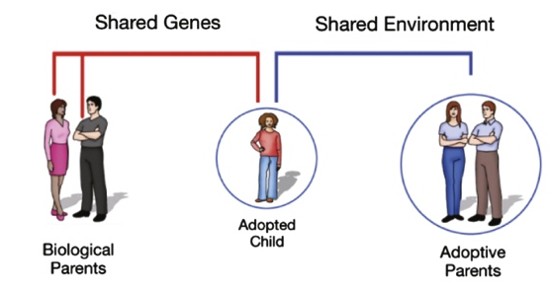
Computing Heritability (2 of 3) Figure 3.5 Heritability and Adoption
Notes:
Biological and adoptive parents differ in the contributions they make to an adopted child. Biological parents contribute genetic influences but not an environmental setting, whereas adoptive parents contribute an environment in which the child grows and develops, but make no genetic contribution.

Slide 31
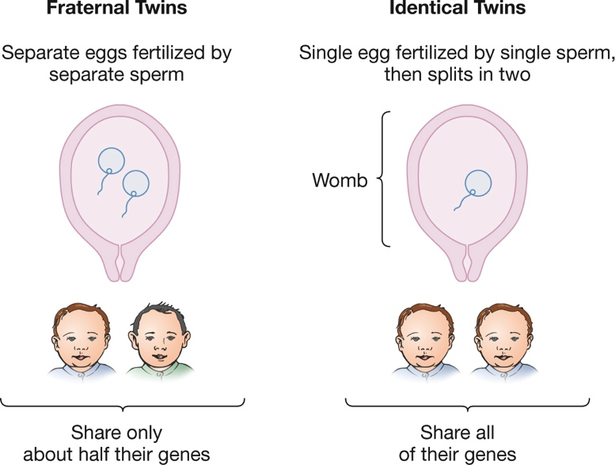
Computing Heritability (3 of 3) Figure 3.6 Twins and Genetics
Notes:
Genetic inheritance differs between fraternal and identical twins. Fraternal twins, which result from fertilization of separate eggs, share half their genes in common. Identical twins, which result when a single fertilized egg splits in two, share all of their genes in common.

Slide 32
Our Human Diversity: The Case of Intelligence
LO 3.5.A Discuss the extent to which intelligence may be heritable.
LO 3.5.B Explain why both between-group and within group variability are important in arguments about group differences in intelligence.
LO 3.5.C List four ways that the environment nurtures or thwarts mental ability, and give an example of each.
LO 3.5.D Explain how both nurture and nature play an interactive role in shaping behavior.

Slide 33
Genes and Individual Differences (1 of 4)
Heritability estimates for intelligence (as measured by tests of one’s intelligence quotient, or IQ) average about:
.40 to .50 for children and adolescents
.60 to .80 for adults

Slide 34
Genes and Individual Differences (2 of 4)
Identical twins are more similar in IQ-test performance than fraternal twins.
Adopted children’s scores correlate more highly with those of their biological parents than with those of their nonbiological relatives.

Slide 35
Genes and Individual Differences (3 of 4)
These results do not mean that genes determine intelligence.
The remaining variance in IQ scores must be due largely to environmental influences.

Slide 36
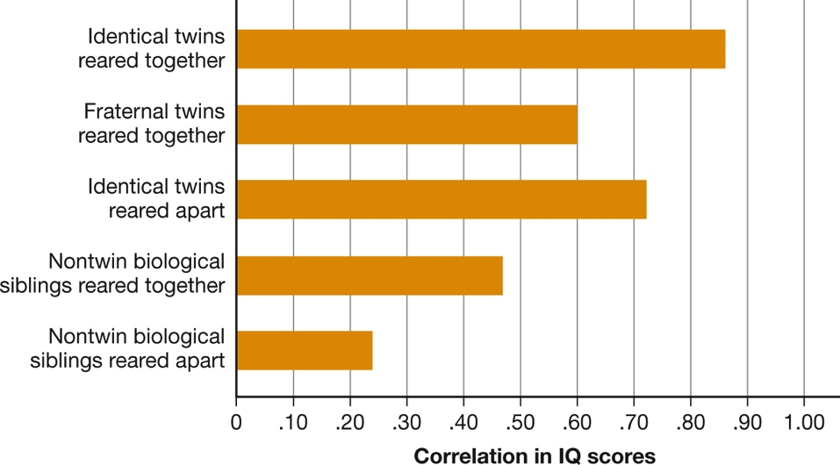
Genes and Individual Differences (4 of 4) Figure 3.7 Correlations in Siblings’ IQ Scores
Notes:
The IQ scores of identical twins are highly correlated, even when they are reared apart. The figures represented in this graph are based on average correlations across many studies.

Slide 37
The Question of Group Differences (1 of 3)
If genes influence individual differences in intelligence, do they also help account for differences between groups?
This question has enormous political and social importance.
It is a mistake to draw conclusions about group differences from heritability estimates based on differences within a group.

Slide 38
The Question of Group Differences (2 of 3)
The available evidence fails to support genetic explanations of black–white differences in performance on IQ tests.
Even among groups popularly thought to be high achievers, purely genetic explanations are unsatisfactory.
Ashkenazi Jews

Slide 39
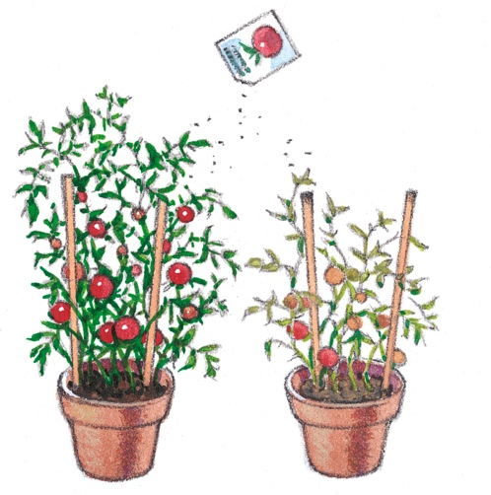
The Question of Group Differences (3 of 3) Figure 3.8 The Tomato Plant Experiment
Notes:
In the hypothetical experiment described in the text, even if the differences among plants within each pot were due entirely to genetics, the average differences between pots could be environmental. The same general principle applies to individual and group differences among human beings.

Slide 40
The Environment and Intelligence (1 of 5)
Environmental factors are associated with lower performance on intelligence tests:
poor prenatal care
malnutrition
exposure to toxins
stressful family circumstances

Slide 41
The Environment and Intelligence (2 of 5)
Conversely, a healthy and stimulating environment can raise IQ scores.
Certain kinds of enrichment activities can improve performance.
Example: Attending a good-quality preschool increases the reading and math skills of children from racial and ethnic minorities.

Slide 42
The Environment and Intelligence (3 of 5)
Children’s mental abilities improve when their parents:
talk to them about many topics
describe things accurately and fully
encourage them to think things through
read to them
expect them to do well
Children’s abilities also improve when their peers value and strive for intellectual achievement.

Slide 43
The Environment and Intelligence (4 of 5)
IQ scores have been rising in many countries for several generations, most likely because of:
improved education
better health
increase in jobs requiring abstract thought

Slide 44
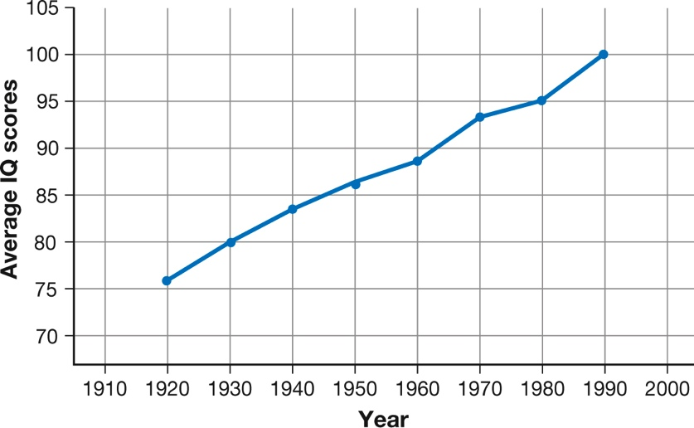
The Environment and Intelligence (5 of 5) Figure 3.9 Climbing IQ Scores
Notes:
Raw scores on IQ tests have been rising in developed countries for many decades at a rate much too steep to be accounted for by genetic changes. Because test norms are periodically readjusted to set the average score at 100, most people are unaware of the increase. On this graph, average scores are calibrated according to 1989 norms. As you can see, performance was much lower in 1918 than in 1989.

Slide 45
Beyond Nature versus Nurture (1 of 3)
The development of a human being (or other animal) is the result of a constant dialogue between:
the genome and
its environment
The interaction between genes and environment is far more complex than anyone previously imagined.

Slide 46
Beyond Nature versus Nurture (2 of 3)
Genes influence which environments people find most congenial.
Environmental factors influence the genome by their effects on mutations and epigenetic changes.

Slide 47
Beyond Nature versus Nurture (3 of 3)
Development of a person is the result of:
a dynamic dialogue between genes and the environment
the addition of chance events
Genetic and environmental influences blend and become indistinguishable in the development of any one person.

