Slide 1
Psychology
Twelfth Edition
Chapter 4
The Brain and Nervous System

Slide 2
The Nervous System: A Basic Blueprint
LO 4.1.A List the major structures of the central nervous system, and describe their primary functions.
LO 4.1.B List the major structures and major divisions of the peripheral nervous system, and describe their primary functions.

Slide 3
The Central Nervous System (1 of 3)
The function of a nervous system is to:
gather and process information
produce responses to stimuli
coordinate the workings of different cells
Scientists divide the nervous system into the:
central nervous system (CNS)
peripheral nervous system (PNS)

Slide 4
The Central Nervous System (2 of 3)
The CNS, which includes the brain and spinal cord:
receives, processes, interprets, and stores information
sends out messages destined for muscles, glands, and organs
The spinal cord produces some behaviors on its own without any help from the brain.
These spinal reflexes are automatic, requiring no conscious effort.

Slide 5
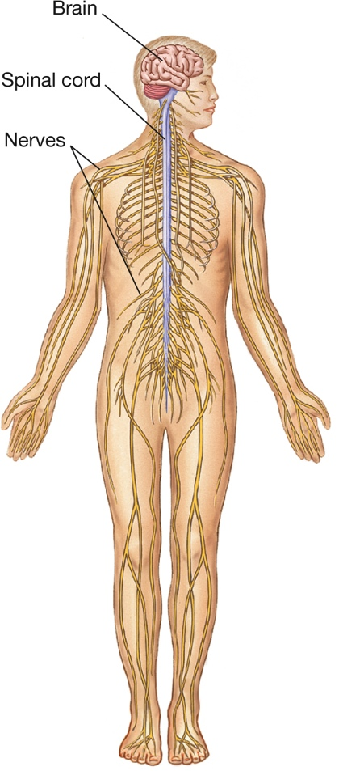
The Central Nervous System (3 of 3) Figure 4.1 The Central and Peripheral Nervous Systems
Notes:
The central nervous system includes the brain and the spinal cord. The peripheral nervous system consists of 43 pairs of nerves that transmit information to and from the central nervous system. Twelve pairs of cranial nerves in the head enter the brain directly; 31 pairs of spinal nerves enter the spinal cord at the spaces between the vertebrae.

Slide 6
The Peripheral Nervous System (1 of 3)
The peripheral nervous system (PNS) handles the central nervous system’s input and output.
The peripheral nervous system consists of the:
somatic nervous system, which permits sensation and voluntary actions
autonomic nervous system, which regulates blood vessels, glands, and internal (visceral) organs
The autonomic system usually functions without conscious control.

Slide 7
The Peripheral Nervous System (2 of 3)
The autonomic nervous system is further divided into the:
sympathetic nervous system, which mobilizes the body for action
parasympathetic nervous system, which conserves energy
These two parts work together, but in opposing ways, to adjust the body to changing circumstances.

Slide 8
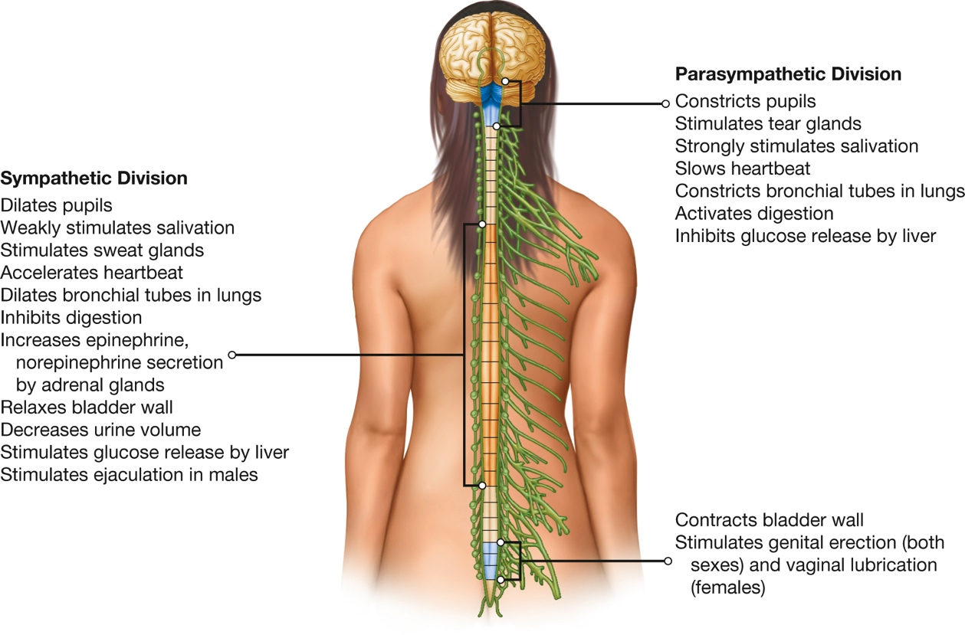
The Peripheral Nervous System (3 of 3) Figure 4.2 The Autonomic Nervous System
Notes:
In general, the sympathetic division of the autonomic nervous system prepares the body to expend energy, and the parasympathetic division restores and conserves energy. Sympathetic nerve fibers exit from areas of the spinal cord shown in orange in this illustration; parasympathetic fibers exit from the base of the brain and from spinal-cord areas shown in blue.

Slide 9
Communication in the Nervous System
LO 4.2.A Compare the functions of neurons and glial cells in the nervous system.
LO 4.2.B Describe each of the three main parts of a neuron, and explain their functions.
LO 4.2.C Explain how stem cells contribute to the process of neurogenesis.
LO 4.2.D Outline the process by which neurons communicate with each other, and explain the basic functions of the synapse, action potential, synaptic vesicles, and neurotransmitters.
LO 4.2.E Summarize the effects of some of the main neurotransmitters in the brain, and list four hormones that influence behavior.

Slide 10
Types of Cells (1 of 2)
Neurons are the basic units of the nervous system.
They are held in place by glial cells, which:
nourish
insulate
protect, and
repair neurons

Slide 11
Types of Cells (2 of 2) Figure 4.3 Different Kinds of Neurons
Notes:
Neurons vary in size and shape, depending on their location and function. More than 200 types of neurons have been identified in mammals.

Slide 12
The Structure of the Neuron (1 of 3)
Each neuron consists of:
dendrites
cell body
axon
Many axons are insulated by a myelin sheath that:
speeds up the conduction of neural impulses
prevents signals in adjacent cells from interfering with one another

Slide 13
The Structure of the Neuron (2 of 3)
In the peripheral nervous system, axons (and sometimes dendrites) are collected together in bundles called nerves.
The human body has 43 pairs of peripheral nerves.
Most of these nerves enter or leave the spinal cord.
12 pairs in the head, the cranial nerves, connect directly to the brain.

Slide 14
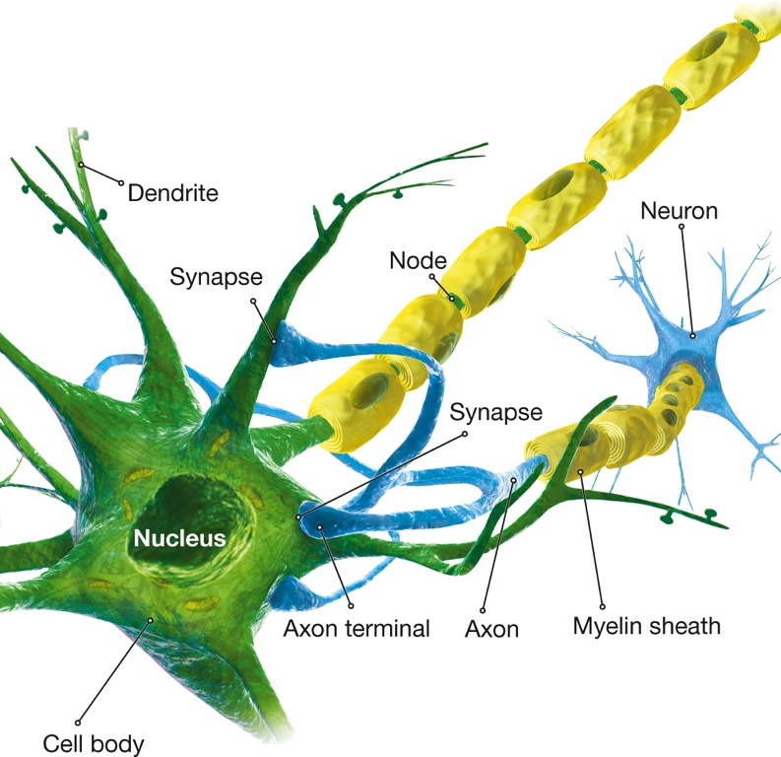
The Structure of the Neuron (3 of 3) Figure 4.4 The Structure of a Neuron
Notes:
Incoming neural impulses are received by the dendrites of a neuron and are transmitted to the cell body. Outgoing signals pass along the axon to terminal branches.

Slide 15
Neurogenesis: The Birth of Neurons (1 of 5)
Research has disproven two old assumptions:
that neurons in the human central nervous system cannot be induced to regenerate
that no new neurons form after early infancy
Neurogenesis: The production of new neurons from immature stem cells.

Slide 16
Neurogenesis: The Birth of Neurons (2 of 5)
Embryonic stem cells are pluripotent, meaning that they can generate many different kinds of cells in the body.
Amazingly, ES cells can generate many types of specialist cells, from neurons to kidney cells.
Stem cells may be useful for treating damaged tissues.
Highly controversial because ES cells come from aborted fetuses and embryos.

Slide 17
Neurogenesis: The Birth of Neurons (3 of 5)
These stem cells in various organs continue to divide and mature throughout adulthood.
They give rise to new neurons.
These include brain areas associated with learning and memory.

Slide 18
Neurogenesis: The Birth of Neurons (4 of 5)
Neurogenesis can be enhanced by:
physical exercise
effortful mental activity
enriched environment
Aging and stress can inhibit the production of stem cells.
Nicotine can kill them.

Slide 19
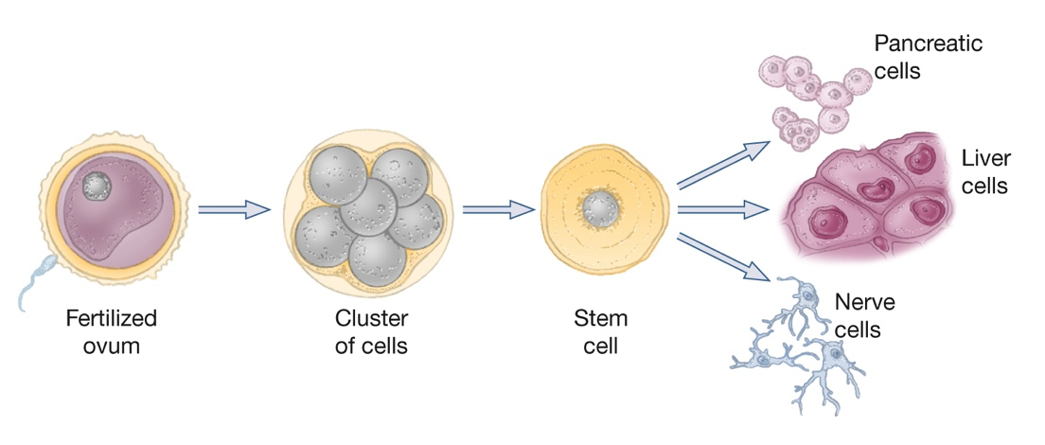
Neurogenesis: The Birth of Neurons (5 of 5) Figure 4.5 Stem Cell Production
Notes:
Embryonic stem cells (ES) exhibit pluripotency, the capacity to develop into many types of mature cells. ES cells appear when an embryo is just a few days old, consisting of a cluster of approximately 100 cells.

Slide 20
How Neurons Communicate (1 of 3)
Communication between two neurons occurs at the synapse.
When a wave of electrical voltage (action potential) reaches the end of a transmitting axon, neurotransmitter molecules are released into the synaptic cleft.

Slide 21
How Neurons Communicate (2 of 3)
These molecules bind to receptor sites on the receiving neuron.
When binding occurs, that neuron becomes either more or less likely to fire.

Slide 22
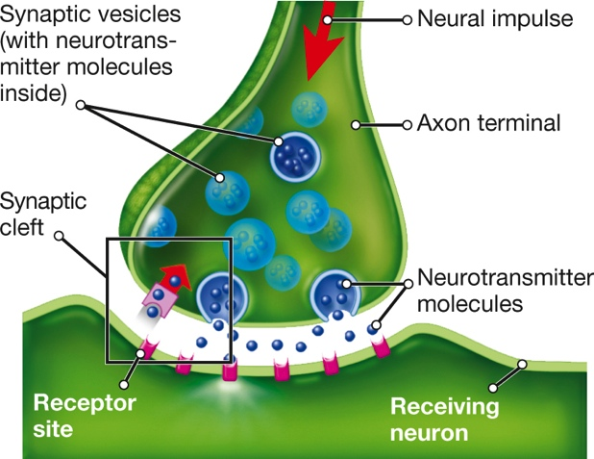
How Neurons Communicate (3 of 3) Figure 4.6 Neurotransmitter Crossing a Synapse
Notes:
Neurotransmitter molecules are released into the synaptic cleft between two neurons from vesicles (chambers) in the transmitting neuron’s axon terminal. The molecules then bind to receptor sites on the receiving neuron. As a result, the electrical state of the receiving neuron changes and the neuron becomes either more likely to fire an impulse or less so, depending on the type of neurotransmitter.

Slide 23
Chemical Messengers in the Nervous System (1 of 6)
Neurotransmitters play a critical role in mood, memory, and psychological well-being.
Neurotransmitters exist not only in the brain but also in:
the spinal cord
peripheral nerves
certain glands

Slide 24
Chemical Messengers in the Nervous System (2 of 6)
Four neurotransmitters each travel a particular path through parts of the brain:
serotonin
dopamine
acetylcholine
norepinephrine
Two other common neurotransmitters are distributed through the entire brain:
GABA
glutamate

Slide 25
Chemical Messengers in the Nervous System (3 of 6)
Hormones are produced mainly by the endocrine glands:
pancreas
ovaries
testes
adrenal glands
They are released directly into the bloodstream.
They affect—and are affected by—the nervous system.

Slide 26
Chemical Messengers in the Nervous System (4 of 6)
Neuroscientists are especially interested in:
melatonin
oxytocin and vasopressin
adrenal hormones
epinephrine
norepinephrine
sex hormones

Slide 27
Chemical Messengers in the Nervous System (5 of 6)
The brain is awash in thousands of other chemicals.
These chemicals affect how neurons and neurotransmitters function.
Because these chemicals modulate (vary the strength of) neural functions, they are called neuromodulators.

Slide 28
Chemical Messengers in the Nervous System (6 of 6)
Endorphins have effects similar to those of natural opiates such as heroin.
They reduce pain and promote pleasure.
They are also thought to play a role in:
appetite
sexual activity
blood pressure
mood
learning
memory

Slide 29
Mapping the Brain
LO 4.3.A Describe three techniques researchers use for intervening in the brain and observing the behavior that results.
LO 4.3.B Describe five techniques researchers use for intervening in behavior and observing the effects on the brain.

Slide 30
Intervening in the Brain and Observing Behavior
Researchers study the brain:
by observing patients with brain damage
by using the lesion method with animals
by using recent techniques such as transcranial magnetic stimulation (TMS) and transcranial direct current stimulation (tDCS)

Slide 31
Intervening in Behavior and Observing the Brain (1 of 5)
Tools allow researchers to investigate the structure and function of the brain:
electroencephalograms (EEGs)
event-related potentials (ERP)
PET (positron emission tomography) scans
magnetic resonance imaging (MRI)
functional MRI (fMRI)

Slide 32
Intervening in Behavior and Observing the Brain (2 of 5)
These tools reveal which parts of the brain are active during different tasks.
However, they do not reveal discrete “centers” for particular functions.
Studies must be interpreted with great caution.
Technology cannot replace critical thinking.

Slide 33
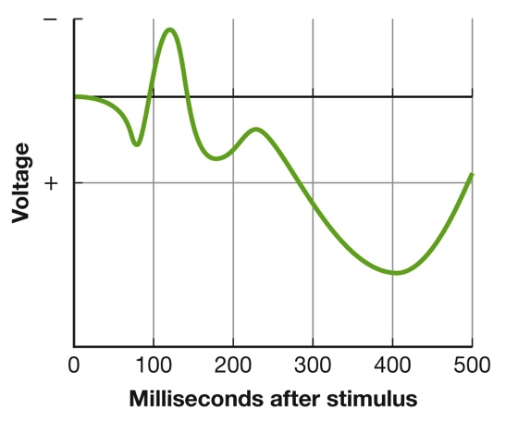
Intervening in Behavior and Observing the Brain (3 of 5) Figure 4.7 An Event-Related Potential
Notes:
An ERP is the brain’s response to a specific event—a wave of electrical activity detected on the scalp after a person encounters a stimulus, such as a picture or a word. The first parts of the wave show brain activity associated with encountering the stimulus; later parts show activity associated with understanding it.

Slide 34
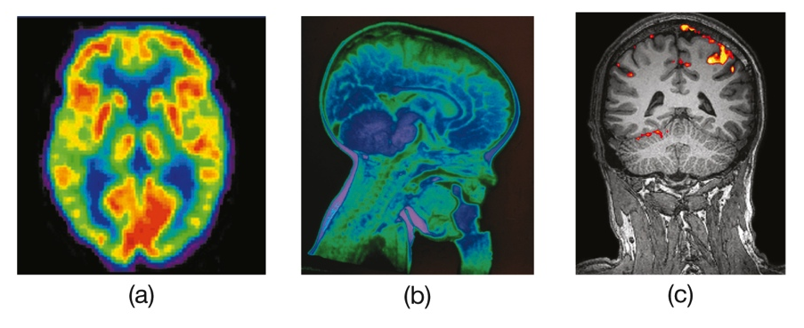
Intervening in Behavior and Observing the Brain (4 of 5) Figure 4.8 Scanning the Brain
Pearson Education
Notes:
(a) The PET scan shows the brain of a healthy 20-year-old. The colors indicate different levels of activity, where red reveals the highest level. (b) An MRI scan shows a child’s brain and the bottle he was drinking from while the image was obtained. (c) This fMRI image shows how a person’s visual cortex is activated while he or she views a red hibiscus flower.

Slide 35
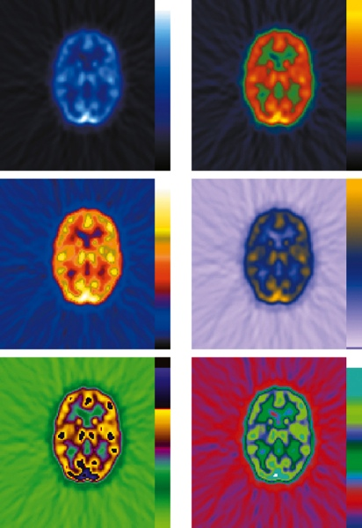
Intervening in Behavior and Observing the Brain (5 of 5) Figure 4.9 Coloring the Brain
Pearson Education
Notes:
By altering the colors used in brain images, such as in this PET scan, researchers can create the appearance of dramatic brain differences. These scans are actually images of the same brain.

Slide 36
A Tour Through the Brain (1 of 3)
LO 4.4.A List and describe three main structures in the brain stem, explain the primary functions each structure performs, and discuss the processes controlled by the cerebellum.
LO 4.4.B Describe the structure, function, and location of the thalamus.
LO 4.4.C Describe the structure, function, and location of the hypothalamus and pituitary gland.
LO 4.4.D Describe the structure, function, and location of the amygdala.

Slide 37
A Tour Through the Brain (2 of 3)
LO 4.4.E Describe the structure, function, and location of the hippocampus.
LO 4.4.F Describe the structure of the cerebrum, and explain the function of the corpus callosum.
LO 4.4.G Sketch the location of each of the lobes of the cerebral cortex, and explain the major functions each lobe performs, with particular reference to the prefrontal cortex.

Slide 38
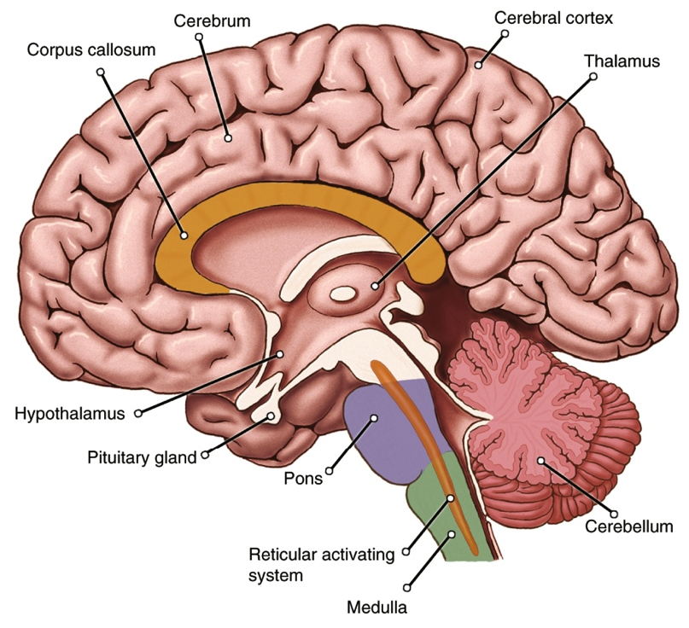
A Tour Through the Brain (3 of 3) Figure 4.10 Major Structures of the Human Brain
Notes:
This cross section depicts the brain as if it were split down the middle and shows the structures described in the text.

Slide 39
The Brain Stem and Cerebellum (1 of 3)
In the lower part of the brain, in the brain stem, the medulla controls automatic functions:
heartbeat
breathing
The pons is involved in:
sleeping
waking
dreaming

Slide 40
The Brain Stem and Cerebellum (2 of 3)
The reticular activating system (RAS):
screens incoming information
is responsible for alertness
The cerebellum:
contributes to balance and muscle coordination
plays a role in cognitive and emotional learning
If your cerebellum were damaged:
you would become clumsy, uncoordinated
have trouble using pencil, threading needle, walking

Slide 41
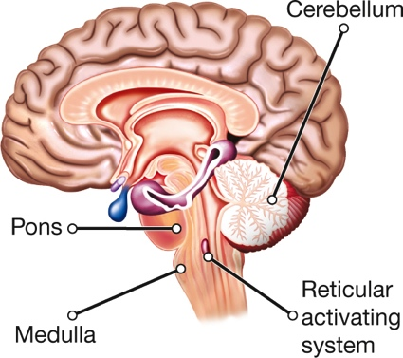
The Brain Stem and Cerebellum (3 of 3) Page 120

Slide 42
The Thalamus (1 of 2)
The thalamus directs sensory messages to appropriate higher centers in the brain.
Smell is the only sense that bypasses the thalamus.
Specialized cells are located in the olfactory bulb.
near areas involved in emotion
may be why particular odors rekindle memories

Slide 43
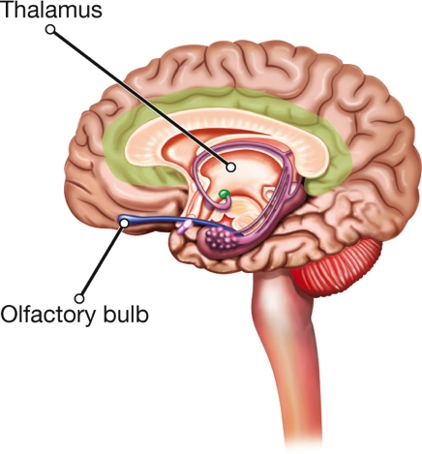
The Thalamus (2 of 2) Page 121

Slide 44
The Hypothalamus and the Pituitary Gland (1 of 2)
The hypothalamus is involved in emotion and in drives associated with survival.
It also:
controls the operations of the autonomic nervous system
sends out chemicals that tell the pituitary gland when to “talk” to other endocrine glands

Slide 45
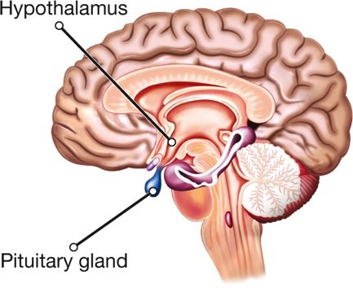
The Hypothalamus and the Pituitary Gland (2 of 2) Page 121

Slide 46
The Amygdala (1 of 2)
The amygdala is responsible for:
evaluating sensory information
quickly determining its importance
This affects the initial decision to approach or withdraw from a person or situation.
It is also involved in:
mediating anxiety and depression
forming and retrieving emotional memories

Slide 47
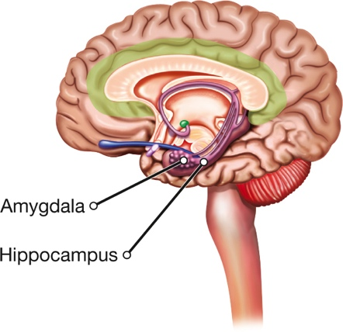
The Amygdala (2 of 2) Page 121

Slide 48
The Hippocampus
The hippocampus moderates the reticular activating system.
It has been called the “gateway to memory.”
It plays a critical role in the formation of long-term memories for facts and events and other aspects of memory.
combines different components of experiences
binds them together into one “memory”

Slide 49
The Cerebrum
Much of the brain’s circuitry is packed into the cerebrum, which is:
divided into two hemispheres (connected by the corpus callosum)
covered by thin layers of cells known collectively as the cerebral cortex

Slide 50
The Cerebral Cortex (1 of 3)
The lobes of the cortex have specialized (but partially overlapping) functions:
occipital
parietal
temporal
frontal
They tend to respond differently when directly stimulated with tiny electrodes during brain surgery.

Slide 51
The Cerebral Cortex (2 of 3)
The association cortex appears to be responsible for higher mental processes.
The frontal lobes, particularly areas in the prefrontal cortex, are involved in:
social judgment
making and carrying out plans
decision making

Slide 52
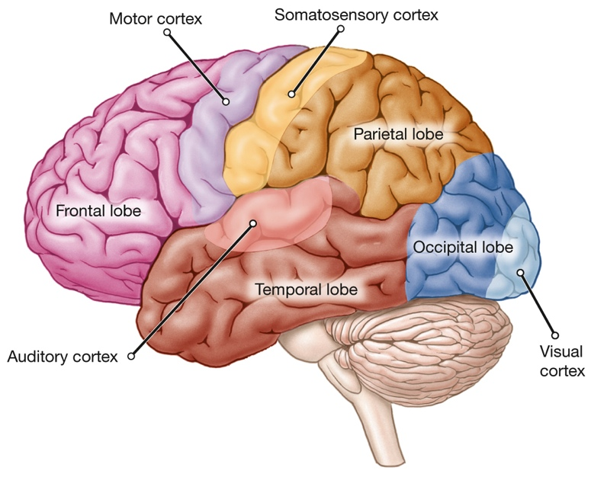
The Cerebral Cortex (3 of 3) Figure 4.11 Lobes of the Cerebrum
Notes:
Deep fissures divide the cortex of each cerebral hemisphere into four regions.

Slide 53
The Two Hemispheres of the Brain
LO 4.5.A Discuss the basic format of a split-brain experiment, and describe what the results of such experiments reveal about the functioning of the cerebral hemispheres.
LO 4.5.B Describe why the two hemispheres of the brain are allies rather than opposites.

Slide 54
Split Brains: A House Divided (1 of 4)
Split-brain surgery involves a severing of the corpus callosum.
Myers and Sperry
Studies of split-brain patients show that the two cerebral hemispheres have somewhat different talents.
Example: In most people, language is processed mainly in the left hemisphere.

Slide 55
Split Brains: A House Divided (2 of 4)
The left hemisphere is generally specialized for:
logical,
symbolic, and
sequential tasks
The right hemisphere is associated with:
visual–spatial tasks
facial recognition
the creation and appreciation of art and music

Slide 56
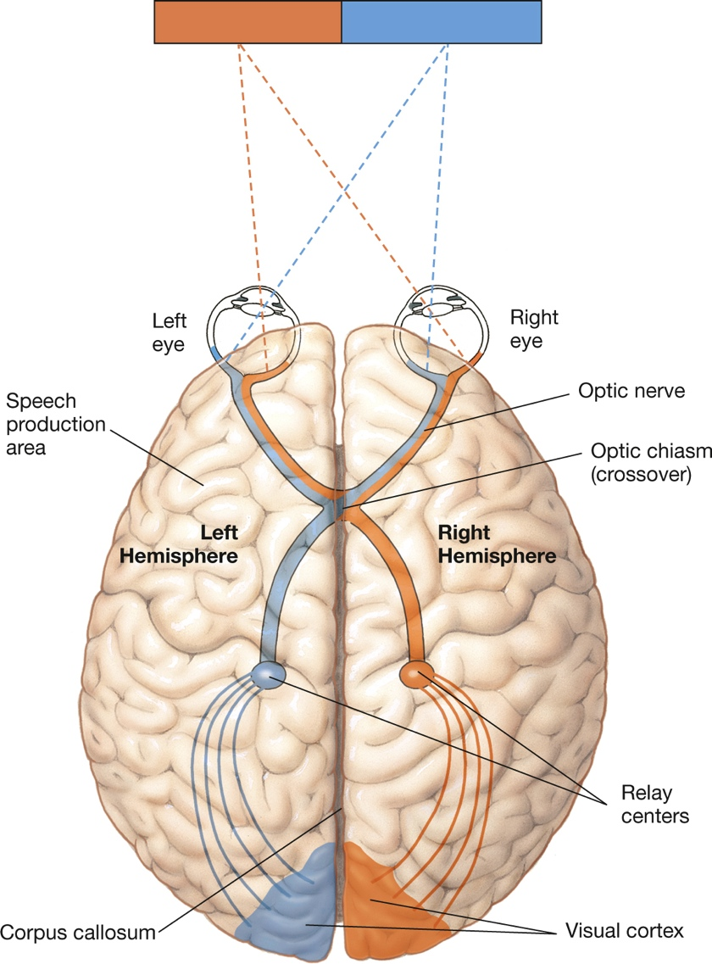
Split Brains: A House Divided (3 of 4) Figure 4.12 Visual Pathways
Notes:
Each cerebral hemisphere receives information from the eyes about the opposite side of the visual field. Thus, if you stare directly at the corner of a room, everything to the left of the juncture is represented in your right hemisphere, and vice versa. This is so because half the axons in each optic nerve cross over (at the optic chiasm) to the opposite side of the brain. Normally, each hemisphere immediately shares its information with the other one, but in split-brain patients, severing the corpus callosum prevents such communication.

Slide 57
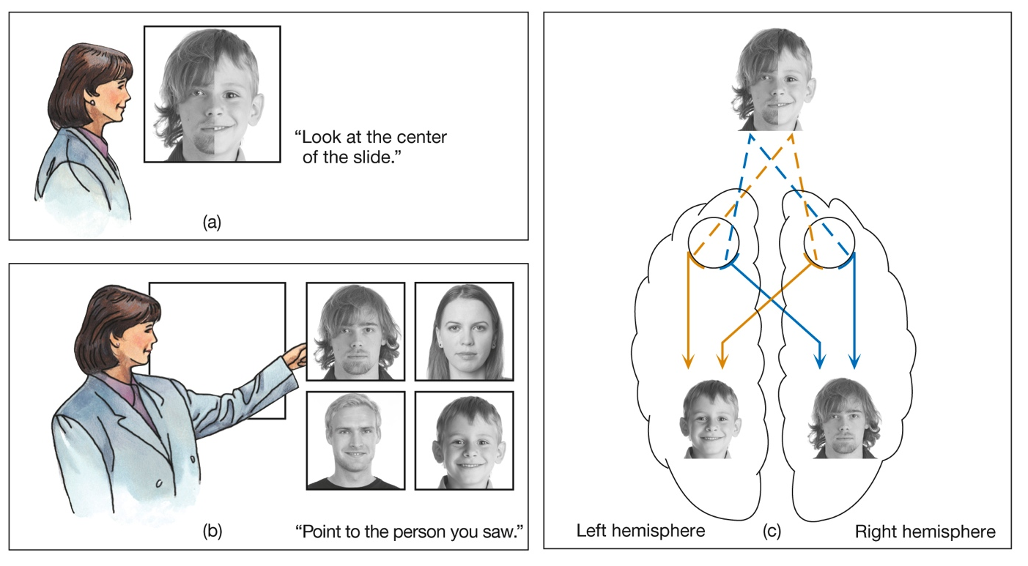
Split Brains: A House Divided (4 of 4) Figure 4.13 Divided View
Pearson Education
Notes:
Split-brain patients were shown composite photographs (a) and were then asked to pick out the face they had seen from a series of intact photographs (b). They said they had seen the face on the right side of the composite, yet they pointed with their left hands to the face that had been on the left. Because the two cerebral hemispheres could not communicate, the verbal left hemisphere was aware of only the right half of the picture, and the relatively mute right hemisphere was aware of only the left half (c).

Slide 58
The Two Hemispheres: Allies or Opposites?
In most mental activities the two hemispheres cooperate as partners.
Each makes a valuable contribution.
The brain is more like an interactive federation than a house divided.

Slide 59
The Flexible Brain
LO 4.6.A Define neural plasticity, and summarize some of the main evidence that the brain has the ability to change in response to new experiences.
LO 4.6.B Summarize five cautions surrounding whether sex differences in anatomical brain size are linked to sex differences in behavior.

Slide 60
Experience and the Brain (1 of 4)
The brain’s circuits are not fixed and immutable.
They are continually changing in response to:
information
challenges
changes in the environment
This phenomenon is known as plasticity.
brain “rewires” itself to adapt

Slide 61
Experience and the Brain (2 of 4)
Examples of plasticity:
in people blind from an early age, brain regions usually devoted to vision are activated by sound
stroke victim regains ability to speak
head injury victim regains use of limb

Slide 62
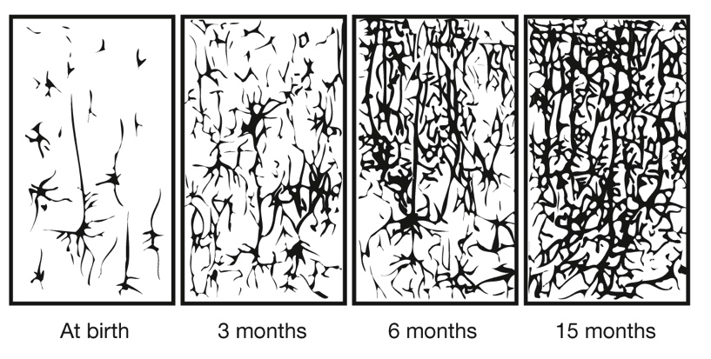
Experience and the Brain (3 of 4) Figure 4.14 Getting Connected
Notes:
Neurons in a newborn’s brain are widely spaced, but they immediately begin to form new connections. These drawings show the marked increase in the number of connections from birth to age 15 months.

Slide 63
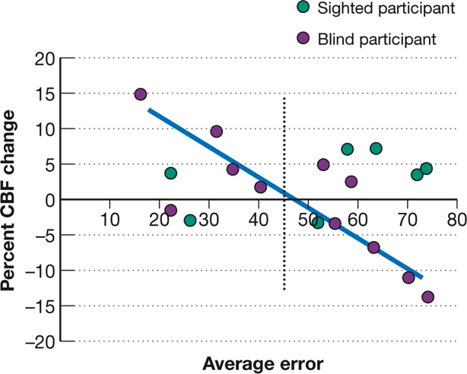
Experience and the Brain (4 of 4) Figure 4.15 Adapting to Blindness
(Adapted from Gougoux et al., 2005.)
Notes:
In some blind people, brain areas usually associated with vision may become active in tasks requiring hearing. The purple circles to the left of the dotted line represent blind individuals with low error rates in a sound-localization task; those to the right represent blind individuals with high error rates. The graph shows that error rates for blind people—but not sighted ones—were correlated with changes in cerebral blood flow (CBF), and thus neural activity, in a visual area of the brain. The more accurate blind people were, the greater the activity in this region. (Adapted from Gougoux et al., 2005.)

Slide 64
Are There “His” and “Hers” Brains? (1 of 3)
Brain scans and other techniques have revealed many male–female differences in brain anatomy and function.
connections between cortex and amygdala
frontal lobes
cortical folds
number of neurons
lateralization of amygdala
Controversy exists, however, about what such differences mean in real life.

Slide 65
Are There “His” and “Hers” Brains? (2 of 3)
Some of the brain research has focused on behavioral or cognitive differences that are small and insignificant.
Even when gender differences are statistically significant, they are often quite small in practical terms.
Some findings have been widely accepted but then have failed to replicate.

Slide 66
Are There “His” and “Hers” Brains? (3 of 3)
Some male–female brain differences may be related to differences in:
behavior
performance
However, others may not.
Sex differences in experience could affect brain organization and function rather than the other way around.

