Slide 1
Psychology
Twelfth Edition
Chapter 5
Body Rhythms and Mental States

Slide 2
Biological Rhythms: The Tides of Experience
LO 5.1.A Define circadian rhythms, and explain how the body’s “biological clock” works (and what happens when it doesn’t).
LO 5.1.B Explain why seasonal affective disorder and premenstrual syndrome are examples of long-term biological rhythms, and summarize the evidence regarding the existence of both phenomena.

Slide 3
Circadian Rhythms (1 of 5)
Consciousness is the awareness of oneself and the environment.
Throughout the day, mood, alertness, efficiency, and consciousness itself are in perpetual flux.
One way to understand consciousness is to study how it changes over time.
Mental and physical states are intertwined.
Examining a person’s ongoing rhythmic cycles is like watching a video of consciousness.

Slide 4
Circadian Rhythms (2 of 5)
Changing states of consciousness are often associated with biological rhythms.
A biological clock in our brains governs:
the waxing and waning of hormone levels
urine volume
blood pressure
the responsiveness of brain cells to stimulation

Slide 5
Circadian Rhythms (3 of 5)
Biological rhythms are typically in tune with:
external time cues, such as changes in clock time, temperature, daylight
Many rhythms continue to occur even in the absence of such cues.
endogenous, generated from within
Circadian fluctuations:
occur about once a day
are governed by a biological clock in the suprachiasmatic nucleus (SCN) of the hypothalamus

Slide 6
Circadian Rhythms (4 of 5)
The SCN regulates and, in turn, is affected by the hormone melatonin.
Melatonin is responsive to changes in light and dark and increases during the dark hours.
secreted by the pineal gland, deep within the brain
induces sleep
helps keep biological clock in phase with light–dark cycle

Slide 7
Circadian Rhythms (5 of 5)
When our normal routine changes, we may experience internal desynchronization.
Example: taking airplane flights across time zones
The usual circadian rhythms are thrown out of phase with one another.
Sleep and wake patterns adjust quickly but temperature and hormone cycles can take days to return to normal.
Jet lag affects energy level, mental skills, motor coordination.

Slide 8
Moods and Long-Term Rhythms (1 of 5)
Some people experience depression every winter in a pattern that has been labeled seasonal affective disorder (SAD).
During the winter months, SAD patients report:
feelings of sadness
lethargy
drowsiness
craving for carbohydrates

Slide 9
Moods and Long-Term Rhythms (2 of 5)
The causes of SAD, which is relatively uncommon, are not yet clear.
SAD is not recognized as an official disorder.
Much of the research to date has been flawed.
Light treatments can be effective in alleviating symptoms.
SAD may occur in people whose circadian rhythms are out of sync.
In essence, they have a chronic form of jet lag.

Slide 10
Moods and Long-Term Rhythms (3 of 5)
Another long-term rhythm is the menstrual cycle, during which various hormones rise and fall.
Well-controlled, double-blind studies have been conducted on premenstrual syndrome.
These studies do not support claims that emotional symptoms are reliably and universally tied to the menstrual cycle.

Slide 11
Moods and Long-Term Rhythms (4 of 5)
How both sexes interpret bodily and emotional changes is affected by:
expectations
learning
Few people of either sex are likely to undergo dramatic monthly mood swings or personality changes because of hormones.

Slide 12
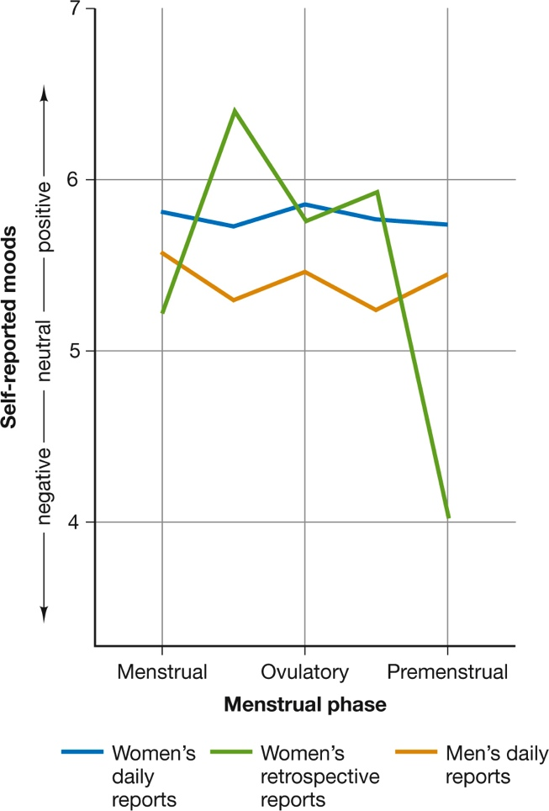
Moods and Long-Term Rhythms (5 of 5) Figure 5.1 Mood Changes in Men and Women
(McFarlane, Martin, & Williams, 1988)
Notes:
In a study that challenged popular stereotypes about premenstrual syndrome, college women and men recorded their moods daily for 70 days without knowing the purpose of the study. At the end of the study, the women thought their moods had been more negative premenstrually than during the rest of the month (green line), but their daily diaries showed otherwise (blue line). Both sexes experienced only moderate mood changes, and there were no significant differences between women and men at any time of the month (McFarlane, Martin, & Williams, 1988).

Slide 13
The Rhythms of Sleep
LO 5.2.A Describe the four stages of sleep, and explain the primary features of each stage.
LO 5.2.B List the mental consequences of sleeplessness and the mental benefits of a good night’s sleep.

Slide 14
The Realms of Sleep (1 of 6)
During sleep, periods of rapid eye movement (REM) alternate with non-REM (NREM) sleep in approximately a 90-minute rhythm.
The REM periods last from a few minutes to as long as an hour.
They average about 20 minutes in length.

Slide 15
The Realms of Sleep (2 of 6)
Non-REM sleep is divided into stages on the basis of characteristic brain-wave patterns.
Alpha waves gradually slow down, passing through three stages, each deeper than the previous one:
Stage NREM-1
Stage NREM-2
sleep spindles
Stage NREM-3
delta waves

Slide 16
The Realms of Sleep (3 of 6)
During REM sleep, the brain is active, and there are other signs of arousal.
Most of the skeletal muscles are limp.
Vivid dreams are reported most often during REM sleep.
REM and non-REM sleep continue to alternate throughout the night.

Slide 17
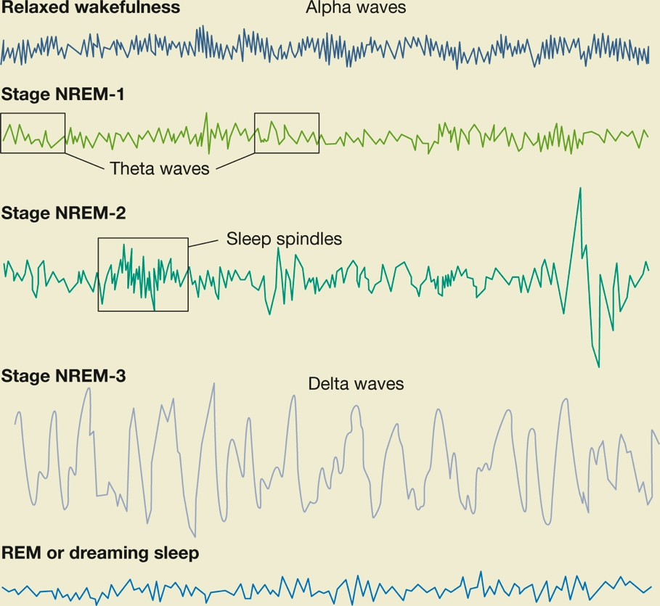
The Realms of Sleep (4 of 6) Figure 5.2 Brain-Wave Patterns during Wakefulness and Sleep
Notes:
Most types of brain waves are present throughout sleep, but different ones predominate at different stages.

Slide 18
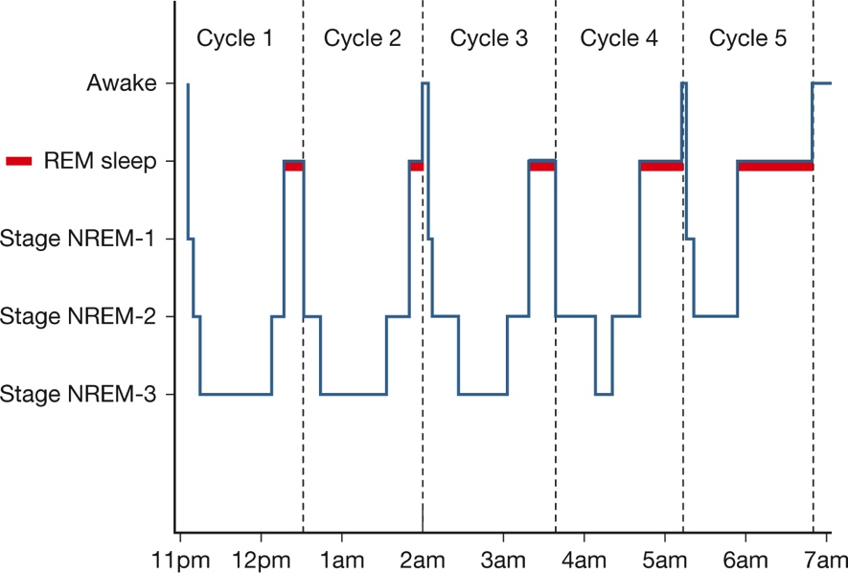
The Realms of Sleep (5 of 6) Figure 5.3 A Typical Night’s Sleep for a Young Adult
Notes:
In this graph, the thin horizontal red bars represent time spent in REM sleep. REM periods tend to lengthen as the night wears on, but Stage 3, which dominates during non-REM sleep early in the night, may disappear as morning approaches.

Slide 19
The Realms of Sleep (6 of 6) Table 5.1 Characteristics of Sleep Stages
REM sleep | Active brain but inactive muscles
NREM-1 | Period when the sleeper is on the edge of consciousness, in a light sleep
NREM-2 | Sleep stage characterized by short bursts of rapid waves
NREM-3 | Sleep stage characterized by very slow waves with high peaks
Alpha waves | Brain activity during a state of relaxed wakefulness
Sleep spindles | Short, high-peaking waves
Delta waves | Waves present during deep sleep

Slide 20
Why We Sleep (1 of 4)
Sleep is necessary for:
bodily restoration
normal mental functioning
Sleep appears to provide a time-out period, so that the body can:
eliminate waste products from muscles
repair cells
conserve or replenish energy stores
strengthen the immune system
recover abilities lost during the day

Slide 21
Why We Sleep (2 of 4)
Many people get less than the optimal amount of sleep, perhaps suffering from:
insomnia
sleep apnea
narcolepsy
REM behavior disorder
The most common reason for daytime sleepiness is probably a simple lack of sleep.
Most adults need more than 6 hours for optimal performance, and many adolescents need 10.

Slide 22
Why We Sleep (3 of 4)
Sleep may contribute to:
the consolidation of memories
subsequent problem solving
These benefits have been associated most closely with slow-wave sleep.
also with REM sleep
The underlying biology appears to involve:
the formation of new synaptic connections
the weakening of connections that are no longer needed

Slide 23
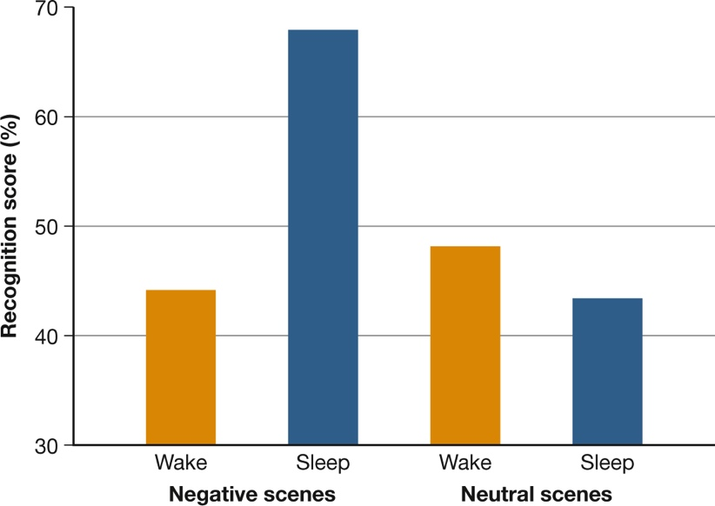
Why We Sleep (4 of 4) Figure 5.4 Sleep and Consolidation in Memory

Slide 24
Exploring the Dream World
LO 5.3.A Discuss explanations for why we dream.
LO 5.3.B Summarize the strengths and weaknesses of each major dream theory.

Slide 25
Explanations of Dreaming (1 of 7)
Freud thought that:
dreams allow us to express forbidden or unrealistic desires
these desires have been forced into the unconscious part of the mind
There is no objective way to verify Freudian interpretations of dreams.
There is no convincing support for most of his claims.

Slide 26
Explanations of Dreaming (2 of 7)
Three modern theories of dreaming emphasize the connections between dreams and waking thoughts:
problem-focused approach
cognitive approach
activation–synthesis theory

Slide 27
Explanations of Dreaming (3 of 7)
The problem-focused approach holds that:
dreams express current concerns
may even help us solve current problems
In this approach, the symbols and metaphors in a dream:
do not disguise its true meaning
they actually convey it
Example of problem focus in dreams: Text-anxiety dreams are common among college students.

Slide 28
Explanations of Dreaming (4 of 7)
The cognitive approach holds that dreams are simply a modification of the cognitive activity that goes on when we are awake.
Thus, the content of our dreams may include:
thoughts,
concepts, and
scenarios that may or may not be related to our daily problems

Slide 29
Explanations of Dreaming (5 of 7)
The difference is that during sleep:
we are cut off from sensory input from the world
our thoughts tend to be more diffuse and unfocused
the only input to the brain is its own output
The brain shows similar patterns of activity when we are night dreaming as when we are daydreaming.
suggests that nighttime dreaming might be a mechanism for simulating events that we think (or fear) might occur in the future

Slide 30
Explanations of Dreaming (6 of 7)
The activation–synthesis theory holds that dreams occur when the cortex tries to make sense of, or interpret, spontaneous neural firing initiated in the pons.
Dreams result from the cortex’s synthesis of:
signals from pons
existing knowledge
memories
In this view, wishes do not cause dreams; brain mechanisms do.

Slide 31
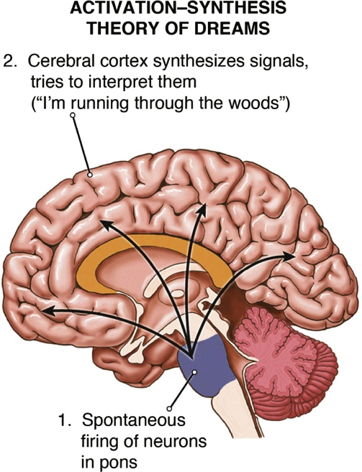
Explanations of Dreaming (7 of 7) Page 159

Slide 32
Evaluating Dream Theories (1 of 2)
All of the current theories of dreams have some support, and all have weaknesses.
Regarding the problem-solving approach:
Some psychologists doubt that people can solve problems during sleep.
Dreams merely give expression to our problems.
The same insights obtained from dreaming could occur while awake.

Slide 33
Evaluating Dream Theories (2 of 2)
The activation–synthesis theory has been criticized, as it does not seem to explain:
coherent, story-like dreams
non-REM dreams
The cognitive approach is now a leading contender.
some of its specific claims remain to be tested
Perhaps it will turn out that different kinds of dreams have different purposes and origins.

Slide 34
The Riddle of Hypnosis
LO 5.4.A Summarize six established facts about hypnosis, and outline the truth and misconceptions associated with each.
LO 5.4.B Contrast the dissociation theory of hypnosis from the sociocognitive approach, noting how each accounts for aspects of hypnotized behavior.

Slide 35
The Nature of Hypnosis (1 of 4)
Hypnosis is a procedure in which the practitioner suggests changes in a person’s:
sensations
perceptions
thoughts
feelings
behavior
The person tries to alter their cognitive processes to comply with the hypnotist’s suggestions.

Slide 36
The Nature of Hypnosis (2 of 4)
Hypnosis has been used successfully for many medical and psychological purposes.
Some worry that thinking of hypnosis as a kind of “dark art” has interfered with understanding it.
People hold many misconceptions about what it can accomplish.

Slide 37
The Nature of Hypnosis (3 of 4)
Hypnotic responsiveness depends more on the efforts and qualities of the person being hypnotized than on the skill of the hypnotist.
Hypnosis cannot:
force people to do things against their will
confer special abilities that are otherwise impossible
increase the accuracy of memory
produce a literal re-experiencing of long ago events

Slide 38
The Nature of Hypnosis (4 of 4)
Hypnosis been used in the treatment of:
pain management
stress
anxiety
obesity
asthma
irritable bowel syndrome
chemotherapy-induced nausea
skin disorders

Slide 39
Theories of Hypnosis (1 of 6)
A leading approach to understanding hypnosis is that it involves dissociation, a split in consciousness.
In one version of this approach, the split is between:
a part of consciousness that is hypnotized
a hidden observer that watches but does not participate

Slide 40
Theories of Hypnosis (2 of 6)
In another version, the split is between:
an executive-control system in the brain
other brain systems responsible for thinking and acting
In hypnosis, the executive system turns off and hands its function over to the hypnotist.
That leaves the hypnotist able to suggest how we should interpret the world and act in it.

Slide 41
Theories of Hypnosis (3 of 6)
The sociocognitive explanation regards hypnosis as a product of normal social and cognitive processes.
There is a combination of:
the hypnotized person’s expectations and beliefs
the desire to comply with the hypnotist’s suggestions
In this view, hypnosis is a form of role-playing.
The role is so engrossing that the person interprets it as real.

Slide 42
Theories of Hypnosis (4 of 6)
Sociocognitive processes can account for:
the apparent age and past life “regressions” of people under hypnosis
reports of alien abductions

Slide 43
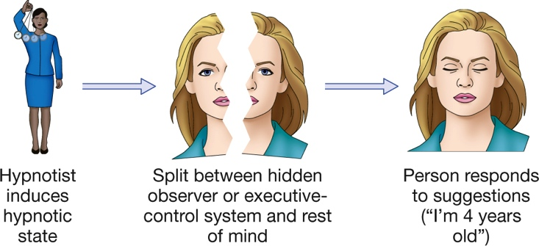
Theories of Hypnosis (5 of 6) Figure 5.5 Dissociation Theories of Hypnosis

Slide 44
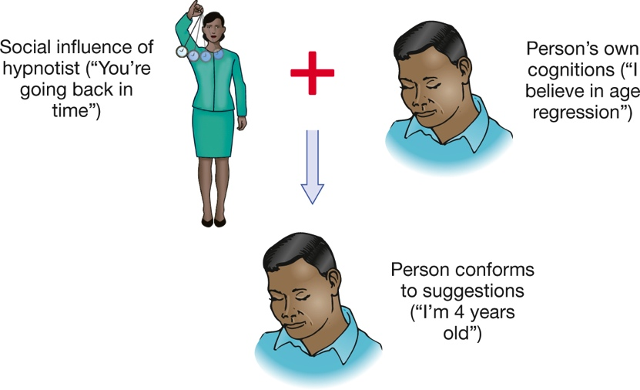
Theories of Hypnosis (6 of 6) Figure 5.6 Sociocognitive Theories of Hypnosis

Slide 45
Consciousness-Altering Drugs
LO 5.5.A List the four main categories of psychoactive drugs, and summarize the main effects of each.
LO 5.5.B Outline the physiology of drug effects, and explain the process by which biochemical changes take place.
LO 5.5.C Summarize four psychological aspects of drug effects, and comment on how each one might moderate physiological drug effects.

Slide 46
Classifying Drugs (1 of 3)
In all cultures, people have found ways to produce altered states of consciousness.
Psychoactive drugs alter cognition and emotion by acting on neurotransmitters in the brain.
They affect:
mood
thinking
memory
behavior

Slide 47
Classifying Drugs (2 of 3)
Most psychoactive drugs are classified as:
stimulants
depressants
opiates
psychedelics
Classification depends on their:
central nervous system effects
impact on behavior and mood

Slide 48
Classifying Drugs (3 of 3)
However, some common drugs, such as marijuana, straddle or fall outside these categories.
Some classify it as a psychedelic; others place it outside the major classifications because of its:
chemical makeup
psychological effects
Heavy smoking of the drug (which is high in tar) may increase the risk of lung damage.

Slide 49
The Physiology of Drug Effects (1 of 3)
Biochemical changes from psychoactive drugs affect cognitive and emotional functioning.
When used frequently and in large amounts, some psychoactive drugs can:
damage neurons in the brain
impair learning and memory
Their use may lead to:
tolerance, in which increasing dosages are needed for the same effect
withdrawal symptoms if a heavy user tries to quit

Slide 50
The Physiology of Drug Effects (2 of 3)
But certain drugs, such as alcohol and marijuana, are also associated with some health benefits when used in moderation.

Slide 51
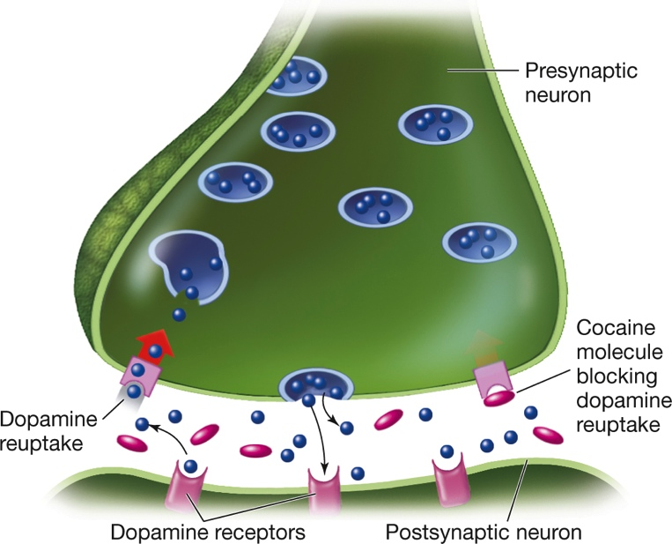
The Physiology of Drug Effects (3 of 3) Figure 5.7 Cocaine’s Effect on the Brain
Notes:
Cocaine blocks the brain’s reuptake of dopamine and norepinephrine so that synaptic levels of these neurotransmitters rise. The result is overstimulation of certain brain receptors and a brief euphoric high. Then, when the drug wears off, a depletion of dopamine may cause the user to “crash” and become sleepy and depressed.

Slide 52
The Psychology of Drug Effects (1 of 2)
Reactions to a psychoactive drug are influenced not only by its chemical properties but also by:
the user’s prior experience with the drug
individual characteristics (body weight, metabolism, initial state of emotional arousal, personality characteristics, physical tolerance for the drug)
environmental setting
mental set—the person’s expectations and motives for taking the drug

Slide 53
The Psychology of Drug Effects (2 of 2)
Expectations can be even more powerful than the drug itself, as shown by the “think–drink” effect.
Example: Men behaved more belligerently when they thought they were drinking vodka than when they thought they were drinking plain tonic water.
This does not mean that alcohol and other drugs are merely placebos.

