Slide 1
Psychology
Twelfth Edition
Chapter 6
Sensation and Perception

Slide 2
Our Sensational Senses
LO 6.1.A Distinguish between the basic processes of sensation and perception, explain how the doctrine of specific nerve energies applies to perception, and discuss how synesthesia contributes to our understanding of sensory modalities.
LO 6.1.B Differentiate between absolute thresholds, difference thresholds, and signal detection.
LO 6.1.C Discuss why the principle of sensory adaptation helps us understand how the human perceptual system works.
LO 6.1.D Describe how selective attention and inattentional blindness are related.

Slide 3
The Riddle of Separate Sensations (1 of 5)
Sensation is the detection of physical energy emitted or reflected by physical objects.
The cells that do the detecting are located in the sense organs:
eyes
ears
tongue
nose
skin
internal body tissues

Slide 4
The Riddle of Separate Sensations (2 of 5)
Perception is the process by which sensory impulses are organized and interpreted.
Sensation begins with the sense receptors, cells located in the sense organs.
Receptors for smell, pressure, pain, and temperature are extensions (dendrites) of sensory neurons.
The receptors convert the energy of a stimulus into electrical impulses that travel along nerves to the brain.

Slide 5
The Riddle of Separate Sensations (3 of 5)
Separate sensations in the nervous system can be accounted for by:
anatomical codes (as set forth by the doctrine of specific nerve energies)
Müller
functional codes

Slide 6
The Riddle of Separate Sensations (4 of 5)
Sensory crossover from one modality to another can sometimes occur.
In synesthesia, sensation in one modality consistently evokes a sensation in another.
A person with synesthesia may say things like:
the color purple smells like a rose
the aroma of cinnamon feels like velvet
the sound of a note on a clarinet tastes like cherries
The neurological basis of synesthesia is uncertain.

Slide 7
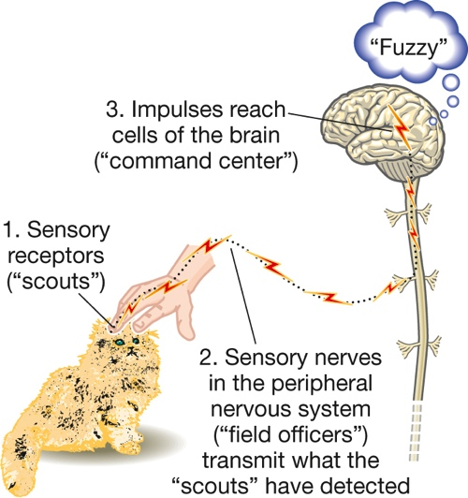
The Riddle of Separate Sensations (5 of 5) Figure 6.1 The General Process of Sensation
Notes:
Although the Individual senses respond to different kinds of energy in the world, the overall process of sensation is the same.

Slide 8
Measuring the Senses (1 of 3)
Psychological scientists specializing in psychophysics have studied sensory sensitivity by measuring absolute and difference thresholds.
Absolute threshold: The smallest quantity of physical energy that can be reliably detected by an observer.
Difference threshold: The smallest difference in stimulation that can be reliably detected by an observer when two stimuli are compared; also called just noticeable difference (jnd).

Slide 9
Measuring the Senses (2 of 3)
Signal-detection theory, however, holds that responses in a detection task depend on both:
a sensory process, and
a decision process
Responses will vary with the person’s:
motivation
alertness
expectations

Slide 10
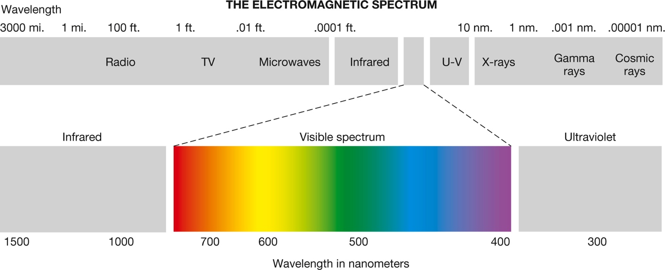
Measuring the Senses (3 of 3) Figure 6.2 The Visible Spectrum of Electromagnetic Energy
Notes:
Our visual system detects only a small fraction of the electromagnetic energy around us.

Slide 11
Sensory Adaptation
Our senses are designed to respond to change and contrast in the environment.
When stimulation is unchanging, sensory adaptation occurs.
sensation fades or disappears
Too little stimulation can cause sensory deprivation.
The human brain requires a minimum amount of sensory stimulation to function normally.

Slide 12
Sensing without Perceiving
Selective attention prevents us from being overwhelmed by the countless stimuli impinging on our senses.
It allows us to focus on what is important.
It also deprives us of sensory information we may need, as in inattentional blindness.
Example: failing to consciously register objects that we are looking straight at

Slide 13
Vision (1 of 2)
LO 6.2.A Describe the three psychological dimensions of vision, and relate them to the three physical properties of light that produce them.
LO 6.2.B Locate the structures and cells of the human eye, tracing the path that light follows all the way from the cornea to the optic nerve.
LO 6.2.C Summarize the evidence indicating that the visual system is not simply a “camera.”

Slide 14
Vision (2 of 2)
LO 6.2.D Compare the strengths and weaknesses of the trichromatic and opponent-process theories of color vision.
LO 6.2.E Summarize the principles and processes that guide form perception, depth and distance perception, visual constancies, and visual illusions.

Slide 15
What We See (1 of 2)
The stimulus for vision is light, which is a form of electromagnetic radiation.
Vision is affected by the wavelength, intensity, and complexity of light.
These produce the psychological dimensions of visual experience:
hue
brightness
saturation

Slide 16
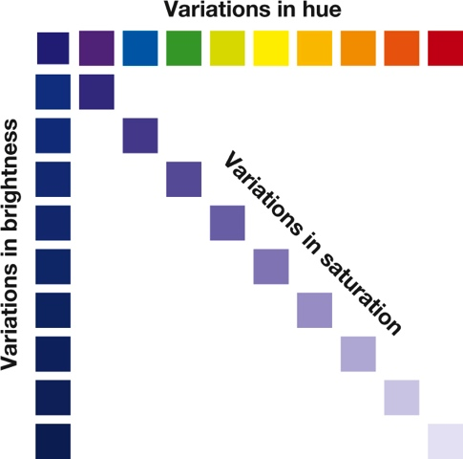
What We See (2 of 2) Figure 6.3 Psychological Dimensions of the Visual World
Notes:
Variations in brightness, hue, and saturation represent psychological dimensions of vision that correspond to the intensity, wavelength, and complexity of wavelengths of light.

Slide 17
An Eye on the World (1 of 7)
The visual receptors are located in the retina of the eye.
rods
cones
They send signals (via other cells) to the ganglion cells and ultimately to the optic nerve.
The optic nerve carries visual information to the brain.

Slide 18
An Eye on the World (2 of 7)
Rods are responsible for vision in dim light.
Cones are responsible for color vision.
The process of dark adaptation involves chemical changes in the rods and cones.
Example: It takes time for our eyes to adjust fully to dim illumination.
Rods and cones are connected by synapses to bipolar cells, which in turn communicate with neurons called ganglion cells.

Slide 19
An Eye on the World (3 of 7)
The axons of the ganglion cells converge to form the optic nerve.
The optic nerve carries information out through the back of the eye and on to the brain.
Where the optic nerve leaves the eye, at the optic disk, there are no rods or cones.
The absence of receptors produces a blind spot in the field of vision.

Slide 20
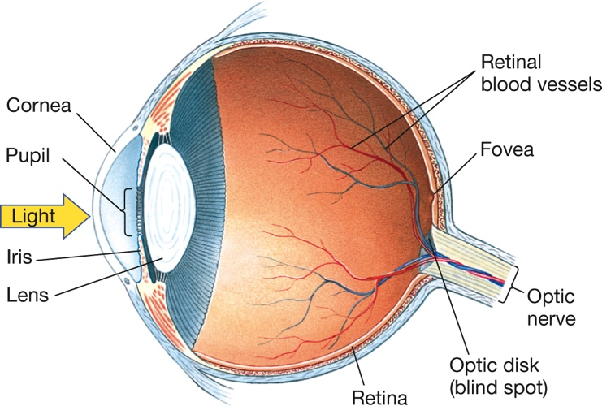
An Eye on the World (4 of 7) Figure 6.4 Major Structures of the Eye
Notes:
Light passes through the pupil and lens and is focused on the retina at the back of the eye. The point of sharpest vision is at the fovea.

Slide 21
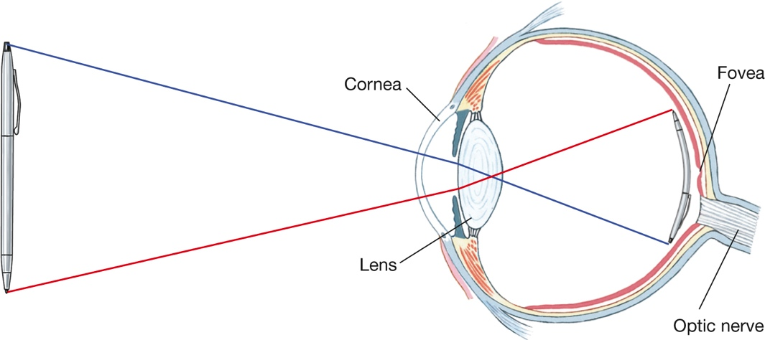
An Eye on the World (5 of 7) Figure 6.5 The Retinal Image
Notes:
When we look at an object, the light pattern on the retina is upside down. René Descartes was probably the first person to demonstrate this fact. He cut a piece from the back of an ox’s eye and replaced the piece with paper. When he held the eye up to the light, he saw an upside-down image of the room on the paper. You could take any ordinary lens and get the same result.

Slide 22
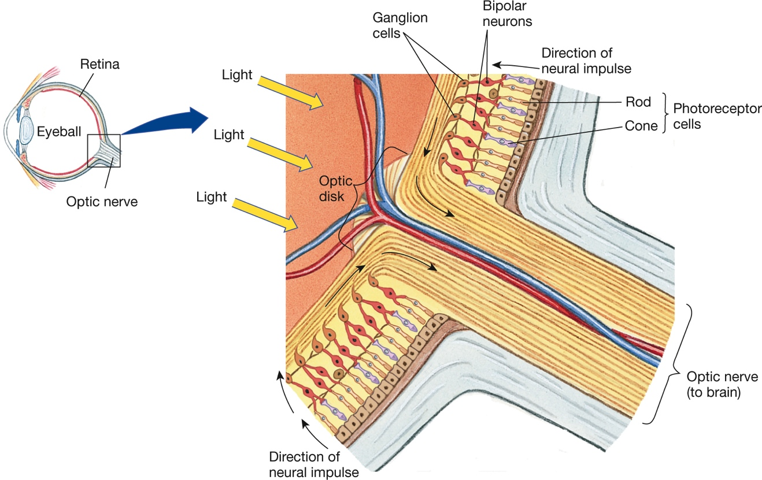
An Eye on the World (6 of 7) Figure 6.6 The Structures of the Retina
Notes:
For clarity, all cells in this drawing are greatly exaggerated in size. To reach the receptors for vision (the rods and cones), light must pass through the ganglion and bipolar cells as well as the blood vessels that nourish them (not shown). Normally, we do not see the shadow cast by this network of cells and blood vessels because the shadow always falls on the same place on the retina, and such stabilized images are not sensed. But when an eye doctor shines a moving light into your eye, the treelike shadow of the blood vessels falls on different regions of the retina and you may see it—a rather eerie experience.

Slide 23
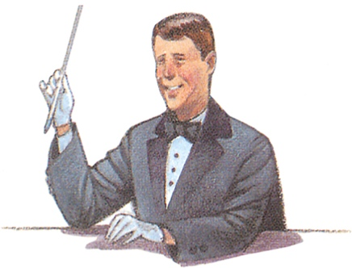
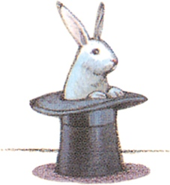
An Eye on the World (7 of 7) Figure 6.7 Find Your Blind Spot
Notes:
A blind spot exists where the optic nerve leaves the back of your eye. Find the blind spot in your left eye by closing your right eye and looking at the magician. Then slowly move the image toward and away from yourself. The rabbit should disappear when the image is between 9 and 12 inches from your eye.

Slide 24
Why the Visual System Is Not a Camera
Specific aspects of the visual world, such as lines at various orientations, are detected by feature-detector cells in the visual areas of the brain.
Some of these cells respond maximally to complex patterns.
Three separate groups of cells in the brain help us identify:
faces
places
bodies

Slide 25
How We See Colors (1 of 2)
The trichromatic and opponent-process theories of color vision apply to different stages of visual processing.
In the first stage, three types of cones in the retina respond selectively to different wavelengths of light.
In the second, opponent-process cells in the retina and the thalamus respond in opposite fashion to short and long wavelengths of light.

Slide 26
How We See Colors (2 of 2) Figure 6.8 A Change of Heart
Notes:
Opponent-process cells that switch on or off in response to green send an opposite message—“red”—when the green is removed, producing a negative afterimage. Stare at the black dot in the middle of this heart for at least 20 seconds. Then shift your gaze to a white piece of paper or a white wall. Do you get a “change of heart”? You should see an image of a red or pinkish heart with a blue border.

Slide 27
Constructing the Visual World (1 of 11)
Perception involves the active construction of a model of the world from moment to moment.
Gestalt psychologists were among the first to study how people organize the world visually into:
meaningful units
patterns
Gestalt principles describe strategies used by the visual system to group sensory building blocks into perceptual units.

Slide 28
Constructing the Visual World (2 of 11)
Here are a few well-known Gestalt principles:
figure and ground
proximity
closure
similarity
continuity
Unfortunately, consumer products are sometimes designed with little thought for Gestalt principles.
This is why it can be a major challenge to, say, operate the correct dials on a new stovetop.

Slide 29
Constructing the Visual World (3 of 11)
We need to know not only what something is but also where it is.
Touch gives us this information directly, but vision does not.
We must infer an object’s location by estimating its distance or depth.
We localize objects in visual space by using both binocular and monocular cues to depth.

Slide 30
Constructing the Visual World (4 of 11)
Perceptual constancies allow us to perceive objects as stable despite changes in the sensory patterns they produce.
The best-studied constancies are visual and include:
size constancy
shape constancy
location constancy
brightness constancy
color constancy

Slide 31
Constructing the Visual World (5 of 11)
Perceptual illusions occur when sensory cues are misleading or when we misinterpret cues.
Visual illusions sometimes occur when the strategies that normally lead to accurate perception are overextended to situations where they do not apply.
Example: Müller-Lyer illusion
Some illusions are simply a matter of physics.
Example: chopstick in half-filled glass of water looks bent because water and air refract light differently

Slide 32
Constructing the Visual World (6 of 11) Figure 6.9 Figure and Ground
Notes:
Which do you notice first in this drawing—the white fish or the black fish?

Slide 33
Constructing the Visual World (7 of 11) Page 192 Proximity

Slide 34
Constructing the Visual World (8 of 11) Page 193 Closure, Similarity, and Continuity

Slide 35
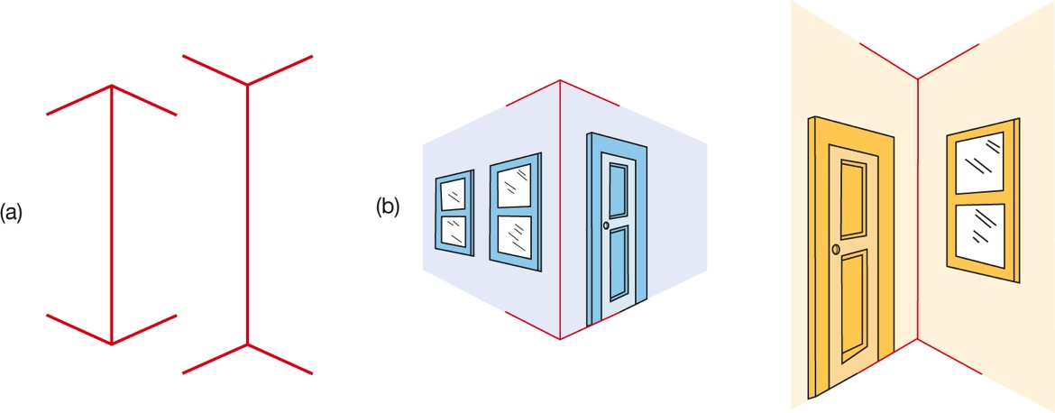
Constructing the Visual World (9 of 11) Figure 6.10 The Müller-Lyer Illusion
Notes:
The two lines in (a) are exactly the same length. We are probably fooled into perceiving them as different because the brain interprets the one with the outward-facing branches as farther away, as if it were the far corner of a room, and the one with the inward-facing branches as closer, as if it were the near edge of a building (b).

Slide 36
Constructing the Visual World (10 of 11) Figure 6.11 Color in Context
Notes:
The way you perceive a color depends on the color surrounding it. In this example, the small squares are exactly the same color and brightness.

Slide 37
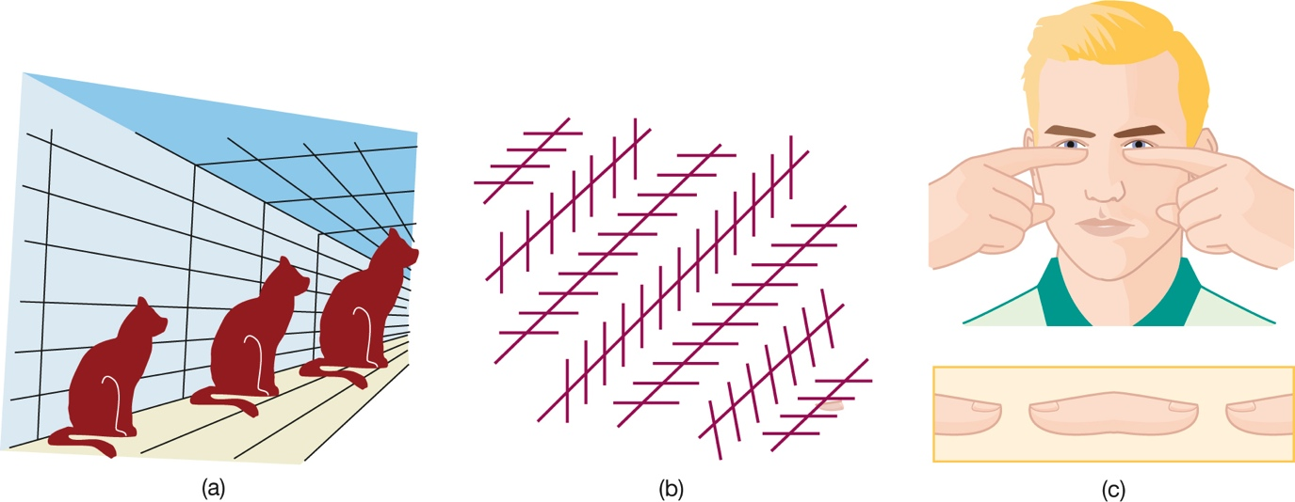
Constructing the Visual World (11 of 11) Figure 6.12 Fooling the Eye
Notes:
Although perception is usually accurate, we can be fooled. In (a), the cats as drawn are exactly the same size; in (b), the diagonal lines are all parallel. To see the illusion depicted in (c), hold your index fingers 5 to 10 inches in front of your eyes as shown and then focus straight ahead. Do you see a floating “fingertip frankfurter”? Can you make it shrink or expand?

Slide 38
Hearing
LO 6.3.A Describe the three psychological dimensions of hearing, and relate them to the three physical properties of sound that produce them.
LO 6.3.B Sketch the major structures of the human ear, and briefly describe the functions of each component.
LO 6.3.C List five Gestalt principles of perception that apply to constructing the auditory world, and give an example of each.

Slide 39
What We Hear
Hearing (audition) is affected by the intensity, frequency, and complexity of pressure waves in the air or other transmitting substance.
These correspond to the experience of:
loudness
decibels (dB)
pitch
frequency; hertz (Hz)
timbre
complexity

Slide 40
An Ear on the World (1 of 3)
The receptors for hearing are:
hair cells (topped by cilia)
embedded in the basilar membrane
located in the organ of Corti
in the interior of the cochlea
These receptors pass signals along to the auditory nerve.
The sounds we hear are determined by patterns of hair-cell movement.

Slide 41
An Ear on the World (2 of 3)
We discriminate high-pitched sounds largely on the basis of where activity occurs along the basilar membrane.
activity at different sites leads to different neural codes
We discriminate low-pitched sounds largely on the basis of the frequency of the basilar membrane’s vibration.
different frequencies lead to different neural codes

Slide 42
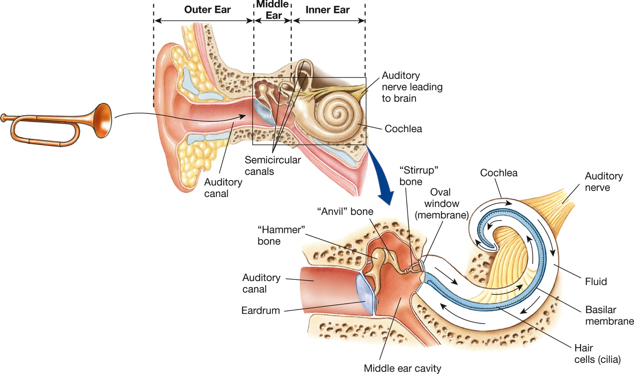
An Ear on the World (3 of 3) Figure 6.13 Major Structures of the Ear
Notes:
Sound waves collected by the outer ear are channeled down the auditory canal, causing the eardrum to vibrate. These vibrations are then passed along to the tiny bones of the middle ear. Movement of these bones intensifies the force of the vibrations separating the middle and inner ear. The receptor cells for hearing (hair cells), located in the organ of Corti (not shown) within the snail-shaped cochlea, initiate nerve impulses that travel along the auditory nerve to the brain.

Slide 43
Constructing the Auditory World (1 of 2)
Gestalt principles help us to make sense of our auditory world.
proximity
figure/ground
continuity
similarity
When we localize sounds, we use as cues subtle differences in how pressure waves reach each of our ears.

Slide 44
Constructing the Auditory World (2 of 2)
A few blind people are able to use echolocation to navigate.
similar to what bats do when they fly around hunting for food
In blind human echolocators, the visual cortex responds to sounds that produce echoes.
sounds with information about the size and location of objects
It does not respond to other sounds without echoes.

Slide 45
Other Senses
LO 6.4.A Identify the major structures of the human tongue, and list the five basic tastes perceived by humans.
LO 6.4.B Describe the basic pathway from smell receptors to the cerebral cortex.
LO 6.4.C List the four basic skin senses that humans perceive.
LO 6.4.D Describe the principles of gate-control theory, and explain what phantom pain is and a novel way to treat it.
LO 6.4.E Discuss the two senses that allow us to monitor our internal environment.

Slide 46
Taste: Savory Sensations (1 of 4)
Taste (gustation) is a chemical sense.
Elevations on the tongue, called papillae, contain many taste buds, which in turn contain the taste receptors.
The basic tastes include:
salty
sour
bitter
sweet

Slide 47
Taste: Savory Sensations (2 of 4)
Umami has also been proposed as a basic taste.
“savory,” associated with the taste of protein
However, findings on umami are controversial.
In most foods containing protein, the umami taste is not perceptible.
unlike how sugar is perceptible in a doughnut
People differ widely in their responses to it.
The main role of umami appears to be in the gut, after protein is eaten and digested.

Slide 48
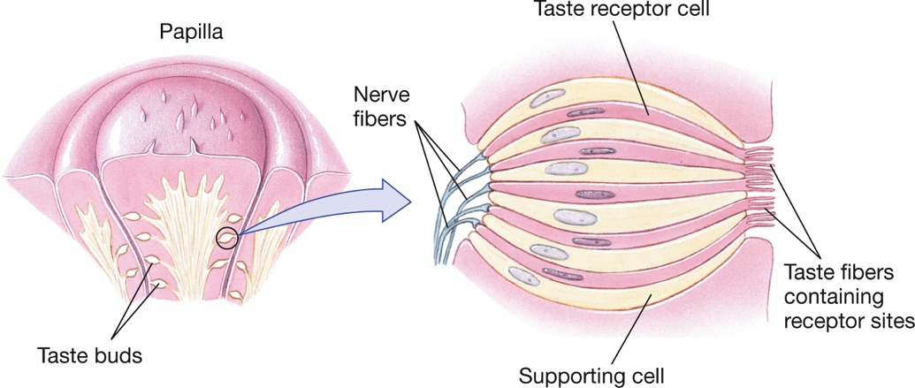
Taste: Savory Sensations (3 of 4) Figure 6.14 Taste Receptors
Notes:
The illustration on the left shows taste buds lining the sides of a papilla on the tongue’s surface. The illustration on the right shows an enlarged view of a single taste bud.

Slide 49
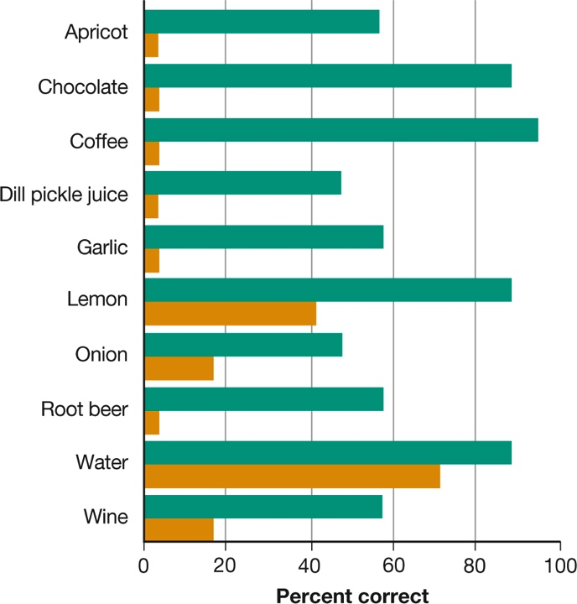
Taste: Savory Sensations (4 of 4) Figure 6.15 Taste Test
(Mozell et al., 1969)
Notes:
The turquoise bars show the percentages of people who could identify a substance dropped on the tongue when they were able to smell it. The orange bars show the percentage that could identify the substance when they were prevented from smelling it (Mozell et al., 1969).

Slide 50
Smell: The Sense of Scents (1 of 3)
Smell (olfaction) is also a chemical sense.
Millions of receptors in each nasal cavity respond to chemical molecules (vapors) in the air.
Figuring out the neural code for smell has been a real challenge.
Of the 10,000 or so smells we detect, no basic odors have been identified.
Up to a thousand different receptor types exist.

Slide 51
Smell: The Sense of Scents (2 of 3)
Researchers have discovered that distinct odors activate unique combinations of receptor types.
Some of those combinations have been identified.
Although smell is less vital for human survival than for the survival of other animals, it is still important.
We sniff out danger by smelling smoke, rotten food, gas leaks, etc.
Odors can also have psychological effects on us and influence our everyday behavior.

Slide 52
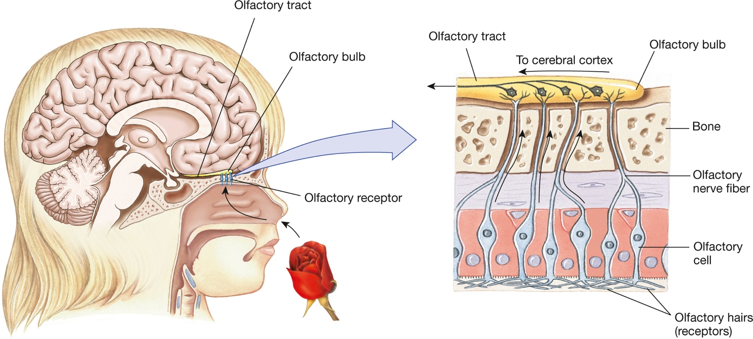
Smell: The Sense of Scents (3 of 3) Figure 6.16 Receptors for Smell
Notes:
Airborne chemical molecules (vapors) enter the nose and circulate through the nasal cavity, where the smell receptors are located. The receptors’ axons make up the olfactory nerve, which carries signals to the brain. When you sniff, you draw more vapors into the nose and speed their circulation. Vapors can also reach the nasal cavity through the mouth by way of a passageway from the throat.

Slide 53
Senses of the Skin
The skin senses include:
touch (pressure)
warmth
cold
pain
variations such as itch and tickle
Receptors for some types of itching and a possible receptor for cold have been discovered.
Many aspects of touch remain baffling.

Slide 54
The Mystery of Pain (1 of 3)
Pain is both a skin sense and an internal sense.
Even when the stimulus producing pain is removed, the sensation may continue, sometimes for years.
Understanding the physiology of pain has been an enormous challenge.
Pain involves the release of several different chemicals and changes in both neurons and glial cells.

Slide 55
The Mystery of Pain (2 of 3)
According to the gate-control theory, the experience of pain depends on whether neural impulses:
get past a “gate” in the spinal cord
reach the brain
In addition, a matrix of neurons in the brain can generate pain even in the absence of signals from sensory neurons.

Slide 56
The Mystery of Pain (3 of 3)
An extreme version of pain without injury occurs in phantom pain, in which a person continues to feel pain that seemingly comes from:
an arm or leg that has been amputated, or
a bodily organ that has been surgically removed
A leading theory of phantom pain holds that it occurs when the brain rewires itself.
A simple but effective treatment involves an illusion using a mirror.

Slide 57
The Environment Within
Kinesthesis tells us where our body parts are located and lets us know when they move.
information provided by pain and pressure receptors
Equilibrium tells us the orientation of the body as a whole.
sense of balance
Together, these two senses provide us with a feeling of physical embodiment.

Slide 58
Perceptual Powers
LO 6.5.A Summarize the evidence suggesting that our perceptual powers are both inborn and dependent on experience.
LO 6.5.B Discuss four psychological factors that influence how we perceive the world.
LO 6.5.C Summarize the evidence both for and against subliminal perception.

Slide 59
Inborn Abilities and Critical Periods (1 of 2)
Many fundamental perceptual skills are inborn or acquired shortly after birth.
However, without certain experiences during critical periods early in life, cells in the nervous system:
deteriorate
change, or
fail to form appropriate neural pathways
As such, perception is impaired.

Slide 60
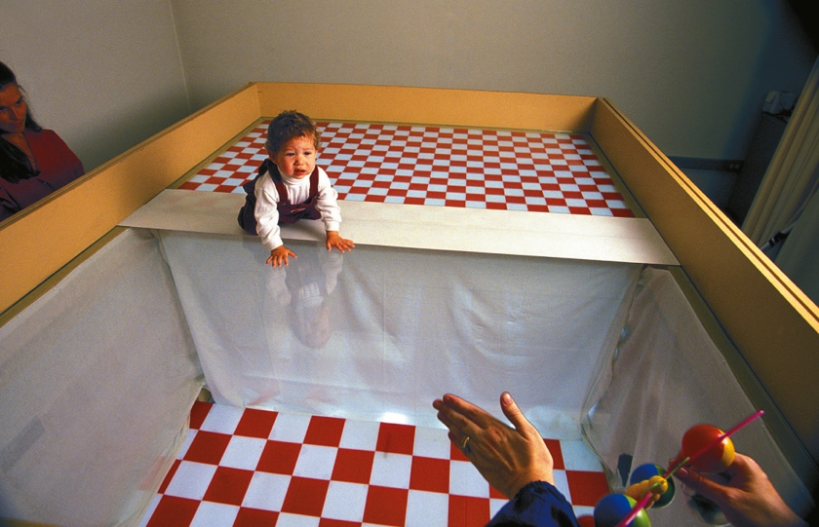
Inborn Abilities and Critical Periods (2 of 2) Figure 6.18 A Cliff-Hanger
Mark Richard/PhotoEdit
Notes:
Infants as young as 6 months usually hesitate to crawl past the apparent edge of a visual cliff, which suggests that they are able to perceive depth.

Slide 61
Psychological and Cultural Influences
Psychological influences on perception include:
needs
beliefs
emotions, and
expectations (which produce perceptual sets)
Expectations can even reduce our reactions to stimuli that would otherwise be unpleasant.
such as the sound of fingernails scratching a chalkboard

Slide 62
Perception Without Awareness (1 of 2)
Behavior can be affected by subliminal stimuli.
that is, stimuli so weak or brief that they are below a person’s absolute threshold for detecting them
In the laboratory, simple visual subliminal messages can influence certain:
behaviors
judgments
However, the level of influence is related to a person’s motivational state.
note research using words “thirst” and “dry”

Slide 63
Perception Without Awareness (2 of 2)
Complex behaviors cannot be altered by the many kinds of “subliminal-perception” recordings on the market.
There is little cause to worry about subliminal manipulation:
no evidence of subliminal persuasion in real life
subtlety of effects in laboratory

