Slide 1
Psychology
Twelfth Edition
Chapter 7
Learning and Conditioning

Slide 2
Classical Conditioning
LO 7.1.A List and explain each of the four key elements that make classical conditioning take place.
LO 7.1.B Discuss the basic principles of classical conditioning, including the extinction and recovery of a classically conditioned response, how higher-order conditioning takes place, and the process of stimulus generalization and discrimination.
LO 7.1.C Explain why the stimulus to be conditioned should precede the unconditioned stimulus in order for classical conditioning to take place.

Slide 3
New Reflexes from Old (1 of 4)
Classical conditioning was first studied by Russian physiologist Ivan Pavlov.
Conditioning refers to a basic kind of learning based on association.
In this type of learning, a neutral stimulus is paired with an unconditioned stimulus (US) that already elicits a certain unconditioned response (UR).
The neutral stimulus becomes associated with the US.

Slide 4
New Reflexes from Old (2 of 4)
The neutral stimulus then becomes a conditioned stimulus (CS).
It has the capacity to elicit a conditioned response (CR) that is similar or related to the UR.
Pavlov showed that all sorts of things became conditioned stimuli for salivation if paired with food.
sounds like ticking metronome, bell, buzzer
touches on leg; pinprick or electric shock

Slide 5
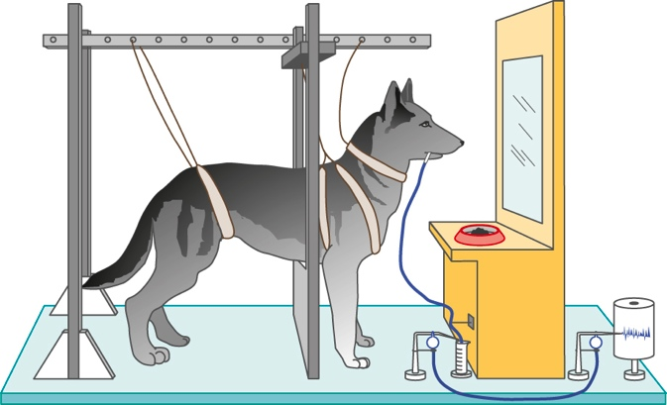
New Reflexes from Old (3 of 4) Figure 7.1 Pavlov’s Method
Notes:
The drawing depicts an apparatus similar to the one he used; saliva from a dog’s cheek flowed down a tube and was measured by the movement of a needle on a revolving drum.

Slide 6
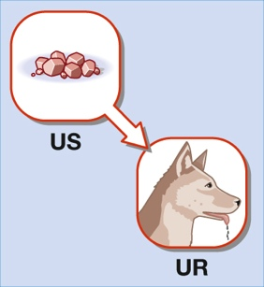
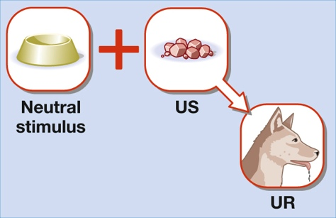
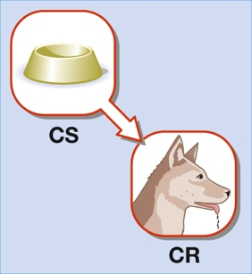
New Reflexes from Old (4 of 4) Page 224

Slide 7
Principles of Classical Conditioning (1 of 5)
In extinction, the conditioned stimulus is repeatedly presented without the unconditioned stimulus.
The conditioned response eventually disappears, although later it may reappear (spontaneous recovery).
Reappearance shows why more than one extinction session is often required.

Slide 8
Principles of Classical Conditioning (2 of 5)
In higher-order conditioning, a neutral stimulus becomes a conditioned stimulus by being paired with an already-established conditioned stimulus.
Higher-order conditioning may explain why some words trigger emotional responses in us.
It may also contribute to the formation of prejudices.
ethnic or national labels paired with disagreeable words like “dumb” or “dirty”

Slide 9
Principles of Classical Conditioning (3 of 5)
In stimulus generalization, after a stimulus becomes a conditioned stimulus for some response, other similar stimuli may produce the same or similar reaction.
“He who hath been bitten by a snake fears a rope.”
In stimulus discrimination, different responses are made to stimuli that resemble the conditioned stimulus in some way.

Slide 10
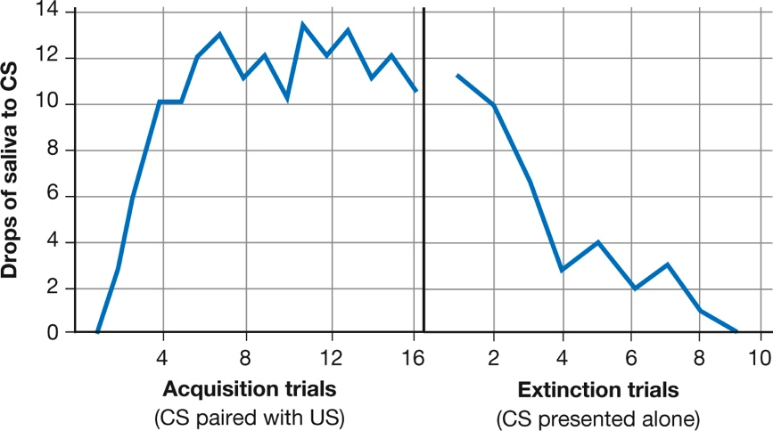
Principles of Classical Conditioning (4 of 5) Figure 7.2 Acquisition and Extinction of a Salivary Response
Notes:
A neutral stimulus that is consistently followed by an unconditioned stimulus for salivation will become a conditioned stimulus for salivation (left side of graph). But when this conditioned stimulus is then repeatedly presented without the unconditioned stimulus, the conditioned salivary response will weaken and eventually disappear; it has been extinguished.

Slide 11
Principles of Classical Conditioning (5 of 5) Figure 7.3 Higher-Order Conditioning
Notes:
In this illustration of higher-order conditioning, the food dish is a previously conditioned stimulus for salivation (left). When the light, a neutral stimulus, is paired with the dish (center), the light also becomes a conditioned stimulus for salivation (right).

Slide 12
What Is Actually Learned in Classical Conditioning? (1 of 2)
Many theorists believe that what an animal or person learns in classical conditioning is:
not just an association between the unconditioned and conditioned stimulus,
but also information conveyed by one stimulus about another.
“If a tone sounds, food is likely to follow.”
Classical conditioning appears to be an evolutionary adaptation that allows an organism to prepare for a biologically important event.

Slide 13
What Is Actually Learned in Classical Conditioning? (2 of 2)
Considerable evidence exists to show that a neutral stimulus does not become a CS unless it reliably:
signals or
predicts the US
Certain concepts open the door to a more cognitive view of classical conditioning.
“information seeking”
“preconceptions”
“representations of the world”

Slide 14
Classical Conditioning in Real Life
LO 7.2.A Provide an example of how classical conditioning takes place in forming preferences.
LO 7.2.B Provide an example of how classical conditioning takes place in avoiding fearful stimuli, and describe how the process of counterconditioning takes place.
LO 7.2.C Describe how classical conditioning is involved in avoiding a food associated with aversive outcomes.
LO 7.2.D Describe how classical conditioning can affect reactions to medical treatments, including a patient’s reaction to a placebo.

Slide 15
Learning to Like (1 of 2)
Classical conditioning helps account for:
positive emotional responses to particular objects and events,
typically through the pairing of a neutral stimulus
a car, for example
with a pleasurable stimulus
an attractive spokesperson
free trinkets
cold hard cash

Slide 16
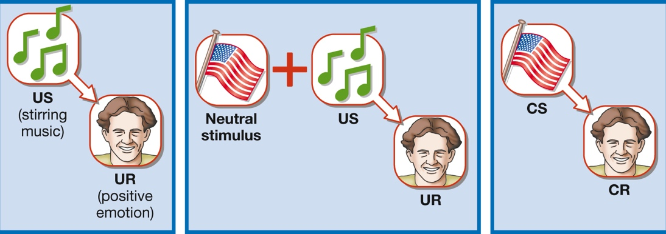
Learning to Like (2 of 2) Page 229

Slide 17
Learning to Fear (1 of 4)
Positive emotions are not the only ones that can be classically conditioned; so can dislikes and fears.
A person can learn to fear just about anything if it is paired with something that elicits:
pain
surprise
embarrassment
When fear becomes irrational and interferes with normal activities, it qualifies as a phobia.

Slide 18
Learning to Fear (2 of 4)
John Watson showed how fears may be learned and then may be unlearned through a process of counterconditioning.
“Little Albert” and rats
Peter and rabbits
Work on classical conditioning is now integrating findings on:
fear
learning
biology

Slide 19
Learning to Fear (3 of 4)
The amygdala plays a central role in the conditioning of fear.
A drug can be used to enhance the activity of a certain receptor in the amygdala.
This activity speeds up the extinction of a phobia during virtual-reality treatments.
Example: fear of heights

Slide 20
Learning to Fear (4 of 4) Page 230

Slide 21
Accounting for Taste (1 of 2)
Classical conditioning can also explain learned reactions to many foods and odors.
Because of evolutionary adaptations, we are biologically primed to acquire some classically conditioned responses easily.
These responses include conditioned taste aversions.
Note research with slugs, carrots, potatoes.

Slide 22
Accounting for Taste (2 of 2)
Often a single trial pairing a stimulus with an unpleasant outcome can produce aversive conditioning.
e.g., a desired meal followed by nausea
Psychologists have utilized this phenomenon to develop humane ways of discouraging predators from preying on livestock.
using conditioned taste aversions instead of traps and poisons

Slide 23
Reacting to Medical Treatments (1 of 2)
Classical conditioning can also account for reactions to medical treatments.
Treatments can create unexpected misery or relief from symptoms for reasons that are entirely unrelated to the treatment itself.
Unpleasant reactions to a treatment can generalize to a wide range of other stimuli.
This is a particular problem for cancer patients.

Slide 24
Reacting to Medical Treatments (2 of 2)
The stimuli themselves can elicit an aversive response as the patient:
associates neutral stimuli
the color of a waiting room
the smell of disinfectant
with an unpleasant outcome
nausea from chemotherapy, pain from an injection
Patients may have reduced pain and anxiety when they receive placebos.
expectancy and classical-conditioning explanations

Slide 25
Operant Conditioning
LO 7.3.A Discuss how Edward Thorndike’s research served as the basis for operant conditioning.
LO 7.3.B Distinguish between reinforcement and punishment and between a positive and negative stimulus, and provide examples of positive and negative reinforcement and punishment and primary and secondary reinforcement and punishment.

Slide 26
The Birth of Radical Behaviorism (1 of 2)
In operant conditioning, behavior becomes more or less likely to occur depending on its consequences.
Responses in operant conditioning are generally not reflexive.
such as the sight of food or the sound of a bell
They are more complex than in classical conditioning.
riding a bicycle, writing a letter, climbing a mountain

Slide 27
The Birth of Radical Behaviorism (2 of 2)
Research in this area is closely associated with B. F. Skinner.
Skinner called his approach “radical behaviorism.”
An early study conducted by Edward Thorndike set the stage for some basic principles of operant conditioning.
cats escaping a puzzle box

Slide 28
The Consequences of Behavior (1 of 7)
In the Skinnerian analysis, reinforcement strengthens or increases the probability of a response.
Punishment weakens or decreases the probability of a response.

Slide 29
The Consequences of Behavior (2 of 7)
Reinforcers are called primary when they are naturally reinforcing.
This is because they satisfy a biological need.
food, water, light stroking of skin, air temperature
They are called secondary when they have acquired their ability to strengthen a response through association with other reinforcers.
money, praise, applause, good grades, awards
A similar distinction is made for punishers.

Slide 30
The Consequences of Behavior (3 of 7)
In positive reinforcement, something pleasant follows a response.
if you get a good grade after studying
In negative reinforcement, something unpleasant is removed.
when taking a pill eliminates your pain
when you take a certain route across campus to avoid a rude person

Slide 31
The Consequences of Behavior (4 of 7)
In positive punishment, something unpleasant follows the response.
if your friends tease you for studying
In negative punishment, something pleasant is removed.
if studying makes you lose time with your friends

Slide 32
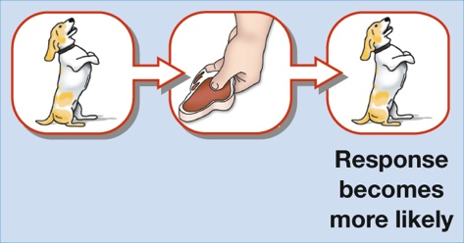
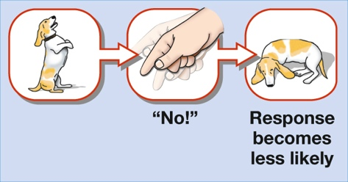
The Consequences of Behavior (5 of 7) Page 235

Slide 33
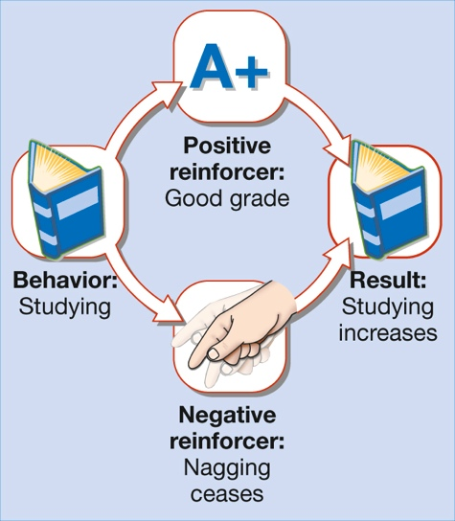
The Consequences of Behavior (6 of 7) Page 236

Slide 34
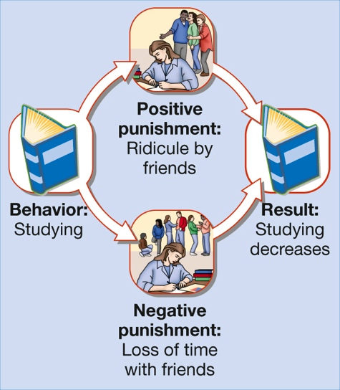
The Consequences of Behavior (7 of 7) Page 237

Slide 35
Principles of Operant Conditioning (1 of 2)
LO 7.4.A Describe the basic principles of operant conditioning, including extinction and recovery, stimulus generalization and discrimination, schedules of learning and shaping, and some biological limits on learning.
LO 7.4.B Discuss some of the misconceptions surrounding the work and ideas of B. F. Skinner and, by extension, some of the misconceptions surrounding the general goals of operant conditioning.

Slide 36
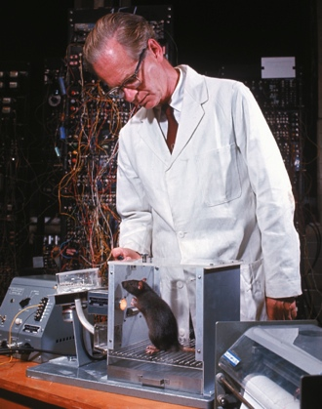
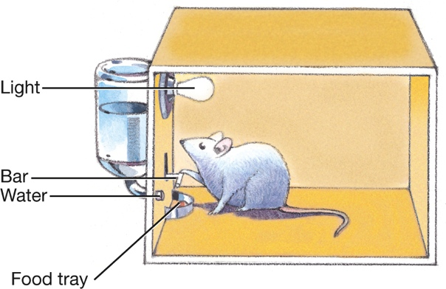
Principles of Operant Conditioning (2 of 2) Figure 7.4 The Skinner Box
Nina Leen/The LIFE Picture Collection/Getty Images
Notes:
When a rat in a Skinner box presses a bar, a food pellet or drop of water is automatically released. The photo shows Skinner training one of his subjects.

Slide 37
The Importance of Responses (1 of 5)
Operant conditioning shares many terms in common with classical conditioning.
Extinction, stimulus generalization, and stimulus discrimination occur in operant conditioning as well as in classical conditioning.
However, operant conditioning focuses on how responses to stimuli get reinforced.

Slide 38
The Importance of Responses (2 of 5)
A discriminative stimulus signals that a response is likely to be followed by a certain type of consequence.
Continuous reinforcement leads to the most rapid learning.
However, intermittent (partial) reinforcement makes a response resistant to extinction.
This helps account for the persistence of superstitious rituals.

Slide 39
The Importance of Responses (3 of 5)
Shaping is used to train behaviors with a low probability of occurring spontaneously.
Reinforcers are given for successive approximations to the desired response until the desired response is achieved.
Using shaping and other techniques, Skinner was able to train pigeons to:
play table tennis with their beaks
“bowl” in a miniature alley, complete with a wooden ball and tiny bowling pins

Slide 40
The Importance of Responses (4 of 5)
Biology places limits on:
what an animal or person can learn through operant conditioning, or
how easily it is learned
Operant-conditioning procedures always work best when they capitalize on inborn tendencies.
Animals sometimes have trouble learning a task because of instinctive drift.

Slide 41
The Importance of Responses (5 of 5)
In human beings, operant learning is affected by:
genetics
biology
the evolutionary history of our species
Human children are biologically disposed to learn:
language
some arithmetic operations
Temperaments and other inborn dispositions may affect how a person responds to reinforcers and punishments.

Slide 42
Skinner: The Man and the Myth
Operant conditioning is one of the mainstays of learning theory.
Its findings and conclusions have been demonstrated repeatedly.
As the sole explanatory system for why organisms do what they do, however, it is incomplete.
Skinner’s radical behaviorism was often misinterpreted as a cold, mechanistic view of the human condition.

Slide 43
Operant Conditioning in Real Life
LO 7.5.A List and discuss six reasons why punishment often fails to effectively change behavior.
LO 7.5.B Discuss reasons why rewards may backfire and not produce their intended results for behavior.

Slide 44
The Pros and Cons of Punishment (1 of 3)
Punishment, when used properly, can discourage undesirable behavior.
An example is criminal behavior.
Danish study
consistency of punishment mattered most
But punishment is frequently misused and can have unintended consequences.

Slide 45
The Pros and Cons of Punishment (2 of 3)
Punishment can fail because:
It is often administered inappropriately because of the emotion of the moment.
It may produce rage and fear.
Its effects are often only temporary.
It is hard to administer immediately.
It conveys little information about the kind of behavior that is desired.
It may provide attention that is rewarding.

Slide 46
The Pros and Cons of Punishment (3 of 3)
Preferable to the use of punishment:
extinction of undesirable behavior
combined with reinforcement of desired behavior
When punishment must be applied:
should not involve physical abuse
should be consistent
should be accompanied by information about appropriate behavior
should be followed by reinforcement of desirable behavior

Slide 47
The Problems with Reward (1 of 4)
Reinforcers can also be misused.
One obvious result of the misuse of rewards in schools has been grade inflation at all levels of education.
Grades have risen, graduation rates have not.
Literacy of graduates has declined.
Rewards that are given out indiscriminately, as in efforts to raise children’s self-esteem, do not reinforce desirable behavior.

Slide 48
The Problems with Reward (2 of 4)
An exclusive reliance on extrinsic reinforcement can sometimes undermine the power of intrinsic reinforcement.
Extrinsic reinforcers: Reinforcers that are not inherently related to the activity being reinforced.
Intrinsic reinforcers: Reinforcers that are inherently related to the activity being reinforced.

Slide 49
The Problems with Reward (3 of 4)
Money and praise do not usually interfere with intrinsic pleasure when:
a person is rewarded for succeeding or making progress rather than for merely participating in an activity, or
when a person is already highly interested in the activity
Findings on extrinsic versus intrinsic reinforcements have wide-ranging implications.
We must be careful not to oversimplify this issue.

Slide 50
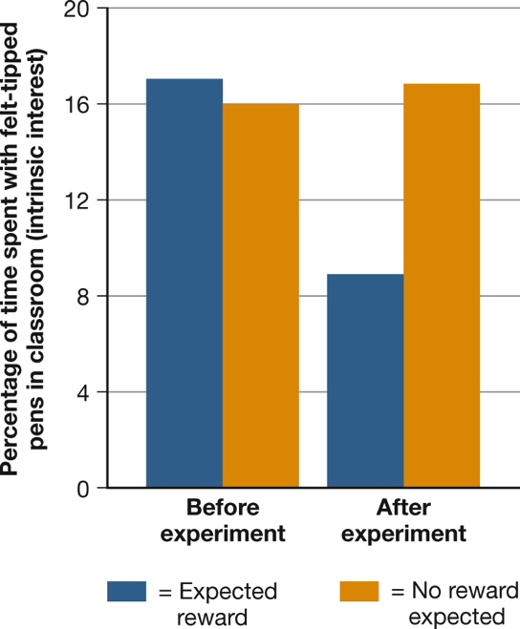
The Problems with Reward (4 of 4) Figure 7.5 Turning Play into Work
(Lepper, Greene, & Nisbett, 1973)
Notes:
Extrinsic rewards can sometimes reduce the intrinsic pleasure of an activity. When preschoolers were promised a prize for drawing with felt-tipped pens, the behavior temporarily increased. But after they got their prizes, they spent less time with the pens than they had before the study began (Lepper, Greene, & Nisbett, 1973).

Slide 51
Learning and the Mind
LO 7.6.A Define latent learning, and give an example of how it might work in the daily life of a college student.
LO 7.6.B Define observational learning, and give an example of how it might influence learning during childhood.

Slide 52
Latent Learning (1 of 4)
Even during behaviorism’s heyday, some researchers were probing the “black box” of the mind.
To them, the box contained irrelevant wiring.
It was enough to know that pushing a button on the box would produce a predictable response.

Slide 53
Latent Learning (2 of 4)
In the 1930s, Edward Tolman studied latent learning.
In latent learning:
no obvious reinforcer is present during learning
a response is not expressed until later, when reinforcement does become available
Latent learning raises questions about what, exactly, is learned during operant learning.

Slide 54
Latent Learning (3 of 4)
What appears to be acquired in latent learning is not a specific response but rather knowledge about responses and their consequences.

Slide 55
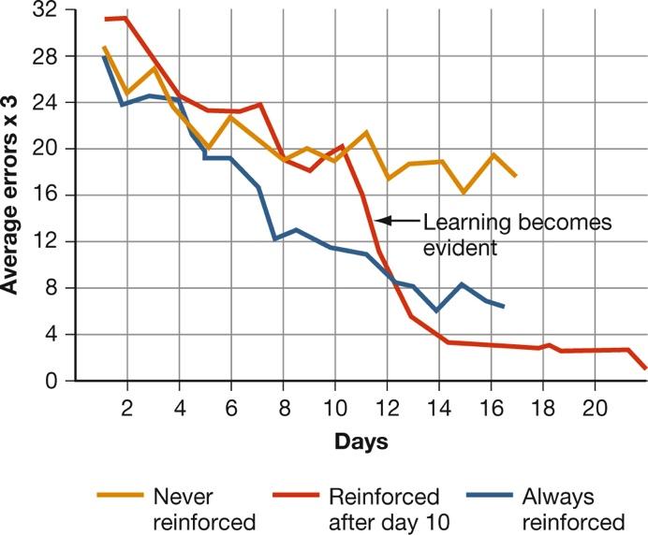
Latent Learning (4 of 4) Figure 7.6 Latent Learning
(Tolman & Honzik, 1930)
Notes:
In a classic experiment, rats that always found food in a maze made fewer and fewer errors in reaching the food (blue curve). In contrast, rats that received no food showed little improvement (gold curve). But rats that got no food for 10 days and then found food on the 11th day showed rapid improvement from then on (red curve). This result suggests that learning involves cognitive changes that can occur in the absence of reinforcement and that may not be acted on until a reinforcer becomes available (Tolman & Honzik, 1930).

Slide 56
Social-Cognitive Learning Theories (1 of 2)
The 1960s and 1970s saw the increased influence of social-cognitive theories of learning.
These theories focus on observational learning and the role played by:
beliefs
interpretations of events, and
other cognitions in determining behavior
Two people may come away with entirely different lessons from the same event.

Slide 57
Social-Cognitive Learning Theories (2 of 2)
Social-cognitive theorists argue that in observational learning, what is acquired is knowledge rather than a specific response.
Bandura showed how important observational learning is for children who are learning the rules of social behavior.
film with Rocky and Johnny
Findings can help us evaluate arguments about the effects of media violence.

