Slide 1
Psychology
Twelfth Edition
Chapter 8
Behavior in Social and Cultural Context

Slide 2
Social Forces
LO 8.1.A Compare social norms and social roles, and note how each contributes to the social rules that govern a culture.
LO 8.1.B Outline the basic procedures and findings of the Milgram obedience experiments, and discuss five conditions that make disobedience to authority more likely.
LO 8.1.C Outline the basic procedures and findings of the Zimbardo prison study.
LO 8.1.D Explain how feelings of entrapment contribute to destructive obedience.

Slide 3
Roles and Rules (1 of 3)
Social norms are rules about how we are supposed to act.
They are enforced by:
threats of punishment if we violate them, and
promises of reward if we follow them
Norms are the conventions of everyday life that make interactions with other people predictable and orderly.

Slide 4
Roles and Rules (2 of 3)
In every society, people also fill a variety of social roles.
gender, occupation, family roles
Social psychologists study how individuals are influenced by:
social roles
attitudes
relationships
groups

Slide 5
Roles and Rules (3 of 3)
Cultural psychologists study the influence of culture on human behavior.
Many cultural rules are unspoken but nonetheless powerful.
such as those governing correct conversational distance
People bring their own personalities and interests to the roles they play.
Nonetheless, the requirements of a social role are strong.

Slide 6
The Obedience Study (1 of 3)
Stanley Milgram wanted to know how many people would obey an authority figure when directly ordered to violate their ethical standards.
Milgram’s study illustrates the power of norms and roles to affect individual actions.
Most people in the role of “teacher” inflicted what they thought was extreme shock on another person because of the authority of the experimenter.

Slide 7
The Obedience Study (2 of 3)
Milgram concluded that obedience was more a function of the situation than of the personalities of the participants.
Some psychologists have questioned Milgram’s conclusion regarding personality traits.
They note that certain traits increase obedience and a willingness to inflict pain on others.
hostility
narcissism
rigidity

Slide 8
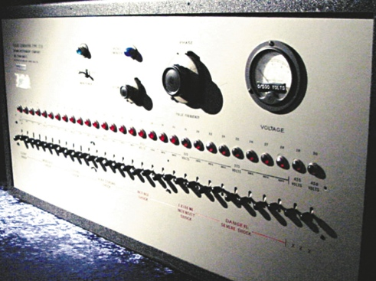
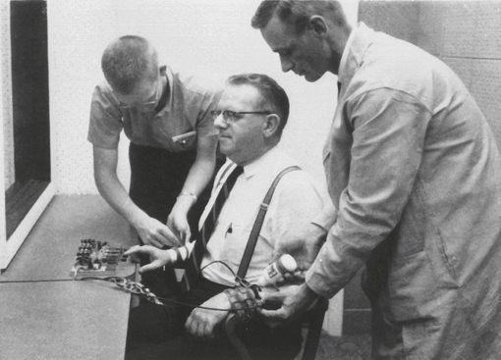
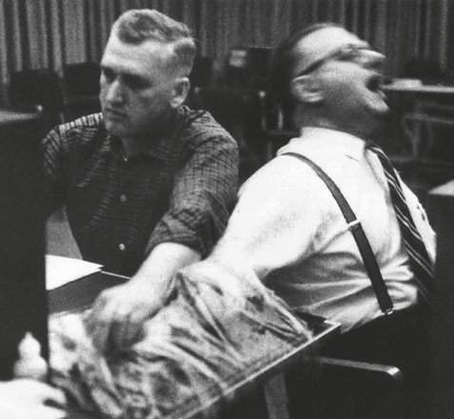
The Obedience Study (3 of 3) Figure 8.1 The Milgram Obedience Experiment
Copyright 1965 by Stanley Milgram. From the film Obedience, distributed by Penn State Media Sales.
Notes:
(a) Milgram’s original shock machine; in 1963, it looked pretty ominous. (b) The “learner” is being strapped into his chair by the experimenter and the “teacher.” (c) In Milgram’s study, when the “teacher” had to administer shock directly to the learner, most subjects refused, but this one continued to obey. Copyright 1965 by Stanley Milgram. From the film Obedience, distributed by Penn State Media Sales.

Slide 9
The Prison Study (1 of 2)
In Zimbardo’s Stanford prison study, college students tended to behave in accordance with the role they had been assigned.
“prisoner”
“guard”
Within a short time, most of the prisoners became distressed and helpless.
The guards, however, began to enjoy their new power.

Slide 10
The Prison Study (2 of 2)
The social situation exerted a powerful influence on individuals’ behavior, often prompting them to behave in uncharacteristic ways.
Zimbardo ended this study after only 6 days.
He had not expected such a speedy and alarming transformation of ordinary students.
Despite flaws in this study, it remains a powerful and useful cautionary tale.

Slide 11
Why People Obey (1 of 3)
Obedience to authority contributes to the smooth running of society.
But obedience can also lead to actions that are:
deadly
foolish
illegal
Throughout history, the plea “I was only following orders” has been offered to excuse such actions.

Slide 12
Why People Obey (2 of 3)
People obey orders because:
they can be punished if they do not
out of respect for authority, and
to gain advantages
Even when they would rather not obey, they may do so because they have been entrapped.

Slide 13
Why People Obey (3 of 3)
Entrapment involves:
justifying each step and decision they make, and
handing over responsibility for any harmful actions they commit to the authority
For many, the demands of the role and the social pressures of the situation defeat the inner voice of conscience.

Slide 14
Social Influences on Beliefs and Behavior
LO 8.2.A Contrast situational and dispositional attributions, explain how and why the fundamental attribution error takes place, and describe three biases that people hold about themselves and others.
LO 8.2.B Outline the process of cognitive dissonance, and explain how the validity effect and the familiarity effect shape our attitudes.
LO 8.2.C Summarize four elements that contribute to indoctrination.

Slide 15
Attributions (1 of 3)
According to attribution theory, people are motivated to search for causes to which they can attribute their own and other people’s behavior.
Situational attribution:
“Joe stole the money because his family is starving.”
Dispositional attribution:
“Joe stole the money because he is a born thief.”

Slide 16
Attributions (2 of 3)
The fundamental attribution error occurs when:
people overestimate personality traits as a cause of behavior, and
underestimate the influence of the situation
It is especially prevalent in Western nations, where middle-class people tend to:
believe that individuals are responsible for their own actions, and
dislike the idea that the situation has much influence over them

Slide 17
Attributions (3 of 3)
Attributions are further influenced by three self-serving biases:
the bias to choose the most flattering and forgiving explanations of our own behavior
the bias that we are better, smarter, and kinder than others, and
the bias that the world is fair (the just-world hypothesis)
These biases can distort communication, impede the resolution of conflicts, and lead to serious misunderstandings.

Slide 18
Attitudes (1 of 3)
People hold many attitudes about people, things, and ideas.
Attitudes may be explicit (conscious) or implicit (unconscious).
Attitudes may change through:
experience
conscious decision, or
as an effort to reduce cognitive dissonance

Slide 19
Attitudes (2 of 3)
One powerful way to influence attitudes is by taking advantage of two effects:
familiarity effect
validity effect
Simply exposing people repeatedly to a name or product makes them like it more.
Repeating a statement over and over again makes it seem more believable.

Slide 20
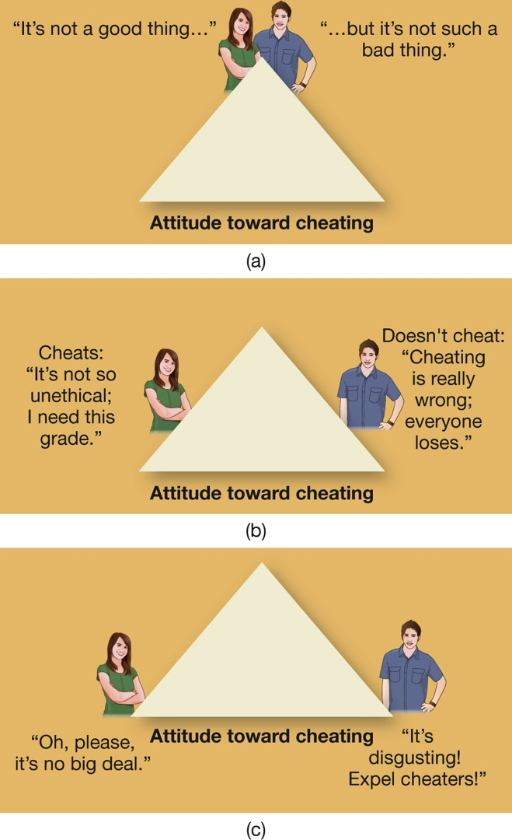
Attitudes (3 of 3) Figure 8.2 The Slippery Slope of Self-Justification
Notes:
(a) Imagine two people with the same neutral attitude toward cheating. (b) Given an opportunity, one cheats and the other doesn’t. (c) Because of the need to reduce cognitive dissonance, each will then justify the action they took so that their opinion about cheating is consonant with their behavior. Over time, they both will have moved a long way from their original attitude.

Slide 21
Persuasion or “Brainwashing”? The Case of Suicide Bombers (1 of 2)
Suicide bombers and terrorists have not been “brainwashed.”
“Brainwashing” implies that a person has had a sudden change of mind without being aware of what is happening.
It sounds mysterious and strange.
The methods used to create a terrorist suicide bomber are neither mysterious nor unusual.

Slide 22
Persuasion or “Brainwashing”? The Case of Suicide Bombers (2 of 2)
Most are not psychopaths or mentally ill.
Many are well-educated and affluent.
They have been:
entrapped into taking increasingly violent actions against real and perceived enemies
encouraged to attribute all problems to that one enemy
offered a new identity and salvation
cut off from access to dissonant information
Methods are similar to religious and other sects.

Slide 23
Individuals in Groups
LO 8.3.A Outline the basic procedures and findings of the Asch line-judging study.
LO 8.3.B List four symptoms of groupthink.
LO 8.3.C Explain how diffusion of responsibility and deindividuation contribute to the madness of crowds.
LO 8.3.D Discuss four situational factors that increase one’s likelihood to offer help to others.

Slide 24
Conformity (1 of 2)
In groups, individuals often behave differently than they would on their own.
Conformity:
permits the smooth running of society, and
allows people to feel in harmony with others like them
Two basic, beneficial motives for conformity are:
the need for social acceptance
the need for information

Slide 25
Conformity (2 of 2)
But like obedience, conformity has negative consequences, notably its power to suppress critical thinking and creativity.
The Asch experiment showed that most people will conform to the judgments of others even when the others are obviously wrong.
In a group, many people will deny their private beliefs, agree with silly notions, and even repudiate their own values—just to be accepted.

Slide 26
Groupthink (1 of 2)
Close-knit groups are vulnerable to groupthink, the tendency of group members to:
think alike
censor themselves
actively suppress disagreement, and
feel that their decisions are invulnerable
Throughout history, groupthink has led to disastrous decisions in military and civilian life.

Slide 27
Groupthink (2 of 2)
Groupthink often produces faulty decisions because group members fail to seek disconfirming evidence for their ideas.
Groupthink can be minimized if the leader:
rewards the expression of doubt and dissent
protects and encourages minority views
asks group members to generate as many alternative solutions to a problem as they can think of, and
has everyone try to think of the risks and disadvantages of the preferred decision

Slide 28
The Wisdom and Madness of Crowds (1 of 4)
Sometimes a group’s collective judgment is better than that of its individual members—the “wisdom of crowds.”
But crowds can also spread:
gossip
panic
rumor
misinformation
They can also turn from joyful and peaceful to violent and destructive in a flash.

Slide 29
The Wisdom and Madness of Crowds (2 of 4)
In groups, responsibility for an outcome is diffused, or spread, among many people, reducing each individual’s personal sense of accountability.
This diffusion of responsibility in a group can lead to inaction on the part of individuals, as in bystander apathy.
Individuals often fail to take action or call for help when they see someone in trouble because they assume that someone else will do so.

Slide 30
The Wisdom and Madness of Crowds (3 of 4)
Diffusion of responsibility is likely to occur under conditions that promote deindividuation, the loss of awareness of one’s individuality.
Deindividuation has long been considered a prime reason for mob violence.
Individuals become disinhibited, just as if they were intoxicated on alcohol.
They are more likely to conform to the norms of the specific situation (antisocial or prosocial).

Slide 31
The Wisdom and Madness of Crowds (4 of 4)
In some situations, crowd norms lead deindividuated people to behave aggressively, but in others, crowd norms foster helpfulness.
In truly dangerous, unambiguous emergencies people are more likely to help.
In fact, they are often spurred to do so by the presence of others.

Slide 32
Altruism and Dissent (1 of 2)
The costs of nonconformity, dissent, courage, and honesty are often high.
Whistle-blowers are punished for their bravery.
But personal convictions and conscience can generate the willingness to:
speak up for an unpopular opinion
blow the whistle on illegal practices
help a stranger in trouble
perform other acts of altruism

Slide 33
Altruism and Dissent (2 of 2)
But several situational factors are also important:
The person perceives that help is needed.
Cultural norms support taking action.
The person has an ally.
The person becomes entrapped in a commitment to help or dissent.
Certain social and cultural factors make altruism, disobedience, and dissent more likely to occur, just as other external factors suppress them.

Slide 34
Us Versus Them: Group Identity
LO 8.4.A Contrast social identity, ethnic identity, and acculturation, and offer examples of each concept.
LO 8.4.B Define ethnocentrism, and describe how it contributes to us–them dichotomies.
LO 8.4.C Define what a stereotype is, and discuss three ways in which stereotypes distort reality.

Slide 35
Ethnic Identity (1 of 3)
People develop social identities based on their:
ethnicity (including nationality)
religion
occupation
other social memberships
In multicultural societies such as the United States and Canada, different social identities sometimes collide.

Slide 36
Ethnic Identity (2 of 3)
People often face the dilemma between:
ethnic identity
a close identification with a religious or ethnic group
acculturation
identification with the dominant culture
The hallmarks of having an ethnic identity:
identify with the group
feel proud to be a member
feel emotionally attached to the group
conform to the group’s rules, values, and norms

Slide 37
Ethnic Identity (3 of 3)
Many Americans today do not want to be pigeonholed into one ethnic or racial category.
Some have created combination identities:
Blaxican (African American and Mexican)
Negripino (African American and Filipino)
Chino-Latino (Chinese and Hispanic)
Most minorities remain identified with their ethnicity of origin, while picking and choosing among the values, foods, and customs of the mainstream culture.

Slide 38
Ethnocentrism (1 of 3)
Ethnocentrism, the belief that one’s own ethnic group or religion is superior to all others, promotes “us–them” thinking.
Ethnocentrism rests on a fundamental social identity: us.
As soon as people have created a category called “us,” they invariably perceive everybody else as “not-us.”

Slide 39
Ethnocentrism (2 of 3)
One effective strategy for reducing us–them thinking and hostility between groups is interdependence, having both sides work together to reach a common goal.
Robbers Cave experiment
Cooperation causes people to think of themselves as members of one big group instead of two opposed groups, us and them.

Slide 40
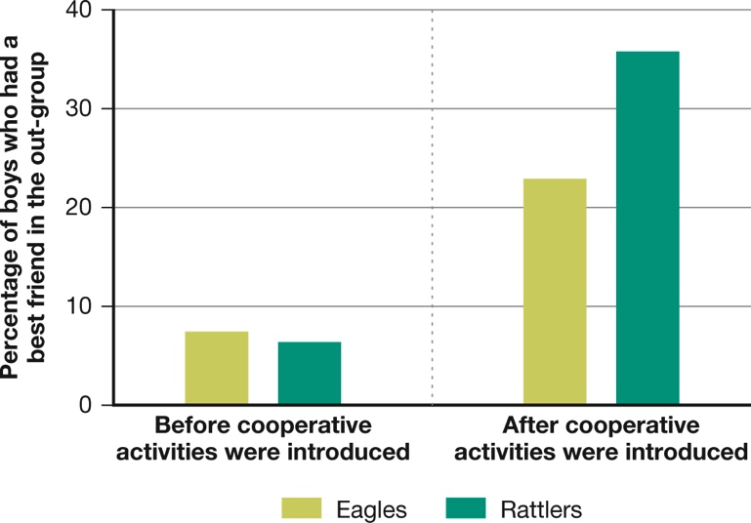
Ethnocentrism (3 of 3) Figure 8.4 The Experiment at Robbers Cave
(Sherif et al., 1961)
Notes:
In this study, competitive games fostered hostility between the Rattlers and the Eagles. Few boys had a best friend from the other group (left). But after the teams had to cooperate to solve various problems, the percentage that made friends across “enemy lines” shot up (right) (Sherif et al., 1961).

Slide 41
Stereotypes (1 of 2)
A stereotype is a summary impression of a group of people in which all members of the group are viewed as sharing a common trait or traits.
Stereotypes help people:
rapidly process new information
organize experience, and
predict how others will behave
Stereotypes aren’t necessarily bad and they are sometimes accurate.

Slide 42
Stereotypes (2 of 2)
But they distort reality by:
exaggerating differences between groups
underestimating the differences within groups
producing selective perception
Cultural values affect:
how people evaluate the actions of another group
whether a stereotype becomes positive or negative

Slide 43
Group Conflict and Prejudice
LO 8.5.A Describe four sources of prejudice.
LO 8.5.B Describe five ways of measuring prejudicial attitudes.
LO 8.5.C Describe four situations that can help reduce prejudice and intergroup conflict.
LO 8.5.D Explain the phrase “the banality of evil,” and discuss how it contributes to otherwise-good people behaving badly.

Slide 44
The Origins of Prejudice (1 of 4)
A prejudice is an unreasonable negative feeling toward a category of people.
It provides the fuel for ethnocentrism.
Prejudice persists everywhere in some form because it has so many sources and functions:
psychological
social
economic
cultural

Slide 45
The Origins of Prejudice (2 of 4)
Psychologically, prejudice wards off feelings of anxiety and doubt and bolsters self-esteem when a person feels threatened (by providing a scapegoat).
Prejudice also has social causes: pressure to conform to views of friends, relatives, associates.
Some prejudices are passed mindlessly from one generation to another, through parental lessons.
“We don’t associate with people like that.”

Slide 46
The Origins of Prejudice (3 of 4)
Prejudice also serves to justify a majority group’s economic interests and dominance.
Prejudice rises and falls with changing economic conditions:
when two groups are in direct competition for jobs
when people are worried about their incomes
The oldest prejudice in the world may be sexism.
It, too, serves to legitimize existing sex roles and inequities in power.

Slide 47
The Origins of Prejudice (4 of 4)
Finally, prejudice serves the cultural and national purpose of bonding people to their social groups and nations.
By disliking “them,” we feel closer to our own group.
We justify whatever we do to “them” to preserve our customs and national policies.
Many people assume that prejudice causes war, but the reverse is far more often the case: War causes prejudice.
enemies described as vermin, heathens, monsters

Slide 48
Defining and Measuring Prejudice (1 of 3)
Psychologists disagree on whether racism and other prejudices are declining or have merely taken new forms.
There is evidence that explicit, conscious prejudices have declined.
It is no longer fashionable to admit one’s prejudices.
But some have used various measures to see whether implicit, unconscious negative feelings between groups have also diminished.

Slide 49
Defining and Measuring Prejudice (2 of 3)
Measurements of implicit prejudicial feelings:
social distance and instances of “microaggressions”
unequal treatment by the police or other institutions
seeing whether people are more likely to behave aggressively toward a target when they are stressed or angry
observing changes in the brain
assessing unconscious positive or negative associations with a group, as with the Implicit Association Test (IAT)

Slide 50
Defining and Measuring Prejudice (3 of 3)
However, the IAT has many critics who claim it is not capturing true prejudice.
Example: Experimenters got an IAT effect by matching target faces with nonsense words and neutral words that had no evaluative connotations at all.
To truly understand prejudice, we must distinguish:
explicit attitudes from unconscious ones
active hostility from simple discomfort
what people say from what they feel
what people feel from how they actually behave

Slide 51
Reducing Conflict and Prejudice (1 of 3)
Efforts to reduce prejudice by appealing to moral or intellectual arguments are not enough.
They need to target both the explicit and implicit attitudes that people have.
They must also touch people’s:
deeper insecurities
fears
negative associations with a group

Slide 52
Reducing Conflict and Prejudice (2 of 3)
Four conditions help to reduce two groups’ mutual prejudices and conflicts:
Both sides must have equal legal status, economic standing, and power.
Both sides must have the legal, moral, and economic support of authorities and cultural institutions.
Both sides must have opportunities to work and socialize together informally and formally (the contact hypothesis).
Both sides must work together for a common goal.

Slide 53
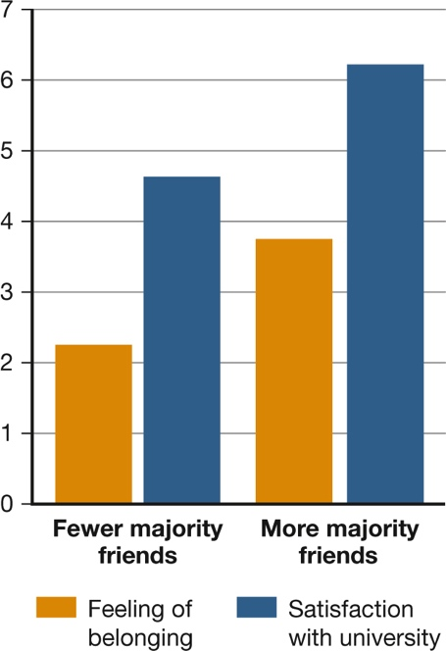
Reducing Conflict and Prejudice (3 of 3) Figure 8.5 The Impact of Cross-Ethnic Friendships on Minority Students’ Well-Being
(Mendoza-Denton & Page-Gould, 2008)
Notes:
Cross-ethnic friendships benefit both parties. In a longitudinal study of minority black students at a predominantly white university, many black students at first felt left out of school life and thus dissatisfied with their educational experience. But the more white friends they made, the higher their sense of belonging (orange bar) and satisfaction with the university (blue bar). This finding was particularly significant for minority students who initially had been the most sensitive to rejection and who had felt the most anxious and insecure about being in a largely white school. The study was later replicated with minority Latino students (Mendoza-Denton & Page-Gould, 2008).

Slide 54
The Question of Human Nature (1 of 2)
Many people believe that only bad people do bad deeds.
But the principles of social and cultural psychology show that under certain conditions, good people often can be induced to do bad things, too.
Everyone is influenced to one degree or another by all-too-normal social processes.
mindless obedience to authority, conformity, groupthink, deindividuation, stereotyping, ethnocentrism, and prejudice

Slide 55
The Question of Human Nature (2 of 2)
Human nature contains the potential for:
unspeakable acts of cruelty
inspiring acts of goodness
By identifying the conditions that create the “banality of evil,” perhaps we can create other conditions that foster the “banality of virtue”:
kindness
selflessness
generosity

