Slide 1
Psychology
Twelfth Edition
Chapter 9
Thinking and Intelligence

Slide 2
Thought: Using What We Know
LO 9.1.A Distinguish between the various elements of cognition, such as concepts, prototypes, propositions, schemas, and mental images.
LO 9.1.B Distinguish between the varieties of conscious thought, such as subconscious thinking, nonconscious thinking, and implicit learning.
LO 9.1.C Contrast algorithms and heuristics as problem-solving strategies, and give an example of each.
LO 9.1.D Discuss the various types of reasoning, such as formal reasoning, informal reasoning, dialectical reasoning, and stages of reflective judgment, and note the defining characteristics of each.

Slide 3
The Elements of Cognition (1 of 5)
A concept is a mental category that groups:
objects
relations
activities
abstractions, or
qualities that share certain properties
Concepts simplify and summarize information about the world:
so that it is manageable and
so that we can make decisions quickly and efficiently

Slide 4
The Elements of Cognition (2 of 5)
Basic concepts have a moderate number of instances.
They are easier to acquire than concepts with few or many instances.
Children seem to learn basic-level concepts earlier than other concepts.
Adults use basic concepts more often than other concepts because basic concepts convey an optimal amount of information in most situations.

Slide 5
The Elements of Cognition (3 of 5)
The qualities associated with a concept do not necessarily all apply to every instance:
some apples are not red
some dogs do not bark
some birds do not fly
But all the instances of a concept do share a family resemblance.
Prototypical instances of a concept are more representative than others.

Slide 6
The Elements of Cognition (4 of 5)
The words used to express concepts may influence or shape how we think about them.
Whorf’s theory
Propositions are made up of concepts and express a unitary idea.
They may be linked together to form cognitive schemas.
Cognitive schemas serve as mental frameworks for thinking about aspects of the world.

Slide 7
The Elements of Cognition (5 of 5)
Mental images also play a role in thinking.
They are also important in constructing cognitive schemas.
Visual images (pictures in the mind’s eye) behave much like images on a computer screen:
We can manipulate them.
They occur in a mental space of a fixed size.
Small ones contain less detail than larger ones.

Slide 8
How Conscious Is Thought? (1 of 4)
Not all mental processing is conscious.
Subconscious processes lie outside of awareness but can be brought into consciousness when necessary.
They allow us to perform two or more actions at once when one action is highly automatic.

Slide 9
How Conscious Is Thought? (2 of 4)
But multitasking—toggling between tasks that are not automatic:
is usually inefficient
introduces errors, and
can even be dangerous
We do not have unlimited cognitive capacity to take on more and more tasks simultaneously.

Slide 10
How Conscious Is Thought? (3 of 4)
Nonconscious processes remain outside of awareness but nonetheless affect behavior.
They are involved in implicit learning, which occurs when we:
learn something but don’t know how we learned it, and
aren’t able to state exactly what we’ve learned
Even conscious processing may be carried out in a mindless fashion if we overlook changes in context that call for a change in behavior.

Slide 11
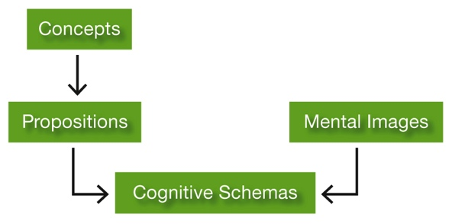
How Conscious Is Thought? (4 of 4) Figure 9.1 The Elements of Cognition

Slide 12
Problem Solving and Decision Making (1 of 2)
When problems are well defined, they can often be solved by applying an algorithm.
Algorithm: A problem-solving strategy guaranteed to produce a correct (or best) solution even if the user does not know how it works.
When problems are fuzzier, people often must apply rules of thumb called heuristics, which:
help limit options to a manageable number of promising ones, and
reduce the cognitive effort it takes to make decision

Slide 13
Problem Solving and Decision Making (2 of 2)
Some problems lend themselves to nonconscious processes such as intuition and insight.
“Fast” thinking applies to rapid, intuitive, emotional, almost automatic decisions.
“Slow” thinking requires intellectual effort, which is why most people rely on the former—and make mistakes.

Slide 14
Reasoning Rationally (1 of 7)
Reasoning is purposeful mental activity that involves operating on information to reach a conclusion.
Unlike impulsive (“fast”) or nonconscious responding, reasoning requires us to draw specific inferences from:
observations
facts, or
assumptions

Slide 15
Reasoning Rationally (2 of 7)
Formal reasoning problems provide the information necessary to:
reach a conclusion or solution and
permit a single correct or best answer
Informal reasoning problems often have no clearly correct solution.
Thus, they require dialectical thinking about opposing points of view.

Slide 16
Reasoning Rationally (3 of 7)
Studies of reflective judgment show that many people have trouble thinking dialectically.
People make different assumptions about how things are known.
They use different ways of justifying their beliefs.

Slide 17
Reasoning Rationally (4 of 7)
Prereflective thinkers do not distinguish between:
knowledge and belief, or
belief and evidence
They tend to assume that:
a correct answer always exists, and
it can be obtained directly
through the senses (“I know what I’ve seen”) or
from authorities (“They said so on the news”; “That’s what I was brought up to believe”)

Slide 18
Reasoning Rationally (5 of 7)
Quasi-reflective thinkers recognize that:
some things cannot be known with absolute certainty
judgments should be supported by reasons
Yet they pay attention only to evidence that fits what they already believe.
They seem to think that because knowledge is uncertain, any judgment about the evidence is purely subjective.
“We all have a right to our own opinion”

Slide 19
Reasoning Rationally (6 of 7)
Those who think reflectively understand that some things cannot be known with certainty.
However, they also understand that some judgments are more valid than others, based on:
their coherence
their fit with the available evidence
their usefulness
They are willing to consider evidence from a variety of sources and to reason dialectically.

Slide 20
Reasoning Rationally (7 of 7) Figure 9.2 Reflective Thinking
Q: Can you ever say you know for sure that your point of view on chemical additives is correct?
A: No, I don’t think so . . . [but] I think that we can usually be reasonably certain, given the information we have now, and considering our methodologies. . . . [I]t might be that the research wasn’t conducted rigorously enough. In other words, we might have flaws in our data or sample, things like that.
Q: How then would you identify the “better opinion”?
A: One that takes as many factors as possible into consideration. I mean one that uses the higher percentage of the data that we have, and perhaps that uses the methodology that has been most reliable.
Q: And how do you come to a conclusion about what the evidence suggests?
A: I think you have to take a look at the different opinions and studies that different groups offer. Maybe some studies offered by the chemical industry, some studies by the government, some private studies. . . . You have to try to interpret people’s motives and that makes it a more complex soup to try to strain out.
Notes:
Here’s an example of the process of reflective thinking. Notice how the discussants consider multiple perspectives and weigh the merits of the available evidence when reaching their conclusions.

Slide 21
Barriers to Reasoning Rationally (1 of 2)
LO 9.2.A Describe how the affect heuristic and the availability heuristic both illustrate the tendency to exaggerate the improbable.
LO 9.2.B Explain how the framing effect leads people to avoid loss in probabilistic judgments.
LO 9.2.C Summarize the mechanisms driving the fairness bias, hindsight bias, confirmation bias, and mental sets, and give an example of each.
LO 9.2.D Explain the process of cognitive dissonance, and describe three conditions under which feelings of cognitive dissonance are likely to occur.

Slide 22
Barriers to Reasoning Rationally (2 of 2)
LO 9.2.E Discuss the conditions under which cognitive biases can be detrimental to reasoning, and when they might be beneficial.

Slide 23
Exaggerating the Improbable (and Minimizing the Probable) (1 of 2)
People tend to exaggerate the likelihood of improbable events in part because of the affect and availability heuristics.
Affect heuristic: The tendency to consult one’s emotions instead of estimating probabilities objectively.
Availability heuristic: The tendency to judge the probability of a type of event by how easy it is to think of examples or instances.

Slide 24
Exaggerating the Improbable (and Minimizing the Probable) (2 of 2)
Being able to easily think of instances of an event, especially one with a strong emotional component, sways us to believe the event is particularly likely to happen.
Catastrophes and shocking accidents stand out in our minds, becoming more available mentally than other kinds of negative events.
We overestimate frequency of deaths from tornadoes.
We underestimate frequency of deaths from asthma.

Slide 25
Avoiding Loss (1 of 2)
People try to avoid or minimize the risk of incurring losses when they make decisions.
We are swayed in our choices by:
the desire to avoid loss and
the framing effect—how the choice is presented
The same information can be evaluated quite differently if it is presented in either a positive or negative light.

Slide 26
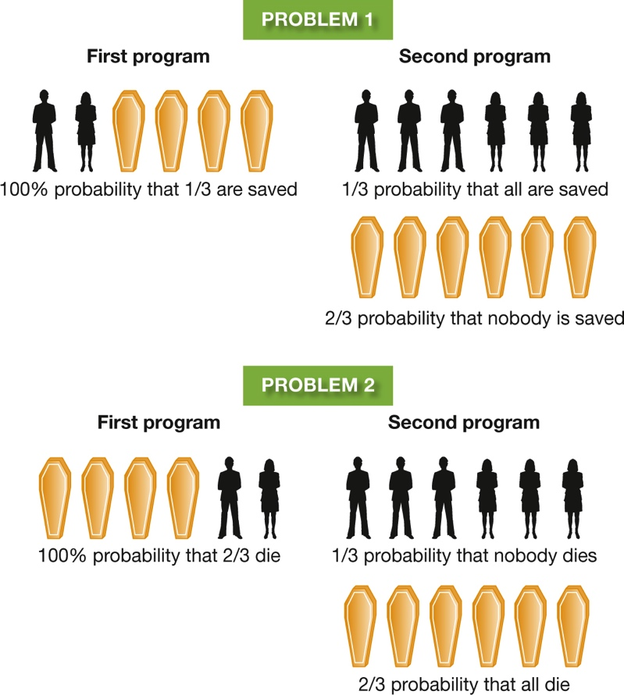
Avoiding Loss (2 of 2) Figure 9.3 A Matter of Wording
Notes:
The decisions we make can depend on how the alternatives are framed. When asked to choose between the two programs in Problem 1, which are described in terms of lives saved, most people choose the first program. When asked to choose between the programs in Problem 2, which are described in terms of lives lost, most people choose the second program. Yet the alternatives in the two problems are actually identical.

Slide 27
Biases and Mental Sets (1 of 6)
People often forgo economic gain because of a fairness bias.
We are motivated to see fairness prevail.
Fairness bias appears to have evolutionary roots.
It is being studied:
in primates
in human toddlers, and
by using brain scans

Slide 28
Biases and Mental Sets (2 of 6)
There is a reason for the saying that hindsight is 20/20.
People often overestimate their ability to have made accurate predictions (the hindsight bias).
The hindsight bias shows up all the time in:
evaluating relationships
medical judgments
military opinions

Slide 29
Biases and Mental Sets (3 of 6)
When people are thinking about an issue they already feel strongly about, they often succumb to the confirmation bias:
paying attention only to evidence that confirms their belief, and
finding fault with evidence that points in a different direction
In thinking critically, most of us apply a double standard; we think most critically about results we dislike.

Slide 30
Biases and Mental Sets (4 of 6)
Another barrier to rational thinking is the development of a mental set.
This is a tendency to try to solve new problems by using the same:
heuristics
strategies, and
rules that worked in the past on similar problems
Mental sets are not helpful when a problem calls for fresh insights and methods.

Slide 31
Biases and Mental Sets (5 of 6) Figure 9.4 Confirming the Confirmation Bias
Notes:
Suppose someone deals out four cards, each with a letter on one side and a number on the other. You can see only one side of each card, as shown here. Your task is to find out whether the following rule is true: “If a card has a vowel on one side, then it has an even number on the other side.” Which two cards do you need to turn over to find out? The majority of people say they would turn over the E and the 6, but they are wrong. You do need to turn over the E (a vowel), because if the number on the other side is even, it confirms the rule, and if it is odd, the rule is false. However, the card with the 6 tells you nothing. The rule does not say that a card with an even number must always have a vowel on the other side. Therefore, it doesn’t matter whether the 6 has a vowel or a consonant on the other side. The card you do need to turn over is the 7, because if it has a vowel on the other side, that fact disconfirms the rule. People do poorly on this problem because they are biased to look for confirming evidence and to ignore the possibility of disconfirming evidence.

Slide 32
Biases and Mental Sets (6 of 6) Figure 9.5 Connect the Dots
Notes:
Copy this figure, and try to connect the dots by using no more than four straight lines without lifting your pencil or pen. A line must pass through each point. Can you do it? Most people have difficulty with this problem because they have a mental set to interpret the arrangement of dots as a square. They then assume that they can’t extend a line beyond the apparent boundaries of the square. Now that you know this, you might try again if you haven’t yet solved the puzzle. Some solutions are given at the end of this chapter.

Slide 33
The Need for Cognitive Consistency (1 of 4)
Mental sets and the confirmation bias cause us to avoid evidence that contradicts our beliefs.
When two cognitions, or a cognition and a behavior, conflict, this is known as cognitive dissonance.
We are motivated to reduce dissonance by:
rejecting or changing a belief
changing our behavior, or
rationalizing

Slide 34
The Need for Cognitive Consistency (2 of 4)
Efforts to reduce dissonance occur under three conditions:
after a decision has been made (postdecision dissonance)
when people’s actions violate their concept of themselves as honest and kind
when they have put hard work into an activity (the justification of effort)

Slide 35
The Need for Cognitive Consistency (3 of 4) Figure 9.6 The Process of Cognitive Dissonance

Slide 36
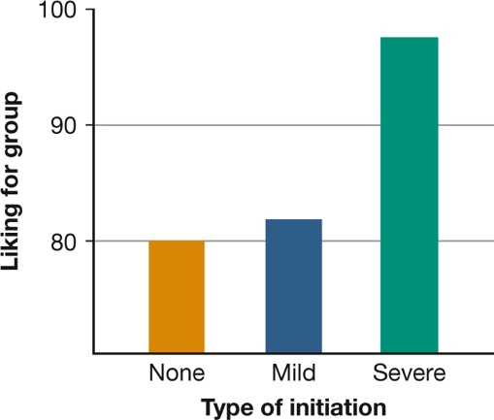
The Need for Cognitive Consistency (4 of 4) Figure 9.7 The Justification of Effort
Photomall/Xinhua Press/Corbiswire/Corbis
Notes:
The more effort you put into reaching a goal, the more highly you are likely to value it. As you can see in the graph on the left, after people listened to a boring group discussion, those who went through a severe initiation to join the group rated it most highly (Aronson & Mills, 1959). In the photo, soldiers undergo special and difficult training to join an elite unit. They will probably become extremely devoted members.

Slide 37
Overcoming Our Cognitive Biases (1 of 2)
“Biases” sound like bad things, but they can sometimes be beneficial by:
speeding our mental processing of a complex world, or
smoothing our social interactions
But mental biases can also get us into trouble.
The “bias blind spot”: we acknowledge that other people have biases that distort reality.
But we tend to think that we are free of bias and see the world as it really is.

Slide 38
Overcoming Our Cognitive Biases (2 of 2)
Most people can reduce their irrationality in many situations, such as when a decision is:
particularly important or
personally meaningful
After we understand a bias, we may be able to reduce or eliminate it.
This can happen if we make an active, mindful effort to do so and take time to think carefully.

Slide 39
Measuring Intelligence: The Psychometric Approach
LO 9.3.A Outline the basic logic underlying factor analysis, and describe its use in measuring intelligence.
LO 9.3.B Summarize the original notion of IQ and some problems associated with it, and discuss how intelligence tests evolved during the early 1900s.

Slide 40
Measuring the Invisible (1 of 2)
Intelligence is difficult to define.
The psychometric approach focuses on how well people perform on standardized aptitude tests.
Most psychometric psychologists believe that a general ability, a g factor, underlies this performance.

Slide 41
Measuring the Invisible (2 of 2)
They hold that this general ability can be further described as either:
crystallized (reflecting accumulated knowledge)
knowledge and skills
do arithmetic, define words, make political decisions
fluid (reflecting the ability to reason and to use information to solve new problems)

Slide 42
The Invention of IQ Tests (1 of 6)
The intelligence quotient, or IQ, represents how well a person has done on an intelligence test compared to other people.
Alfred Binet designed the first widely used intelligence test to identify children who could benefit from remedial work.
But in the United States, people:
assumed that intelligence tests revealed natural ability
used the tests to categorize people

Slide 43
The Invention of IQ Tests (2 of 6)
IQ tests have been criticized for being biased in favor of white, middle-class people.
But efforts to construct tests that are free of cultural influence have been disappointing.
Culture affects nearly everything to do with taking a test, from attitudes to problem-solving strategies.

Slide 44
The Invention of IQ Tests (3 of 6)
Stereotypes exist about a person’s:
ethnicity
gender, or
age
These may cause the person to feel stereotype threat, which can lead to:
anxiety that interferes with test performance
in the case of negative stereotypes
enhanced performance
in the case of positive stereotypes

Slide 45
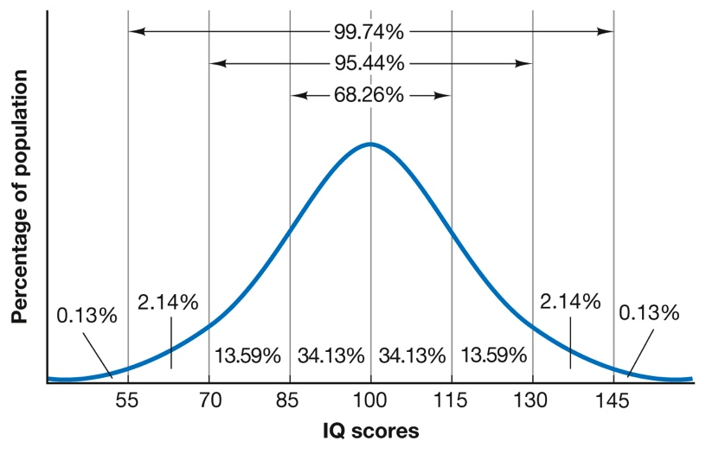
The Invention of IQ Tests (4 of 6) Figure 9.8 Expected Distribution of IQ Scores
Notes:
In a large population, IQ scores tend to be distributed on a normal (bell-shaped) curve. On most tests, about 68 percent of all people will score between 85 and 115; about 95 percent will score between 70 and 130; and about 99.7 percent will score between 55 and 145. In any actual sample, however, the distribution will depart somewhat from the theoretical ideal.

Slide 46
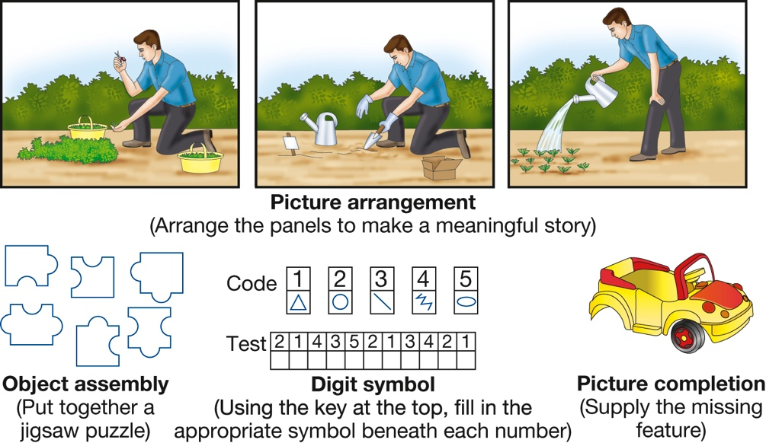
The Invention of IQ Tests (5 of 6) Figure 9.9 Performance Tasks on the Wechsler Tests
Notes:
Nonverbal items such as these are particularly useful for measuring the abilities of those who have poor hearing, are not fluent in the tester’s language, have limited education, or resist doing classroom-type problems. A large gap between a person’s verbal score and performance on nonverbal tasks such as these sometimes indicates a specific learning problem.

Slide 47
The Invention of IQ Tests (6 of 6) Figure 9.10 Stereotype Threat

Slide 48
Dissecting Intelligence: The Cognitive Approach
LO 9.4.A Describe how metacognition, the triarchic theory of intelligence, the theory of multiple intelligences, and emotional intelligence shed light on the diversity of what “intelligence” means.
LO 9.4.B Outline how longitudinal studies and crosscultural studies shed light on the interplay of motivation, hard work, and intellectual achievement.

Slide 49
Elements of Intelligence (1 of 5)
Cognitive approaches to intelligence emphasize:
several kinds of intelligence, and
the strategies people use to solve problems
An important cognitive ingredient of intelligence is metacognition, which involves the:
knowledge or awareness of your own cognitive processes, and the
ability to monitor and control those processes

Slide 50
Elements of Intelligence (2 of 5)
Robert Sternberg’s triarchic theory proposes three aspects of intelligence.
Componential/analytical:
the information-processing strategies you draw on when you are thinking intelligently about a problem
Experiential/creative:
creativity in transferring skills to new situations
Contextual/practical:
practical application of intelligence

Slide 51
Elements of Intelligence (3 of 5)
Gardner’s multiple intelligences theory holds that an intelligence is best characterized as a capacity to process certain kinds of information.
Rather than spotlighting a single g factor, Gardner claims that the information-processing skills we possess can take many forms.

Slide 52
Elements of Intelligence (4 of 5)
Emotional intelligence is also important.
It involves the ability to:
identify your own and other people’s emotions accurately
express emotions clearly, and
regulate emotions in yourself and others
Emotional intelligence can facilitate social interactions.

Slide 53
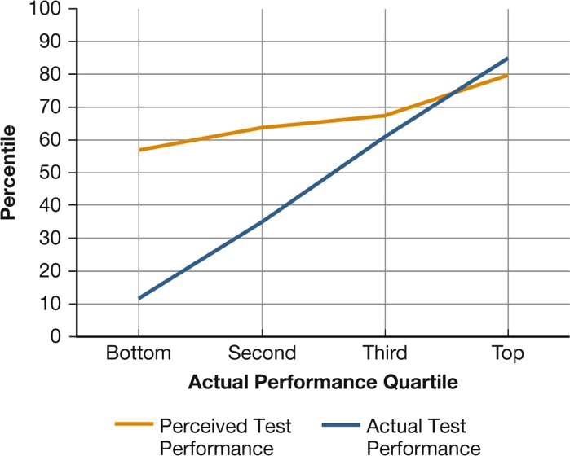
Elements of Intelligence (5 of 5) Figure 9.11 Ignorance Is Bliss
(Dunning et al., 2003)
Notes:
In school and in other settings, people who perform poorly often have poor metacognitive skills and therefore fail to recognize their own lack of competence. As you can see, the lower that students scored on an exam, the greater the gap between how they thought they had done and how they actually had done (Dunning et al., 2003).

Slide 54
Motivation, Hard Work, and Intellectual Success (1 of 3)
Intellectual achievement also depends on:
motivation
hard work, and
self-discipline
Cross-cultural work shows that differences in academic performance are strongly influenced by:
beliefs about the origins of mental abilities
parental standards, and
attitudes toward education

Slide 55
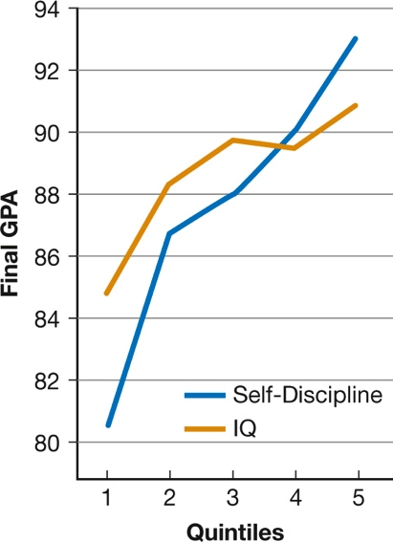
Motivation, Hard Work, and Intellectual Success (2 of 3) Figure 9.12 Grades, IQ, and Self-Discipline
(Duckworth & Seligman, 2005)
Notes:
Eighth-grade students were divided into five groups (quintiles) based on their IQ scores and then followed them for a year to test their academic achievement. Self-discipline was a stronger predictor of success than IQ was (Duckworth & Seligman, 2005).

Slide 56
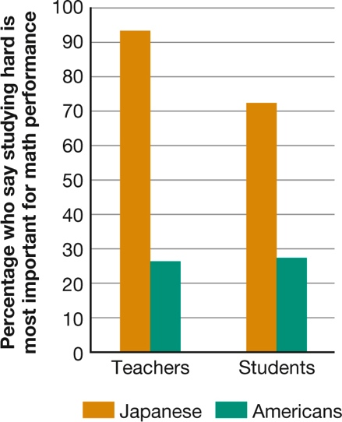
Motivation, Hard Work, and Intellectual Success (3 of 3) Figure 9.13 What’s the Secret of Math Success?
(Stevenson, Chen, & Lee, 1993)
Notes:
Japanese schoolteachers and students are much more likely than their American counterparts to believe that the secret to doing well in math is working hard. Americans tend to think that you either have mathematical intelligence or you don’t (Stevenson, Chen, & Lee, 1993).

Slide 57
Animal Minds
LO 9.5.A Summarize the evidence both supporting and refuting the concept of animal intelligence.
LO 9.5.B Summarize the evidence both supporting and refuting the concept of animal language use.
LO 9.5.C Explain why both anthropomorphism and anthropodenial are unwise approaches to understanding animal cognition.

Slide 58
Animal Intelligence (1 of 2)
Some researchers, especially those in cognitive ethology, argue that nonhuman animals have greater cognitive abilities than previously thought.
Some animals can use objects as simple tools.
Chimpanzees and birds have shown evidence of a simple understanding of numbers.

Slide 59
Animal Intelligence (2 of 2)
Certain animals may have aspects of a theory of mind, an understanding of how their own minds and the minds of others work.
great apes
dolphins
elephants
Chimps and even monkeys may also be capable of some metacognition, the ability to understand and monitor their own cognitive processes.

Slide 60
Animals and Language (1 of 2)
In projects using visual symbol systems or American Sign Language, primates have acquired linguistic skills.
words as geometric plastic shapes
symbols on a keyboard monitored by a computer
Animals in these studies learned to:
follow instructions
answer questions, and
make requests

Slide 61
Animals and Language (2 of 2)
They even seemed to use their newfound skills to:
apologize for being disobedient
scold their trainers
talk to themselves
Some animals seem able to use simple grammatical ordering rules to convey or comprehend meaning.
even nonprimates such as dolphins and African gray parrots

Slide 62
Thinking about the Thinking of Animals
Scientists are divided about how to interpret the findings on animal cognition.
Some worry about anthropomorphism (falsely attributing human qualities to nonhuman beings).
Others are concerned about anthropodenial (believing that human beings have nothing in common with other animals).

