Slide 1

Psychology
Twelfth Edition
Chapter 10
Memory

Slide 2
Reconstructing the Past
LO 10.1.A Explain why the workings of memory are more reconstructive than people imagine them to be.
LO 10.1.B Describe three conditions under which confabulation is especially likely to occur.
LO 10.1.C Summarize the evidence indicating that eyewitness testimony can be susceptible to memory errors.
LO 10.1.D Explain the conditions under which children might provide reliable versus unreliable eyewitness testimony.

Slide 3
The Manufacture of Memory (1 of 3)
Unlike a digital recorder or video camera, human memory is highly selective and is reconstructive.
It is more like watching a few unconnected clips and then figuring out what the rest of the recording must have been like.
People add, delete, and change elements in ways that help them make sense of information and events.

Slide 4
The Manufacture of Memory (2 of 3)
In reconstructing their memories, people often draw on many sources.
They take bits and pieces and build one integrated account.
They often experience source misattribution, the inability to distinguish information stored during an event from information added later.

Slide 5
The Manufacture of Memory (3 of 3)
Shocking or tragic events do hold a special place in memory.
  So do some unusual, exhilaratingly happy events.
Yet even these vivid flashbulb memories tend to become less accurate or complete over time.
People typically remember the gist of a startling, emotional event.
But over time, errors creep into the details; after a few years, some people even forget the gist.

Slide 6
The Conditions of Confabulation
Because memory is so often reconstructive, it is subject to confabulation.
  the confusion of imagined events with actual ones
Confabulation is especially likely when people have thought, heard, or told others about the imagined event many times.
They thus experience imagination inflation.
The image of the event contains many details, or the event is easy to imagine.

Slide 7
The Eyewitness on Trial (1 of 2)
The reconstructive nature of memory also makes memory vulnerable to suggestion.
Eyewitness testimony is especially vulnerable to error when:
  the suspect’s ethnicity differs from that of the witness
  leading questions are put to witnesses, or
  witnesses are given misleading information

Slide 8
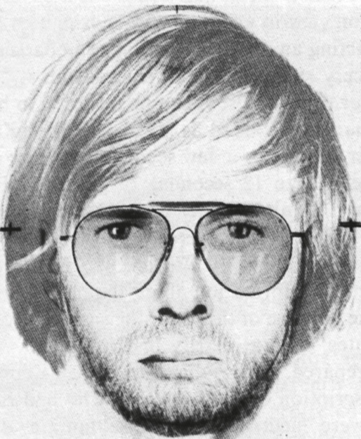
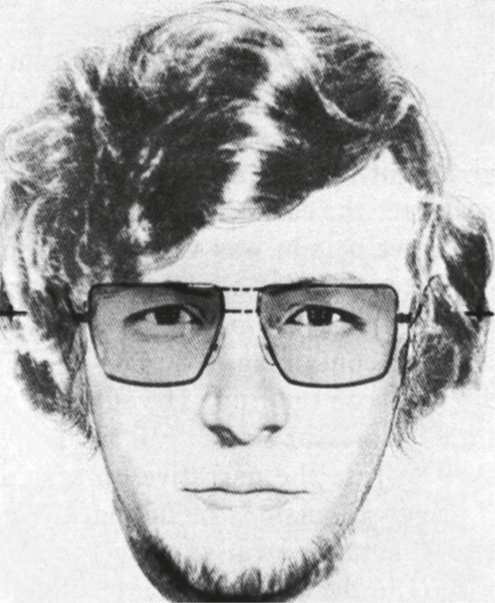
The Eyewitness on Trial (2 of 2)
Figure 10.1
The Influence of Misleading Information
Elizabeth Loftus
(Loftus & Greene, 1980)
Notes:
Students saw the face of a young man with straight hair and then had to reconstruct it from memory. On the left is one student’s reconstruction in the absence of misleading information about the man’s hair. On the right is another person’s reconstruction of the same face after exposure to misleading information that mentioned curly hair (Loftus & Greene, 1980).

Slide 9
Children’s Testimony (1 of 2)
Like adults, children often remember the essential aspects of an event accurately.
However, they can also be suggestible, especially when:
  responding to biased interviewing by adults
  asked questions that blur the line between fantasy and reality
  asked leading questions
  told what “other kids” had supposedly said
  praised for making false allegations

Slide 10
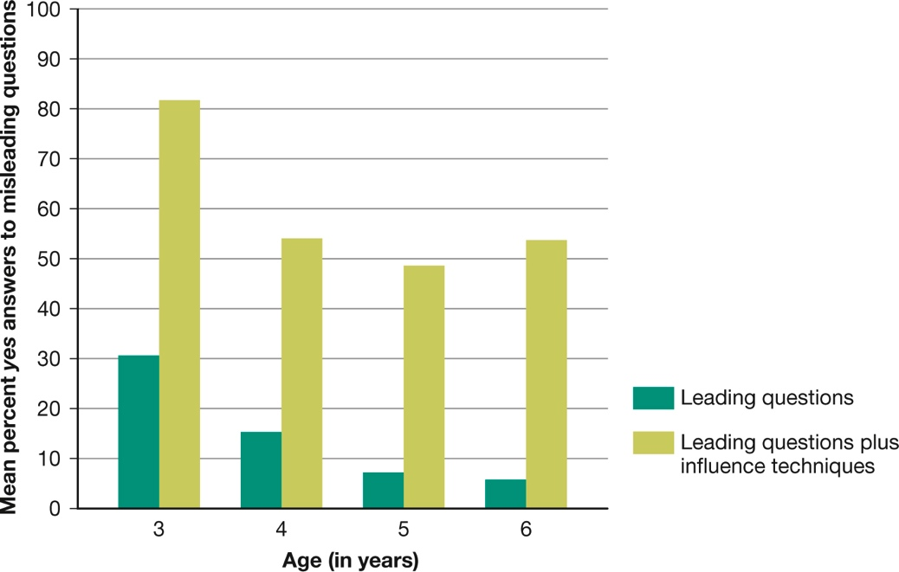
Children’s Testimony (2 of 2)
Figure 10.2
Social Pressure and Children’s False Allegations
(Garven et al., 1998)
Notes:
When researchers asked 3-year-olds leading questions about events that had not occurred—such as whether a previous visitor to their classroom had committed aggressive acts—nearly 30 percent said that yes, he had. This percentage declined among older children. But when the researchers used influence techniques taken from actual child-abuse investigations, most of the children agreed with the false allegation, regardless of their age (Garven et al., 1998).

Slide 11
In Pursuit of Memory
LO 10.2.A Distinguish between recall and recognition tasks in explicit memory, and distinguish between priming and relearning in implicit memory.
LO 10.2.B Describe the basic characteristics of three memory systems according to the information-processing model, and note the challenges to this view proposed by parallel distributed processing.

Slide 12
Measuring Memory (1 of 2)
The ability to remember depends in part on the type of performance called for.
In tests of explicit memory (conscious recollection), recognition is usually better than recall.
Recognition for visual images is particularly impressive.

Slide 13
Measuring Memory (2 of 2)
Implicit memory is measured by indirect methods such as:
  priming and
  the relearning method
In tests of implicit memory, past experiences may affect current thoughts or actions.
This can occur even when these experiences are not consciously remembered.

Slide 14
Models of Memory (1 of 3)
In information-processing models, memory involves the:
  encoding
  storage, and
  retrieval of information
The three-box model proposes three interacting systems:
  the sensory register
  short-term memory, and
  long-term memory

Slide 15
Models of Memory (2 of 3)
Some cognitive scientists prefer a parallel distributed processing (PDP) or connectionist model.
This model represents knowledge as connections:
  among numerous interacting processing units
  distributed in a vast network, and
  all operating in parallel
The model is similar to neurons of the brain.
  The ability of units to excite or inhibit each other is constantly adjusted to reflect new knowledge.

Slide 16
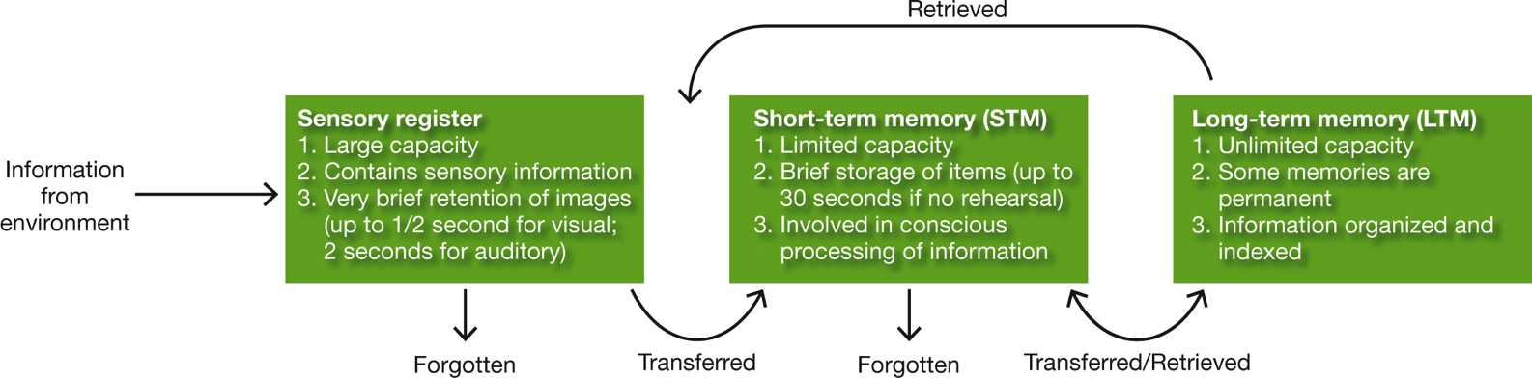
Models of Memory (3 of 3)
Figure 10.3
Three Memory Systems
Notes:
In the three-box model of memory, information that does not transfer out of the sensory register or short-term memory is assumed to be forgotten forever. Once in long-term memory, information can be retrieved for use in analyzing incoming sensory information or performing mental operations in short-term memory.

Slide 17
The Three-Box Model of Memory
LO 10.3.A Explain the functions, duration, and location of the sensory registers in the three-box model of memory.
LO 10.3.B Explain the functions and duration of short-term memory, and contrast the leaky bucket and working memory approaches to understanding this “box” of memory.
LO 10.3.C Describe semantic categories and four forms of long-term memory, and explain how primacy and recency illustrate the serial-position effect in transferring information from short-term to long-term memory.

Slide 18
The Sensory Register: Fleeting Impressions
In the three-box model, incoming sensory information makes a brief stop in the sensory register.
The sensory register momentarily retains it in the form of sensory images.
Information that does not quickly go on to short-term memory vanishes forever.
The fleeting nature of incoming sensations is beneficial; it prevents “double exposures.”

Slide 19
Short-Term Memory: Memory’s
Notepad (1 of 3)
Short-term memory (STM) retains new information for up to 30 seconds (unless rehearsal takes place).
In short-term memory, the material is no longer an exact sensory image.
Instead, it is an encoding of one, such as a word or a phrase.
This material either transfers into long-term memory or decays and is lost forever.

Slide 20
Short-Term Memory: Memory’s
Notepad (2 of 3)
The capacity of STM is extremely limited but can be extended if information is organized into larger units by chunking.
A chunk can be:
  a word
  a phrase
  a sentence
  an image
  and it depends on previous experience

Slide 21
Short-Term Memory: Memory’s
Notepad (3 of 3)
Early models of STM portrayed it mainly as a bin for the temporary storage of information.
But many models now envision it as a part of a more general working-memory system.
Working memory permits us to:
  control attention
  resist distraction, and therefore
  maintain information in an active, accessible state

Slide 22
Long-Term Memory: Memory’s Storage System (1 of 8)
The capacity of long-term memory seems to have no practical limits.
The vast amount of information stored there enables us to:
  learn
  get around in the environment, and
  build a sense of identity and a personal history
But it must be organized to make it manageable.

Slide 23
Long-Term Memory: Memory’s Storage System (2 of 8)
Words (or the concepts they represent) are often organized by semantic categories.
Evidence on the storage of information by semantic category also comes from cases of people with brain damage.
Many models of long-term memory represent its contents as a vast network of interrelated concepts and propositions.

Slide 24
Long-Term Memory: Memory’s Storage System (3 of 8)
Research on tip-of-the-tongue (TOT) states shows that words are also indexed in terms of:
  sound and
  form
Information in long-term memory may also be organized by its:
  familiarity
  relevance, or
  association with other information

Slide 25
Long-Term Memory: Memory’s Storage System (4 of 8)
Most theories of memory distinguish skills or habits (“knowing how”) from abstract or representational knowledge (“knowing that”).
Memories can take different forms, such as:
  procedural or
  declarative
And within declarative memories, either:
  semantic or
  episodic

Slide 26
Long-Term Memory: Memory’s Storage System (5 of 8)
The three-box model is often invoked to explain the serial-position effect in memory.
Serial-position effect: The tendency for recall of the first and last items on a list to surpass recall of items in the middle of the list.
The model can explain the primacy effect.
However, it cannot explain why a recency effect sometimes occurs after a considerable delay.

Slide 27
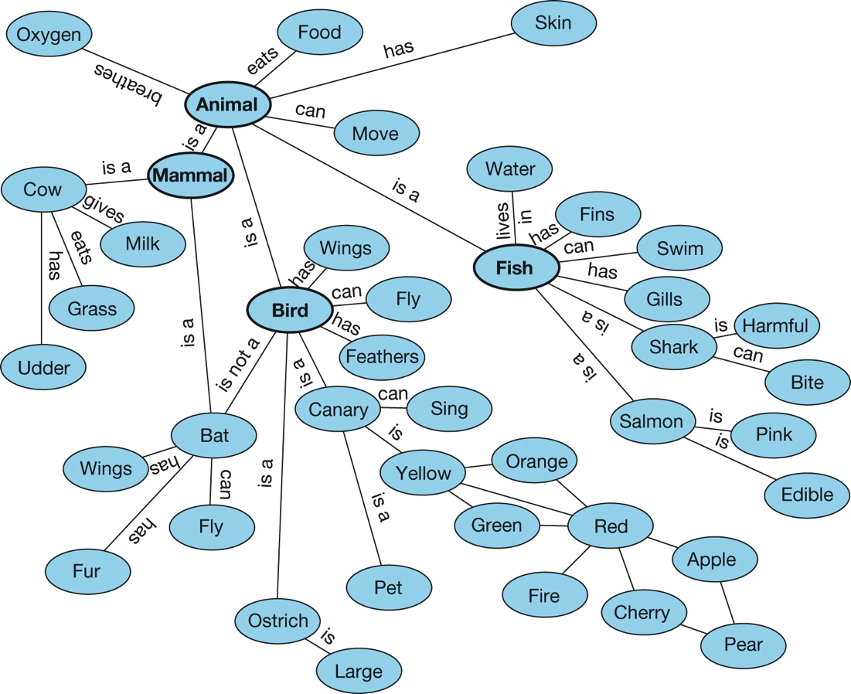
Long-Term Memory: Memory’s Storage System (6 of 8)
Figure 10.4
Part of a Conceptual Grid in Long-Term Memory
Notes:
Many models of memory represent the contents of long-term semantic memory as an immense network or grid of concepts and the relationships among them. This illustration shows part of a hypothetical grid for animals.

Slide 28
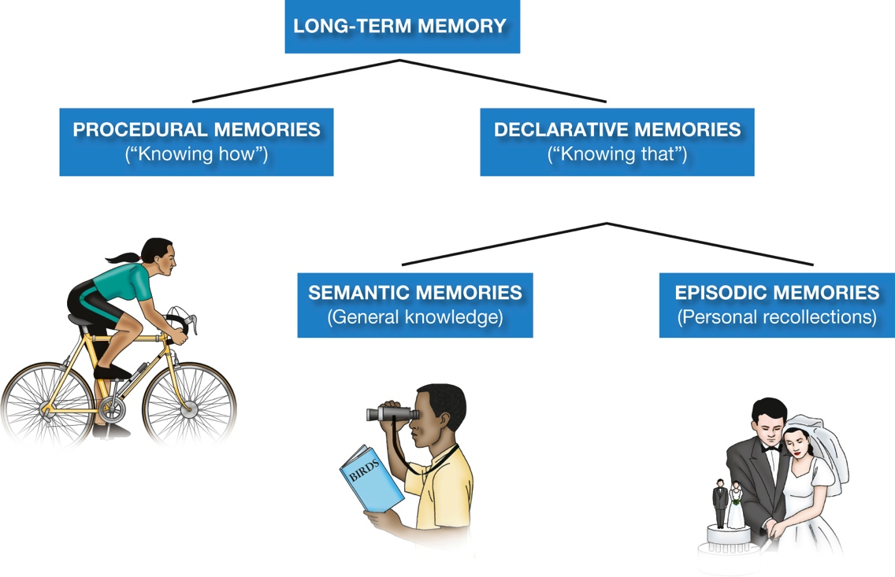
Long-Term Memory: Memory’s Storage System (7 of 8)
Figure 10.5
Types of Long-Term Memories
Notes:
This diagram summarizes the distinctions among long-term memories. A procedural memory might be of learning how to ride a bike; a declarative memory might be knowing that Ottawa is the capital of Canada. Can you come up with your own examples of each memory type?

Slide 29
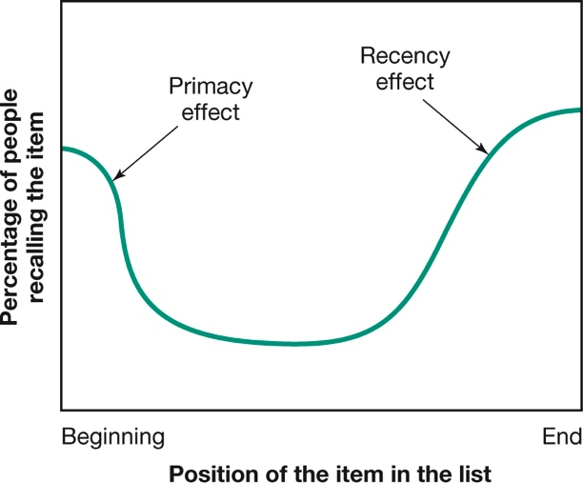
Long-Term Memory: Memory’s Storage System (8 of 8)
Figure 10.6
The Serial-Position Effect
Notes:
When people try to recall a list of similar items immediately after learning it, they tend to remember the first and last items best and the ones in the middle worst.

Slide 30
The Biology of Memory
LO 10.4.A Outline the process of long-term potentiation in the formation of memories.
LO 10.4.B Evaluate the evidence that memories are not stored in any one “place” in the brain.
LO 10.4.C Summarize the evidence that memory can be influenced by emotion and hormonal levels.

Slide 31
Changes in Neurons and Synapses (1 of 3)
Short-term memory involves temporary changes within neurons.
These changes alter their ability to release neurotransmitters.
Long-term memory involves lasting structural changes in the brain.
  neurons
  synapses

Slide 32
Changes in Neurons and Synapses (2 of 3)
Long-term potentiation seems to be an important mechanism of long-term memory.
It likely underlies many and perhaps all forms of learning and memory.
It involves an increase in the strength of synaptic responsiveness.

Slide 33
Changes in Neurons and Synapses (3 of 3)
Neural changes associated with long-term potentiation take time to develop.
This helps explain why long-term memories require a period of consolidation.
  However, memories probably never completely solidify.
  The act of remembering can make them unstable again.
Sleep plays a role in ensuring consolidation of new information.

Slide 34
Where Memories Are Made (1 of 5)
The amygdala is involved in the:
  formation
  consolidation, and
  retrieval of emotional memories
Areas of the frontal lobes are especially active during short-term and working-memory tasks.
The efficient encoding of words and pictures involves:
  the prefrontal cortex and
  parts of the temporal lobes

Slide 35
Where Memories Are Made (2 of 5)
The hippocampus plays a critical role in the:
  formation and
  retrieval of long-term declarative memories
Other areas are crucial for the formation of procedural memories.
  the cerebellum

Slide 36
Where Memories Are Made (3 of 5)
Studies of patients with amnesia suggest that different brain systems are active during:
  explicit and
  implicit memory tasks
The long-term storage of declarative memories possibly takes place in cortical areas.
These areas would have been active during the original perception of the information or event.

Slide 37
Where Memories Are Made (4 of 5)
The typical “memory” is a complex cluster of information.
The various components of a memory are probably stored at different sites.
All of these sites participate in the representation of the event as a whole.

Slide 38
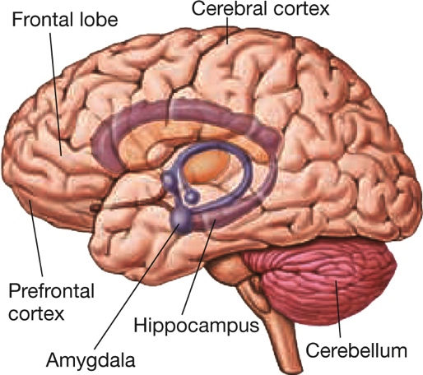
Where Memories Are Made (5 of 5)
Figure 10.7
Brain Areas Involved in Memory
Notes:
Different parts of the brain are involved in different aspects of memory. As you can see here, some centers deep within the brain (such as the amygdala and hippocampus) play an important role, but so too do “higher” centers of the brain in the cerebral cortex. Forming and storing a memory relies on many interacting processes.

Slide 39
Hormones, Emotion, and Memory (1 of 2)
Hormones are released by the adrenal glands during:
  stress
  emotional arousal
These hormones can enhance memory:
  epinephrine
  norepinephrine

Slide 40
Hormones, Emotion, and Memory (2 of 2)
These adrenal hormones cause the level of glucose to rise in the bloodstream.
Glucose may enhance memory directly or by altering the effects of neurotransmitters.
However, the effective dose of glucose is narrow.
Too much can impair cognitive functioning instead of helping it.

Slide 41
How We Remember
LO 10.5.A Describe some major strategies that contribute to memory retention, and give an example of each.

Slide 42
Encoding, Rehearsal, and Retrieval (1 of 3)
Some kinds of information, such as material in a college course, require effortful encoding.
  as opposed to automatic encoding
To retain such information, we might have to:
  select the main points
  label concepts, or
  associate the information with personal experiences or with material we already know
We must make the material digestible.

Slide 43
Encoding, Rehearsal, and Retrieval (2 of 3)
Rehearsal of information:
  keeps it in short-term memory and
  increases the chances of long-term retention
Elaborative rehearsal is more likely to result in transfer to long-term memory than is maintenance rehearsal.
Elaboration involves:
  association of items with stored or factual information
  analysis of the physical, sensory, semantic features of an item

Slide 44
Encoding, Rehearsal, and Retrieval (3 of 3)
A related strategy for prolonging retention is deep processing, or the processing of meaning.
Deep processing is usually a more effective retention strategy than shallow processing.
Retrieval practice is necessary if a memory is going to be consolidated.
  For students, short quizzes and repeated testing can have large benefits.

Slide 45
Why We Forget
LO 10.6.A Summarize the processes of decay, replacement, interference, and cue dependent forgetting, and explain how each contributes to our understanding of forgetting.
LO 10.6.B Explain why claims of repressed memories should be greeted with a strong skeptical reaction.
LO 10.6.C Discuss three reasons why childhood amnesia is likely to take place.

Slide 46
Mechanisms of Forgetting (1 of 6)
Forgetting can occur for several reasons.
Information in sensory and short-term memory appears to decay if it does not receive further processing.
  memories fade with time if not accessed
New information may erase and replace old information in long-term memory.
  just as writing over the contents of a hard drive will obliterate the original material

Slide 47
Mechanisms of Forgetting (2 of 6)
Proactive and retroactive interference may take place.
Similar items of information interfere with one another in either storage or retrieval.
The information may get into memory and stay there, but it becomes confused with other information.

Slide 48
Mechanisms of Forgetting (3 of 6)
Cue-dependent forgetting may occur when retrieval cues are inadequate.
Cues that were present when you learned a new fact or had an experience are apt to be especially useful later as retrieval aids.
Overlap of present and past cues may help account for the phenomenon of déjà vu.

Slide 49
Mechanisms of Forgetting (4 of 6)
A person’s mental or physical state may act as a retrieval cue.
This evokes a state-dependent memory.
We tend to remember best those events that are congruent with our current mood (mood-congruent memory).

Slide 50
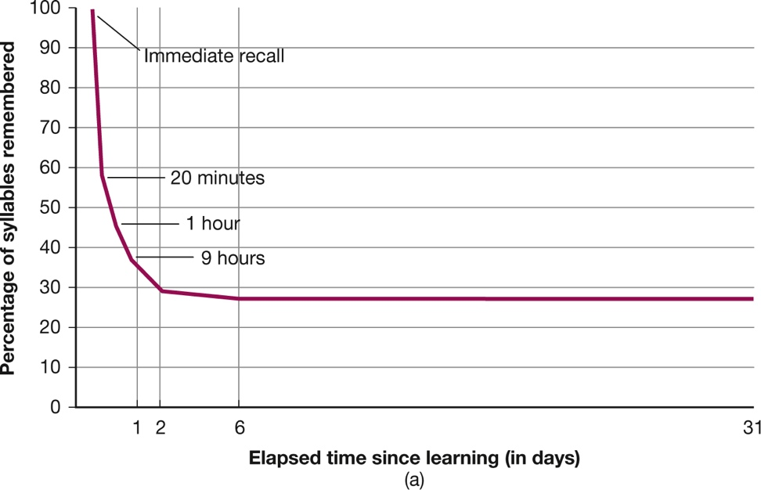
Mechanisms of Forgetting (5 of 6)
Figure 10.8
Two Kinds of Forgetting Curves
Notes:
Hermann Ebbinghaus, who tested his own memory for nonsense syllables, found that his forgetting was rapid at first and then tapered off (a). In contrast, when Marigold Linton tested her own memory for personal events over a period of several years, her retention was excellent at first, but then it fell off at a gradual but steady rate (b).

Slide 51
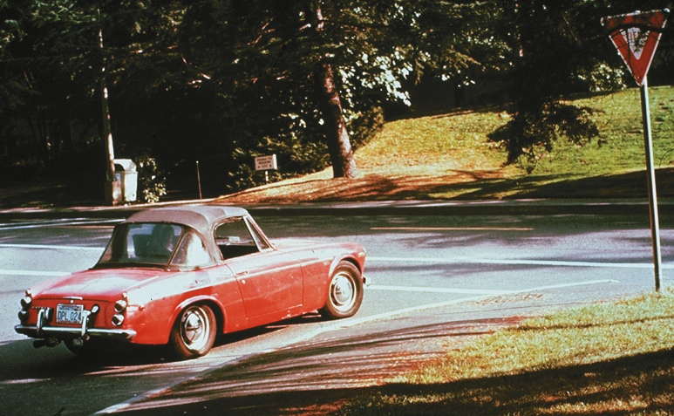
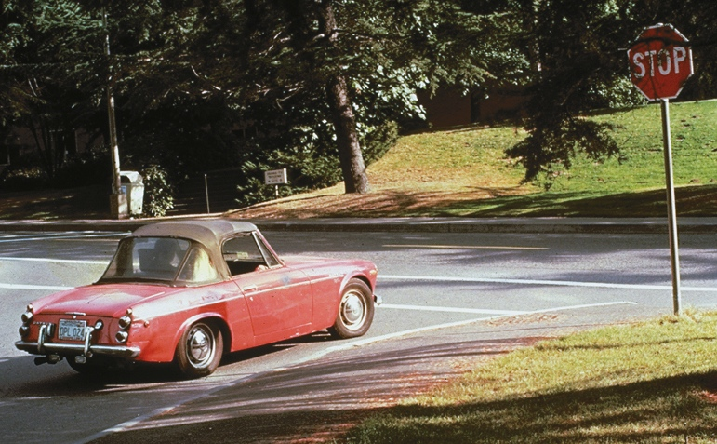
Mechanisms of Forgetting (6 of 6)
Figure 10.9
The Stop-Sign Study
Photos: Dr. Elizabeth Loftus.
Notes:
When people who saw a car with a yield sign (left) were later asked if they had seen “the stop sign” (a misleading question), many said they had. Similarly, when those shown a stop sign were asked if they had seen “the yield sign,” many said yes. These false memories persisted even after the participants were told about the misleading questions, suggesting that misleading information might have erased their original mental representations of the signs (Loftus, Miller, & Burns, 1978).

Slide 52
The Repression Controversy (1 of 3)
Amnesia involves the forgetting of important personal information.
It usually occurs because of disease or injury to the brain.
Psychogenic amnesia, which involves a loss of personal identity and has psychological causes, is rare.

Slide 53
The Repression Controversy (2 of 3)
Traumatic amnesia is highly controversial.
It allegedly involves the forgetting of specific traumatic events for long periods of time.
When the memory returns, it is supposedly:
  immune to the usual processes of distortion and confabulation, and
  recalled with perfect accuracy
The notion of traumatic amnesia originated with Freud.

Slide 54
The Repression Controversy (3 of 3)
Freud argued that the mind defends itself from unwelcome and upsetting memories through the mechanism of repression:
  the involuntary pushing of threatening or upsetting information into the unconscious
These concepts lack good empirical support.
Psychological scientists are skeptical about:
  their validity and
  the accuracy of “recovered memories”

Slide 55
Childhood Amnesia: The Missing
Years (1 of 2)
Most people cannot recall any events from earlier than the age of 2.
Very early childhood memories are merely:
  reconstructions based on photographs
  family stories
  imagination
The “remembered” event may not even have taken place.

Slide 56
Childhood Amnesia: The Missing
Years (2 of 2)
The reasons for such childhood amnesia include:
  the immaturity of certain brain structures, making it difficult for very young children to focus attention, encode, and remember
  cognitive factors such as immature cognitive schemas, lack of linguistic skills, and lack of a self-concept
  lack of knowledge of social conventions for encoding and reporting events

