Slide 1
Psychology
Twelfth Edition
Chapter 11
Emotion, Stress, and Health

Slide 2
The Nature of Emotion
LO 11.1.A Explain the components that define an emotion, list the emotions that have a universal facial expression, and describe some of the limits affecting the ability to decode facial expressions of emotion.
LO 11.1.B Discuss the brain structures involved in the experience of emotions, explain what mirror neurons do, and describe the primary chemicals involved in emotional experience.
LO 11.1.C Summarize the basic research findings indicating that cognitive appraisal plays a role in emotional experience.

Slide 3
Emotion and the Face (1 of 6)
Emotions evolved to:
bind people together
motivate them to achieve their goals, and
help them make decisions and plans
The experience of emotion involves:
physiological changes
cognitive processes
action tendencies, and
subjective feelings

Slide 4
Emotion and the Face (2 of 6)
Ekman gathered evidence that facial expressions are widely recognized across cultures:
anger
fear
sadness
happiness
disgust
surprise
contempt
(and possibly) pride

Slide 5
Emotion and the Face (3 of 6)
Facial expressions not only reflect our internal feelings but also influence them.
In the process of facial feedback, the facial muscles send messages to the brain about the basic emotion being expressed.
a smile tells us that we’re happy
a frown that we’re angry or perplexed

Slide 6
Emotion and the Face (4 of 6)
There are important cultural and social limits to the universal readability of facial expressions.
An accurate reading of others’ facial expressions increases among members of the same ethnicity.
It also depends on the social context.
People can interpret identical facial expressions in very different ways, depending on the situation.

Slide 7
Emotion and the Face (5 of 6)
People can and do disguise their emotions.
Their expressions do not always communicate accurately.

Slide 8
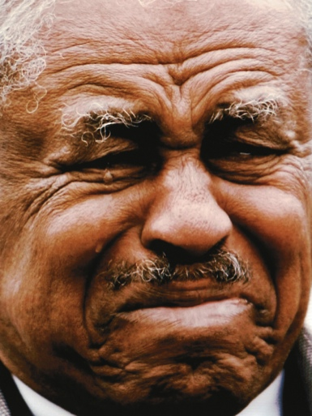
Emotion and the Face (6 of 6) Figure 11.1 Some Universal Expressions
Jason Stitt/Shutterstock; Platslee/Shutterstock; Eric Gay/AP Images; Giuseppe Lancia/Fotolia; photomak/Shutterstock; Bbressonimages/Fotolia; Alexandre Nunes/123RF
Notes:
Most people around the world can readily identify expressions of anger, happiness, disgust, surprise, contempt, sadness, and fear—no matter what the age, culture, sex, or historical era of the person conveying the emotion. Can you match the emotion to each face shown here?

Slide 9
Emotion and the Brain (1 of 4)
Various parts of the brain are involved in the different components of emotional experience:
recognizing another person’s emotion
feeling a specific emotion
expressing an emotion, and
acting on an emotion
The amygdala is responsible for initially evaluating the emotional importance of incoming sensory information.
It is especially involved in fear.

Slide 10
Emotion and the Brain (2 of 4)
The cerebral cortex provides the cognitive ability to override the amygdala’s initial appraisal.
Regions of the left prefrontal cortex appear to be specialized for the motivation to approach others.
as with happiness and anger
Regions of the right prefrontal region are specialized for withdrawal or escape.
as with disgust and fear

Slide 11
Emotion and the Brain (3 of 4)
Mirror neurons throughout the brain are activated when people observe others.
This is especially true regarding other people of the same group or others they like.
These neurons seem to be involved in:
empathy
imitation
synchrony, and
mood contagion

Slide 12
Emotion and the Brain (4 of 4)
During the experience of any emotion, epinephrine and norepinephrine produce a state of physiological arousal.
pupils dilate, widening to allow in more light
heart beats faster
blood pressure increases
breathing speeds up
blood sugar rises
These changes provide the body with the energy needed to take action.

Slide 13
Emotion and the Mind (1 of 3)
Cognitive approaches to emotion emphasize the perceptions and appraisals that are involved in different emotions.
People make appraisals to explain their own and other people’s behavior. They involve:
beliefs
perceptions of the situation
expectations
goals, and
attributions

Slide 14
Emotion and the Mind (2 of 3)
The importance of appraisals in emotion explains why two people often have different emotional reactions to the same situation.
Appraisal patterns also differ across cultures.
Example: Japanese and Americans differ in their appraisals of the causes and responsibility for errors and for success.

Slide 15
Emotion and the Mind (3 of 3)
Cognitions and physiology are inextricably linked in the experience of emotion.
Thoughts and emotions operate reciprocally, each influencing the other.
Some emotions, such as shame and guilt, require complex cognitive capacities.

Slide 16
Emotion and Culture
LO 11.2.A Describe the ways emotional experience can differ across cultures, in terms of concepts, language, and expectations.
LO 11.2.B Explain how display rules and emotion work influence the communication of emotion in a social and cultural context.
LO 11.2.C Explain sex differences that appear to exist in emotional experience, and comment on the complex reasons for these differences.

Slide 17
How Culture Shapes Emotions (1 of 2)
Many psychologists believe that all human beings share the ability to experience certain basic emotions.
However, cultural differences in values, norms, and appraisals generate:
emotion blends and
culture-specific emotional feelings

Slide 18
How Culture Shapes Emotions (2 of 2)
Culture affects almost every aspect of emotional experience, including:
which emotions are considered appropriate or wrong, and
what people feel emotional about
All emotions depend on the culture and context that produce them and shape their expression.
Example: Anger may be universal, but the way it is experienced will vary from culture to culture.

Slide 19
Communicating Emotions (1 of 2)
Culture strongly influences display rules that regulate how and whether people express their emotions.
Display rules include those governing nonverbal body language.
Many aspects of body language are specific to particular languages and cultures.
This makes even the simplest gesture subject to misunderstanding and offense.

Slide 20
Communicating Emotions (2 of 2)
Emotion work is the effort a person makes to display an emotion:
he or she does not feel, but
feels obliged to convey
It is part of our efforts to regulate our emotions when we are with others.
Sometimes emotion work is a job requirement.
flight attendants, waiters, customer service (happy)
bill collectors (stern)

Slide 21
Gender and Emotion (1 of 2)
Women and men are equally likely to feel all emotions.
However, gender rules shape differences in emotional expression.
American women on average are more expressive than men.
But they are less so when it comes to expressing anger at strangers.

Slide 22
Gender and Emotion (2 of 2)
Both sexes:
are less expressive to a person of higher status than they
will do the emotion work their job requires
Some situations foster expressiveness in everybody.
There are also cultural differences that affect expression by gender.

Slide 23
The Nature of Stress
LO 11.3.A Describe the three phases of the general adaptation syndrome, and discuss how modern conceptualizations of the HPA axis and psychoneuroimmunology extend those ideas.
LO 11.3.B Describe some of the contributions to health that result from optimism, conscientiousness, and a sense of control.

Slide 24
Stress and the Body (1 of 7)
Hans Selye argued that environmental stressors produce a general adaptation syndrome.
stressors such as heat, cold, toxins, and danger
The body mobilizes its resources to fight off these stressors.
It responds in three stages:
alarm
resistance, and
exhaustion

Slide 25
Stress and the Body (2 of 7)
Selye observed that if a stressor persists, it may overwhelm the body’s ability to cope, and illness may result.
Modern research has added to Selye’s work.
When a person is under stress or in danger, the hypothalamus sends messages to:
the endocrine glands, along
two major pathways

Slide 26
Stress and the Body (3 of 7)
One activates the sympathetic division of the autonomic nervous system.
Adrenal hormones are released from the inner part of the adrenal glands.
In the other, the hypothalamus initiates activity along the HPA axis.
The adrenal cortex secretes cortisol.
Elevated levels of cortisol can lead to various physical and emotional problems.

Slide 27
Stress and the Body (4 of 7)
When the stressors of poverty and unemployment become chronic, they can:
increase people’s stress levels, and
increase their chances of illness
But responses to stress differ across individuals, depending on:
the type of stressor and
the individual’s own genetic predispositions

Slide 28
Stress and the Body (5 of 7)
Researchers in psychoneuroimmunology (PNI) are studying the interaction among:
psychological factors
the nervous and endocrine systems, and
the immune system
particularly the white blood cells that destroy harmful foreign bodies, called antigens
Some PNI researchers focus on cell damage.
to see how stress can lead to illness, aging, and even premature death

Slide 29
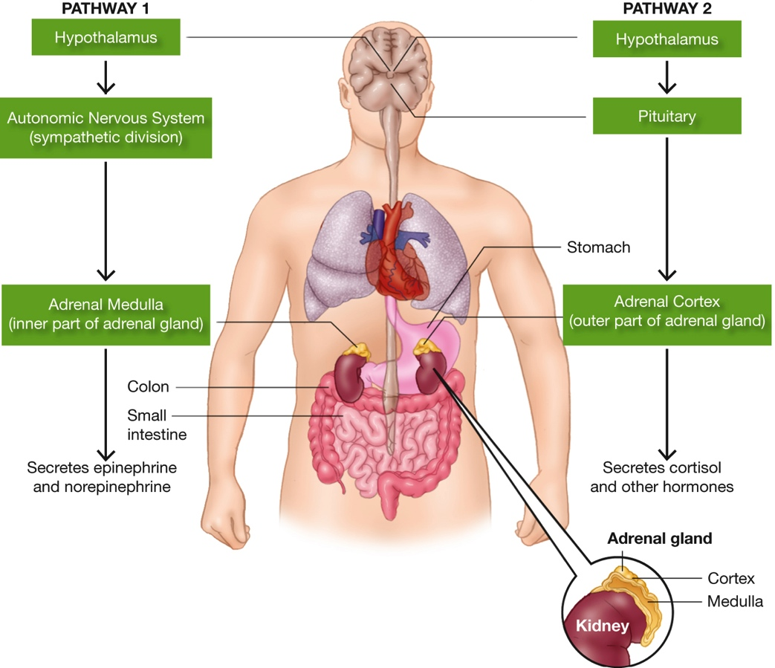
Stress and the Body (6 of 7) Figure 11.3 The Brain and Body Under Stress
Notes:
When a person is in danger or under stress, the hypothalamus sends messages to the endocrine glands along two major pathways. In one, the hypothalamus activates the sympathetic division of the autonomic nervous system, which stimulates the adrenal medulla to produce epinephrine and norepinephrine. The result is the many bodily changes associated with “fight or flight.” In the other pathway, messages travel along the HPA axis to the adrenal cortex, which produces cortisol and other hormones. The result is increased energy and protection from tissue inflammation in case of injury.

Slide 30
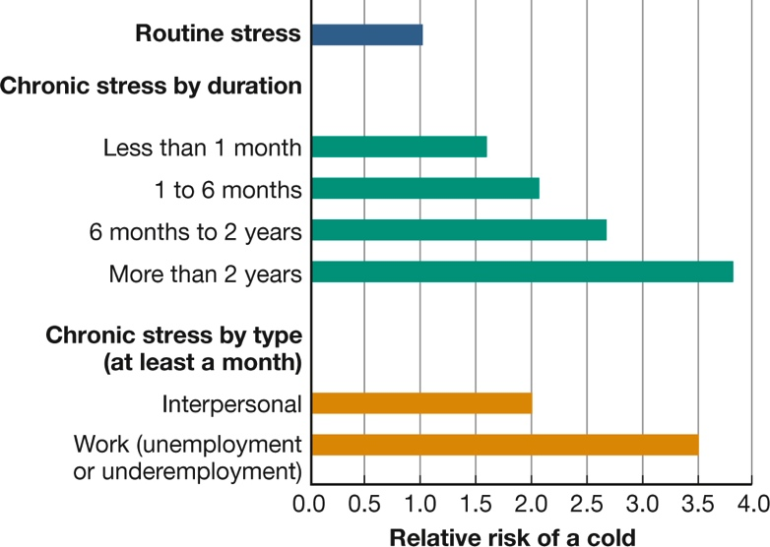
Stress and the Body (7 of 7) Figure 11.4 Stress and the Common Cold
(Cohen et al., 1998)
Notes:
Chronic stress lasting a month or more boosts the risk of catching a cold. The risk is increased among people undergoing problems with their friends or loved ones; it is highest among people who are out of work (Cohen et al., 1998).

Slide 31
Stress and the Mind
Immune function is improved by:
realistic optimism
conscientiousness, and
having an internal locus of control
These mindsets increase a person’s ability to:
tolerate pain
live with ongoing problems, and
recover from illness
People are motivated to take better care of themselves.

Slide 32
Stress and Emotion
LO 11.4.A Summarize the evidence that negative emotions (such as hostility and depression) detract from health.
LO 11.4.B Summarize the evidence that positive emotions contribute to health.
LO 11.4.C Discuss how confession, forgiveness, and other forms of “letting grievances go” contribute to health benefits.

Slide 33
Hostility and Depression: Do They Hurt? (1 of 4)
Researchers have sought links between:
emotions
stress, and
illness
Studies of the “Type A” personality focused on qualities thought to be associated with heart disease.
ambitiousness, impatience, anger, working hard, high standards
The toxic ingredient turned out to be hostility.

Slide 34
Hostility and Depression: Do They Hurt? (2 of 4)
Chronic anger is a strong risk factor in heart disease.
This is especially true if it occurs in the form of cynical or antagonistic hostility.
Proneness to anger is a significant risk factor for:
impairments of the immune system
elevated blood pressure
heart disease, and even
slower healing of wounds

Slide 35
Hostility and Depression: Do They Hurt? (3 of 4)
Clinical depression is linked to at least a doubled risk of:
later heart attack
cardiovascular disease
For some time, researchers thought that depression might also lead to cancer.
But now it looks as though the reverse is true—that cancer can cause depression.

Slide 36
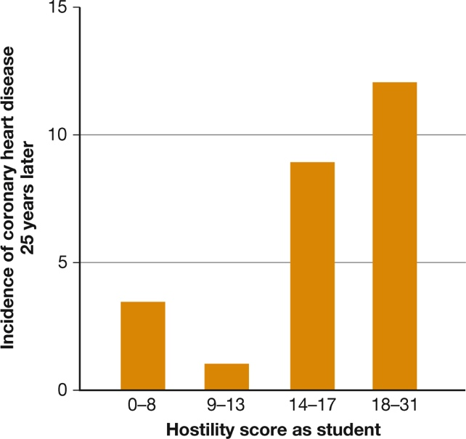
Hostility and Depression: Do They Hurt? (4 of 4) Figure 11.5 Hostility and Heart Disease
(Williams, Barefoot, & Shekelle, 1985)
Notes:
Anger is more hazardous to health than a heavy workload. Men who had the highest hostility scores as young medical students were the most likely to have coronary heart disease 25 years later (Williams, Barefoot, & Shekelle, 1985).

Slide 37
Positive Emotions: Do They Help?
Just as negative emotions can be unhealthful, positive emotions seem to be healthful.
But it is difficult to separate cause and effect.
Positive emotions may:
be physically beneficial
dispose people to think more creatively and be more motivated
help people attract friends and supporters

Slide 38
Emotional Inhibition and Expression (1 of 3)
Two ways of letting go of negative emotions include:
confession
forgiveness
The goal is to:
achieve insight and understanding
distance oneself from the bad experience, and
let go of grudges

Slide 39
Emotional Inhibition and Expression (2 of 3)
Forgiveness can be harmful, of course, if it keeps people in violent and abusive relationships.
Forgiveness does not mean that the offended person denies, ignores, or excuses the offense, which might be serious.
It does mean that the victim is able, finally, to:
come to terms with the injustice and
let go of obsessive feelings of hurt, rage, and vengefulness

Slide 40
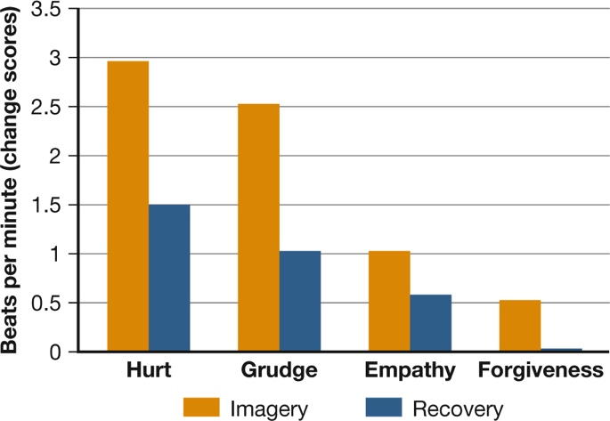
Emotional Inhibition and Expression (3 of 3) Figure 11.6 Heartfelt Forgiveness
Notes:
Participants in a study were asked to think of someone who they felt had offended or hurt them. Then they were asked to imagine unforgiving reactions (such as rehearsing the hurt and harboring a grudge) and forgiving reactions (such as feeling empathy or forgiving the person). As you can see from the orange bars, people’s heart rates increased much more sharply when their thoughts were unforgiving. The blue bars indicate the heart rates also took longer to return to normal in the unforgiving conditions.

Slide 41
Coping with Stress
LO 11.5.A Discuss how emotion-focused coping and problem-focused coping contribute to the problem-solving approach to dealing with stress.
LO 11.5.B Describe three effective coping strategies that rely on rethinking the stressful problem at hand, and give an example of each.
LO 11.5.C Discuss the ways in which friends can help or hinder successful coping efforts.

Slide 42
Solving the Problem
An effective approach to coping is to focus on solving the problem (problem-focused coping).
The specific steps in problem-focused coping depend on the nature of the problem.
An ineffective approach is venting the emotions caused by the problem (emotion-focused coping).
Emotion-focused coping concentrates on the emotions the problem has caused, whether anger, anxiety, or grief.

Slide 43
Rethinking the Problem
Some problems cannot be solved.
Health psychologists have identified three effective cognitive coping methods:
reappraisal of the situation
learning from the experience, and
making social comparisons
Rethinking can provide new insights and a revised frame of mind.

Slide 44
Drawing on Social Support (1 of 4)
Social support is essential in maintaining physical health and emotional well-being.
Relationships and social groups provide individuals with a sense of:
meaning
purpose
belonging
Social support prolongs life and speeds recovery from illness.

Slide 45
Drawing on Social Support (2 of 4)
When social support comes from a loving partner, its benefits on the immune system are especially powerful.
A touch or a hug from a supportive partner:
calms the alarm circuits of the brain and
raises levels of oxytocin
This may result in reduced heart rate and blood pressure.

Slide 46
Drawing on Social Support (3 of 4)
However, friends and family can also be sources of stress.
In close relationships, couples who fight in a hostile and negative way show impaired immune function.

Slide 47
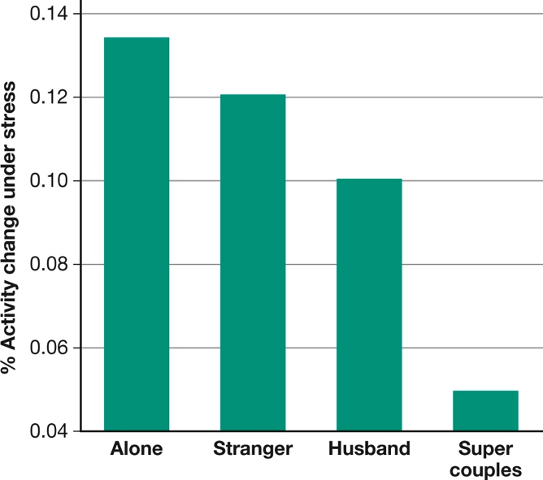
Drawing on Social Support (4 of 4) Figure 11.7 Hugs and Health
(Coan, Schaefer, & Davidson, 2006)
Notes:
Women had to lie in an MRI machine while receiving mild but stressful shocks on their ankle. Those who showed the highest activation of the hypothalamus and other regions of the brain involved in stress and anxiety went through the test alone. A stranger’s calming touch reduced activation somewhat, and a husband’s touch reduced it even more. The women in “super couples,” those who felt the closest to their husbands (right bar), showed the lowest signs of stress (Coan, Schaefer, & Davidson, 2006).

