Slide 1

Psychology
Twelfth Edition
Chapter 13
Development over
the Lifespan

Slide 2
From Conception Through the First Year
LO 13.1.A Outline the three stages of prenatal development, and list six factors that can adversely affect a woman’s pregnancy.
LO 13.1.B Describe some inborn abilities that infants have, and summarize some cultural influences on physical and psychological development.
LO 13.1.C Discuss how contact comfort and separation anxiety contribute to feelings of attachment, and list four factors that contribute to insecure attachment.

Slide 3
Prenatal Development (1 of 3)
Prenatal development begins at fertilization.
The male sperm unites with the female ovum (egg) to form a single-celled egg called a zygote.
During the first 8 weeks of prenatal development, the organism is called an embryo.
After that, it is known as a fetus.

Slide 4
Prenatal Development (2 of 3)
Harmful influences that can adversely affect the fetus’s development include:
  German measles
  toxic substances
  some sexually transmitted diseases
  cigarettes
  alcohol
  illegal drugs
  over-the-counter medications, and
  chronic maternal stress

Slide 5
Prenatal Development (3 of 3)
Fathers affect prenatal development, too.
The sperm of teenage boys and men over age 50 may have mutations that increase their offspring’s risk of:
  miscarriage
  birth defects, and
  certain diseases

Slide 6
The Infant’s World
Babies are born with:
  motor reflexes
  perceptual abilities, and
  rudimentary cognitive skills
Cultural practices affect the timing of physical milestones.
  Example: sleeping through the night

Slide 7
Attachment (1 of 5)
Babies’ innate need for contact comfort gives rise to emotional attachment to their caregivers.
  Harlow experiment with “wire mother” and “cloth mother” for monkeys
By the age of 6 to 8 months, infants begin to feel separation anxiety.
  Ainsworth devised an experimental method called the Strange Situation.

Slide 8
Attachment (2 of 5)
Studies of the Strange Situation have distinguished secure from insecure attachment.
Insecurity can take one of two forms:
  avoidant attachment or
  anxious-ambivalent attachment
Styles of attachment are relatively unaffected by the normal range of childrearing practices.
  The same appears to be true whether or not babies spend time in daycare.

Slide 9
Attachment (3 of 5)
Insecure attachment is promoted by:
  parents’ rejection, mistreatment, or abandonment of their infants
  a mother’s postpartum depression, which can affect her ability to care for her baby
  the child’s own fearful, insecure temperament, or
  stressful family situations

Slide 10

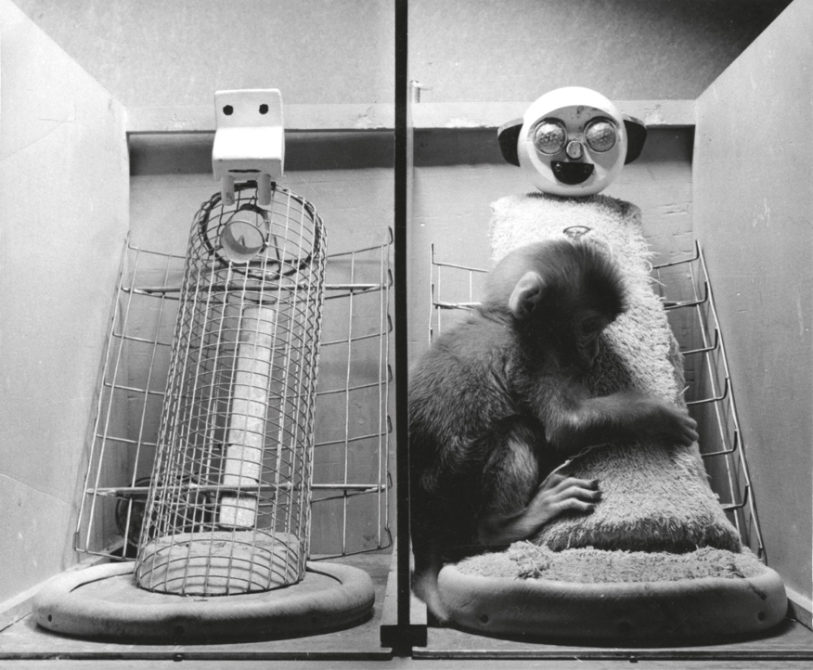
Attachment (4 of 5)
Figure 13.1
The Comfort of Contact
Photo Researchers/Science Source
Notes:
Infants need cuddling as much as they need food. In Margaret and Harry Harlow’s studies, infant rhesus monkeys were reared with a cuddly terrycloth “mother” and with a bare wire “mother” that provided milk. The infants would cling to the terry-cloth mother when they were not being fed. But when an unfamiliar and scary toy (a mechanical spider or a large teddy bear) was placed in the enclosure, the infant monkey would run to the terry-cloth mother for comfort. Only when reassured by that contact comfort would the infant venture back out to examine the toy.

Slide 11
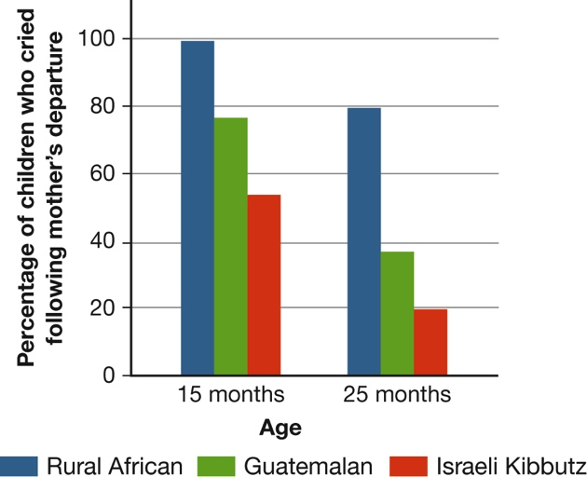
Attachment (5 of 5)
Figure 13.2
The Rise and Fall of Separation Anxiety
(Data from Kagan, Kearsley, & Zelazo, 1978.)
Notes:
At around 6 months of age, many babies begin to show separation anxiety when the person who is their main source of attachment tries handing them over to someone else or leaves the room. This anxiety typically peaks at about a year of age and then steadily declines. But the proportion of children responding this way varies across cultures. It is high among rural African children and low among children raised in a communal Israeli kibbutz, where children become attached to many adults. (Data from Kagan, Kearsley, & Zelazo, 1978.)

Slide 12
Cognitive Development
LO 13.2.A List the milestones of language development that occur between the first 2 months and 6 years of life.
LO 13.2.B Describe the four stages of cognitive development proposed by Piaget, explain the defining characteristics of each stage, and discuss four modifications of Piaget’s theory.

Slide 13
Language (1 of 3)
Noam Chomsky holds that the human brain contains a mental module that is sensitive to a universal grammar.
Evidence comes from several directions:
  Children from different cultures go through similar stages of language development.
  Adults do not consistently correct their children’s syntax.
  Groups of children who have never been exposed to adult language often invent their own.

Slide 14
Language (2 of 3)
However, languages also vary around the world, suggesting that language is a cultural tool.
It’s also possible that children learn the statistical probability that any given word or syllable will follow another.
  infants are more like statisticians than grammarians
  their “statistics” are based on experience
Language development depends on both biological readiness and social experience.

Slide 15
Language (3 of 3)
At 4 to 6 months of age, babies begin to recognize the sounds of their own language.
They go through a babbling phase from age 6 months to 1 year.
At about 1 year, they start saying single words and using symbolic gestures.
At age 2, children speak in two- or three-word telegraphic sentences that convey a variety of messages.

Slide 16
Thinking (1 of 6)
Children do not think the way adults do, yet they are smart in their own way.
According to Piaget, as children develop, their minds constantly adapt to new situations and experiences.
Sometimes they assimilate new information into their existing mental categories.
They also change their mental categories to accommodate their new experiences.

Slide 17
Thinking (2 of 6)
Piaget proposed four stages of cognitive development:
  sensorimotor (birth to age 2), during which the child learns object permanence
  preoperational (ages 2 to 7), during which language and symbolic thought develop, although the child remains egocentric in reasoning
  concrete operations (ages 7 to 12), during which the child comes to understand conservation, and
  formal operations (age 12 to adulthood), during which abstract reasoning develops

Slide 18
Thinking (3 of 6)
Today, we know that the changes from one stage to another are not as clear-cut as Piaget implied.
Development is more continuous and overlapping.
The result has been a modification of Piaget’s ideas.
Some developmental scientists go so far as to say that his ideas have been overturned.

Slide 19
Thinking (4 of 6)
Current views of cognitive development:
  Cognitive abilities develop in continuous, overlapping waves rather than discrete steps or stages.
  Preschoolers are not as egocentric as Piaget thought.
  Children, even infants, reveal cognitive abilities much earlier than Piaget believed possible.
  Cognitive development is influenced by a child’s culture.

Slide 20
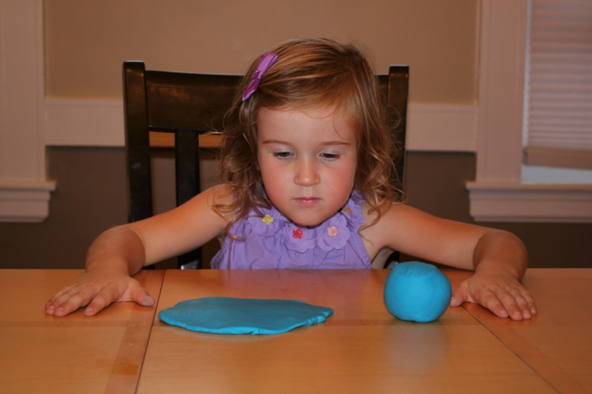
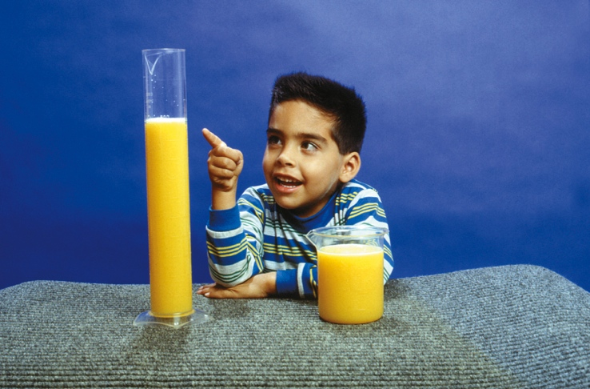
Thinking (5 of 6)
Figure 13.3
Piaget’s Principle of Conservation
Tony Freeman/PhotoEdit
Notes:
If you’ve got access to young children (through babysitting; as an aunt, uncle, or sibling; through a local daycare center; or as a parent yourself), you can examine some of Piaget’s principles yourself. In one test for conservation of size (left), the child must say which is bigger—a round lump of clay or the same amount of clay pressed flat. Preoperational children think that the flattened clay is bigger because it seems to take up more space. In a test for conservation of quantity (right), the child is shown two short glasses with equal amounts of liquid. Then the contents of one glass are poured into a tall, narrower glass, and the child is asked whether one container now has more. Most preoperational children do not understand that pouring liquid from a short glass into a taller one leaves the amount of liquid unchanged. They judge only by the height of liquid in the glass.

Slide 21
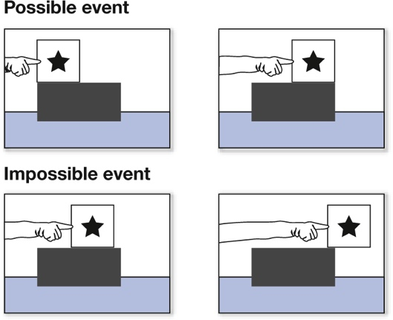
Thinking (6 of 6)
Figure 13.4
Testing Infants’ Knowledge
(Baillargeon, 1994)
Notes:
In this clever procedure, a baby watches as a box is pushed from left to right along a platform. The box is pushed until it reaches the end of the platform (a possible event) or until only a bit of it rests on the platform (an impossible event). Babies look longer at the impossible event, suggesting that it surprises them. Somehow they know that an object needs physical support and cannot just float on air (Baillargeon, 1994).

Slide 22
Moral Development
LO 13.3.A Discuss the evidence for and against the proposition that moral development occurs in distinct stages over time.
LO 13.3.B Compare the ways in which power assertion, inductive appeals, self-regulation, and conscience contribute to moral development.

Slide 23
Early Views of Moral Development (1 of 2)
Lawrence Kohlberg proposed that as children mature cognitively, they go through three levels of moral reasoning.
Kohlberg was right that moral reasoning skills increase during the school years, but unfortunately so do:
  cheating
  lying
  cruelty, and
  the cognitive ability to rationalize these actions

Slide 24
Early Views of Moral Development (2 of 2)
Developmental psychologists study how children learn to:
  internalize standards of right and wrong and
  behave accordingly
This ability depends on the emergence of conscience and the moral emotions of:
  guilt
  shame, and
  empathy

Slide 25
Getting Children to Be Good (1 of 3)
Many parents try to enforce moral standards and good behavior by relying on power assertion, which includes:
  threats
  physical punishment
  depriving the child of privileges, and
  generally taking advantage of being bigger, stronger, and more powerful
Power assertion, physical punishment, and harsh methods can be ineffective and backfire.

Slide 26
Getting Children to Be Good (2 of 3)
In contrast to power assertion, a parent can use induction, appealing to the child’s own:
  abilities
  empathy
  helpful nature
  affection for others, and
  sense of responsibility

Slide 27
Getting Children to Be Good (3 of 3)
One of the most important skills children need to acquire is the ability to control their immediate impulses and wishes.
They need to learn to delay gratification to gain later benefits.
The ability to postpone gratification has powerful long-term effects on:
  health
  success, and
  well-being

Slide 28
Gender Development
LO 13.4.A Distinguish between biological sex, gender identity, gender typing, and intersex conditions.
LO 13.4.B Summarize the basic findings regarding biological, cognitive, and learning influences on gender identity and gender typing.

Slide 29
Gender Identity (1 of 3)
Gender development includes:
  the emerging awareness of gender identity
    a child’s sense of belonging to one sex and not the other
  the understanding that a person is biologically male or female regardless of what he or she does or wears, and
  gender typing, the process by which boys and girls learn what it means to be masculine or feminine in their culture

Slide 30
Gender Identity (2 of 3)
Sex and gender development can be complex.
This is especially apparent in people who do not fit the familiar categories of male and female.
These individuals are born with intersex physical conditions.
This means they are living with the physical attributes of both sexes, and consider themselves to be transgender.

Slide 31
Gender Identity (3 of 3)
Some feel uncomfortable in their sex of rearing and wish to be considered a member of the other sex.
Transsexuals feel that they are male in a female body or vice versa.
Their gender identity is at odds with their anatomical sex.
Many transsexuals try to make a full transition to the other sex through surgery or hormones.

Slide 32
Influences on Gender Development (1 of 3)
Universally, young children tend to prefer same-sex toys and playing with other children of their own sex.
Biological psychologists account for this phenomenon in terms of:
  genes and
  prenatal androgens

Slide 33
Influences on Gender Development (2 of 3)
Cognitive psychologists study how children develop gender schemas for the categories “male” and “female.”
Gender schemas are a mental network of beliefs and expectations about:
  what it means to be male or female, and
  what each sex is supposed to wear, do, feel, and think
These in turn shape their gender-typed behavior.

Slide 34
Influences on Gender Development (3 of 3)
Behavioral and social-cognitive learning theorists study how the process of gender socialization instills messages in children.
They find that gender socialization begins at the moment of birth.
Parents, teachers, and other adults convey their beliefs and expectations about gender.
In today’s world, society’s messages about gender keep evolving.

Slide 35
Adolescence
LO 13.5.A Outline the physiological changes that girls and boys experience during adolescence.
LO 13.5.B Outline the psychological and behavioral changes that girls and boys experience during adolescence.

Slide 36
The Physiology of Adolescence (1 of 2)
During adrenarche, the adrenal glands begin releasing hormones that affect brain development.
  most notably an androgen called DHEA
Adolescence begins with the physical changes of puberty.
From puberty on:
  boys have a higher level of androgens than girls do, and
  girls have a higher level of estrogens than boys do

Slide 37
The Physiology of Adolescence (2 of 2)
In girls, puberty is signaled by:
  menarche and
  the development of breasts
In boys, it begins with:
  the onset of nocturnal emissions and
  the development of the testes, scrotum, and penis
Hormones produce secondary sex characteristics, such as pubic hair in both sexes and a deeper voice in males.

Slide 38
The Psychology of Adolescence (1 of 3)
Most American adolescents do not go through extreme emotional turmoil, anger, or rebellion.
However, there is an increase in:
  conflict with parents
  mood swings
  depression, and
  reckless, risky or rule-breaking behavior

Slide 39
The Psychology of Adolescence (2 of 3)
Peers become especially influential in adolescence.
They represent the values and style of the generation that teenagers identify with.
Feeling rejected by their peers can be more devastating than punitive treatment by parents.

Slide 40
The Psychology of Adolescence (3 of 3)
Adolescents who are lonely, depressed, anxious, or angry tend to express these concerns in ways characteristic of their sex.
  Boys tend to externalize their problems.
  Girls tend to internalize.
The “psychology of adolescence” also depends profoundly on the larger culture in which teenagers live.
  Narcissism seems to be rising among today’s cohort of college students and teenagers.

Slide 41
Adulthood
LO 13.6.A List the eight “crises” of development proposed by Erik Erikson.
LO 13.6.B Outline the psychological and behavioral changes that women and men experience as they progress through emerging adulthood and middle age.
LO 13.6.C Summarize the findings regarding declines or improvements in cognitive functioning as people age, and distinguish between fluid intelligence and crystallized intelligence.

Slide 42
Stages and Ages (1 of 2)
Erik Erikson proposed that life consists of eight stages.
  trust versus mistrust
  autonomy (independence) versus shame and doubt
  initiative versus guilt
  competence versus inferiority
  identity versus role confusion
  intimacy versus isolation
  generativity versus stagnation
  ego integrity versus despair

Slide 43
Stages and Ages (2 of 2)
Each stage presents a unique psychological challenge, or crisis, that must be resolved.
  Example: identity crisis in adolescence
Erikson identified many of the essential concerns of adulthood and showed that development is a lifelong process.
However, psychological issues or crises are not confined to particular chronological periods or stages.

Slide 44
The Transitions of Life (1 of 4)
In industrialized nations, major demographic changes have postponed the timing of:
  career decisions
  marriage or cohabitation, and
  parenthood
Many young people 18–25 are in college and at least partly dependent financially on their parents.
This phenomenon has created a phase of life called emerging adulthood.

Slide 45
The Transitions of Life (2 of 4)
The middle years are generally not a time of turmoil or crisis but the prime of most people’s lives.
These years are typically a time of:
  psychological well-being
  good health
  productivity, and
  community involvement
They are also often a time of reflection and reassessment.

Slide 46
The Transitions of Life (3 of 4)
In women, menopause begins in the late 40s or early 50s.
  the cessation of menstruation after the ovaries stop producing estrogen and progesterone
In middle-aged men:
  hormone production slows down and sperm counts decline
  fertility continues, but with increased risk of fetal abnormalities

Slide 47
The Transitions of Life (4 of 4)
The physical changes of midlife do not by themselves predict:
  how people will feel about aging or
  how they will respond to it
People’s views of aging are influenced by:
  the culture they live in, and
  the promises of technology to prolong life and health

Slide 48
Old Age (1 of 4)
The speed of cognitive processing slows down in old age.
Fluid intelligence parallels other biological capacities in its eventual decline.
Crystallized intelligence depends heavily on:
  culture
  education, and
  experience
It tends to remain stable over the lifespan.

Slide 49
Old Age (2 of 4)
Many of the physical and mental losses that do occur in old age are:
  physiologically and genetically based and
  are seen in all societies
Other losses have to do with factors that are:
  cultural
  behavioral, and
  psychological

Slide 50
Old Age (3 of 4)
Many results of aging are often avoidable:
  senility
  depression, and
  physical frailty
Older people can profit from aerobic exercise and strength training, which:
  maintain physical strength and flexibility
  boost the brain’s blood supply, and
  promote the development of new cells in the hippocampus and other areas of the brain

Slide 51
Old Age (4 of 4)
As people get older, most become better able to regulate negative feelings and emphasize the positive.
People who are more likely than others to maintain their cognitive abilities and well-being:
  have challenging occupations and interests
  remain active mentally
  exercise regularly, and
  adapt flexibly to change and loss

