Slide 1
Psychology
Twelfth Edition
Chapter 14
Theories of Personality

Slide 2
Psychodynamic Theories of Personality
LO 14.1.A Describe the structure of personality according to psychoanalysis, five psychological defense mechanisms, and five stages of psychosexual development.
LO 14.1.B Explain how the views of Carl Jung and the object-relations school differed from Sigmund Freud’s approach to personality.
LO 14.1.C Summarize three ways in which psychodynamic theories falter under scientific scrutiny.

Slide 3
Freud and Psychoanalysis (1 of 4)
Sigmund Freud was the founder of psychoanalysis, the first psychodynamic theory.
Psychodynamic theories emphasize unconscious processes going on within the mind.
They assume the formative role of childhood experiences and early unconscious conflicts.

Slide 4
Freud and Psychoanalysis (2 of 4)
To Freud, the personality consists of three major systems that must be kept in balance:
Id: the reservoir of unconscious psychological energies and the motives to avoid pain and obtain pleasure.
Ego: a referee between the needs of instinct and the demands of society.
Superego: the voice of conscience, representing morality and parental authority.

Slide 5
Freud and Psychoanalysis (3 of 4)
Defense mechanisms protect the ego from unconscious anxiety.
They include:
repression
projection
displacement (one form of which is sublimation)
regression, and
denial

Slide 6
Freud and Psychoanalysis (4 of 4)
Freud believed that personality develops in a series of psychosexual stages.
oral
anal
phallic
latency
genital
The phallic (Oedipal) stage is the most crucial.
When resolved, the personality is fundamentally formed.

Slide 7
Other Psychodynamic Approaches (1 of 2)
Several thinkers splintered from Freud’s original psychodynamic views.
Carl Jung believed that people share a collective unconscious.
It contains universal memories and images, called archetypes.
Jung had more confidence than Freud in the positive, forward-moving strengths of the ego.

Slide 8
Other Psychodynamic Approaches (2 of 2)
The object-relations school emphasizes:
the importance of the first 2 years of life rather than the Oedipal phase
the infant’s representations of important figures, especially the mother, rather than sexual needs and drives
the problem in male development of breaking away from the mother

Slide 9
Evaluating Psychodynamic Theories (1 of 2)
Psychodynamic approaches have been criticized for:
violating the principle of falsifiability
overgeneralizing from atypical patients to everyone
basing theories on the unreliable memories and retrospective accounts of adults
Retrospective analysis has another problem: It creates an illusion of causality between events.
if A came before B, then A must have caused B

Slide 10
Evaluating Psychodynamic Theories (2 of 2)
However, some psychodynamic ideas have received empirical support.
These include the existence of:
nonconscious processes
defenses
Research has also confirmed that we are often unaware of the motives behind our own puzzling or self-defeating actions.

Slide 11
The Modern Study of Personality
LO 14.2.A Outline some ways in which objective personality inventories differ from popular personality tests used in business, dating, or other areas.
LO 14.2.B List the Big Five personality dimensions, and describe the characteristics of each one.

Slide 12
Popular Personality Tests (1 of 2)
Unscientific tests of personality types are aimed at predicting:
how people will do at work
whether they will get along with others
whether they will succeed as leaders
But popular tests that divide personality into “types” are not valid or reliable.
Example: Myers-Briggs

Slide 13
Popular Personality Tests (2 of 2)
In research, psychologists typically rely on objective tests (inventories) to identify and study personality traits and disorders.
They provide information about countless aspects of personality, including:
values
interests
self-esteem
emotional problems, and
typical ways of responding to situations

Slide 14
Core Personality Traits (1 of 4)
Gordon Allport argued that people have:
a few central traits that are key to their personalities and
a greater number of secondary traits that are less fundamental
Raymond Cattell advanced the study of this issue by applying a statistical method called factor analysis.
It identified clusters of traits that he considered the basic components of personality.

Slide 15
Core Personality Traits (2 of 4)
Today, studies around the world provide strong evidence for the Big Five dimensions of personality:
extroversion versus introversion
neuroticism (negative emotionality) versus emotional stability
agreeableness versus antagonism
conscientiousness versus impulsiveness
openness to experience versus resistance to new experience

Slide 16
Core Personality Traits (3 of 4)
Although these dimensions are quite stable, some of them do change over the lifespan, reflecting:
maturational development
societal events, and
adult responsibilities
The Big Five do not provide a complete picture of personality.
mental disorders are missing
other significant traits are missing

Slide 17
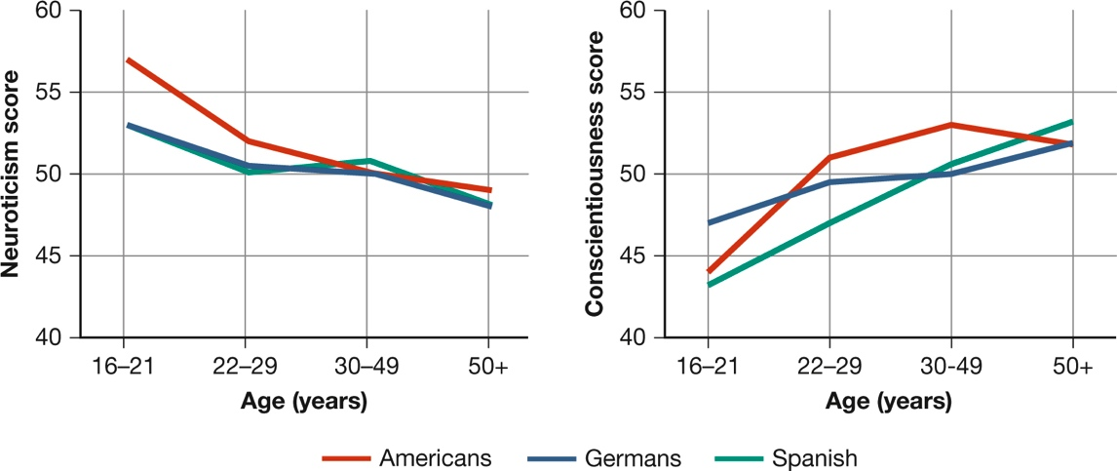
Core Personality Traits (4 of 4) Figure 14.1 Consistency and Change in Personality over the Lifespan
(Costa et al., 1999)
Notes:
Although the Big Five traits are fairly stable, changes do occur over the lifespan. As you can see, neuroticism (negative emotionality) is highest among young adults and then declines, whereas conscientiousness is lowest among young adults and then steadily increases (Costa et al., 1999).

Slide 18
Genetic Influences on Personality
LO 14.3.A Define what temperaments are, and discuss how they relate to personality traits.
LO 14.3.B Explain how twin studies can be used to estimate the heritability of personality traits.
LO 14.3.C Summarize the arguments for and against the conclusion that personality “is all in our genes.”

Slide 19
Heredity and Temperament
In human beings, individual differences in temperaments emerge at birth or early in life.
These differences influence subsequent personality development.
They include:
reactivity
soothability, and
positive or negative emotionality

Slide 20
Heredity and Traits
Heritability refers to the proportion of the total variation in a trait that is attributable to genetic variation within a group.
Behavioral-genetic data from twin and adoption studies suggest that the heritability of many adult personality traits is about .50.
Genetic influences:
create dispositions and
set limits on the expression of specific traits

Slide 21
Evaluating Genetic Theories
Even traits that are highly heritable are often modified throughout life by:
circumstances
chance, and
learning
Conclusions that “biology is destiny” or our fates are controlled by our genes are not warranted.
Having a genetic predisposition does not necessarily imply genetic inevitability.

Slide 22
Environmental Influences on Personality
LO 14.4.A Explain how reciprocal determinism and the nonshared environment contribute to our understanding of how traits and behavior can be shaped by the environment.
LO 14.4.B Summarize three lines of evidence that suggest parental influence over children’s personality development is limited.
LO 14.4.C Discuss some ways in which peers influence the development of personality in children.

Slide 23
Situations and Social Learning (1 of 3)
The very definition of a trait is that it is consistent across situations.
But people often behave inconsistently in different circumstances.
The reason for people’s inconsistency is that in different contexts, different behaviors are:
rewarded
punished, or
ignored

Slide 24
Situations and Social Learning (2 of 3)
According to social-cognitive learning theory, personality results from the interaction of the environment and aspects of the individual.
This process is known as reciprocal determinism.
Children are shaped by interactions involving:
varied experiences that affect each differently
chance events that cannot be predicted
situations that they find themselves in, and
peer groups that they belong to

Slide 25
Situations and Social Learning (3 of 3) Page 516 Reciprocal Determinism

Slide 26
Parental Influence—and Its Limits (1 of 2)
Three lines of evidence challenge the popular assumption that parents have the greatest impact on their children’s personalities and behavior:
(1) Behavioral-genetic studies find that the major environmental influence is from the nonshared environment.
(2) Few parents have a consistent childrearing style over time and with all their children.
(3) Even when parents try to be consistent, there may be little relation between what they do and how the children turn out.

Slide 27
Parental Influence—and Its Limits (2 of 2)
However, parents can:
modify their children’s temperaments
prevent children at risk of delinquency from choosing a path of antisocial behavior, and
influence many of their children’s values and attitudes

Slide 28
The Power of Peers (1 of 2)
Children, like adults, live in two environments: their homes and their world outside the home.
At home, children learn how their parents want them to behave and what they can get away with.
At school, however, they conform to their peers’:
dress
habits
language
rules

Slide 29
The Power of Peers (2 of 2)
Peers play a tremendous role in shaping our personality traits and behavior.
They can cause us to emphasize some attributes or abilities and downplay others.
Of course, our temperaments and dispositions also cause us to select particular peer groups.
Likewise, our temperaments influence how we behave within the group.

Slide 30
Cultural Influences on Personality
LO 14.5.A Compare individualist and collectivist cultures, describe some average personality differences between them, and describe three traits that show considerable cultural variability.
LO 14.5.B Evaluate some pros and cons of the cultural approach to understanding personality.

Slide 31
Culture, Values, and Traits (1 of 4)
Many qualities that Western psychologists treat as individual personality traits are heavily influenced by culture.
People from individualist cultures define themselves in different terms than those from collectivist cultures.
In individualist cultures, the independence of the individual often takes precedence over the group.
In collectivist cultures, the self is defined in the context of relationships and the community.

Slide 32
Culture, Values, and Traits (2 of 4)
Individualist and collectivist ways of defining the self influence many aspects of life, including:
which personality traits we value
how and whether we express emotions
how much we value having relationships or maintaining freedom, and
how freely we express angry or aggressive feelings
Even the “Big Five” traits that occur universally show variations within different cultures.

Slide 33
Culture, Values, and Traits (3 of 4)
People often attribute another person’s actions to individual personality traits when they are really due to cultural norms.
Cultures vary in their norms for many behaviors, such as:
cleanliness
helpfulness, and
notions of time

Slide 34
Culture, Values, and Traits (4 of 4) Table 14.1
Members of Individualist Cultures | Members of Collectivist Cultures
Define the self as autonomous, independent of groups. | Define the self as an interdependent part of groups.
Give priority to individual, personal goals. | Give priority to the needs and goals of the group.
Value independence, leadership, achievement, self-fulfillment. | Value group harmony, duty, obligation, security.
Give more weight to an individual’s attitudes and preferences than to group norms as explanations of behavior. | Give more weight to group norms than to individual attitudes as explanations of behavior.
Attend to the benefits and costs of relationships; if costs exceed advantages, a person is likely to drop the relationship. | Attend to the needs of group members; if a relationship is beneficial to the group but costly to the individual, the individual is likely to stay in the relationship.
Source: Triandis (1996).

Slide 35
Evaluating Cultural Approaches
Cultural psychologists face the problem of how to describe cultural influences on personality without oversimplifying or stereotyping.
Nonetheless, cultural rules are what, on average, make Swedes different from Bedouins, and Cambodians different from Italians.
All key aspects of personality begin with the culture in which we are raised.
the traits that we value, our sense of self versus community, and our notions of the right way to behave

Slide 36
The Inner Experience
LO 14.6.A Describe the core humanist ideas advanced by Abraham Maslow, Carl Rogers, and Rollo May.
LO 14.6.B Discuss how the narrative approach to personality hinges on answering the central question, “Who am I?”
LO 14.6.C Summarize the shortcomings of the humanist approach to personality, and identify some areas of substantial contribution.

Slide 37
Humanist Approaches (1 of 4)
The leaders of humanist psychology argued that it was time to replace psychoanalysis and behaviorism with a “third force” in psychology.
The humanist approach focuses on a person’s:
subjective sense of self and
the free will to determine our own actions and futures
They emphasize:
human potential and
the strengths of human nature

Slide 38
Humanist Approaches (2 of 4)
Abraham Maslow emphasized peak experiences, rare moments of rapture caused by:
the attainment of excellence or
the experience of beauty
The traits Maslow thought most central to personality were those of the self-actualized person—who strives for a life that is:
meaningful
challenging, and
satisfying

Slide 39
Humanist Approaches (3 of 4)
Carl Rogers stressed the importance of unconditional positive regard in creating a “fully functioning” person.
Fully functioning people experience congruence between the image they project to others and their true feelings and wishes.
They are trusting, warm, and open, rather than defensive or intolerant.
Their beliefs about themselves are realistic.

Slide 40
Humanist Approaches (4 of 4)
Rollo May emphasized some of the inherently difficult and tragic aspects of the human condition:
loneliness
anxiety, and
alienation
May’s existentialism emphasized:
the search for the meaning of life
the need to confront death, and
the necessity of taking responsibility for our actions

Slide 41
Narrative Approaches
As another way of understanding personality from the “inside,” some personality psychologists study life narratives.
These are the stories people create to explain themselves and make sense of their lives.
These stories may serve to:
suppress changes in our lives or
encourage them

Slide 42
Evaluating Humanist and Narrative Approaches
Some ideas from humanist psychology are subjective and difficult to measure.
Others have fostered research on positive aspects of personality, such as:
optimism
resilience under adversity, and
the importance of life narratives

