Slide 1
Psychology
Twelfth Edition
Chapter 16
Approaches to Treatment and Therapy

Slide 2
Biological Treatments for Mental Disorders
LO 16.1.A Describe the four main categories of drugs commonly prescribed for the treatment of mental disorders, and discuss five major cautions associated with drug treatment.
LO 16.1.B Identify four forms of direct brain intervention used in treating mental disorders, and discuss the limitations of each.

Slide 3
The Question of Drugs (1 of 5)
Biological treatments for mental disorders are in the ascendance.
There are two reasons:
research findings on the genetic and biological causes of some disorders
economic and social factors
The most common treatment is medication that alters the production of or response to neurotransmitters in the brain.

Slide 4
The Question of Drugs (2 of 5)
The medications most commonly prescribed for mental disorders include:
antipsychotic drugs
antidepressants
anti-anxiety drugs (tranquilizers), and
lithium carbonate

Slide 5
The Question of Drugs (3 of 5)
Drawbacks of drug treatment include:
the placebo effect
high dropout and relapse rates among people who take medications without also learning how to cope with their problems
the difficulty of finding the correct dose for each individual
the long-term risks of medication and of possible drug interactions when several are being taken

Slide 6
The Question of Drugs (4 of 5)
Medication should not be prescribed uncritically and routinely.
This is especially true when psychological therapies can work as well for many mood and behavioral problems.

Slide 7
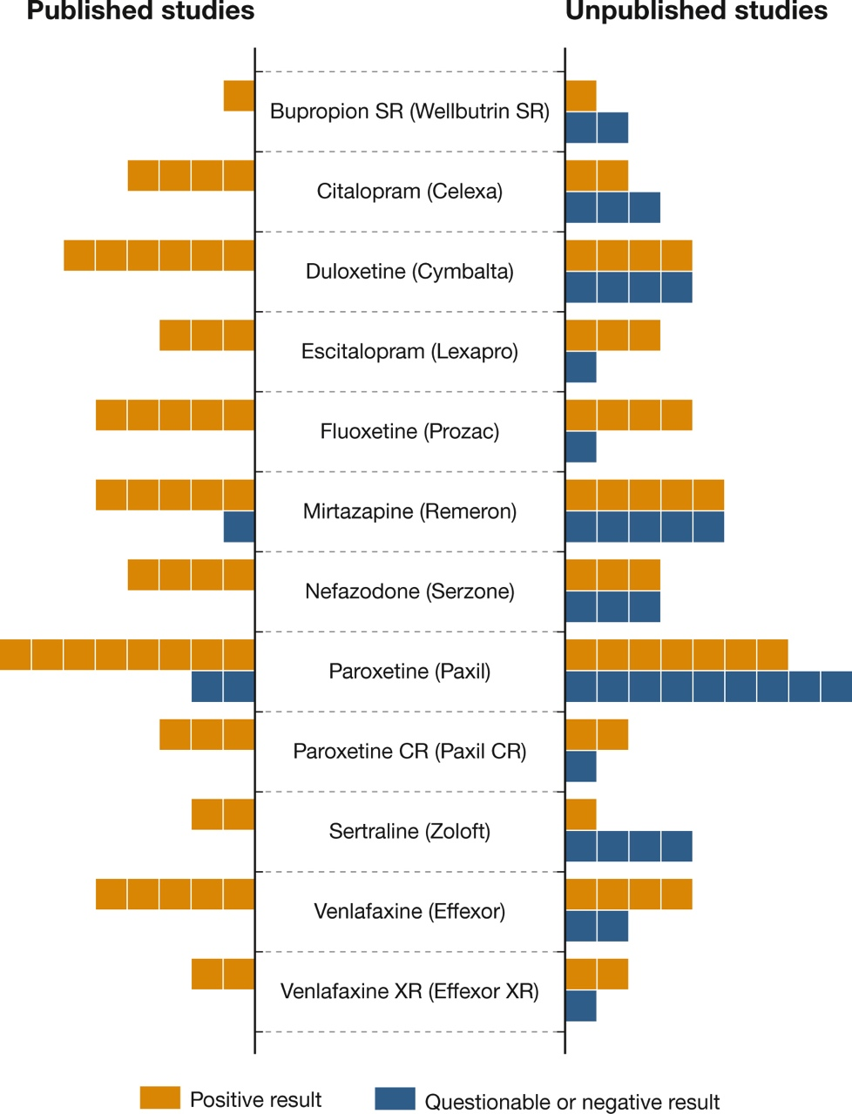
The Question of Drugs (5 of 5) Figure 16.1 Drugs and Publication Bias
(Based on Turner et al., 2008.)
Notes:
To get FDA approval for a new medication, a pharmaceutical company must present evidence of the drug’s effectiveness. On the bars in this figure, each box represents one study. On the left side, you can see that most of the published studies supported the effectiveness of 12 antidepressants. But when independent researchers got hold of all of the data submitted to the FDA, they found that many unpublished studies had questionable or negative results (right). (Based on Turner et al., 2008.)

Slide 8
Direct Brain Intervention (1 of 3)
Drugs and psychotherapy have failed to help seriously disturbed people.
In those cases, some psychiatrists have intervened directly in the brain (psychosurgery).
Prefrontal lobotomy never had any scientific validation, yet was performed on many thousands of people.

Slide 9
Direct Brain Intervention (2 of 3)
Electroconvulsive therapy (ECT) has been used successfully to treat acute episodes of suicidal depression.
“shock therapy”
However, its benefits rarely last.
A newer method, transcranial magnetic stimulation (TMS), is being studied as a way of treating severe depression.

Slide 10
Direct Brain Intervention (3 of 3)
Deep brain stimulation (DBS) requires the surgical implantation of electrodes and a stimulation device.
DBS was originally approved for patients with Parkinson’s disease and epilepsy.
Now it is being used for a variety of mental disorders.
obsessive–compulsive disorder
No one knows how or why it might be helpful.

Slide 11
Major Schools of Psychotherapy
LO 16.2.A Summarize the main elements of psychodynamic therapy.
LO 16.2.B Describe four methods of behavior therapy, and discuss the main techniques used in cognitive therapy.
LO 16.2.C Summarize the similarities and differences between client-centered therapy and existential therapy.
LO 16.2.D List the hallmarks of the family-systems perspective, and describe how they apply to family and couples therapy.

Slide 12
Psychodynamic Therapy (1 of 2)
Psychodynamic (“depth”) therapies include Freudian psychoanalysis and its modern variations.
One approach is object-relations theory, which emphasizes:
the unconscious influence of people’s earliest mental representations of their parents, and
how these affect reactions to separations and losses throughout life

Slide 13
Psychodynamic Therapy (2 of 2)
These therapies explore unconscious dynamics.
defenses and conflicts
They focus on the process of transference to break through the patient’s defenses.
the client’s transfer (displacement) of emotional elements of their inner life outward onto the analyst
They also examine:
childhood issues
past experiences

Slide 14
Behavior and Cognitive Therapy (1 of 3)
Behavior therapists draw on classical and operant principles of learning.
They use such methods as:
graduated exposure
flooding
systematic desensitization
behavioral self-monitoring
skills training

Slide 15
Behavior and Cognitive Therapy (2 of 3)
Cognitive therapists aim to change the irrational thoughts involved in:
negative emotions and
self-defeating actions
Two leading approaches are:
Aaron Beck’s cognitive therapy
Albert Ellis’s rational emotive behavior therapy (REBT)

Slide 16
Behavior and Cognitive Therapy (3 of 3)
Cognitive-behavioral therapy (CBT) is now the most common approach.
A new wave of CBT practitioners propose a form of CBT based on “mindfulness” and “acceptance.”
nonjudgmental approach
focus on coping techniques
“attentional breathing”

Slide 17
Humanist and Existential Therapy (1 of 3)
Humanist therapy holds that human nature is essentially good.
People behave badly or develop problems when they have been warped by self-imposed limits.
It attempts to help people feel better about themselves by focusing on:
here-and-now issues
their capacity for change

Slide 18
Humanist and Existential Therapy (2 of 3)
Carl Rogers developed client-centered (nondirective) therapy.
The therapist’s role is to listen to the client’s needs in an accepting, nonjudgmental way.
It emphasizes the importance of the therapist’s empathy and ability to provide unconditional positive regard.

Slide 19
Humanist and Existential Therapy (3 of 3)
Existential therapy helps people cope with the great questions of existence, such as:
death
freedom
loneliness
meaninglessness
All therapies help people determine:
what matters to them
what values guide them, and
what changes they will have the courage to make

Slide 20
Family and Couples Therapy (1 of 2)
Family therapies are based on the view that individual problems:
develop in the context of the whole family
are sustained by the dynamics of the family, and that
any changes made will affect the family
The family-systems perspective recognizes that people’s behavior in a family is interconnected.

Slide 21
Family and Couples Therapy (2 of 2)
In couples therapy, the therapist usually sees both partners in a relationship.
By seeing both partners, the therapist cuts through blaming and attacking.
(“She never listens to me!” “He never does anything!”)
They instead focus on helping the couple:
resolve their differences
get over hurt and blame, and
make specific behavioral changes to reduce anger and conflict

Slide 22
Evaluating Psychotherapy
LO 16.3.A Define the scientist–practitioner gap, and identify some of the problems associated with assessing the effectiveness of therapy.
LO 16.3.B Provide examples of areas in which cognitive and behavior therapies have shown themselves to be particularly effective.
LO 16.3.C Discuss four ways in which therapy has the potential to harm clients, and give an example of each.

Slide 23
The Scientist–Practitioner Gap (1 of 5)
Successful therapy depends, in part, on the bond between the therapist and client.
This is called the therapeutic alliance.
The client is more likely to improve when both parties:
respect each other
understand each other
agree on the goals of treatment

Slide 24
The Scientist–Practitioner Gap (2 of 5)
Over the years, the breach between scientists and therapists has widened.
This has created what is commonly called the scientist–practitioner gap.
Researchers and clinicians tend to hold different assumptions about the value of empirical research, particularly for:
doing psychotherapy and
assessing its effectiveness

Slide 25
The Scientist–Practitioner Gap (3 of 5)
In assessing the effectiveness of psychotherapy, researchers need to control for:
the placebo effect and
the justification of effort effect
They rely on randomized controlled trials to determine which therapies are empirically supported.

Slide 26
The Scientist–Practitioner Gap (4 of 5)
Sometimes the results of randomized controlled trials have been startling.
critical incident stress debriefing (CISD) interventions

Slide 27
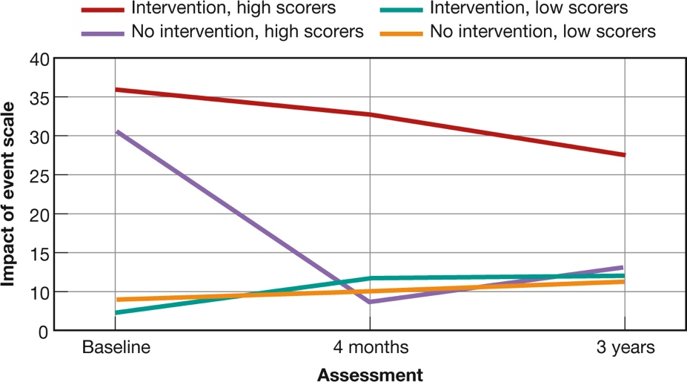
The Scientist–Practitioner Gap (5 of 5) Figure 16.2 Do Posttraumatic Interventions Help—or Harm?
(Mayou et al., 2000)
Notes:
Victims of serious car accidents were assessed at the time of the event, 4 months later, and 3 years later. Half received a form of posttraumatic intervention called critical incident stress debriefing (CISD); half received no treatment. As you can see, almost everyone had recovered within 4 months, but one group had higher stress symptoms than everyone else, even after 3 years: the people who were the most emotionally distressed right after the accident and who received CISD. The therapy actually impeded their recovery (Mayou et al., 2000).

Slide 28
When Therapy Helps (1 of 3)
Some psychotherapies are better than others for specific problems.
Behavior therapy and cognitive-behavioral therapy are often the most effective for:
depression
anxiety disorders
anger problems
certain health problems
pain, insomnia, eating disorders
childhood and adolescent behavior problems

Slide 29
When Therapy Helps (2 of 3)
Family-systems therapies are especially helpful for:
children
young adults with schizophrenia, and
aggressive adolescents
These therapies are particularly effective when combined with behavioral techniques.
as in multisystemic therapy

Slide 30
When Therapy Helps (3 of 3)
The length of time needed for successful therapy depends on the problem and the individual.
Some methods, such as motivational interviewing, produce benefits in only a session or two.
Long-term psychodynamic therapy can be helpful for people with:
severe disorders and
personality problems

Slide 31
When Therapy Harms (1 of 2)
In some cases, therapy is harmful.
The therapist may:
use empirically unsupported and potentially harmful techniques, such as “rebirthing”
inadvertently create new disorders in the client through undue influence or suggestion
hold a prejudice about the client’s gender, ethnicity, religion, or sexual orientation
behave unethically
for example, by permitting a sexual relationship with the client

Slide 32
When Therapy Harms (2 of 2) Table 16.1 Potentially Harmful Therapies
Intervention | Potential Harm
Critical incident stress debriefing (CISD) | Heightened risk of emotional symptoms
Scared Straight interventions | Worsening of conduct problems
Facilitated communication | False allegations of sexual and child abuse
Attachment therapies | Death and serious injury to children
Recovered-memory techniques (e.g., dream analysis) | Induction of false memories of trauma, family breakups
“Multiple personality disorder”–oriented therapy | Induction of “multiple” personalities
Grief counseling for people with normal bereavement reactions | Increased depressive symptoms
Expressive-experiential therapies | Worsening and prolonging painful emotions
Boot-camp interventions for conduct disorder | Worsening of aggression and conduct problems
DARE (Drug Abuse and Resistance Education) | Increased use of alcohol and other drugs
Based on Lilienfeld (2007).

